Slide 1
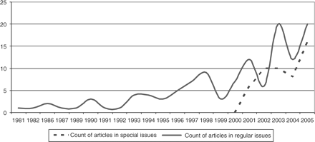
Figure 1 University entrepreneurship articles published per year in regular issues versus special issues, 1981–2005.
Notes:
Figure 1 University entrepreneurship articles published per year in regular issues versus special issues, 1981–2005.
Unless provided in the caption above, the following copyright applies to the content of this slide: © The Author 2007. Published by Oxford University Press on behalf of Associazione ICC. All rights reserved.

Slide 2
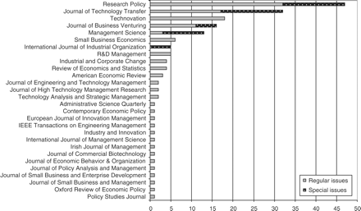
Figure 2 University entrepreneurship articles published per academic journal, 1981–2005.
Notes:
Figure 2 University entrepreneurship articles published per academic journal, 1981–2005.
Unless provided in the caption above, the following copyright applies to the content of this slide: © The Author 2007. Published by Oxford University Press on behalf of Associazione ICC. All rights reserved.

Slide 3
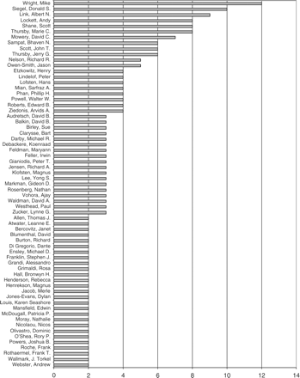
Figure 3 University entrepreneurship articles in academic journals ≥2 by authors, 1981–2005.
Notes:
Figure 3 University entrepreneurship articles in academic journals ≥2 by authors, 1981–2005.
Unless provided in the caption above, the following copyright applies to the content of this slide: © The Author 2007. Published by Oxford University Press on behalf of Associazione ICC. All rights reserved.

Slide 4
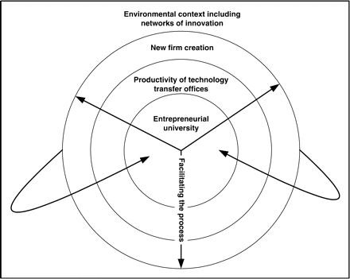
Figure 4 Conceptual framework of university entrepreneurship.
Notes:
Figure 4 Conceptual framework of university entrepreneurship.
Unless provided in the caption above, the following copyright applies to the content of this slide: © The Author 2007. Published by Oxford University Press on behalf of Associazione ICC. All rights reserved.

Slide 5
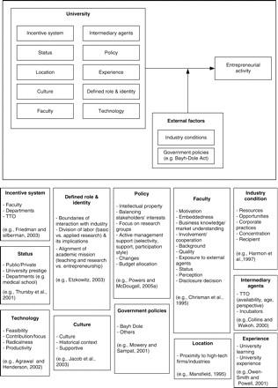
Figure 5 Entrepreneurial research university.
Notes:
Figure 5 Entrepreneurial research university.
Unless provided in the caption above, the following copyright applies to the content of this slide: © The Author 2007. Published by Oxford University Press on behalf of Associazione ICC. All rights reserved.

Slide 6
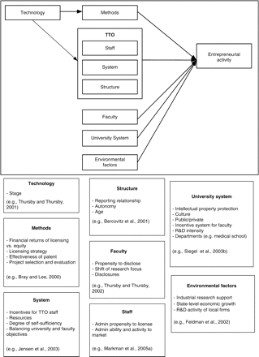
Figure 6 Productivity of technology transfer offices.
Notes:
Figure 6 Productivity of technology transfer offices.
Unless provided in the caption above, the following copyright applies to the content of this slide: © The Author 2007. Published by Oxford University Press on behalf of Associazione ICC. All rights reserved.

Slide 7
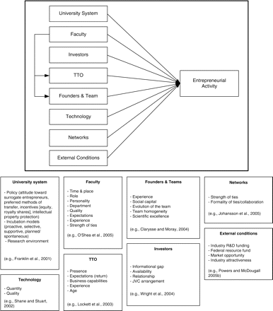
Figure 7 New firm creation.
Notes:
Figure 7 New firm creation.
Unless provided in the caption above, the following copyright applies to the content of this slide: © The Author 2007. Published by Oxford University Press on behalf of Associazione ICC. All rights reserved.

Slide 8
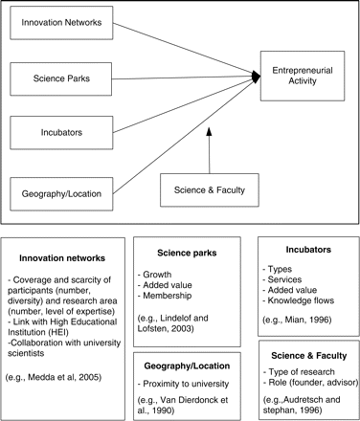
Figure 8 Environmental context including networks of innovation.
Notes:
Figure 8 Environmental context including networks of innovation.
Unless provided in the caption above, the following copyright applies to the content of this slide: © The Author 2007. Published by Oxford University Press on behalf of Associazione ICC. All rights reserved.

