Slide 1
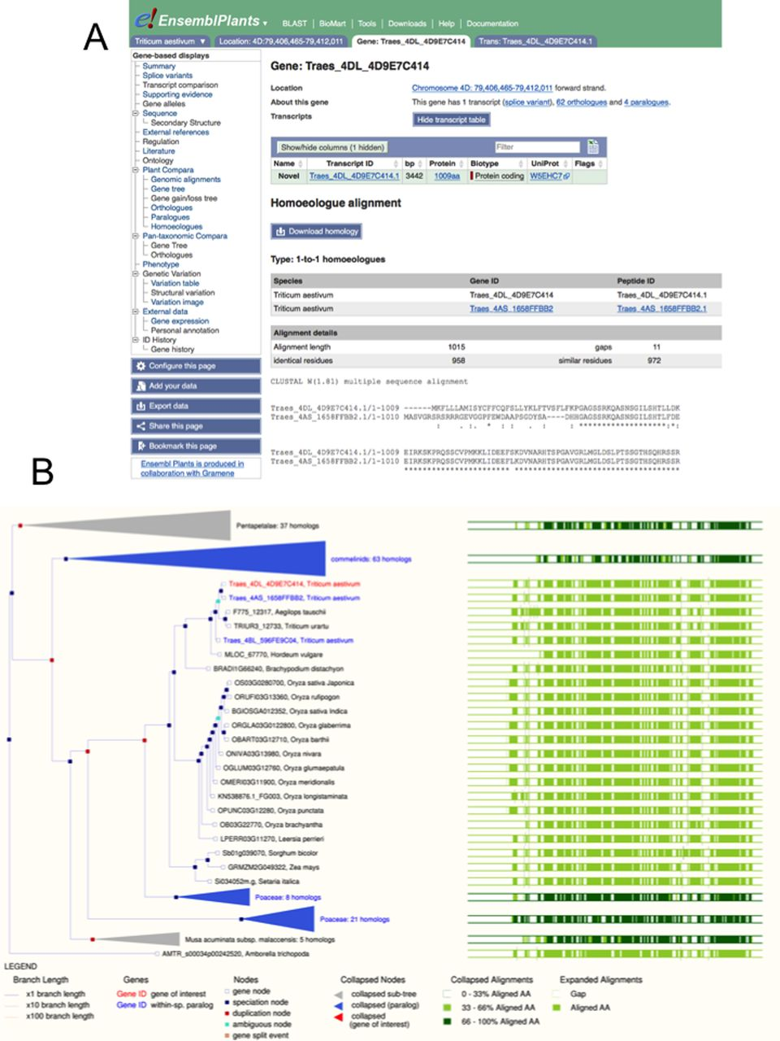
Figure 1. Comparative genomics of bread wheat, as visualized in Ensembl Plants. Panel A shows the alignments of two ...
Notes:
Figure 1. Comparative genomics of bread wheat, as visualized in Ensembl Plants. Panel A shows the alignments of two homoeologous genes at the level of protein sequence. The selected gene is highlighted in red. Panel B shows these genes in the wider context of a gene tree, showing 1:1 orthology over 21 grass genomes including the 3 bread wheat genomes and the two sequenced diploid precursors.
Unless provided in the caption above, the following copyright applies to the content of this slide: © The Author(s) 2015. Published by Oxford University Press on behalf of Nucleic Acids Research.This is an Open Access article distributed under the terms of the Creative Commons Attribution License (http://creativecommons.org/licenses/by/4.0/), which permits unrestricted reuse, distribution, and reproduction in any medium, provided the original work is properly cited.

Slide 2
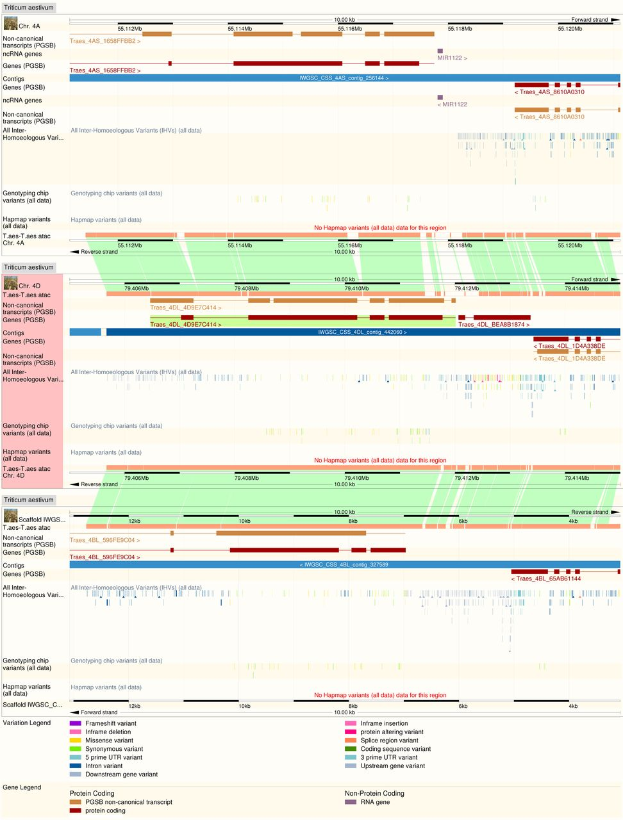
Figure 2. Whole genome alignment between the three bread wheat component genomes at a set of homoeologous loci. ...
Notes:
Figure 2. Whole genome alignment between the three bread wheat component genomes at a set of homoeologous loci. Inter-homoeologous variant calls and inter-variety polymorphisms are visible on tracks on each genome.
Unless provided in the caption above, the following copyright applies to the content of this slide: © The Author(s) 2015. Published by Oxford University Press on behalf of Nucleic Acids Research.This is an Open Access article distributed under the terms of the Creative Commons Attribution License (http://creativecommons.org/licenses/by/4.0/), which permits unrestricted reuse, distribution, and reproduction in any medium, provided the original work is properly cited.

