Slide 1
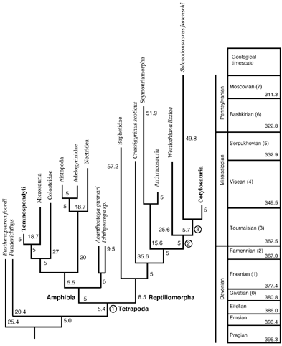
Figure 2 Alternative phylogeny in which the relationships between the main clades are based on Panchen and Smithson ...
Notes:
Figure 2 Alternative phylogeny in which the relationships between the main clades are based on Panchen and Smithson (1988). The relationships within the main clades are as in Figure 1. Thus, large clades have been collapsed into single terminal taxa, to avoid redundancy and to highlight the differences. Extant taxa are in bold type. Panchen and Smithson (1988) considered that extant amphibians were derived from temnospondyls; therefore, Temnospondyli is considered extant in the context of this phylogeny. Nodes where body size is evaluated in other topologies (Tables 7, 8) are indicated by circled numbers; only clades 1 to 3 are identified in the figure because the others are Cotylosauria (4) or part of the latter.
Unless provided in the caption above, the following copyright applies to the content of this slide: © 2004 Society of Systematic Biologists

Slide 2
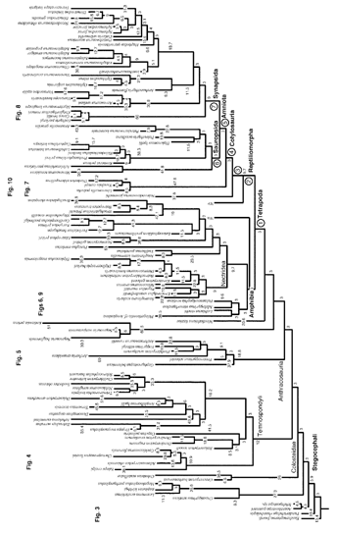
Figure 1 Stegocephalian phylogeny used to study body size evolution. The groups for which body size evolution is shown ...
Notes:
Figure 1 Stegocephalian phylogeny used to study body size evolution. The groups for which body size evolution is shown on subsequent figures are identified. Wa and Wr indicate alternative plausible hypothesis (not the most parsimonious ones) about the affinities of Westlothiana, as an early amphibian (Wa) or reptiliomorph (Wr). Branch length (in My) is indicated (this is the version with minimal internal branch length of 3 My; another version with internal branch length of 5 My was also used in the tests). Extant taxa are in bold type. Nodes where body size is evaluated in other topologies (Tables 7, 8) are indicated by circled numbers (1–7).
Unless provided in the caption above, the following copyright applies to the content of this slide: © 2004 Society of Systematic Biologists

Slide 3
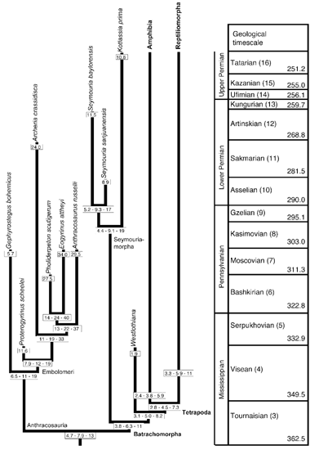
Figure 5 Cranial length evolution in anthracosaurs and seymouriamorphs. All lengths are expressed in cm, and represent ...
Notes:
Figure 5 Cranial length evolution in anthracosaurs and seymouriamorphs. All lengths are expressed in cm, and represent the distance from the anterior tip of the premaxilla to the posterior end of the skull table. Abbreviations: M. Per, Middle Permian; U. Per, Upper Permian. Extant taxa are in bold type.
Unless provided in the caption above, the following copyright applies to the content of this slide: © 2004 Society of Systematic Biologists

Slide 4
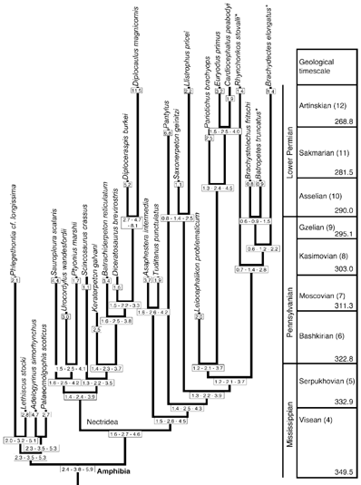
Figure 6 Cranial length evolution in early amphibians. The taxa marked by an asterisk (*) have been argued to be ...
Notes:
Figure 6 Cranial length evolution in early amphibians. The taxa marked by an asterisk (*) have been argued to be closely related to lissamphibians, or to at least one group of lissamphibians. All lengths are expressed in cm, and represent the distance from the anterior tip of the premaxilla to the posterior end of the skull table. Extant taxa are in bold type.
Unless provided in the caption above, the following copyright applies to the content of this slide: © 2004 Society of Systematic Biologists

Slide 5
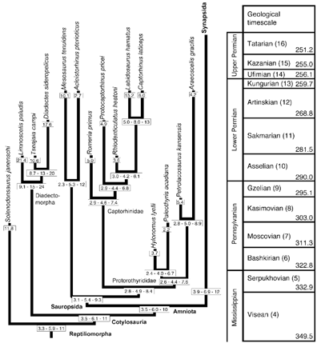
Figure 7 Cranial length evolution in reptiliomorphs. All lengths are expressed in cm, and represent the distance from ...
Notes:
Figure 7 Cranial length evolution in reptiliomorphs. All lengths are expressed in cm, and represent the distance from the anterior tip of the premaxilla to the posterior end of the skull table. Abbreviations as in Figure 4. Extant taxa are in bold type.
Unless provided in the caption above, the following copyright applies to the content of this slide: © 2004 Society of Systematic Biologists

Slide 6
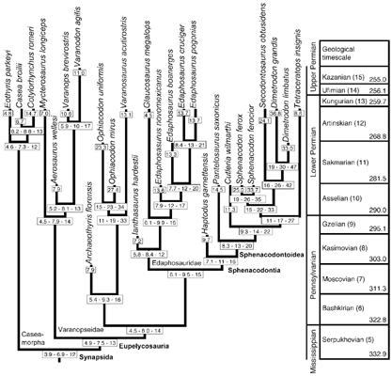
Figure 8 Cranial length evolution in synapsids. All lengths are expressed in cm, and represent the distance from the ...
Notes:
Figure 8 Cranial length evolution in synapsids. All lengths are expressed in cm, and represent the distance from the anterior tip of the premaxilla to the posterior end of the skull table. Extant taxa are in bold type.
Unless provided in the caption above, the following copyright applies to the content of this slide: © 2004 Society of Systematic Biologists

Slide 7
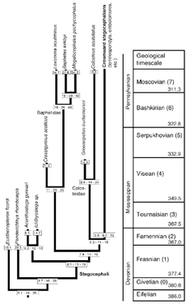
Figure 3 Cranial length evolution in early stem-tetrapods. All lengths (averages for adult specimens of each taxon) ...
Notes:
Figure 3 Cranial length evolution in early stem-tetrapods. All lengths (averages for adult specimens of each taxon) are expressed in cm, and represent the distance from the anterior tip of the premaxilla to the posterior end of the skull table. In this figure, and in all the subsequent ones, the size estimates of the hypothetical ancestors are reported with two significant numbers. Three values are given for every node: the lower limit of the 95% confidence interval, the estimated value, and the upper limit of the 95% confidence interval. The estimated value is not in the middle of the confidence interval because all calculations were performed on log-transformed values, and the results were converted back to cm. Extant taxa are in bold type.
Unless provided in the caption above, the following copyright applies to the content of this slide: © 2004 Society of Systematic Biologists

Slide 8
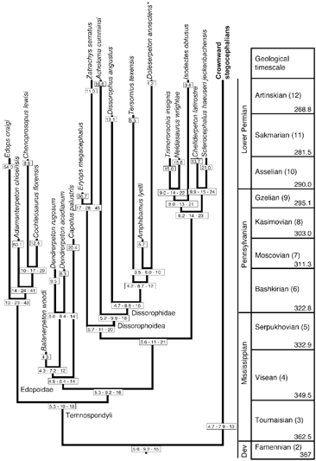
Figure 4 Cranial length evolution in temnospondyls. The taxon (Doleserpeton) marked by an asterisk (*) has been argued ...
Notes:
Figure 4 Cranial length evolution in temnospondyls. The taxon (Doleserpeton) marked by an asterisk (*) has been argued to be closely related to lissamphibians, or to at least anurans. All lengths are expressed in cm, and represent the distance from the anterior tip of the premaxilla to the posterior end of the skull table. Extant taxa are in bold type.
Unless provided in the caption above, the following copyright applies to the content of this slide: © 2004 Society of Systematic Biologists

Slide 9
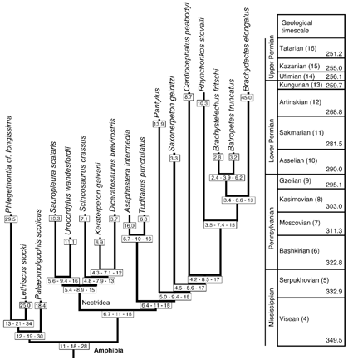
Figure 9 Presacral length evolution in early amphibians. The taxa marked by an asterisk (*) have been argued to be ...
Notes:
Figure 9 Presacral length evolution in early amphibians. The taxa marked by an asterisk (*) have been argued to be closely related to lissamphibians, or to at least one group of lissamphibians. All lengths are expressed in cm, and represent the distance from the anterior tip of the atlantal centrum to the anterior tip of the sacral centrum. Extant taxa are in bold type.
Unless provided in the caption above, the following copyright applies to the content of this slide: © 2004 Society of Systematic Biologists

Slide 10
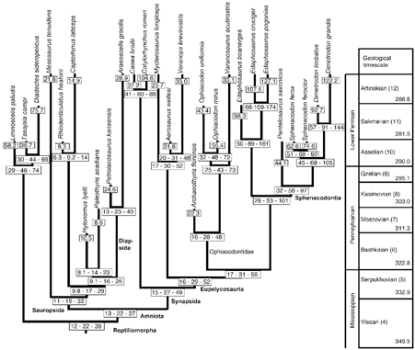
Figure 10 Presacral length evolution in early reptiliomorphs. All lengths are expressed in cm, and represent the ...
Notes:
Figure 10 Presacral length evolution in early reptiliomorphs. All lengths are expressed in cm, and represent the distance from the anterior tip of the atlantal centrum to the anterior tip of the first sacral centrum. Extant taxa are in bold type.
Unless provided in the caption above, the following copyright applies to the content of this slide: © 2004 Society of Systematic Biologists

Slide 11
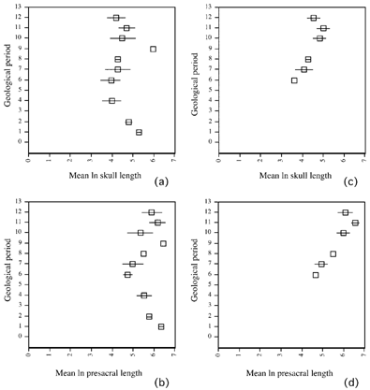
Figure 11 Mean body size (x-axis) through time (y-axis). (a) Mean cranial length of stegocephalians. (b) Mean presacral ...
Notes:
Figure 11 Mean body size (x-axis) through time (y-axis). (a) Mean cranial length of stegocephalians. (b) Mean presacral length of stegocephalians. (c) Mean cranial length of reptiliomorphs. (d) Mean presacral length of reptiliomorphs. For reptiliomorphs (c, d), there are no size data before period 6 because reptiliomorphs appear in the fossil record at that time; no size data are available for that group in period 9. In period 1, sampled taxa are finned, primitively aquatic sarcopterygians closely related to stegocephalians; periods 2 to 12 are represented only by stegocephalians. The time periods are defined in Appendix 3. All values have been log-transformed (ln of the dimensions, in mm). The horizontal bars passing through each point represent the standard deviation. Points without bars represent single values. There are no data for period 3.
Unless provided in the caption above, the following copyright applies to the content of this slide: © 2004 Society of Systematic Biologists

