Slide 1
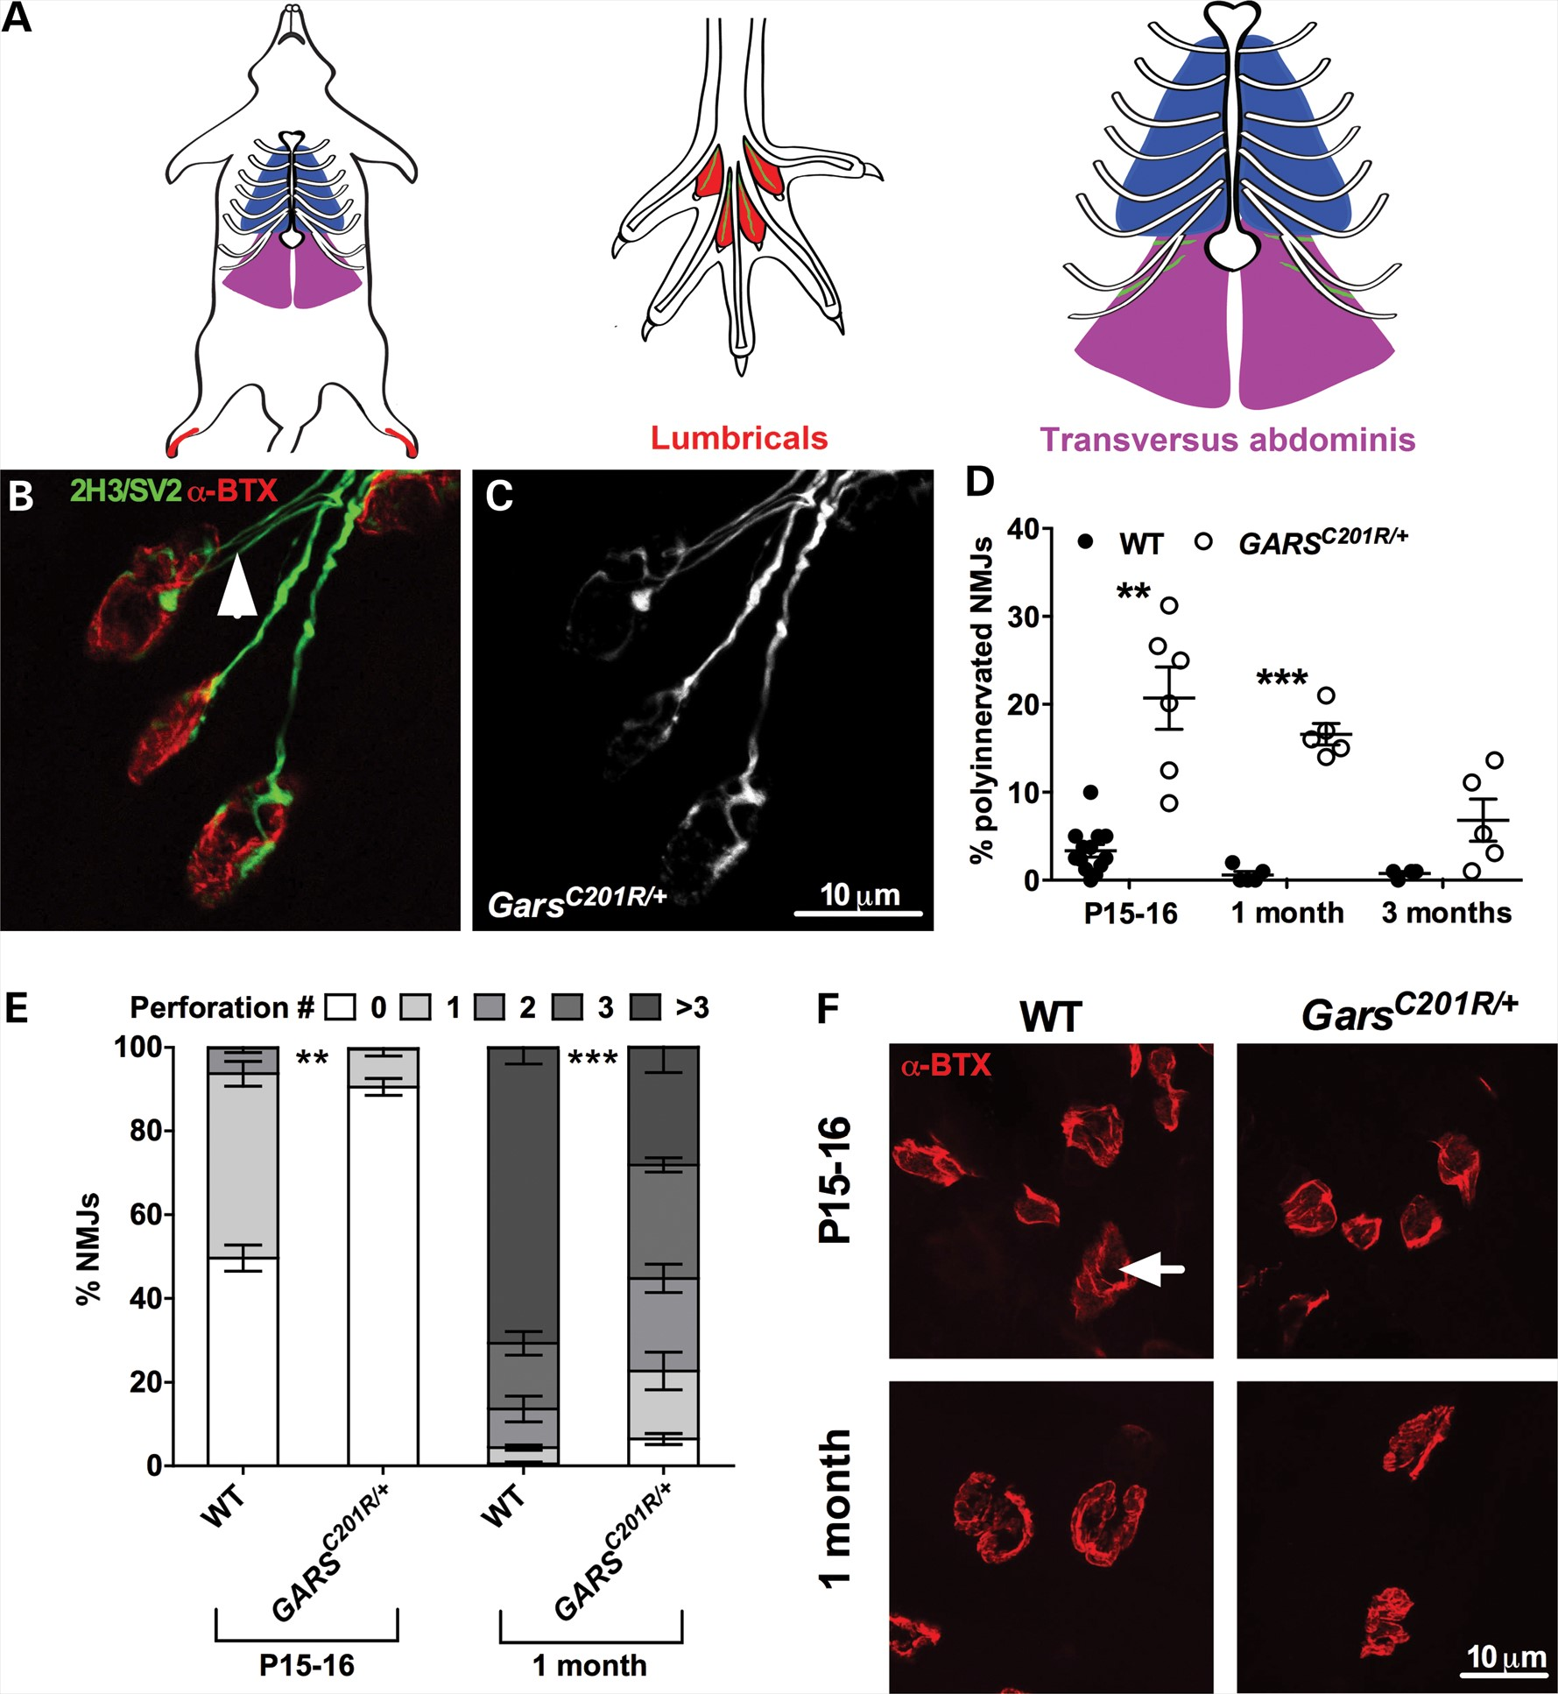
Figure 1. Gars^{C201R/+} lumbrical NMJs display impaired development of pre- and post-synaptic structures. (A) ...
Notes:
Figure 1. GarsC201R/+ lumbrical NMJs display impaired development of pre- and post-synaptic structures. (A) Schematics of the anatomical locations of the lumbrical and TVA muscles in the mouse. The lumbrical muscles are coloured red, the TVA muscles purple and the main nerve branches of each muscle are depicted in green. Figure adapted from (36). (B and C). Example P15-16 GarsC201R/+ mouse NMJs with one showing polyinnervation (arrowhead). As is the case for all subsequent figures, nervous tissue is stained green (2H3, neurofilament; SV2, synaptic vesicle 2) and post-synaptic AChRs are stained red (α-BTX, α-bungarotoxin). (D) GarsC201R/+ lumbrical muscles show a significant impairment in the process of synapse elimination as shown by the increased percentage of NMJs with more than one innervating neuron at all time-points. P < 0.001, Kruskal–Wallis test. **P < 0.01, ***P < 0.001, Dunn's multiple comparison test. (E) Mutant NMJs have significantly fewer post-synaptic perforations at P15-16 and 1 month, indicative of hindered progression from the immature plaque to the mature pretzel conformation. **P < 0.01, ***P < 0.001, unpaired t-test with Welch's Correction. (F) Example endplates from wild-type and mutant mice at P15-16 and 1 month. Note the reduced complexity and size. The arrow highlights a single perforation. A total of 4–13 mice/genotype/time-point were assayed.
Unless provided in the caption above, the following copyright applies to the content of this slide: © The Author 2013. Published by Oxford University Press. All rights reserved. For Permissions, please email: journals.permissions@oup.com

Slide 2
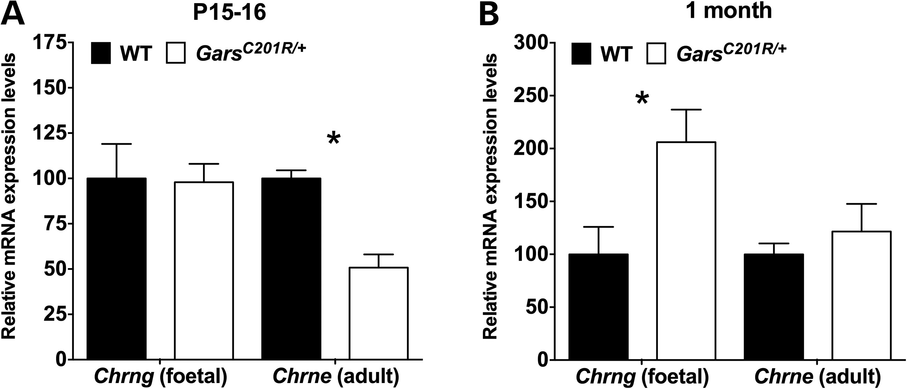
Figure 2. The transcriptional maturation of Gars^{C201R/+} lumbrical NMJs is also defective. (A) At P15-16, ...
Notes:
Figure 2. The transcriptional maturation of GarsC201R/+ lumbrical NMJs is also defective. (A) At P15-16, GarsC201R/+ lumbricals show a delay in expression of the adult AChR subunit (Chrne) as assessed by qPCR. P = 0.0286, Kruskal–Wallis test. (B) At 1 month, Chrne expression in mutant mice has normalized to wild-type levels, but foetal subunit (Chrng) expression persists. P = 0.109, Kruskal–Wallis test. Gapdh (ENSMUSG00000057666) was used as the reference gene. *P < 0.05, Dunn's multiple comparison test. A total of 2–6 mice/genotype/time-point were assayed (two wild-type mice were studied at P15-16 and 1 month for the Chrng and Chrne analyses, respectively).
Unless provided in the caption above, the following copyright applies to the content of this slide: © The Author 2013. Published by Oxford University Press. All rights reserved. For Permissions, please email: journals.permissions@oup.com

Slide 3
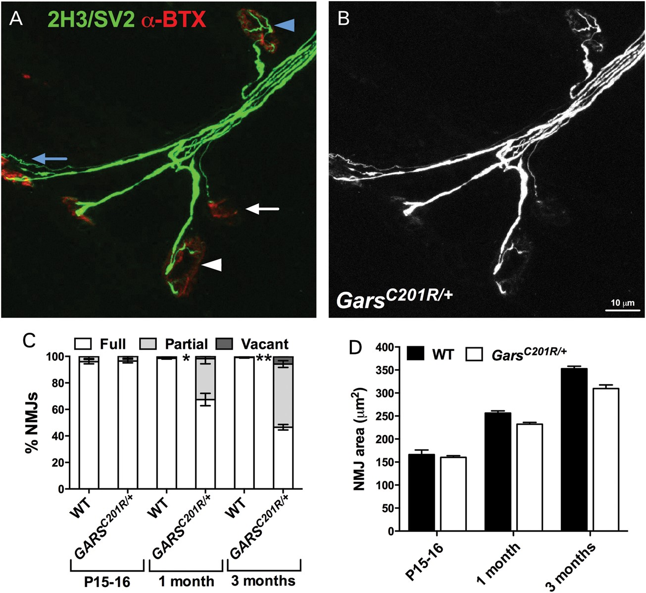
Figure 3. Gars^{C201R/+} lumbrical muscle denervation succeeds the dysfunctional NMJ maturation. (A and B) ...
Notes:
Figure 3. GarsC201R/+ lumbrical muscle denervation succeeds the dysfunctional NMJ maturation. (A and B) Examples of fully occupied (blue arrowhead), partially occupied (white arrowhead), almost vacant (white arrow) and polyinnervated (blue arrow) NMJs from lumbrical muscle of a 3-month-old GarsC201R/+ mouse. (C) At P15-16, a time when mutant lumbrical NMJ development is perturbed (Figs 1 and 2), no denervation is observed. However, at 1 month, there is a significant increase in the number of partially innervated NMJs, which becomes progressively worse by 3 months, suggesting that maturation defects precede loss of lower motor neuron connectivity. P < 0.001, Kruskal–Wallis test. *P < 0.05, Dunn's multiple comparison test. (D) There is a small reduction in the average mutant NMJ area at 1 month, which becomes more distinct with time, although does not reach significance between genotypes at any time-point. P = 0.0053, Kruskal–Wallis test. A total of 3–5 mice/genotype/time-point were assayed.
Unless provided in the caption above, the following copyright applies to the content of this slide: © The Author 2013. Published by Oxford University Press. All rights reserved. For Permissions, please email: journals.permissions@oup.com

Slide 4
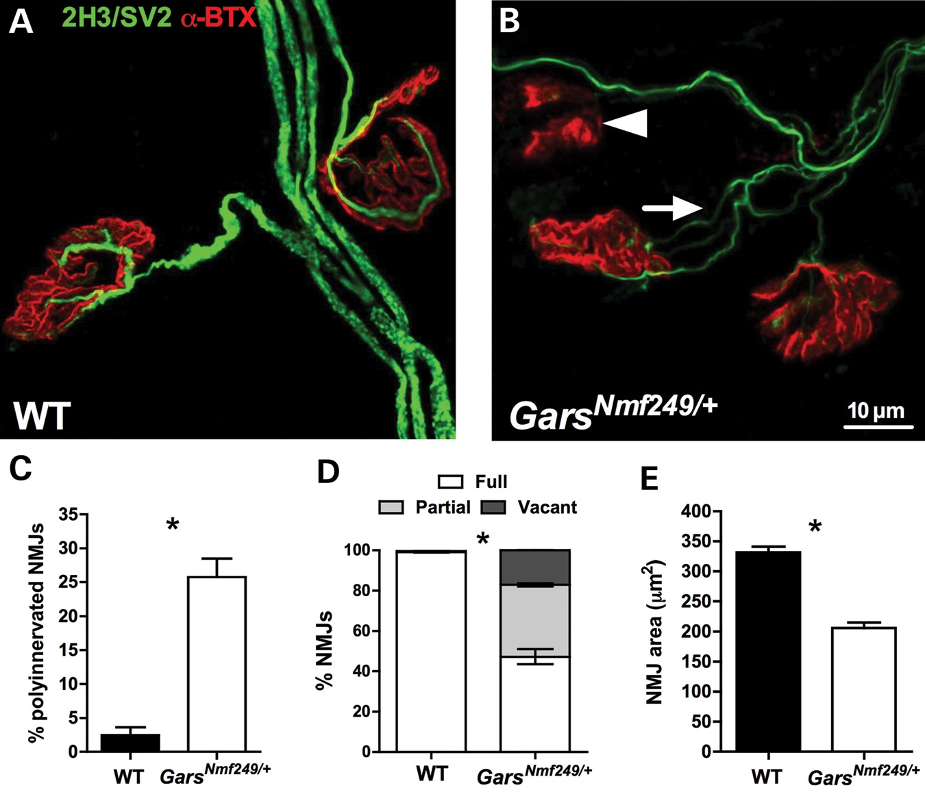
Figure 4. Gars mouse lumbrical NMJ defects correlate with mutant severity. (A and B) Example lumbrical muscle NMJs from ...
Notes:
Figure 4. Gars mouse lumbrical NMJ defects correlate with mutant severity. (A and B) Example lumbrical muscle NMJs from 2-month-old wild-type and GarsNmf249/+ mice. A denervated (arrowhead) and polyinnervated (arrow) NMJ can be seen in the mutant muscle. Differences in post-synaptic complexity and size are evident between genotypes. Neuronal atrophy can also be seen in the mutant mouse. (C–E) At 2 months, the more severe mutant mouse, GarsNmf249/+, displays significantly more NMJs that are polyinnervated (C, P = 0.0159), denervated (D, P = 0.0175) and smaller (E, P = 0.0159) than wild-type mice. The degree of GarsNmf249/+ polyinnervation is greater than that seen in GarsC201R/+ mice at any time-point. Similarly, denervation and the reduction in NMJ size are also more severe. *P < 0.05, Mann–Whitney U test. A total of 4–5 mice/genotype/time-point were assayed.
Unless provided in the caption above, the following copyright applies to the content of this slide: © The Author 2013. Published by Oxford University Press. All rights reserved. For Permissions, please email: journals.permissions@oup.com

Slide 5
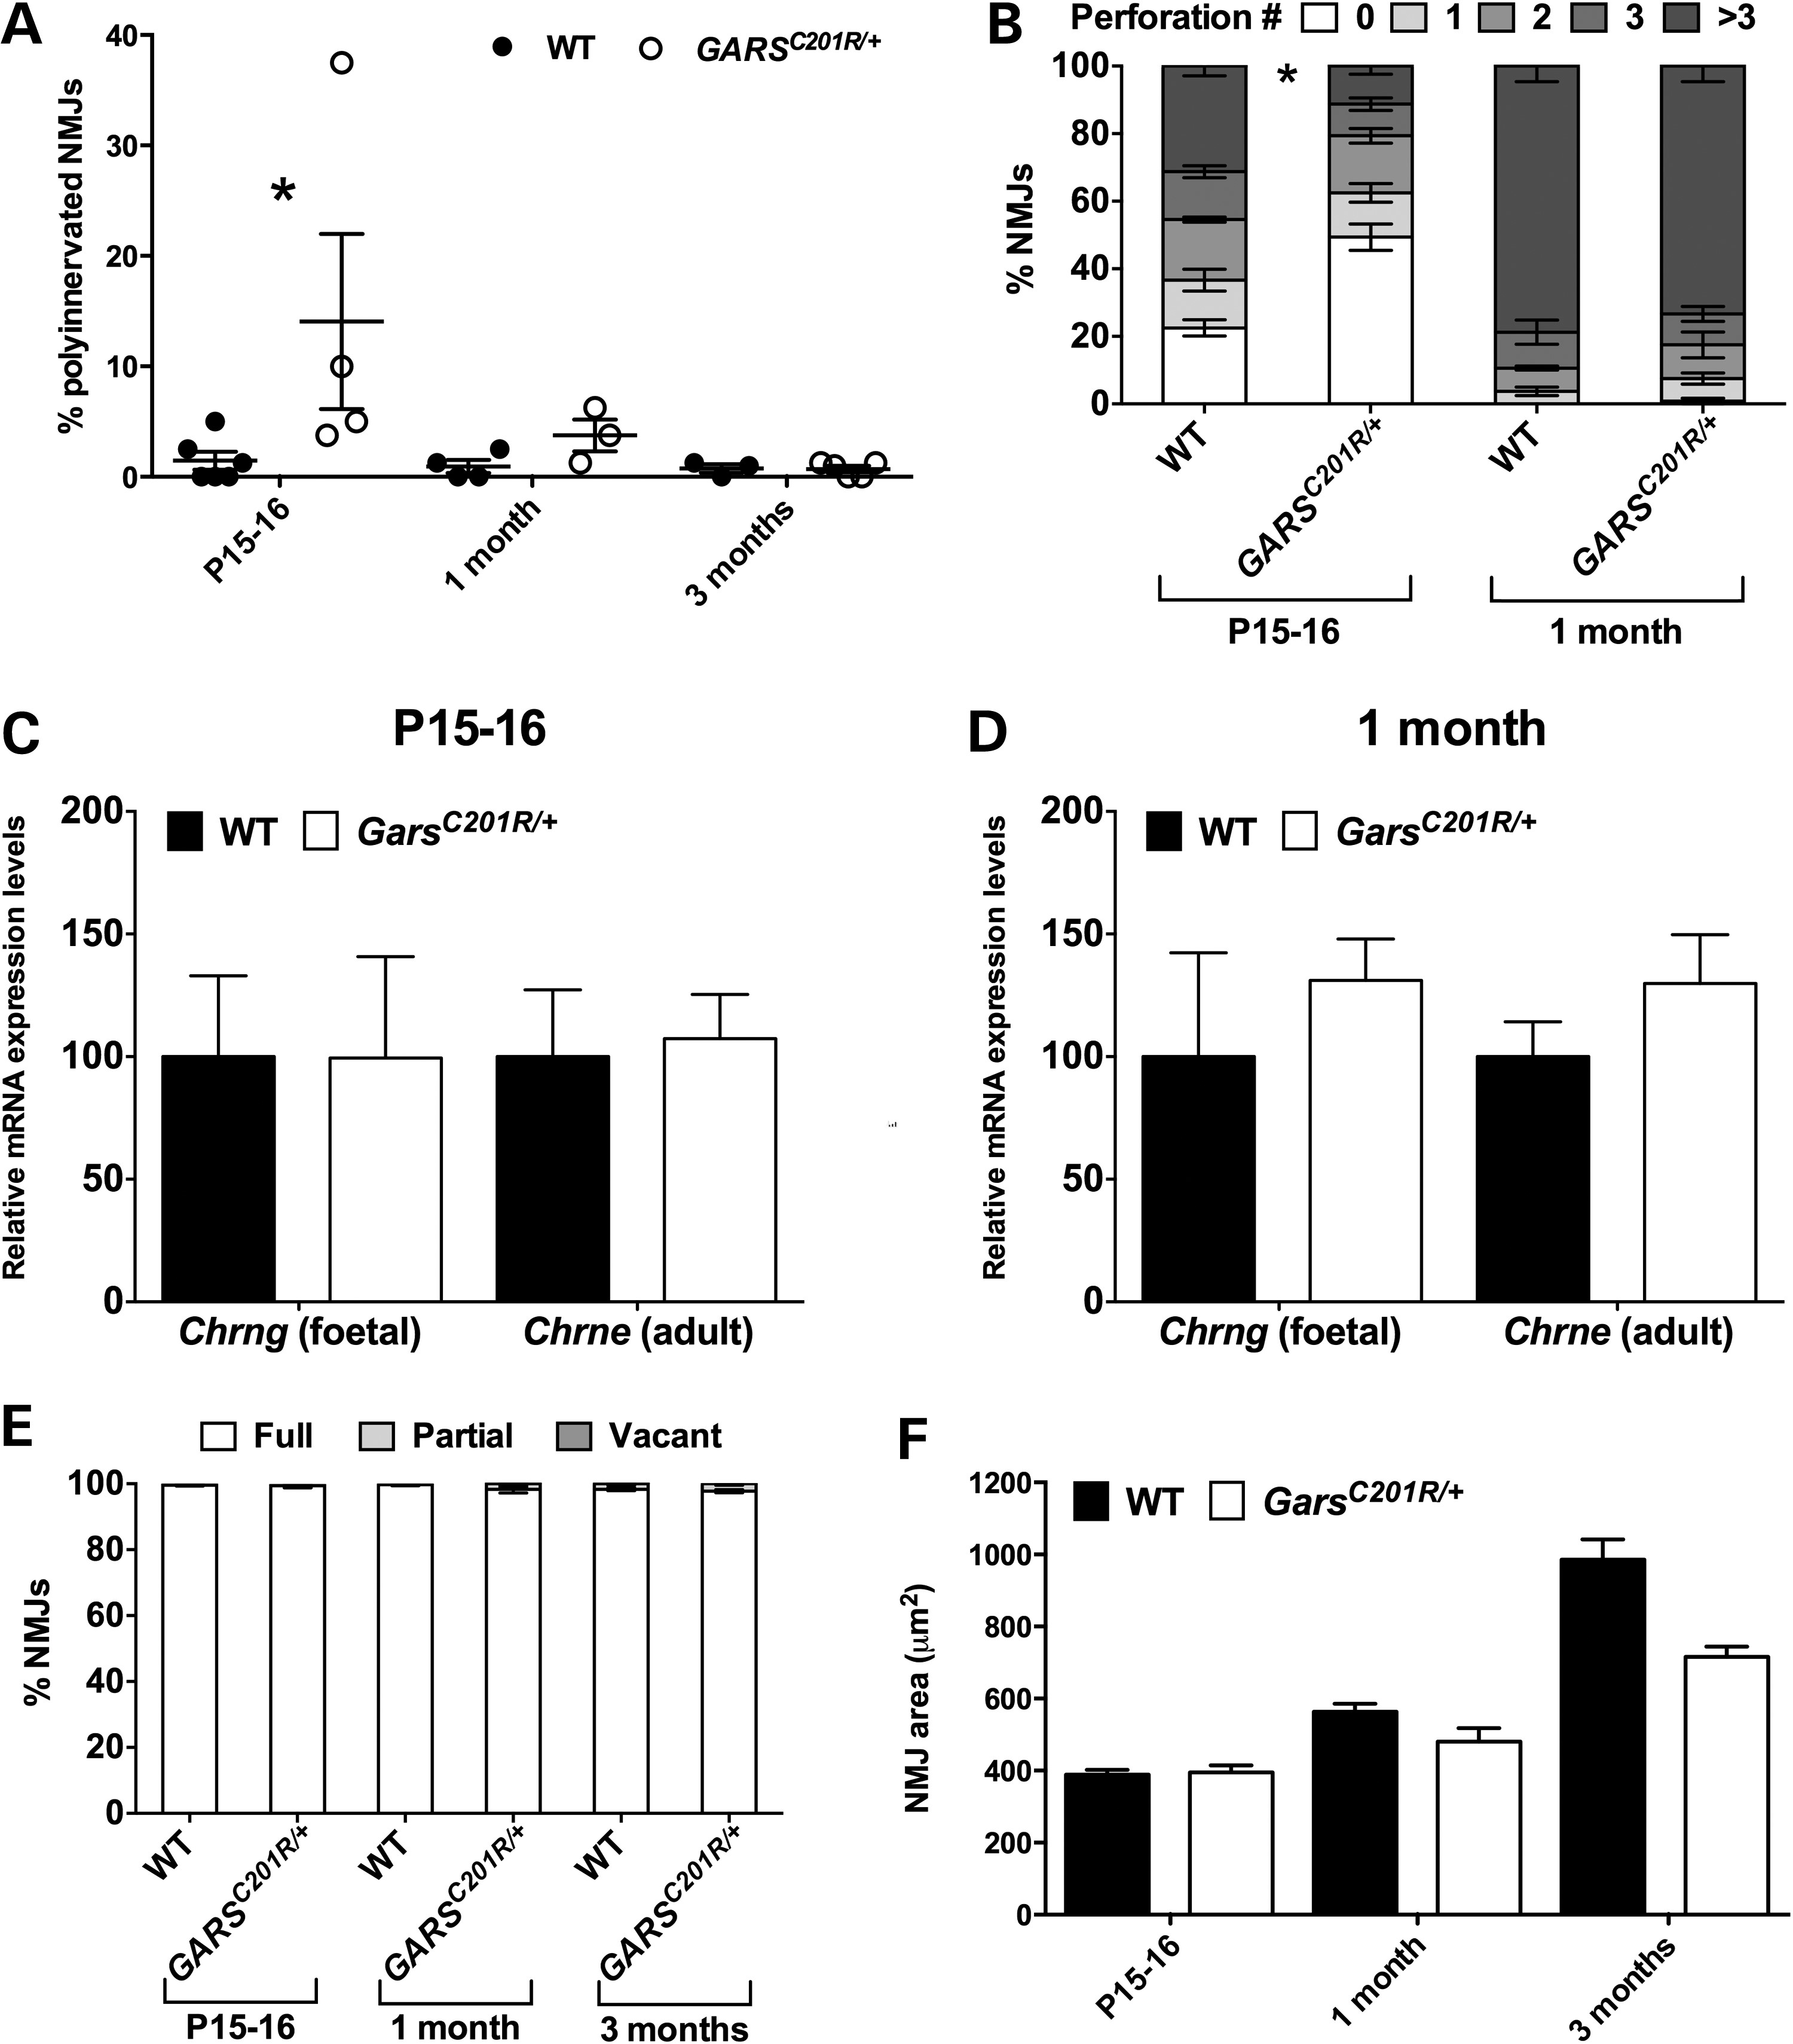
Figure 5. Gars^{C201R/+} TVA NMJs are relatively unaffected and show no impairment in lower motor neuron ...
Notes:
Figure 5. GarsC201R/+ TVA NMJs are relatively unaffected and show no impairment in lower motor neuron connectivity. (A) Significant polyinnervation in the TVA muscle of GarsC201R/+ mice is observed at P15-16, but not at 1 month, indicating that synapse elimination is only subtly delayed, and to a much lesser extent than in the lumbrical muscles. P = 0.0303, Kruskal–Wallis test. *P < 0.05, Dunn's multiple comparison test. (B) The post-synapse also shows only a mild defect in maturation at P15-16 (P = 0.0139) that is recovered by 1 month (P = 0.3725). *P < 0.05, Mann–Whitney U test. (C and D) Mutant TVA muscles show no difference in the expression of foetal (Chrng) and adult (Chrne) AChR subunit genes at P15-16 (C, P = 0.921, Kruskal–Wallis test) and 1 month (D, P = 0.622, Kruskal–Wallis test). (E) No difference in lower motor neuron connectivity was detected in mutant TVA muscle compared with wild-type at any time-point. P = 0.0554, Kruskal–Wallis test. (F) Similar to the lumbrical muscles, the NMJs of the TVA displayed a small reduction in area at 1 month, becoming progressively more pronounced by 3 months, although again not reaching significance between genotypes. P < 0.001, Kruskal–Wallis test. A total of 2–6 mice/genotype/time-point were assayed (two wild-type mice were used at 1 month for the Chrng qPCR analysis). See also Supplementary Material, Figure S1.
Unless provided in the caption above, the following copyright applies to the content of this slide: © The Author 2013. Published by Oxford University Press. All rights reserved. For Permissions, please email: journals.permissions@oup.com

Slide 6
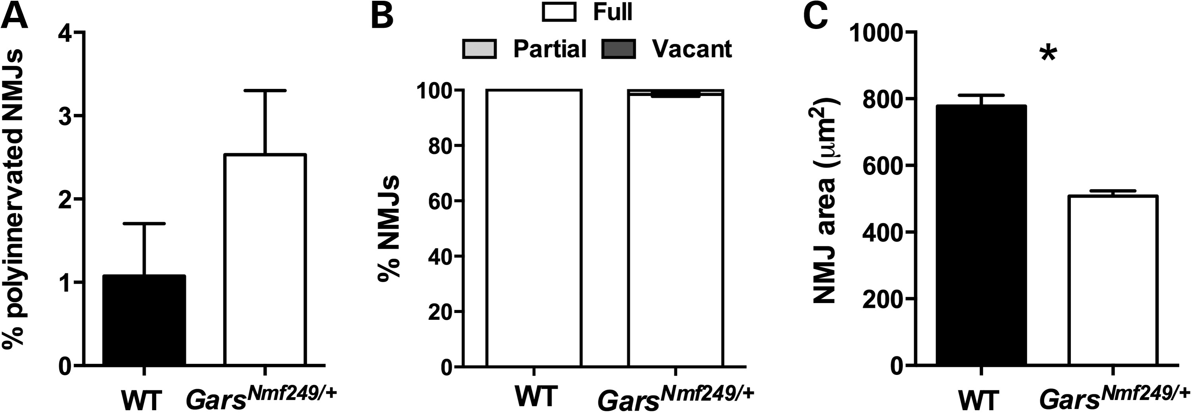
Figure 6. The TVA muscles are also comparatively unaffected in Gars^{Nmf249/+} mice. (A and B) At 2 months, ...
Notes:
Figure 6. The TVA muscles are also comparatively unaffected in GarsNmf249/+ mice. (A and B) At 2 months, GarsNmf249/+ TVA muscles show no difference in the percentage of polyinnervated (A, P = 0.279, Mann–Whitney U test) or fully innervated (B, P = 0.167, Mann–Whitney U test) NMJs. (C) Similar to the less severe mutant, GarsNmf249/+ TVA NMJs are significantly smaller than wild-type synapses (P = 0.0159). *P < 0.05, Mann–Whitney U test. A total of 4–5 mice/genotype were assayed. See also Supplementary Material, Figure S2.
Unless provided in the caption above, the following copyright applies to the content of this slide: © The Author 2013. Published by Oxford University Press. All rights reserved. For Permissions, please email: journals.permissions@oup.com

