Slide 1
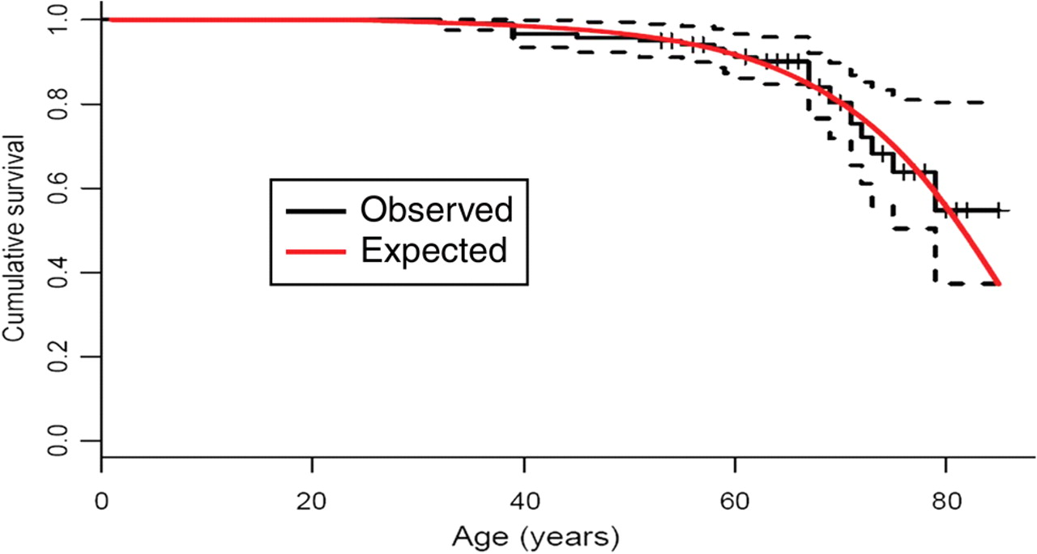
Figure 1 Survival curve of former athletes participating in the Tour de Suisse compared with a male age- and calendar ...
Notes:
Figure 1 Survival curve of former athletes participating in the Tour de Suisse compared with a male age- and calendar time-matched Swiss reference population. The dotted lines represent a 95% pointwise confidence interval for the Kaplan–Meier estimate
Unless provided in the caption above, the following copyright applies to the content of this slide: Published on behalf of the European Society of Cardiology. All rights reserved. © The Author 2007. For permissions please email: journals.permissions@oxfordjournals.org

