Slide 1
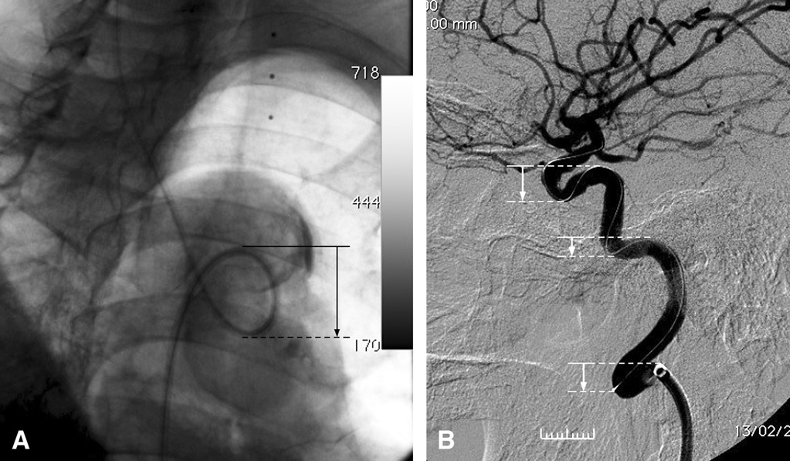
FIGURE 1 A, radiograph showing a reverse curve of the vascular access path at the aortic arch. The downward vector of ...
Notes:
FIGURE 1 A, radiograph showing a reverse curve of the vascular access path at the aortic arch. The downward vector of the reverse curve is shown with an arrow. B, radiograph showing a reverse curve of the vascular access path at the cervical internal carotid artery and 2 reverse curves of the vascular access path at the intracranial internal carotid artery. The downward vectors of the reverse curves are shown with arrows.
Unless provided in the caption above, the following copyright applies to the content of this slide: Copyright © 2011 by the Congress of Neurological Surgeons

Slide 2
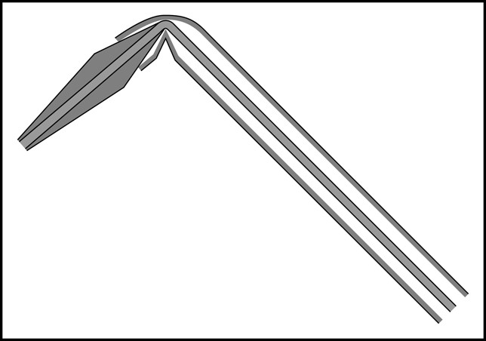
FIGURE 2 Diagram showing the mechanism of the unsheathing difficulty due to a bent nose cone. The bend causes a kink ...
Notes:
FIGURE 2 Diagram showing the mechanism of the unsheathing difficulty due to a bent nose cone. The bend causes a kink at the sheath tip that grips onto the inner core and resists unsheathing. The mechanism was revealed in one of the retrieved systems.
Unless provided in the caption above, the following copyright applies to the content of this slide: Copyright © 2011 by the Congress of Neurological Surgeons

Slide 3
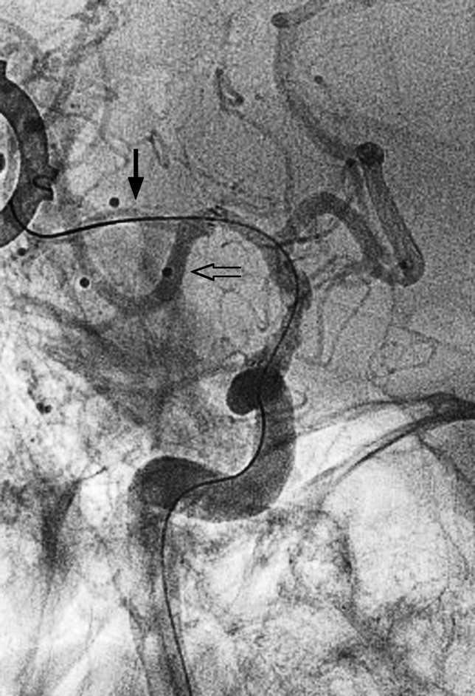
FIGURE 3 Angiography of a case in which difficulty in unsheathing of the stent occurred when the nose cone was bent ...
Notes:
FIGURE 3 Angiography of a case in which difficulty in unsheathing of the stent occurred when the nose cone was bent when it was placed into an inferior division of M2 (open arrow). The problem was resolved when the bending of the nose cone was eliminated with repositioning of the nose cone to a straight path (arrow).
Unless provided in the caption above, the following copyright applies to the content of this slide: Copyright © 2011 by the Congress of Neurological Surgeons

Slide 4
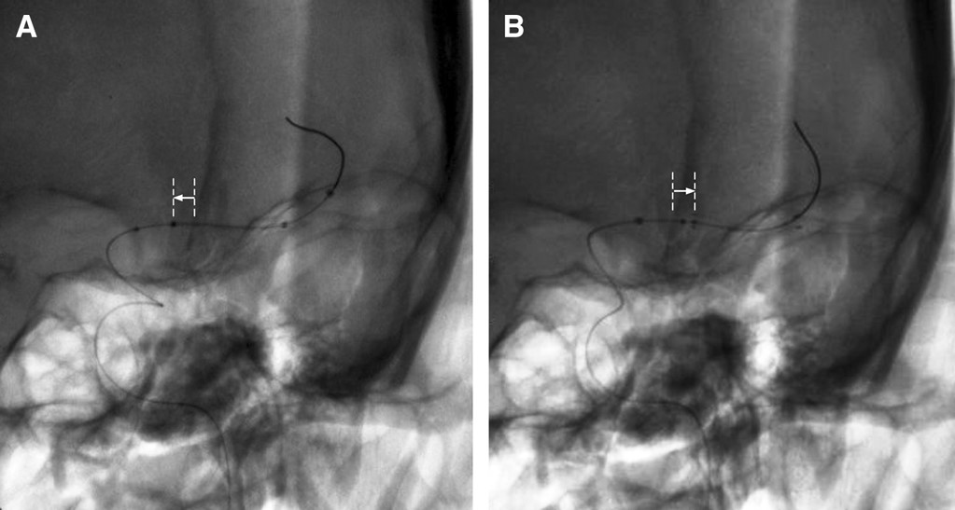
FIGURE 4 A, radiograph showing the position of a stent before stent deployment, the proximal end of the stent (arrow) ...
Notes:
FIGURE 4 A, radiograph showing the position of a stent before stent deployment, the proximal end of the stent (arrow) was located to the left (from the reader's perspective) of the calcified falx cerebri (straight line). B, radiograph showing the position of a deployed stent, after stent deployment, the proximal end of the stent (arrow) was located to the right (from the reader's perspective) of the calcified falx cerebri (straight line). Forward migration of the stent position occurred because of vascular tortuosity.
Unless provided in the caption above, the following copyright applies to the content of this slide: Copyright © 2011 by the Congress of Neurological Surgeons

Slide 5
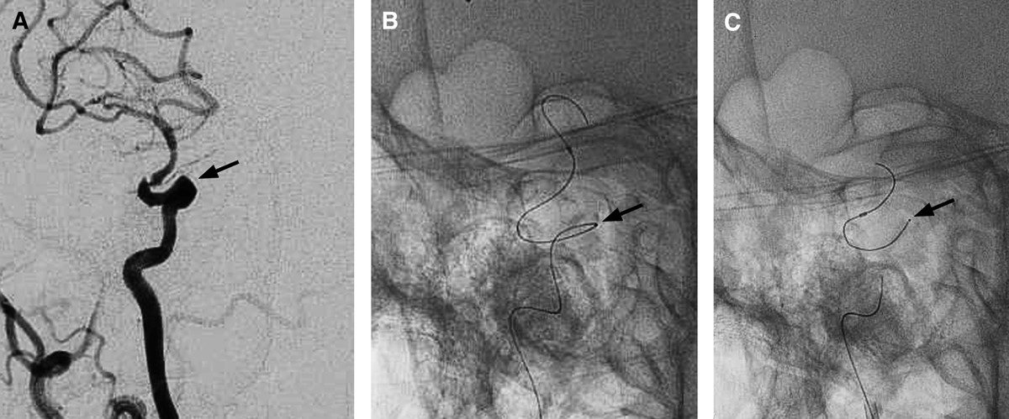
FIGURE 5 A, angiography of a case in which a sharp angulation (arrow) was present just proximal to the carotid siphon. ...
Notes:
FIGURE 5 A, angiography of a case in which a sharp angulation (arrow) was present just proximal to the carotid siphon. B, radiograph showing successful advancement of an angioplasty balloon catheter across the sharp angulation (arrow) over a microwire. C, radiograph showing fracture of the microwire at the location of sharp angulation (arrow), which occurred during an attempt to withdraw the angioplasty catheter while the microwire was forced to stay.
Unless provided in the caption above, the following copyright applies to the content of this slide: Copyright © 2011 by the Congress of Neurological Surgeons

