Slide 1
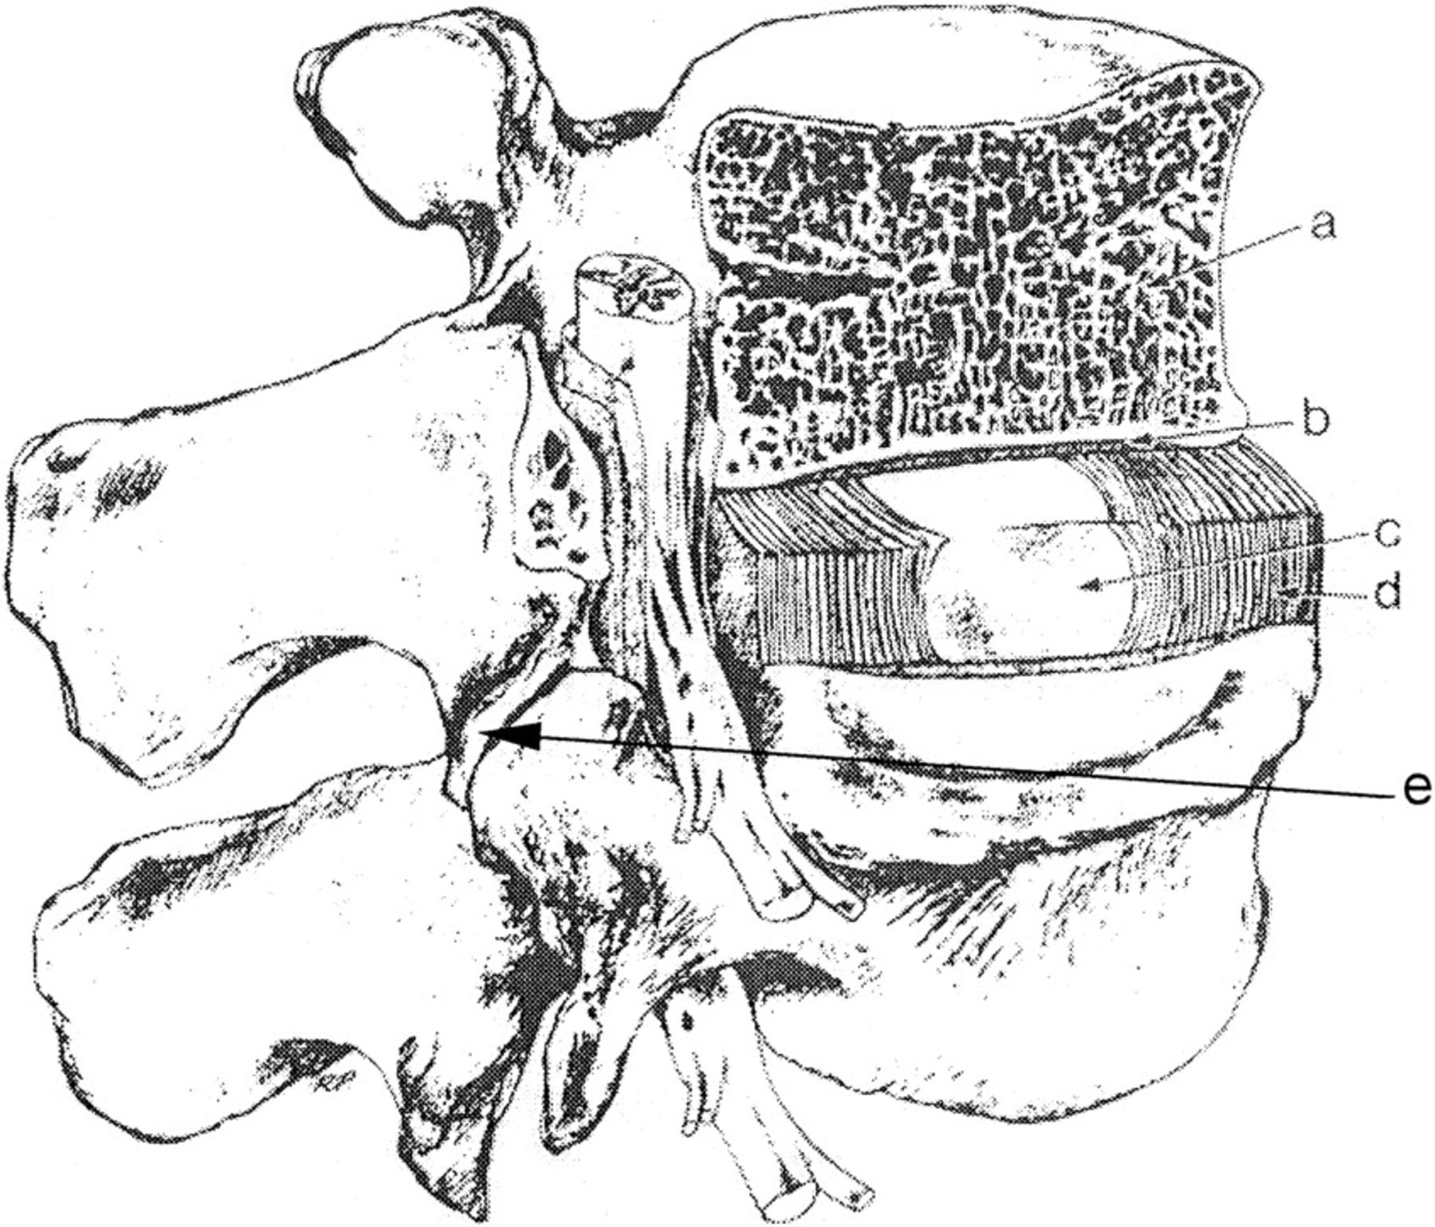
Fig. 1. Schematic view of the intervertebral disc cut away to show the subchondral plate and adjacent ...
Notes:
Fig. 1. Schematic view of the intervertebral disc cut away to show the subchondral plate and adjacent structures (adapted from Urban and Roberts, 1995. (a) vertebral body (b) cartilaginous endplate (c) nucleus pulposus (d) annulus fibrosus (e) apophyseal joint.
Unless provided in the caption above, the following copyright applies to the content of this slide: The Society for Integrative and Comparative Biology

Slide 2
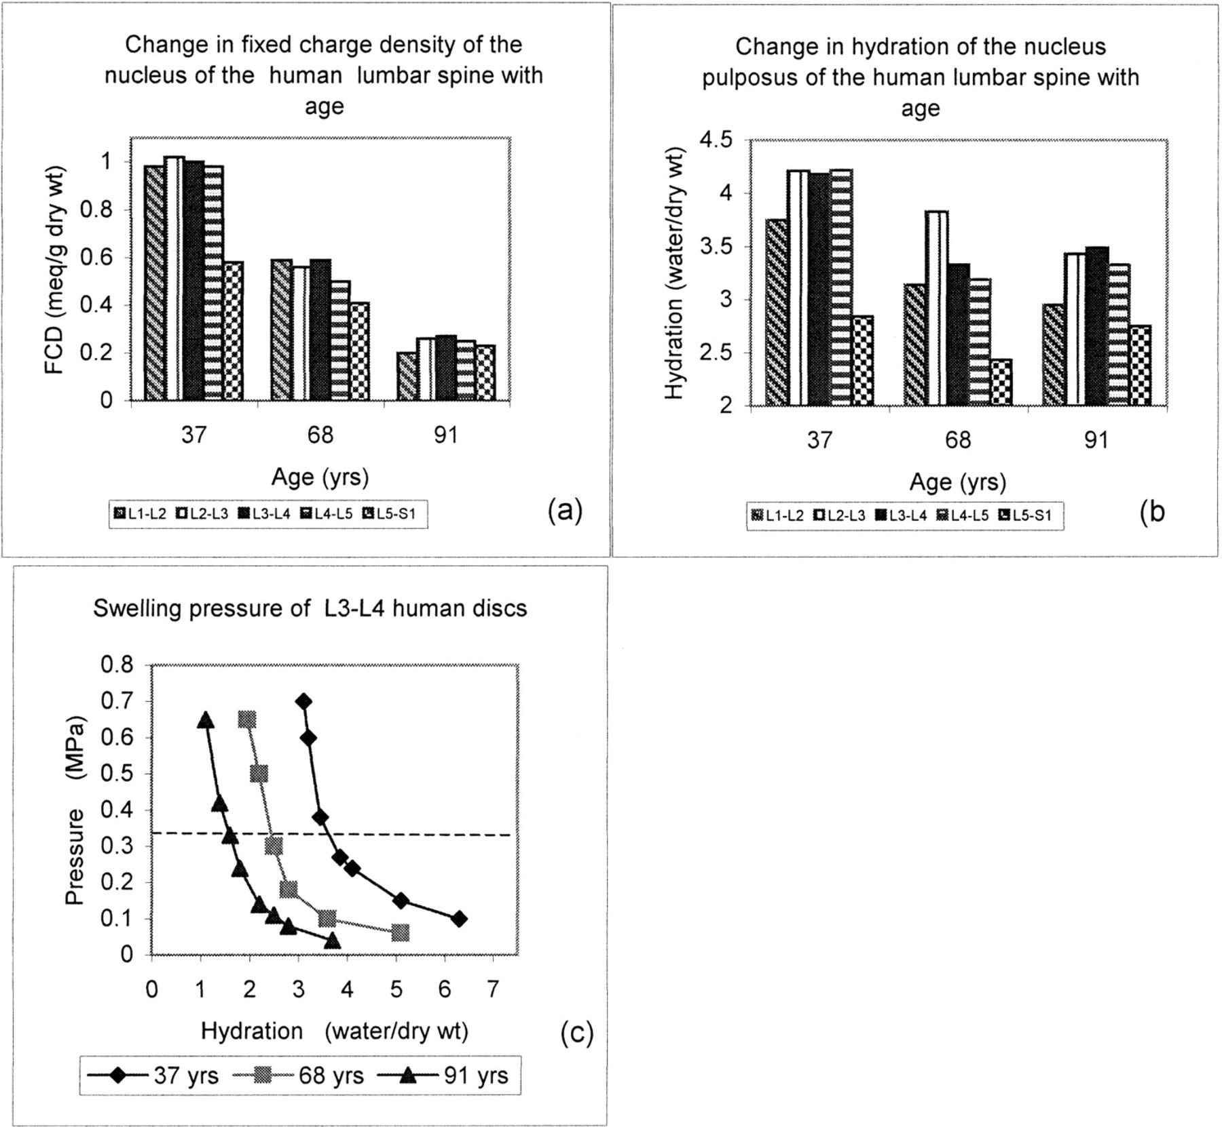
Fig. 2. Changes with age and spinal level in human lumbar discs. (a). Changes in fixed charge density as a ...
Notes:
Fig. 2. Changes with age and spinal level in human lumbar discs. (a). Changes in fixed charge density as a measure of aggrecan concentration. (b). Changes in water content.(c). Changes in swelling pressure of L3–L4 discs. At the same applied pressure, the water content of the 95 yr disc is much lower than that of 35 yr disc.
Unless provided in the caption above, the following copyright applies to the content of this slide: The Society for Integrative and Comparative Biology

Slide 3
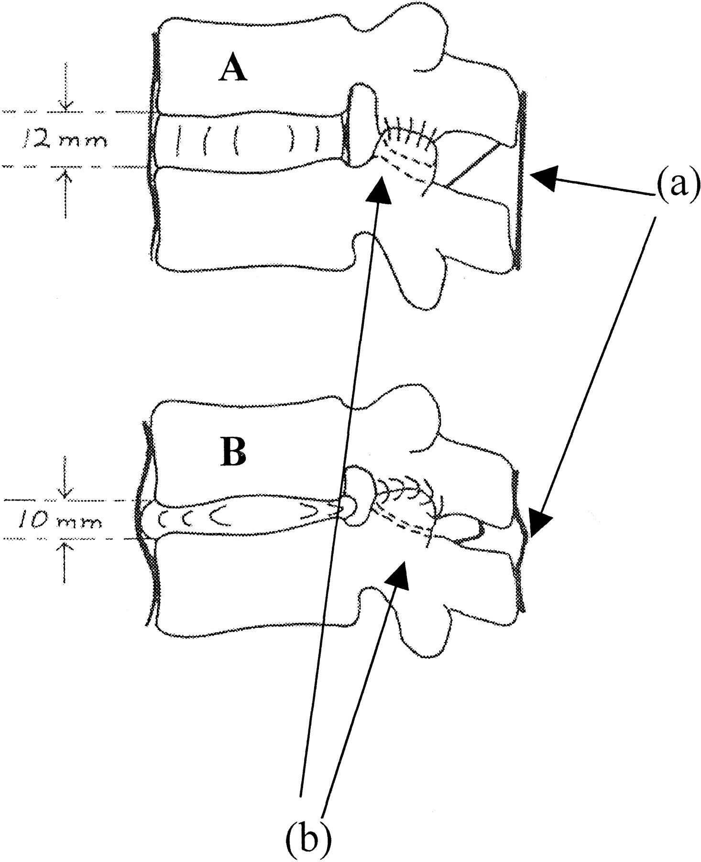
Fig. 3. Schematic view of the effect of loss in height with load on other spinal structures (adapted from ...
Notes:
Fig. 3. Schematic view of the effect of loss in height with load on other spinal structures (adapted from Adams et al., 1990) The degenerate disc (B) shows loss of disc height relative to the normal disc (A), with disc bulging, (a) buckling of ligaments and (b) loss of apophyseal joint space.
Unless provided in the caption above, the following copyright applies to the content of this slide: The Society for Integrative and Comparative Biology

Slide 4
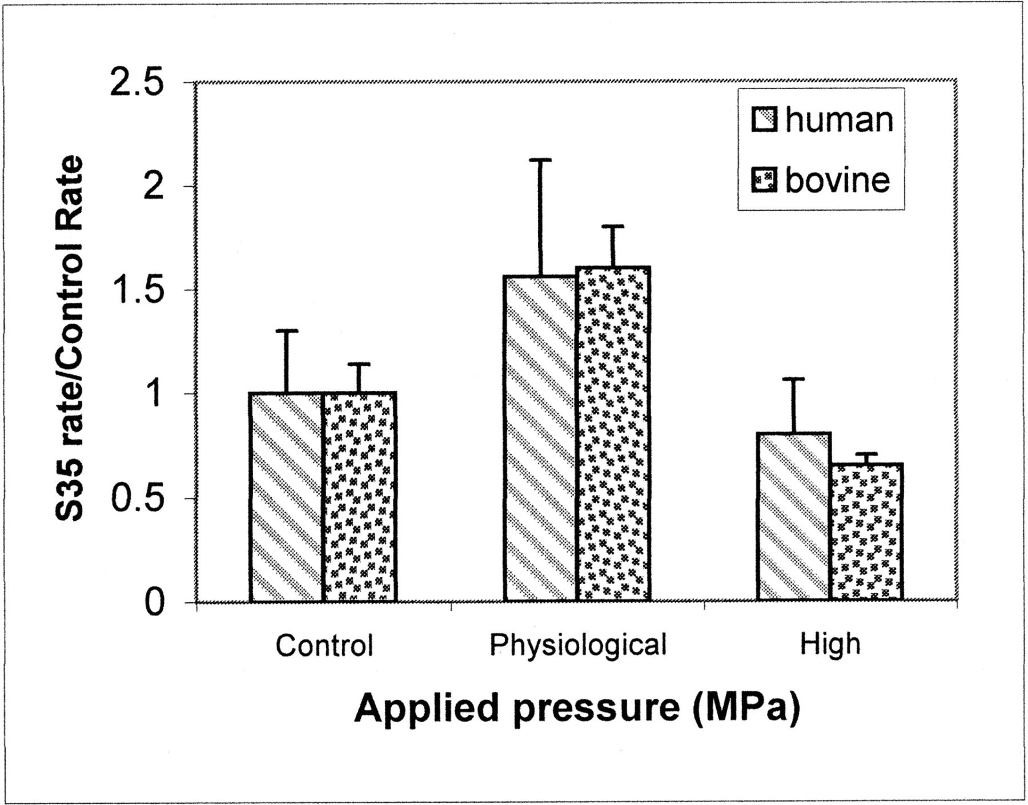
Fig. 4. Effect of hydrostatic pressure on aggrecan synthesis rates in the intervertebral disc nucleus. ...
Notes:
Fig. 4. Effect of hydrostatic pressure on aggrecan synthesis rates in the intervertebral disc nucleus. Physiological pressures (3 MPa) stimulate synthesis relative to unpressurised control tissue whereas high pressures (7.5 MPa) inhibit it (adapted from Ishihara et al., 1997).
Unless provided in the caption above, the following copyright applies to the content of this slide: The Society for Integrative and Comparative Biology

