Slide 1
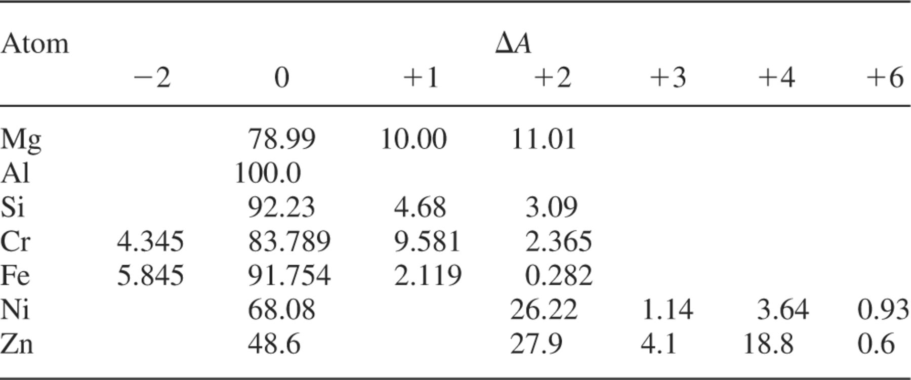
Table 3. The percentage terrestrial abundances of the atoms used in our analysis (Rosman & Taylor 1998). The neutron ...
Notes:
Table 3. The percentage terrestrial abundances of the atoms used in our analysis (Rosman & Taylor 1998). The neutron number is defined relative to that of the isotope with the largest abundance and is denoted as ?A (negative values representing lighter isotopes).
Unless provided in the caption above, the following copyright applies to the content of this slide: © 2001 RAS

Slide 2
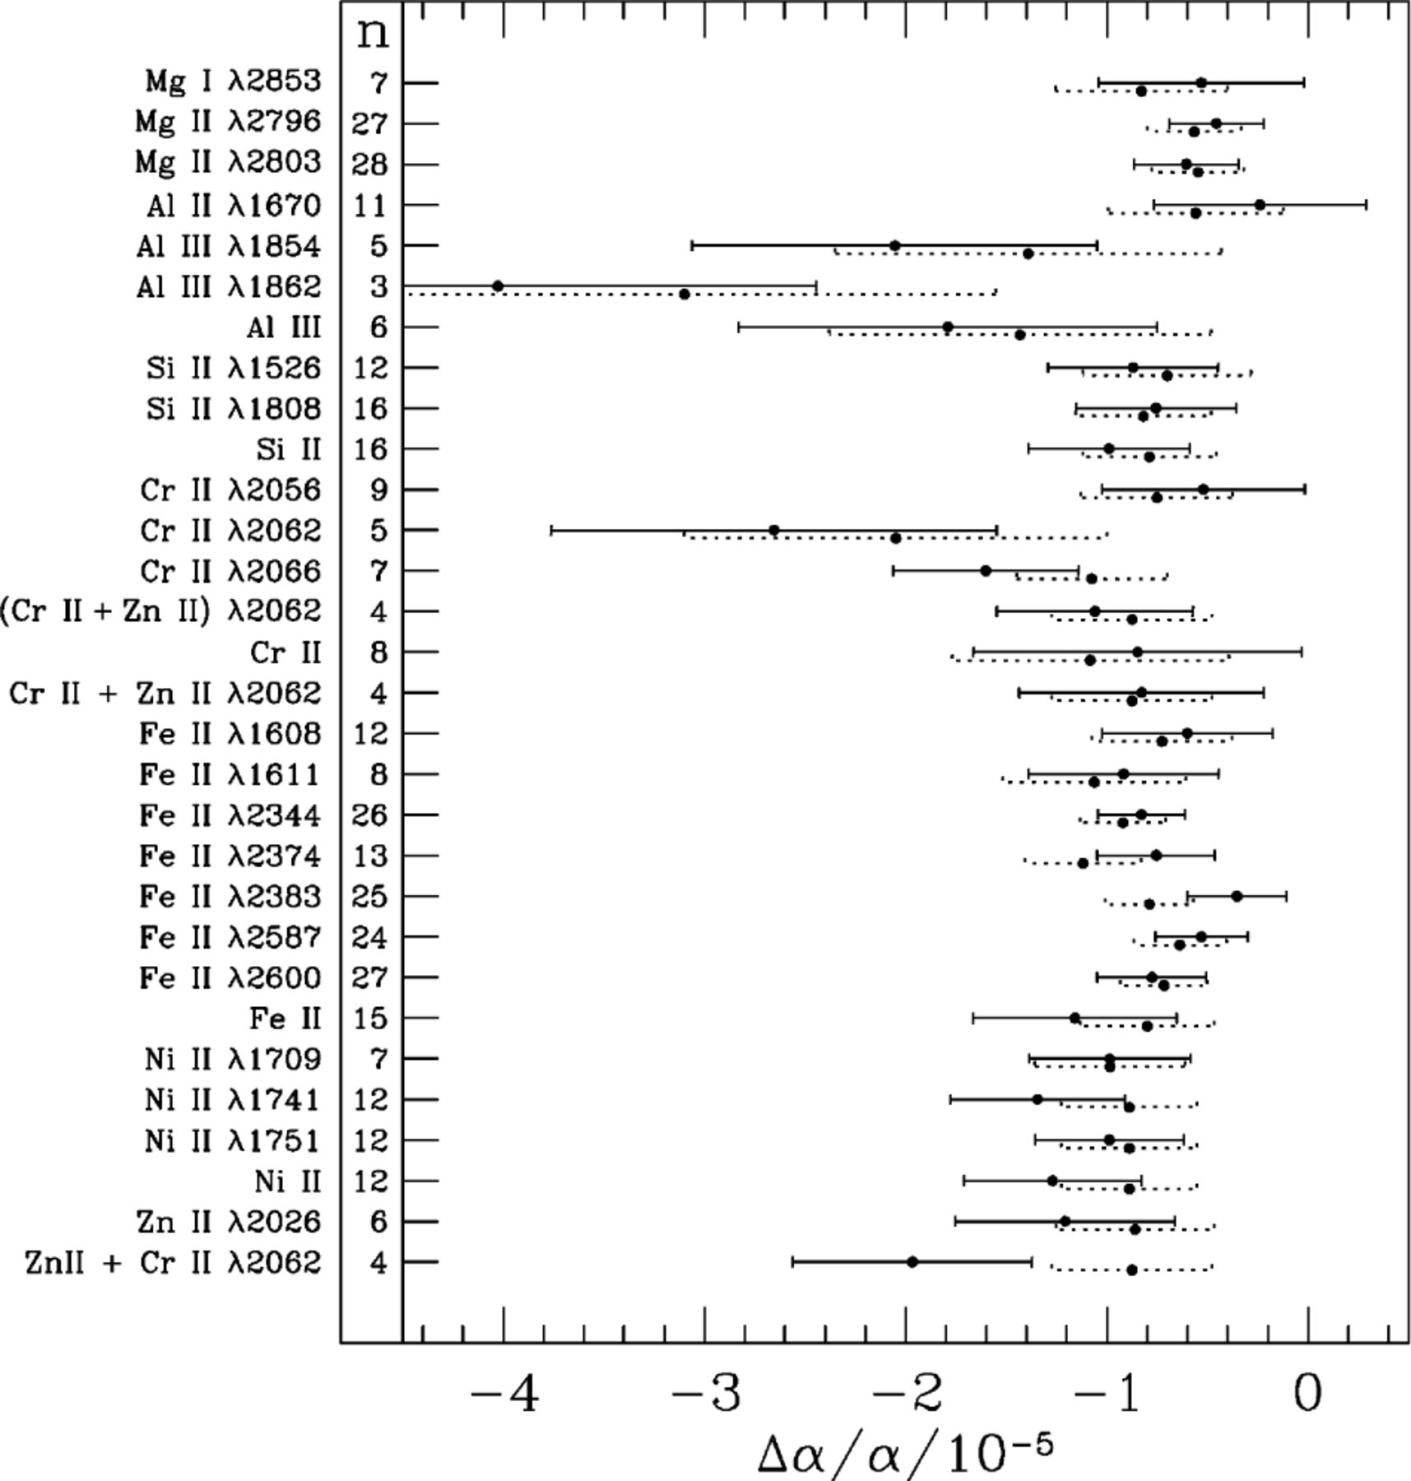
Figure 4. Comparison of the weighted mean of before (dotted error bar) and after (solid error bar) line removal. The ...
Notes:
Figure 4. Comparison of the weighted mean of before (dotted error bar) and after (solid error bar) line removal. The transitions removed are listed on the left together with the number of systems, n, for which removal of that transition was possible. It is stressed that comparing the values and error bars before and after line removal is difficult since these quantities are not independent. Note that there may be some confusion due to the occasional blending of the Cr-ii and Zn-iiλ2062 lines: ‘(Cr-ii+Zn-ii) λ2062’ refers to cases where both transitions had to be removed simultaneously; ‘Cr-ii+Zn-iiλ2062’ refers to cases when all Cr-ii transitions were removed along with the blended Zn-ii line; a similar definition applies to ‘Zn-ii+Cr-iiλ2062’; ‘Cr-ii‘ then refers only to the removal of all Cr-ii transitions in cases where there was no blending with the Zn-ii line. Only one similar case occurred for removal of all Zn-ii lines and so we do not present this result.
Unless provided in the caption above, the following copyright applies to the content of this slide: © 2001 RAS

Slide 3
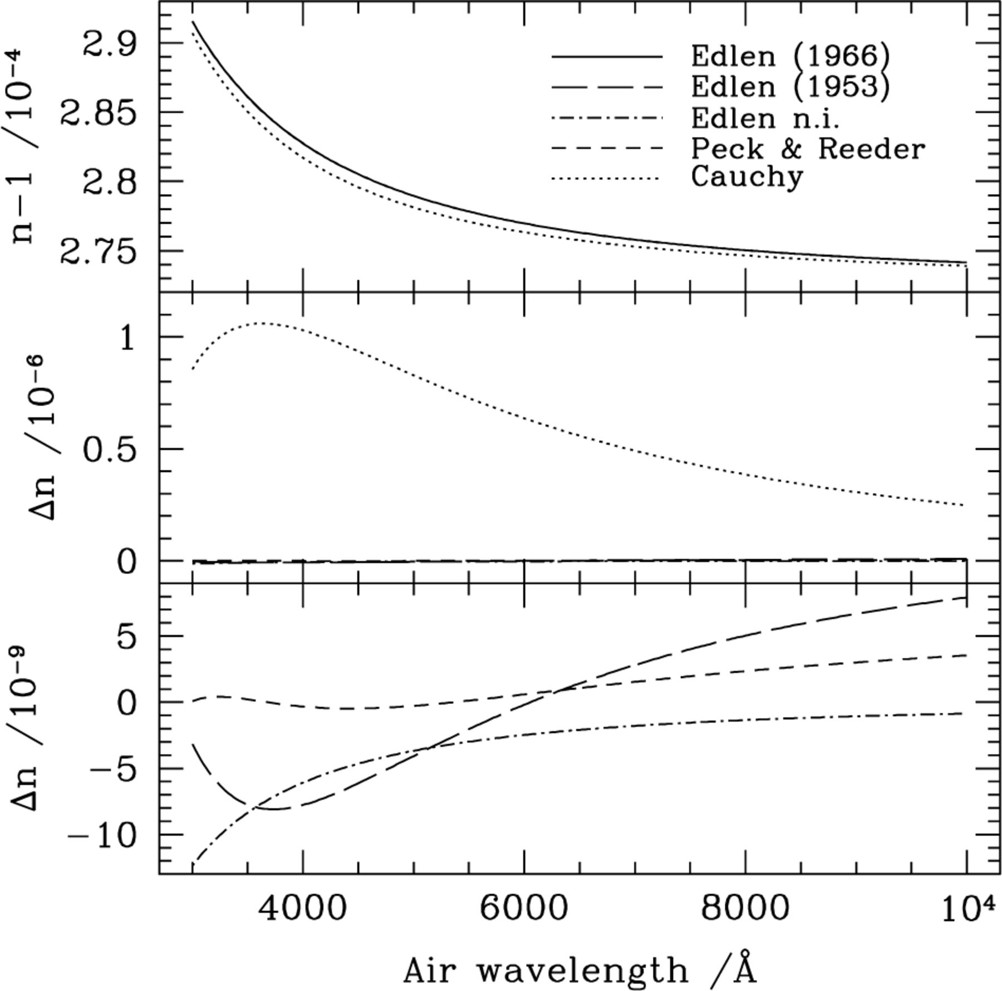
Figure 1. Comparison of the various air dispersion formulae used in the literature (all for 15°C and atmospheric ...
Notes:
Figure 1. Comparison of the various air dispersion formulae used in the literature (all for 15°C and atmospheric pressure). We use the Edlén (1966) formula as our reference since the atlases of Palmer & Engleman (1983) and Norlén (1973) use this to convert their vacuum wavelengths to air wavelengths. The top panel shows the dispersion for the Edlén (1966) and Edlén (1953) formulae together with that of Peck & Reeder (1972) and the Cauchy formula (Weast 1979). We also plot the approximation made within iraf where the Edlén formula has not been inverted to convert air wavelengths to vacuum (denoted ‘Edlen n.i.’). The middle and lower panels show the difference between the Edlén (1966) refractive index, nE, and that derived from the other formulae, nX: .
Unless provided in the caption above, the following copyright applies to the content of this slide: © 2001 RAS

Slide 4
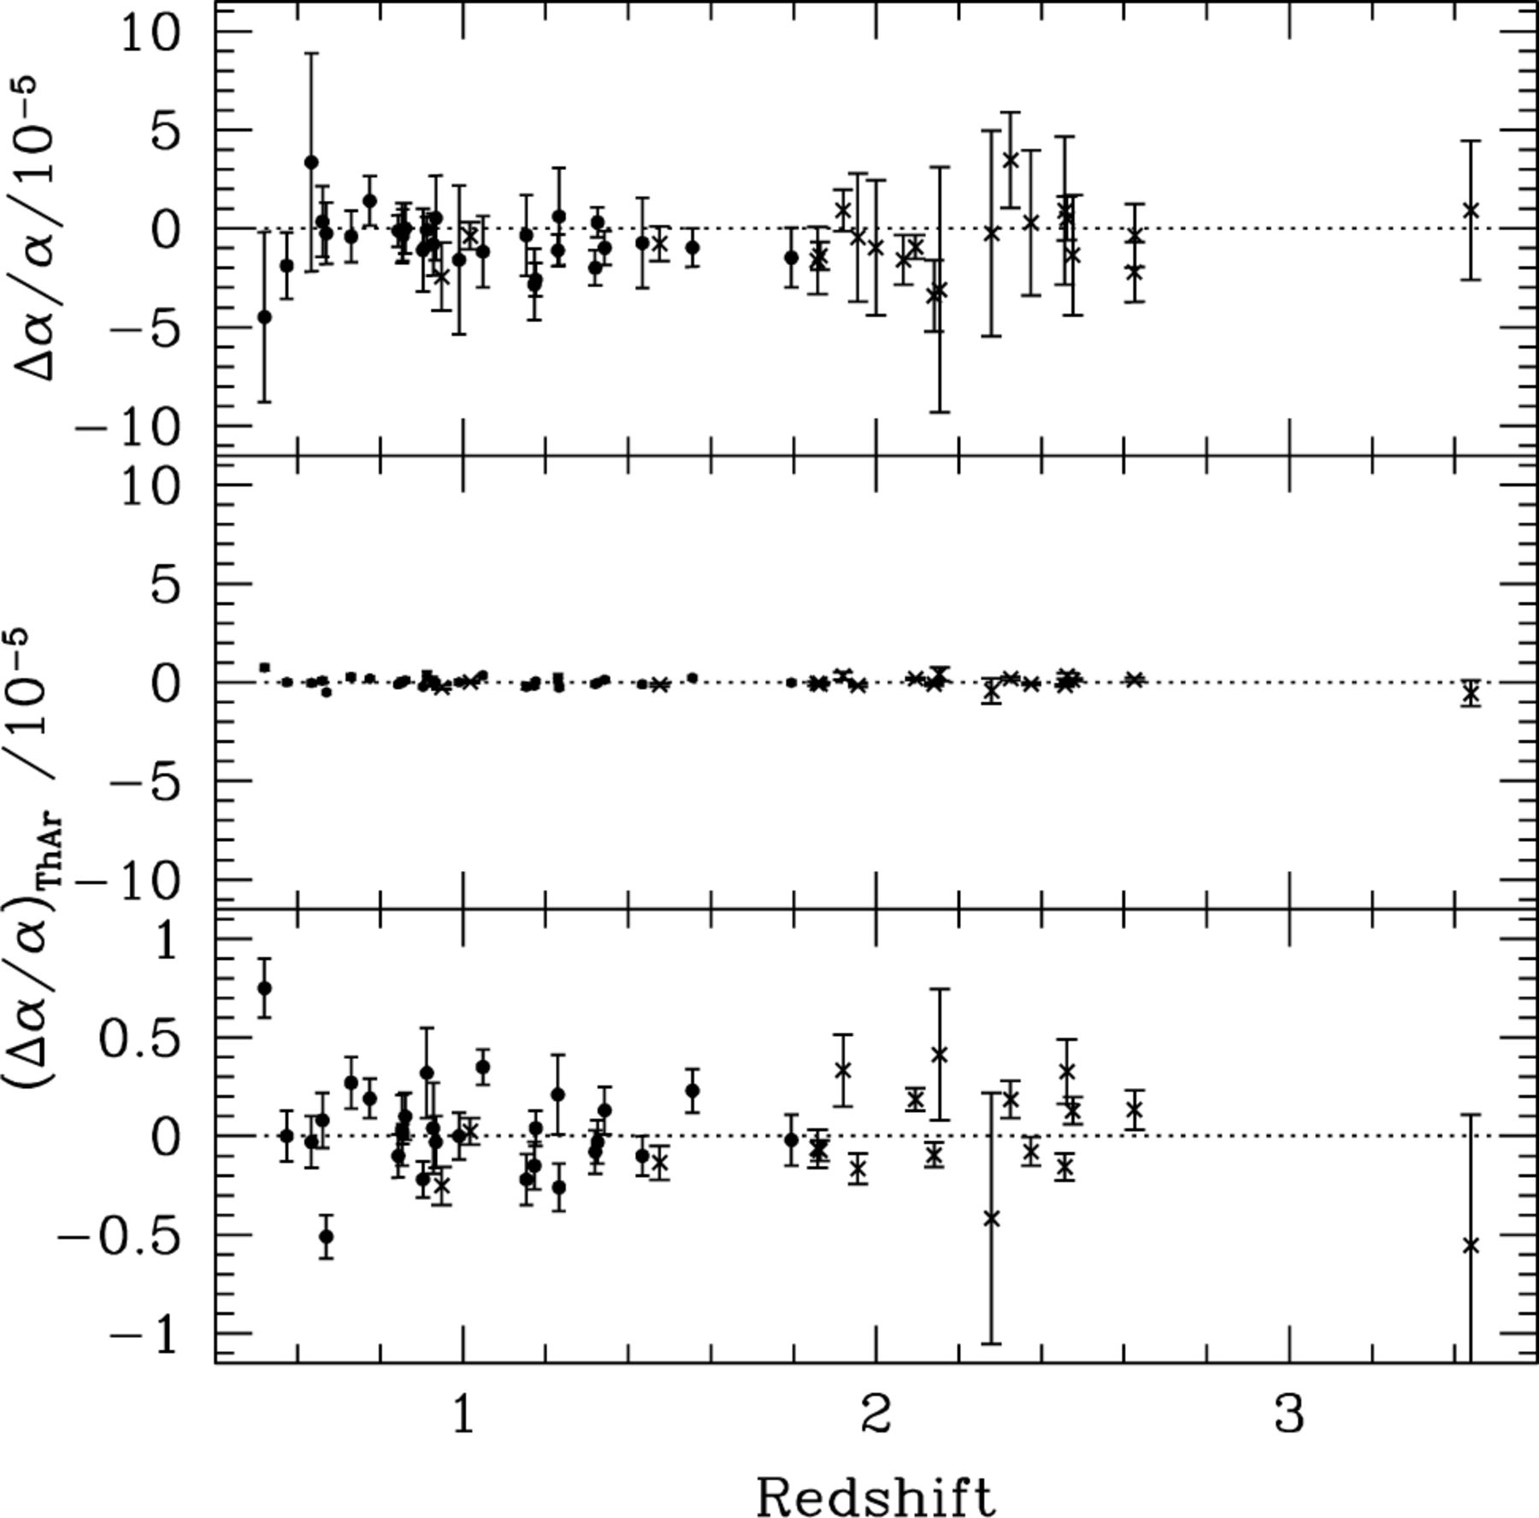
Figure 2. The top panel shows the results of M01a and W01. The middle panel compares the ThAr calibration error on the ...
Notes:
Figure 2. The top panel shows the results of M01a and W01. The middle panel compares the ThAr calibration error on the same scale. The lower panel gives an expanded view of the ThAr results. The weighted mean of the ThAr sample is . ThAr data were not available for five of the absorption systems. Clearly, this does not affect our conclusions.
Unless provided in the caption above, the following copyright applies to the content of this slide: © 2001 RAS

Slide 5
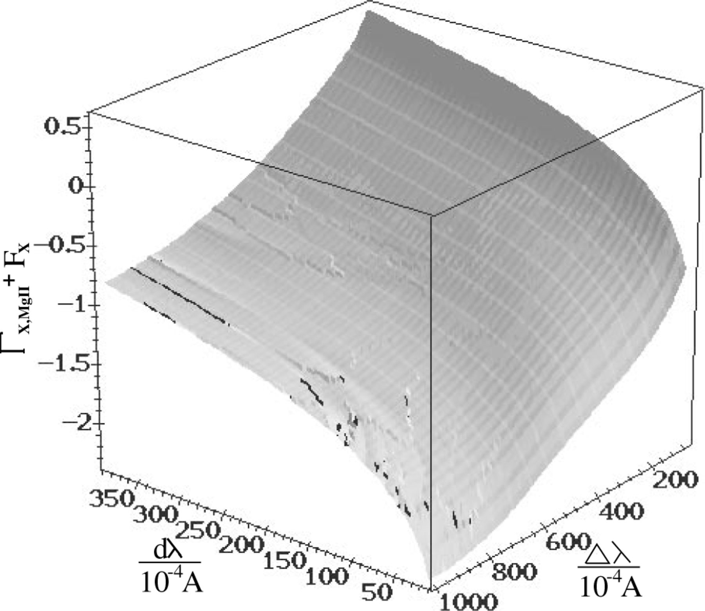
Figure 3. Three space of results from the blending simulation. dλ directly corresponds to a value of if blending is ...
Notes:
Figure 3. Three space of results from the blending simulation. dλ directly corresponds to a value of if blending is responsible for all observed shifts in fig. 3 of M01a. The figure is shaded according to values of ΓX,-Mg-ii. Ripples on the surface reflect errors due to the restrictive upper bound on b(X). The ‘lightness’ of the figure has been adjusted to maximize their visibility, and the main errors have been highlighted in black.
Unless provided in the caption above, the following copyright applies to the content of this slide: © 2001 RAS

Slide 6
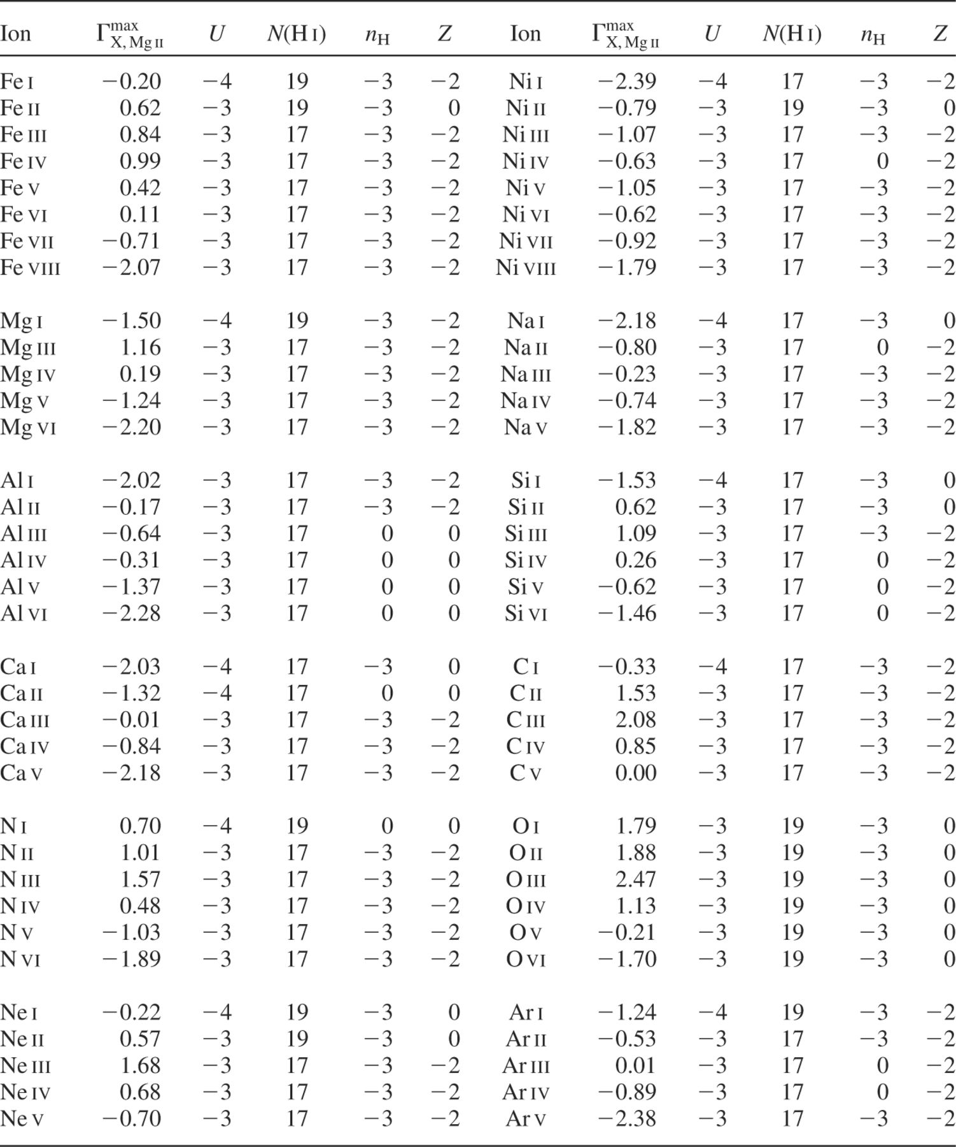
Table 1. Results of the cloudy photoionization equilibrium calculation showing the upper limit on . The model used is ...
Notes:
Table 1. Results of the cloudy photoionization equilibrium calculation showing the upper limit on . The model used is specified by the logarithmic parameters, U, N(H i), nH and Z.
Unless provided in the caption above, the following copyright applies to the content of this slide: © 2001 RAS

Slide 7
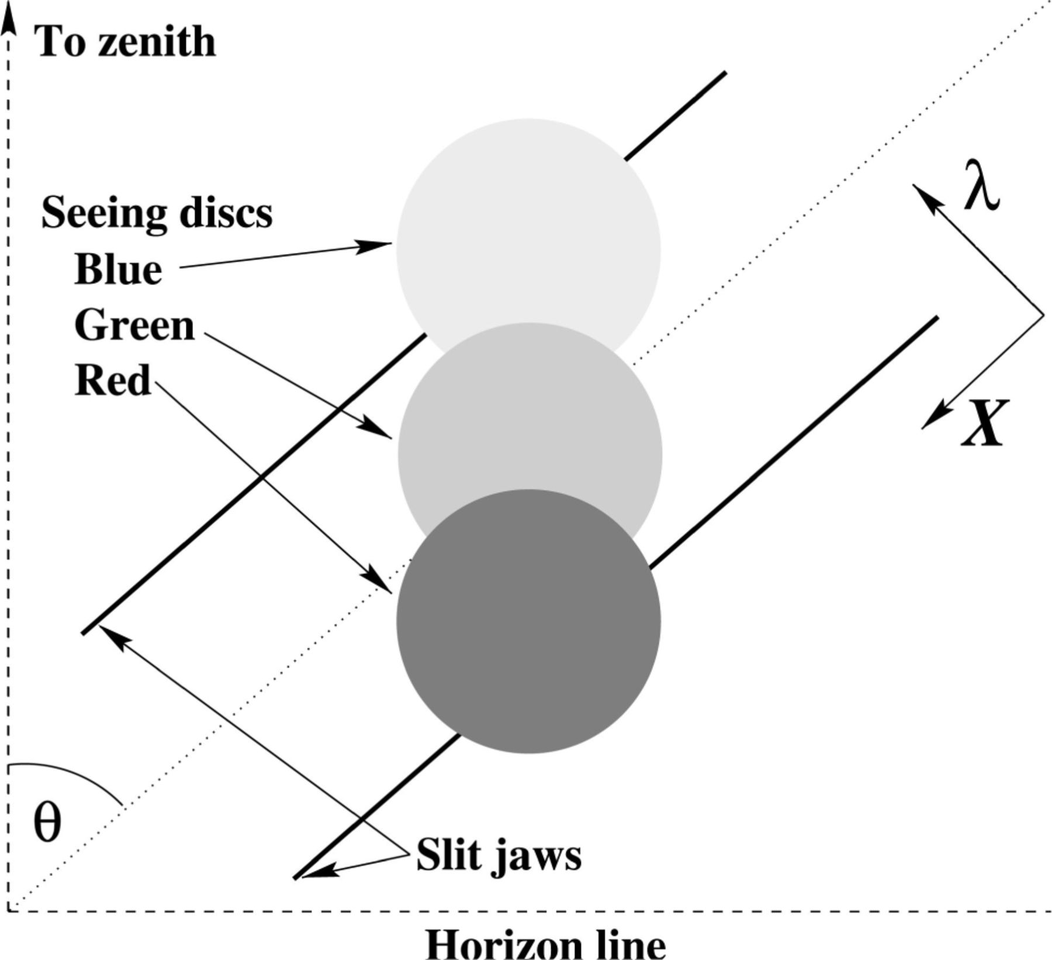
Figure 5. Schematic diagram showing the effects of atmospheric dispersion. The HIRES slit is projected on to the sky so ...
Notes:
Figure 5. Schematic diagram showing the effects of atmospheric dispersion. The HIRES slit is projected on to the sky so that we see the seeing discs of blue, red and green light from a point source dispersed with some component along the spectral direction of the slit. The spectral direction is indicated by λ and the spatial direction by X. Note that the refraction is worse in the blue.
Unless provided in the caption above, the following copyright applies to the content of this slide: © 2001 RAS

Slide 8
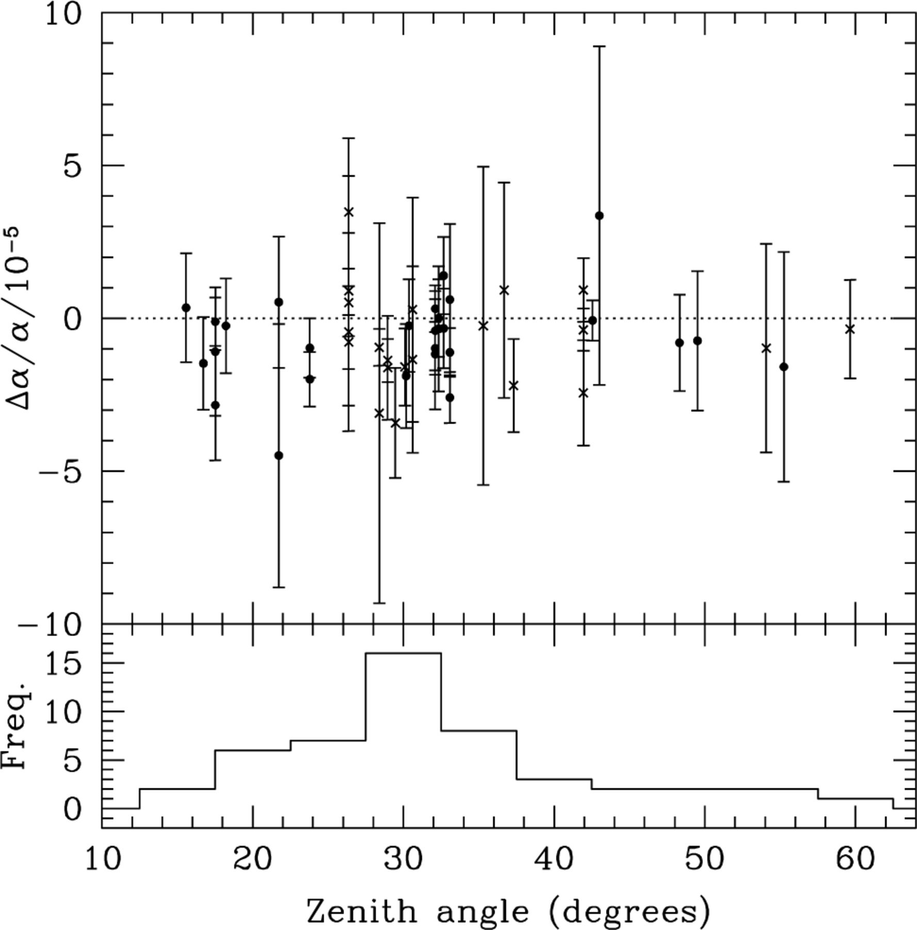
Figure 6. The lower panel shows the distribution of absorption systems over average zenith distance. The upper panel ...
Notes:
Figure 6. The lower panel shows the distribution of absorption systems over average zenith distance. The upper panel shows the QSO data as a function of zenith distance. We do not see any obvious correlation. When we remove points for which there should be no atmospheric dispersion effect, the Spearman rank correlation coefficient is 0.18 with an associated probability of 0.41. The coefficients for the low-redshift (filled circles) and high-redshift (crosses) samples are 0.16 and −0.09 with probabilities 0.43 and 0.71 respectively.
Unless provided in the caption above, the following copyright applies to the content of this slide: © 2001 RAS

Slide 9
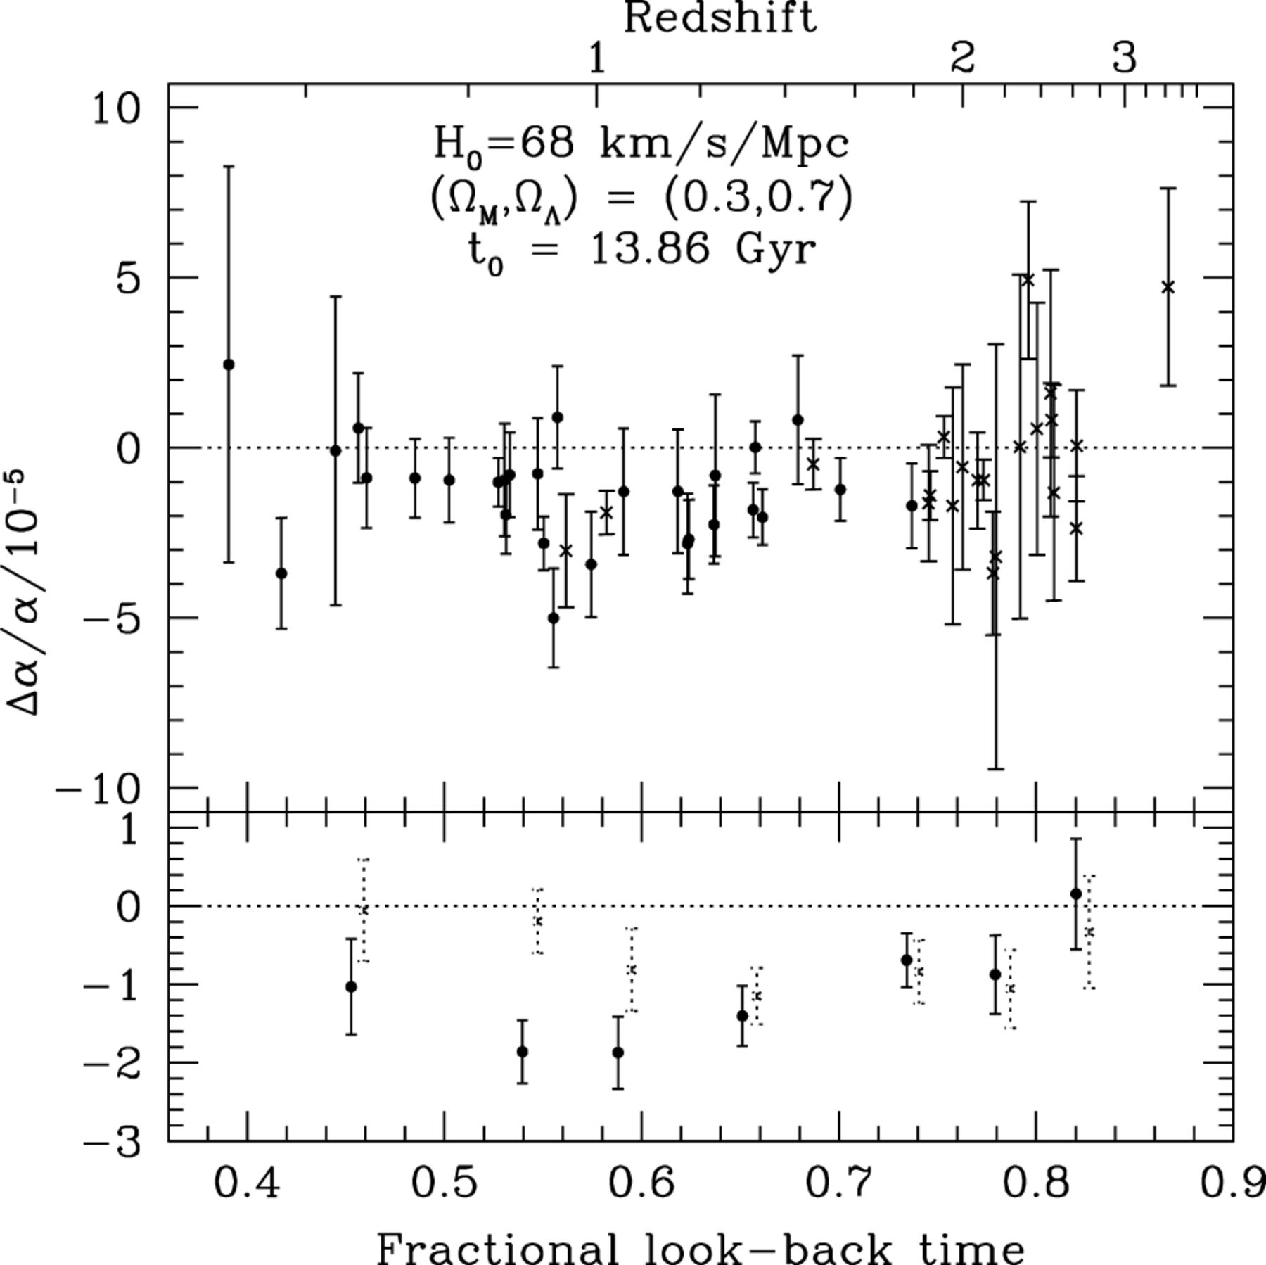
Figure 7. Results after removal of atmospheric dispersion effects. The top panel shows our raw results for as a ...
Notes:
Figure 7. Results after removal of atmospheric dispersion effects. The top panel shows our raw results for as a function of look-back time in a flat, Λ cosmology. The redshift scale is also provided for comparison. The lower panel shows an arbitrary binning of the results, which emphasizes the susceptibility of the low-z sample to this systematic error (the dotted lines are the results of M01a and W01, slightly shifted for clarity). Note, however, that the correction made here is an extreme and will be diminished by seeing and tracking effects.
Unless provided in the caption above, the following copyright applies to the content of this slide: © 2001 RAS

Slide 10
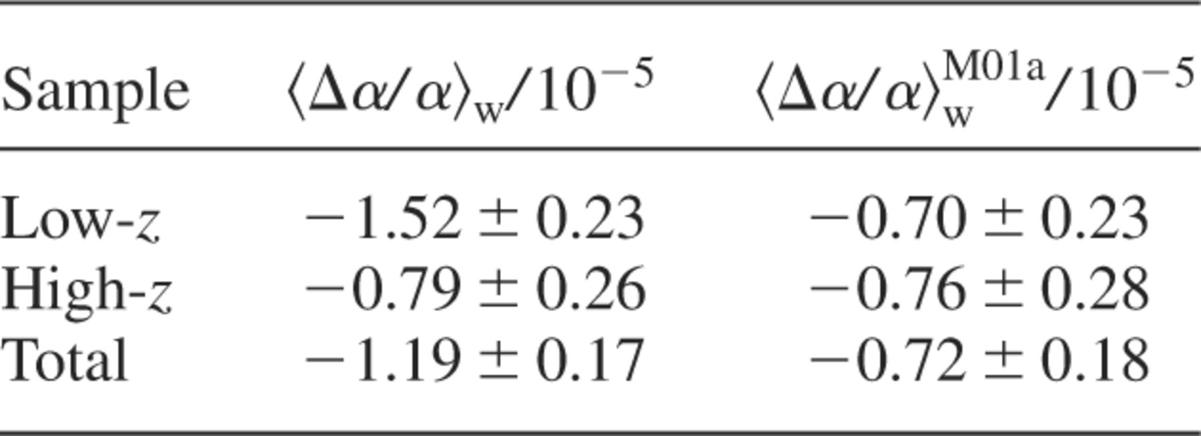
Table 2. Comparison of the weighted means, , with the results of M01a and W01, after correction for atmospheric ...
Notes:
Table 2. Comparison of the weighted means, , with the results of M01a and W01, after correction for atmospheric dispersion effects.
Unless provided in the caption above, the following copyright applies to the content of this slide: © 2001 RAS

Slide 11
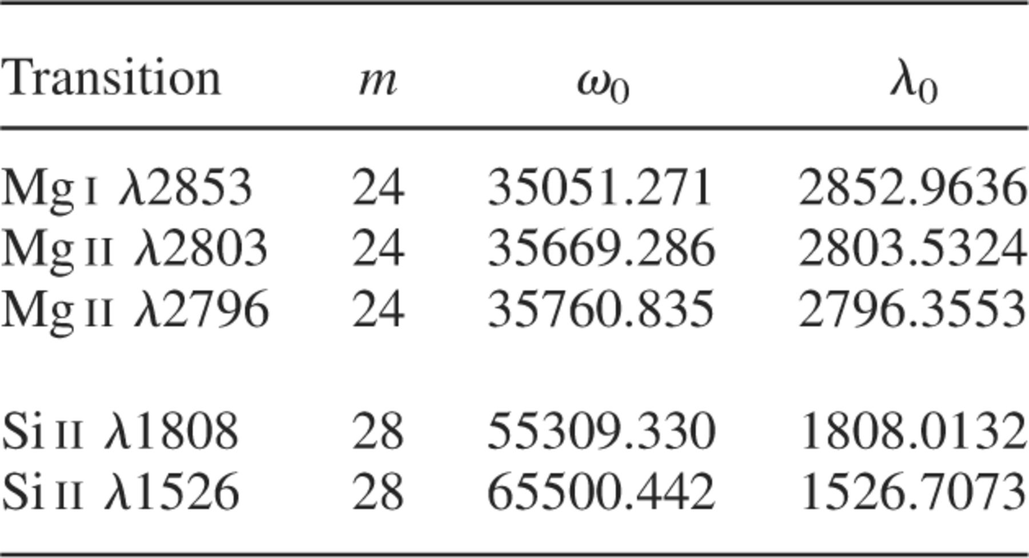
Table 4. Wavelengths of the dominant isotopic components of the Mg and Si transitions. Those of Mg are derived from ...
Notes:
Table 4. Wavelengths of the dominant isotopic components of the Mg and Si transitions. Those of Mg are derived from experimental data in Pickering et al. (1998) while those of Si are calculated in M01a on the basis of a scaling by the mass shift from the basic Mg isotopic structure.
Unless provided in the caption above, the following copyright applies to the content of this slide: © 2001 RAS

Slide 12
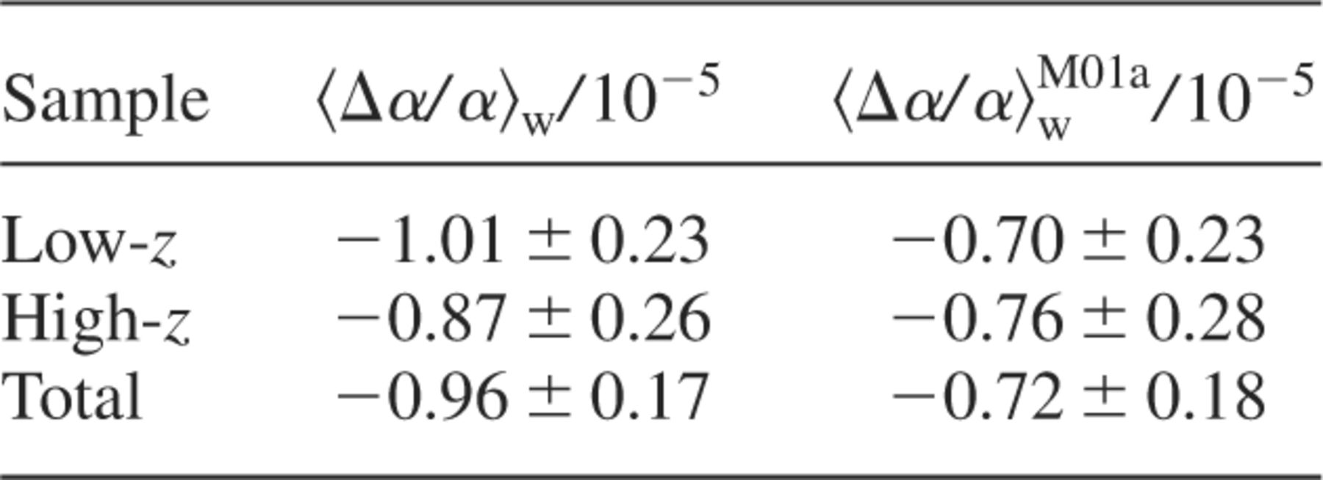
Table 5. Comparison of the weighted means, , with the results of M01a and W01, after maximal correction for possible ...
Notes:
Table 5. Comparison of the weighted means, , with the results of M01a and W01, after maximal correction for possible variation in isotopic ratios.
Unless provided in the caption above, the following copyright applies to the content of this slide: © 2001 RAS

Slide 13
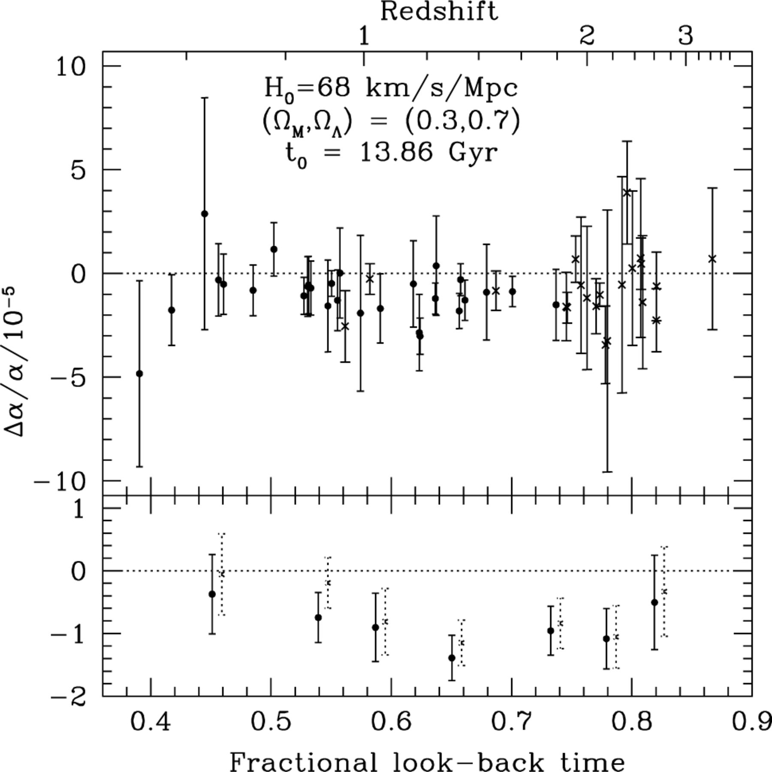
Figure 8. Results after removing the weaker isotopic components of Mg and Si. The upper panel shows our raw results and ...
Notes:
Figure 8. Results after removing the weaker isotopic components of Mg and Si. The upper panel shows our raw results and the lower panel shows an arbitrary binning, which emphasizes the susceptibility of the low-z sample to this systematic error (the dotted lines are the results of M01a and W01, slightly shifted for clarity). Note, however, that the correction made here is extreme.
Unless provided in the caption above, the following copyright applies to the content of this slide: © 2001 RAS

Slide 14
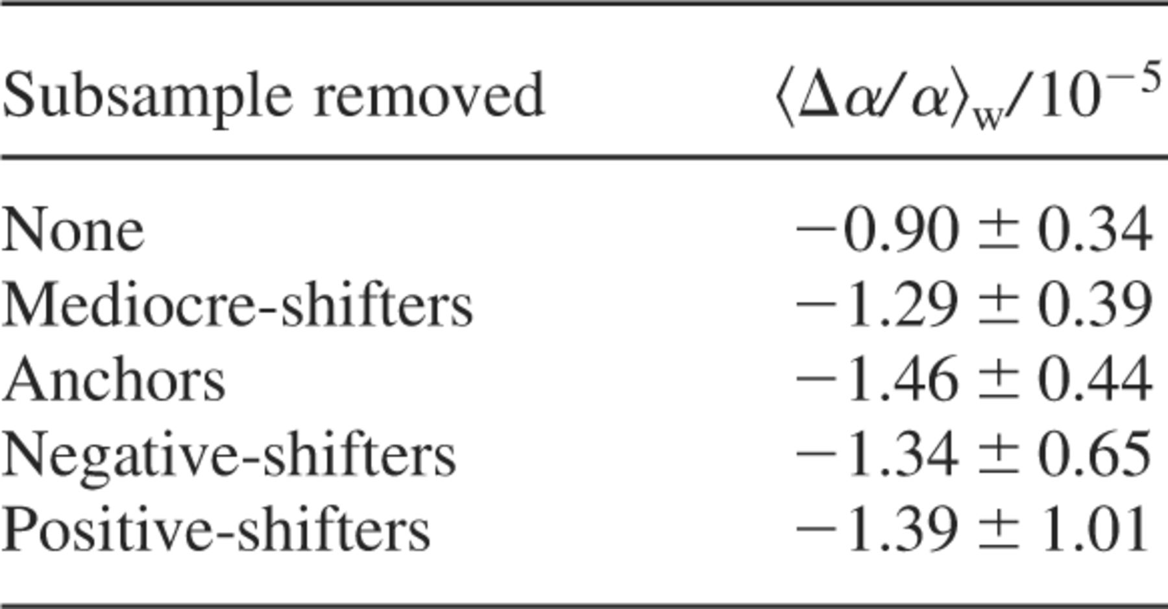
Table 6. Results of a general test for systematic errors. We removed the three different types of transition from a ...
Notes:
Table 6. Results of a general test for systematic errors. We removed the three different types of transition from a subsample of the 21 high-z systems. The new is given for each case. These should be compared to the value obtained when only transitions with mediocre q1 coefficients were removed. Note that neither the values nor the 1s errors are independent of each other.
Unless provided in the caption above, the following copyright applies to the content of this slide: © 2001 RAS

