Slide 1
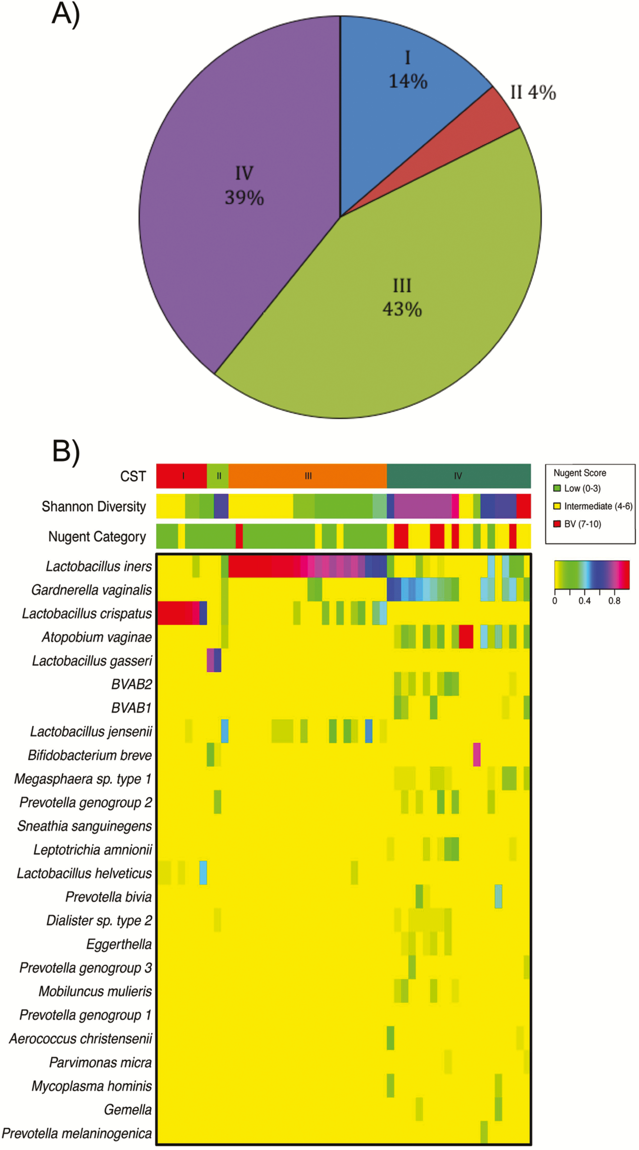
Figure 1. Community state type distribution and bacterial phylotypes. Distribution of vaginal bacterial community state ...
Notes:
Figure 1. Community state type distribution and bacterial phylotypes. Distribution of vaginal bacterial community state types in the overall study cohort (N = 51) (A), and a heat map of the relative abundance of the 30 most common bacterial phylotypes within the study cohort with the Shannon diversity index and Nugent score indicated (B).
Unless provided in the caption above, the following copyright applies to the content of this slide: © The Author 2017. Published by Oxford University Press for the Infectious Diseases Society of America. All rights reserved. For permissions, e-mail: journals.permissions@oup.com.

Slide 2
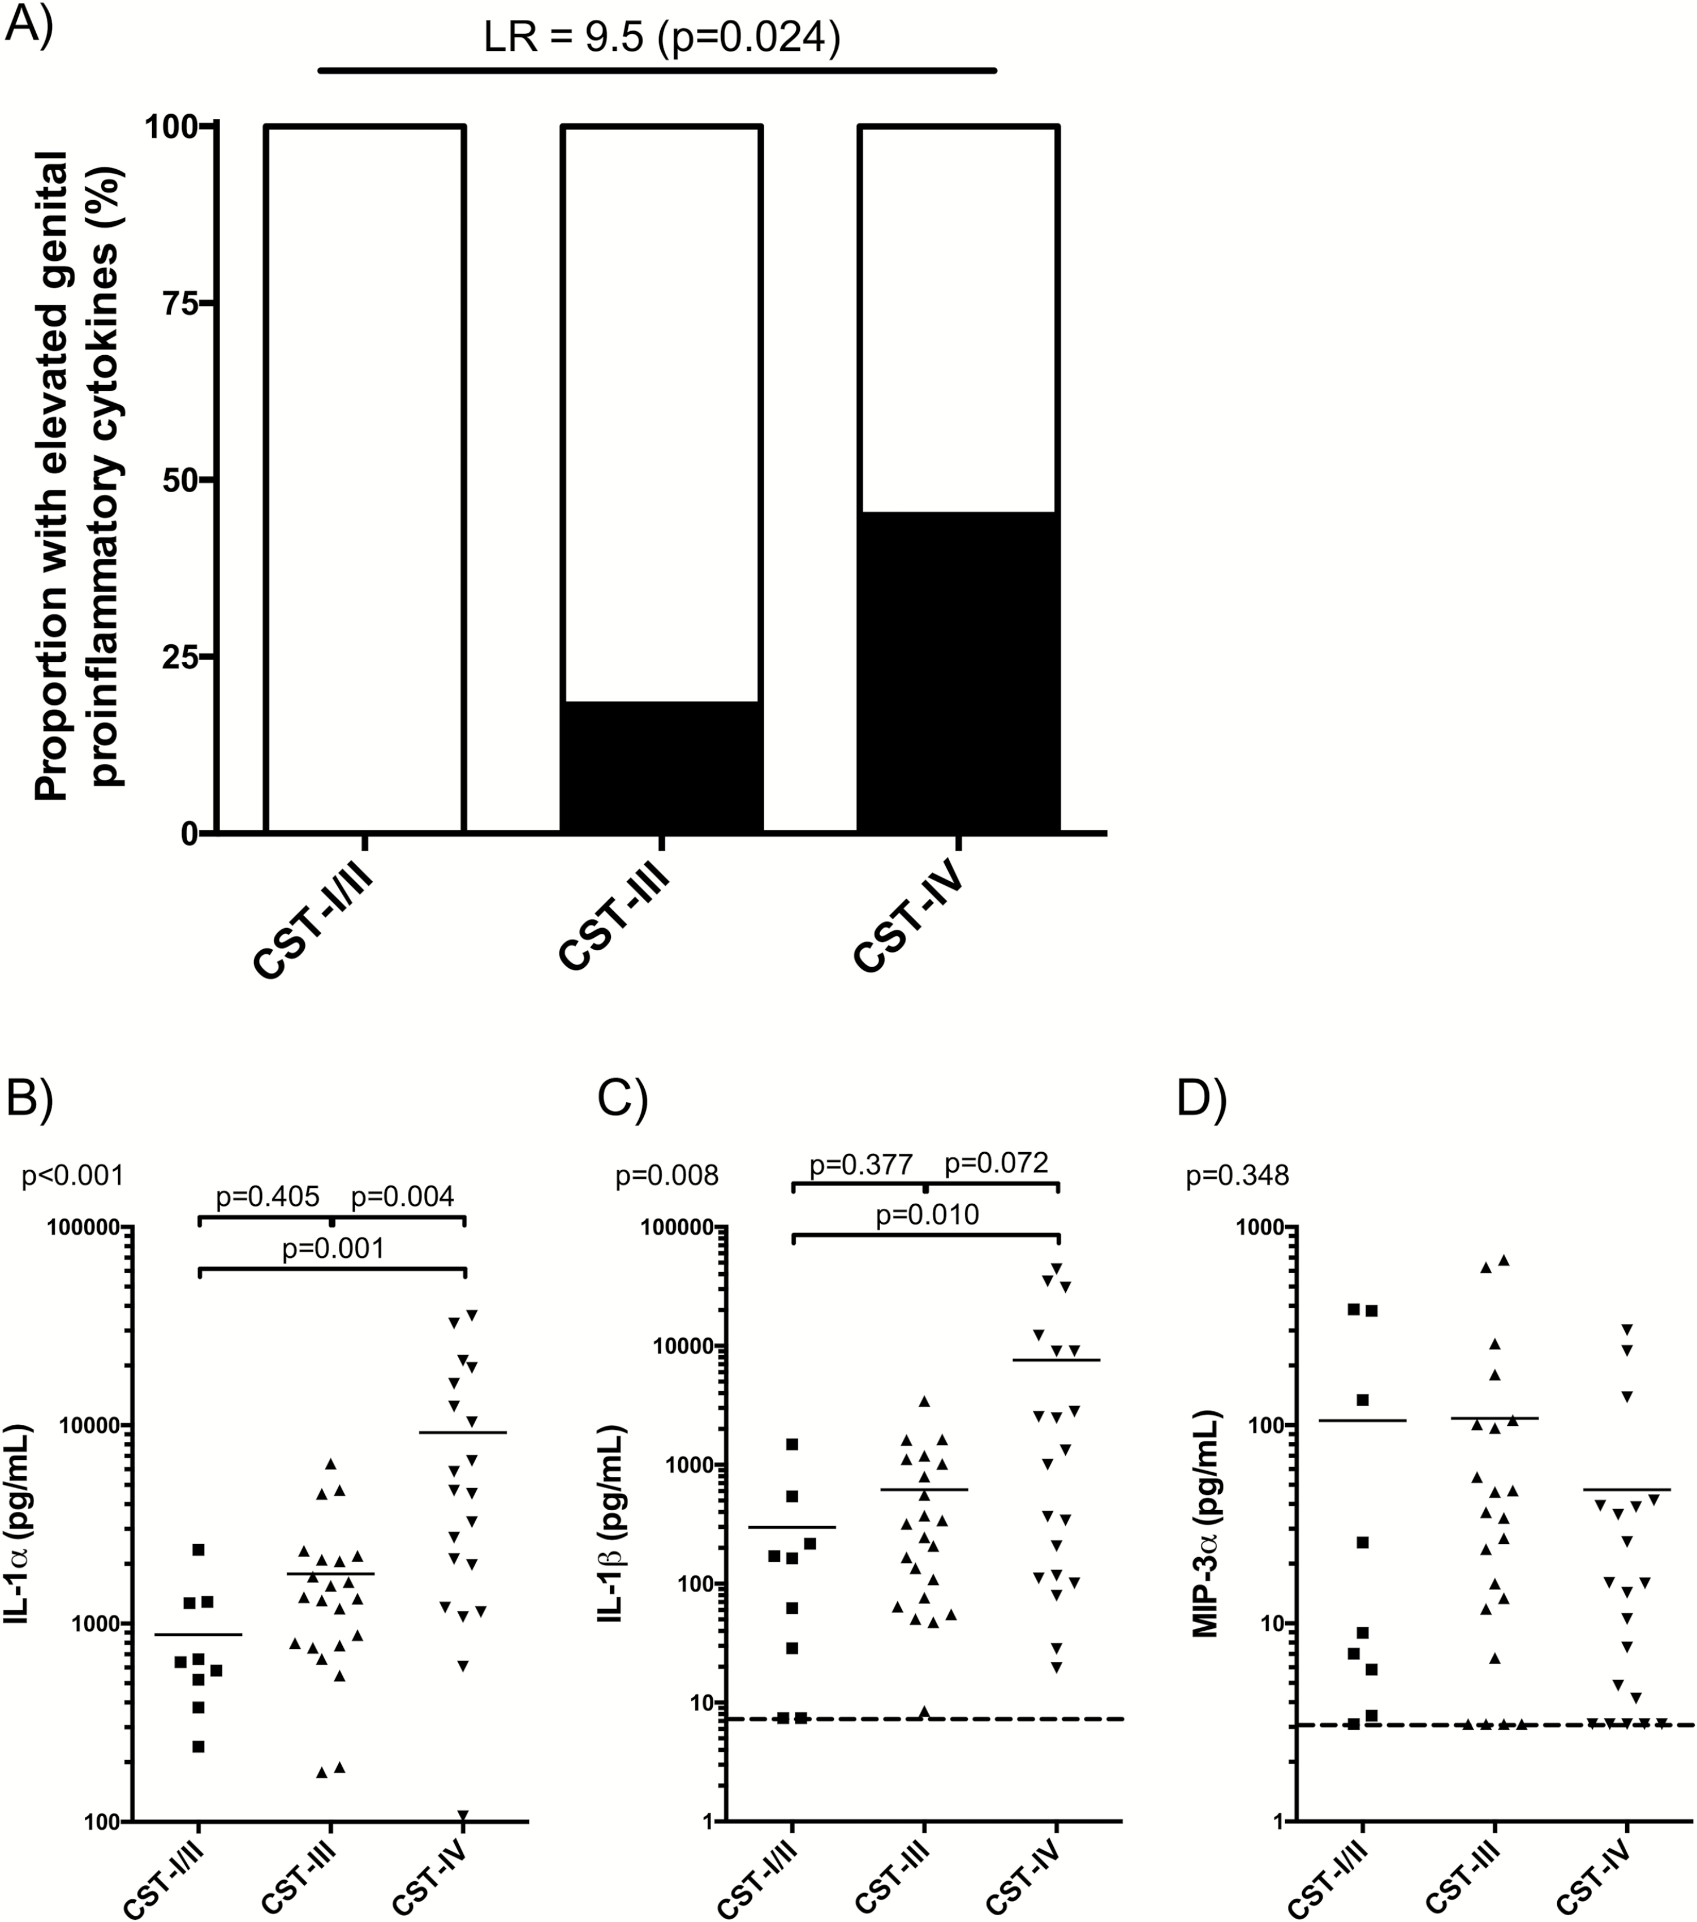
Figure 2. Genital cytokines and the cervicovaginal microbiome. A, Association of elevated levels of vaginal ...
Notes:
Figure 2. Genital cytokines and the cervicovaginal microbiome. A, Association of elevated levels of vaginal proinflammatory cytokines with the cervicovaginal microbiome, particularly CST group IV. LR and associated P value indicated above the graph. Specific association of some individual cytokines (IL-1α and IL-1β (B, C) but not others (MIP-3α) (D) with the cervicovaginal microbiome. One-way ANOVA P values indicated above the y-axis of each graph and, if significant, post-hoc Tukey P values indicated above each pair-wise comparison. Solid line indicates the mean, and dotted lines indicate the lower limit of quantification of the assay. Abbreviations: ANOVA, analysis of variance; CST, community state type; IL, interleukin; LR, likelihood ratio; MIP-3α, macrophage inflammatory protein 3α.
Unless provided in the caption above, the following copyright applies to the content of this slide: © The Author 2017. Published by Oxford University Press for the Infectious Diseases Society of America. All rights reserved. For permissions, e-mail: journals.permissions@oup.com.

Slide 3
Figure 3. Genital inflammation and the relative abundance of specific bacterial phyla. General additive models and ...
Notes:
Figure 3. Genital inflammation and the relative abundance of specific bacterial phyla. General additive models and ordinary logistic regression linear and spline models were fit to inflammation status and each phylotype’s log10 relative abundance for all phylotypes that were detected in at least 50% of all samples (n = 14 phylotypes). The resulting plots of inflammation risk as a function of log10-transformed relative abundance of Lactobacillus crispatus (A), L. iners (B), Gardnerella vaginalis (C), and Prevotella bivia (D) are shown; the number of participants with detectable levels is shown above each. Horizontal gray lines indicate the estimated inflammation risk at the lowest detected relative abundance; if the 95% confidence region (shaded) does not contain this line, the inflammation risk is significantly associated with the relative abundance of the given phylotype.
Unless provided in the caption above, the following copyright applies to the content of this slide: © The Author 2017. Published by Oxford University Press for the Infectious Diseases Society of America. All rights reserved. For permissions, e-mail: journals.permissions@oup.com.

Slide 4
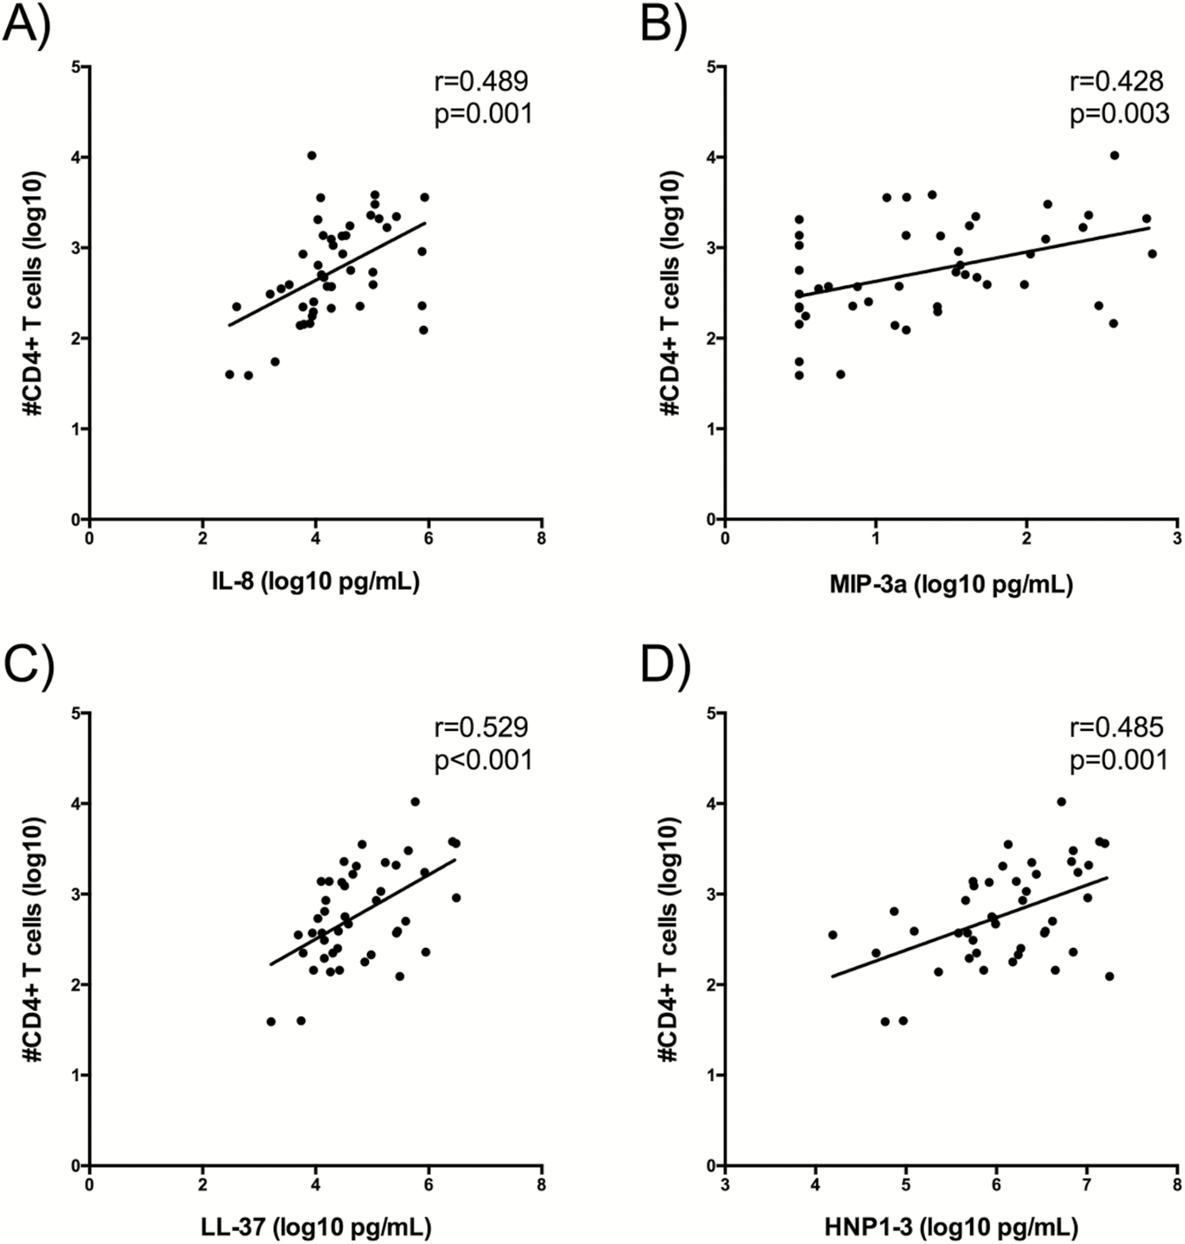
Figure 4. Correlation of specific cytokines and host defense peptides with cervical CD4⁺ T-cell numbers. ...
Notes:
Figure 4. Correlation of specific cytokines and host defense peptides with cervical CD4+ T-cell numbers. Absolute number of endocervical CD4+ T cells/cytobrush correlated with the concentration of IL-8, MIP-3α, LL-37, and HNP1–3 (A–D) in undiluted cervicovaginal secretions collected by Instead Cup. Normalization was achieved through log10 transformation of CD4+ T-cell numbers, and the Pearson product-momentum correlation was performed with the r and P values indicated. Abbreviations: IL, interleukin; HNP1–3, human neutrophil peptides 1–3; MIP-3α, macrophage inflammatory protein 3α.
Unless provided in the caption above, the following copyright applies to the content of this slide: © The Author 2017. Published by Oxford University Press for the Infectious Diseases Society of America. All rights reserved. For permissions, e-mail: journals.permissions@oup.com.

