Slide 1
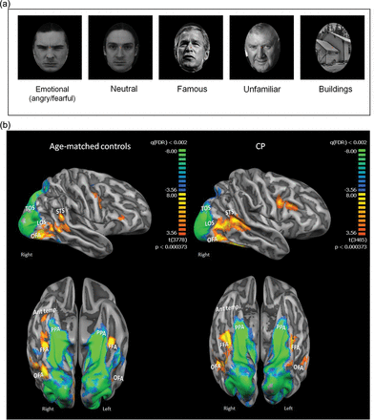
Figure 1. Visual stimulation experiment and activation maps in core face network and anterior temporal cortex. (a) ...
Notes:
Figure 1. Visual stimulation experiment and activation maps in core face network and anterior temporal cortex. (a) Examples of the stimuli used in the visual stimulation experiment. (b) Averaged activation maps for controls (left panel) and CPs. The activation maps are overlaid on a group-averaged folded cortical mesh of each group and are presented in a lateral view (top row) and a ventral view (bottom row). The maps for the face activation were obtained by the contrast all faces > buildings (red to yellow colors). Note the similarity of the activation maps across groups in the core face network including bilateral OFA, LOS, FFA, and pSTS. This is in sharp contrast to the activation in anterior temporal cortex in the right hemisphere that is clearly evident in controls but is completely lacking in the CP map. Also shown is the building-selective activation obtained from the contrast buildings>all faces (blue to green colors) in the PPA and TOS, which is also very similar across groups. The 2 group maps and both contrasts are presented in the same statistical threshold. Abbreviations: Ant. temp.: anterior temporal cortex.
Unless provided in the caption above, the following copyright applies to the content of this slide: © The Author 2013. Published by Oxford University Press. All rights reserved. For Permissions, please e-mail: journals.permissions@oup.com

Slide 2
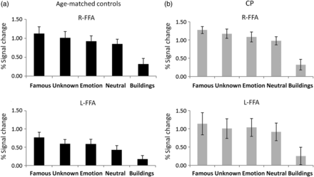
Figure 2. Activation profiles in FFA: Activation profiles from bilateral FFA obtained from the visual stimulation ...
Notes:
Figure 2. Activation profiles in FFA: Activation profiles from bilateral FFA obtained from the visual stimulation experiment using the contrast all faces > buildings for the age-matched controls (a) and CPs (b). The profiles were obtained individually for each participant and then averaged across the group. Percent signal change is shown for each experimental condition. As is evident, the activation profile is very similar across the 2 groups and statistical analysis did not reveal any group differences. Interestingly, in both groups, famous faces elicited a stronger signal compared with all other face categories (P < 0.0007) and, additionally, emotional faces elicited a stronger signal compared with neutral faces (P < 0.005). Error bars indicate standard error across participants in each group.
Unless provided in the caption above, the following copyright applies to the content of this slide: © The Author 2013. Published by Oxford University Press. All rights reserved. For Permissions, please e-mail: journals.permissions@oup.com

Slide 3
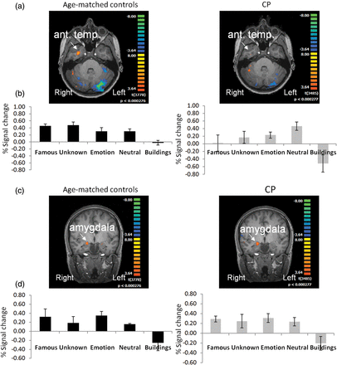
Figure 3. Activation maps and profiles in anterior temporal cortex and amygdala: (a) Activation maps in right anterior ...
Notes:
Figure 3. Activation maps and profiles in anterior temporal cortex and amygdala: (a) Activation maps in right anterior temporal cortex obtained for the contrast all faces > buildings; maps are projected on a horizontal slice. Robust activation can be seen in controls (left panel) in the right anterior temporal cortex, while only very weak activation is observed in CPs when applying the same statistical threshold. Note that in the activation map shown in Figure 1b, no activity is evident in this region at the group level in the CP. When examined individually, only 3 CP individuals exhibited activation in this region and contributed to the activation profile presented here. (b) Activation profiles obtained from anterior temporal cortex in controls (left) and CP (right). (c) Activation maps obtained in right amygdala for each group projected on a coronal slice. Given that the maps presented in Figure 1b only exhibit cortical activation, averaged activity of the amygdala could not be observed, and it is therefore projected on a coronal slice for each group. (d) Activation profiles obtained from individually defined right amygdala in each participant in each group. Robust and comparable amygdala activation was found in both groups as evident from the activation maps and profiles. Conventions and statistical analysis as in Figure 2.
Unless provided in the caption above, the following copyright applies to the content of this slide: © The Author 2013. Published by Oxford University Press. All rights reserved. For Permissions, please e-mail: journals.permissions@oup.com

Slide 4
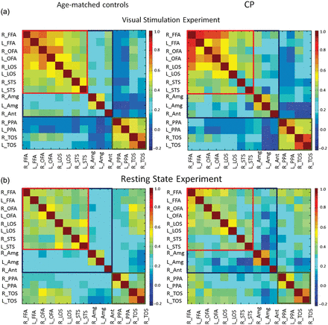
Figure 4. Functional connectivity maps obtained from localizer (a) and resting state scan (b). Matrices show all ...
Notes:
Figure 4. Functional connectivity maps obtained from localizer (a) and resting state scan (b). Matrices show all pairwise correlations between regions within the core face network (red rectangle), regions in the extended face network (blue rectangle), and regions that are building-selective (green rectangle). All ROIs were sampled from the visual stimulation experiment, and activation profiles were extracted from this experiment (a) and from the resting state scans (b). The color code indicates the level of correlation calculated between each pair of regions in each subject and then averaged across groups.
Unless provided in the caption above, the following copyright applies to the content of this slide: © The Author 2013. Published by Oxford University Press. All rights reserved. For Permissions, please e-mail: journals.permissions@oup.com

