Slide 1
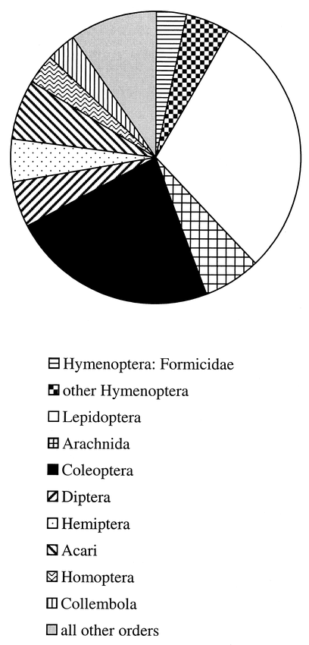
Fig. 1. Proportion of studies devoted to particular arthropod taxa
Notes:
Fig. 1. Proportion of studies devoted to particular arthropod taxa
Unless provided in the caption above, the following copyright applies to the content of this slide: © 2000 Entomological Society of AmericaThis article is published and distributed under the terms of the Oxford University Press, Standard Journals Publication Model (https://academic.oup.com/journals/pages/open_access/funder_policies/chorus/standard_publication_model)

Slide 2
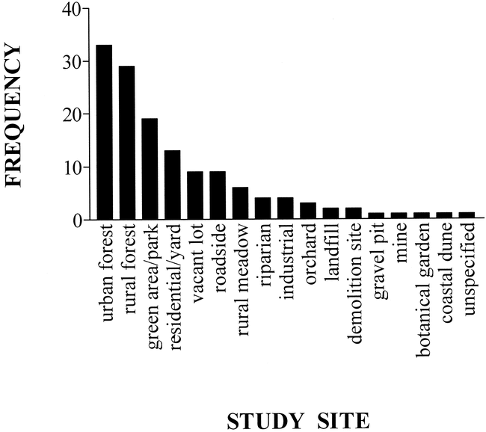
Fig. 2. Number of studies conducted in various types of land use. Some studies were conducted in more than one type ...
Notes:
Fig. 2. Number of studies conducted in various types of land use. Some studies were conducted in more than one type of land use, therefore the total frequency is greater than the number of studies reviewed (79)
Unless provided in the caption above, the following copyright applies to the content of this slide: © 2000 Entomological Society of AmericaThis article is published and distributed under the terms of the Oxford University Press, Standard Journals Publication Model (https://academic.oup.com/journals/pages/open_access/funder_policies/chorus/standard_publication_model)

