Slide 1
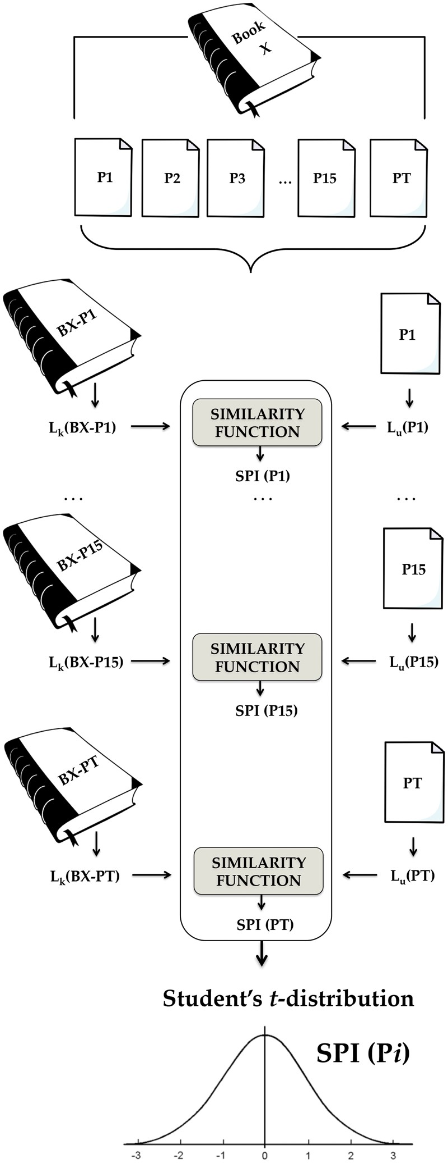
Fig. 1 The proposed approach for authorship verification of PT
Notes:
Fig. 1 The proposed approach for authorship verification of PT
Unless provided in the caption above, the following copyright applies to the content of this slide: © The Author 2016. Published by Oxford University Press on behalf of EADH. All rights reserved. For Permissions, please email: journals.permissions@oup.com

Slide 2
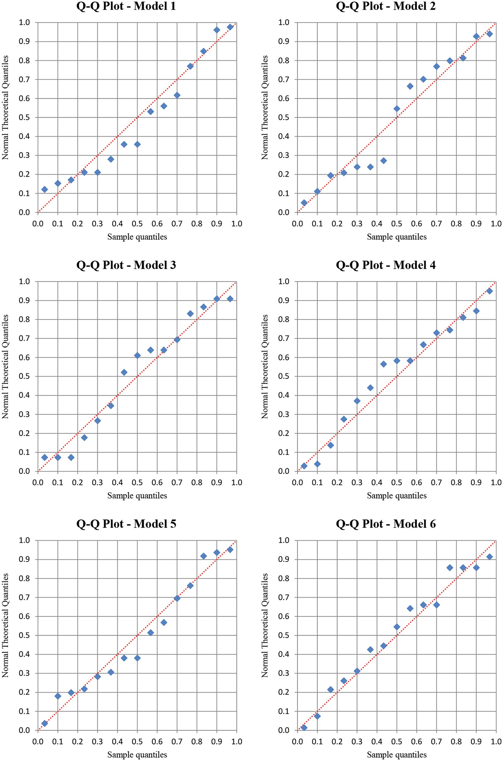
Fig. 2 The Q-Q plots of the SPI values for the six models
Notes:
Fig. 2 The Q-Q plots of the SPI values for the six models
Unless provided in the caption above, the following copyright applies to the content of this slide: © The Author 2016. Published by Oxford University Press on behalf of EADH. All rights reserved. For Permissions, please email: journals.permissions@oup.com

Slide 3
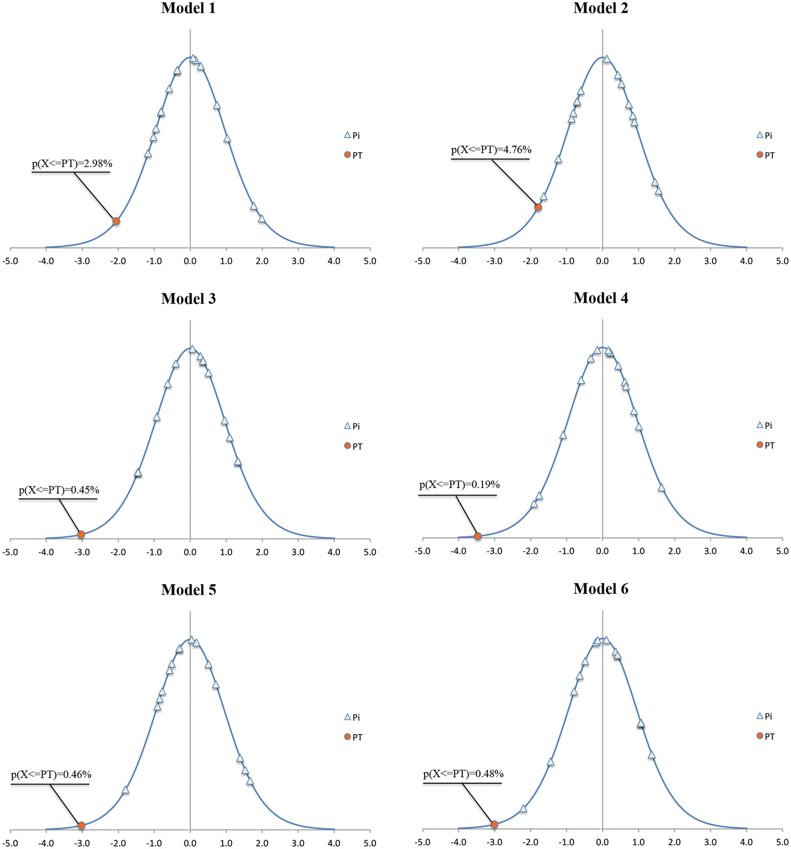
Fig. 3 Student’s t distribution of SPI values for Pi and PT in the six models
Notes:
Fig. 3 Student’s t distribution of SPI values for Pi and PT in the six models
Unless provided in the caption above, the following copyright applies to the content of this slide: © The Author 2016. Published by Oxford University Press on behalf of EADH. All rights reserved. For Permissions, please email: journals.permissions@oup.com

Slide 4
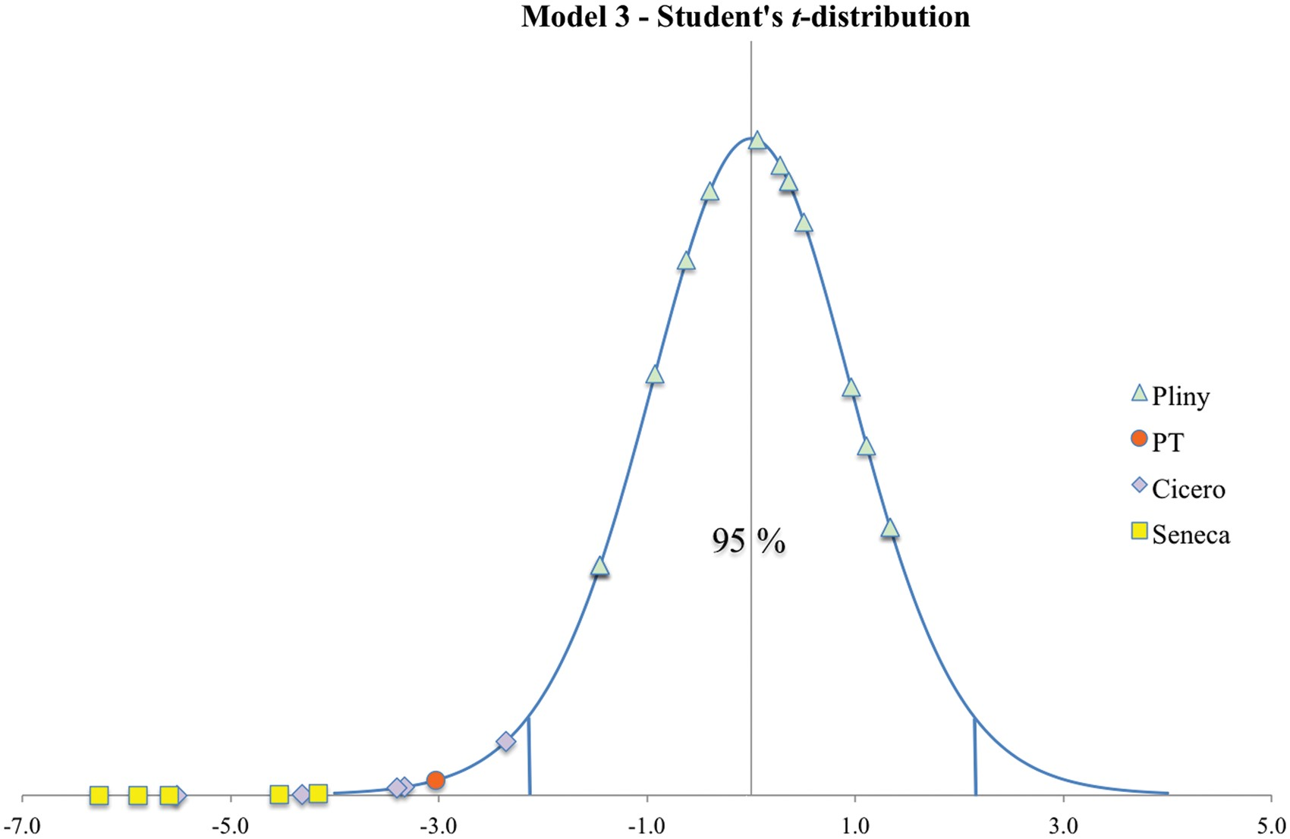
Fig. 6 Student’s t-distribution of the SPI values for all the samples considered
Notes:
Fig. 6 Student’s t-distribution of the SPI values for all the samples considered
Unless provided in the caption above, the following copyright applies to the content of this slide: © The Author 2016. Published by Oxford University Press on behalf of EADH. All rights reserved. For Permissions, please email: journals.permissions@oup.com

Slide 5
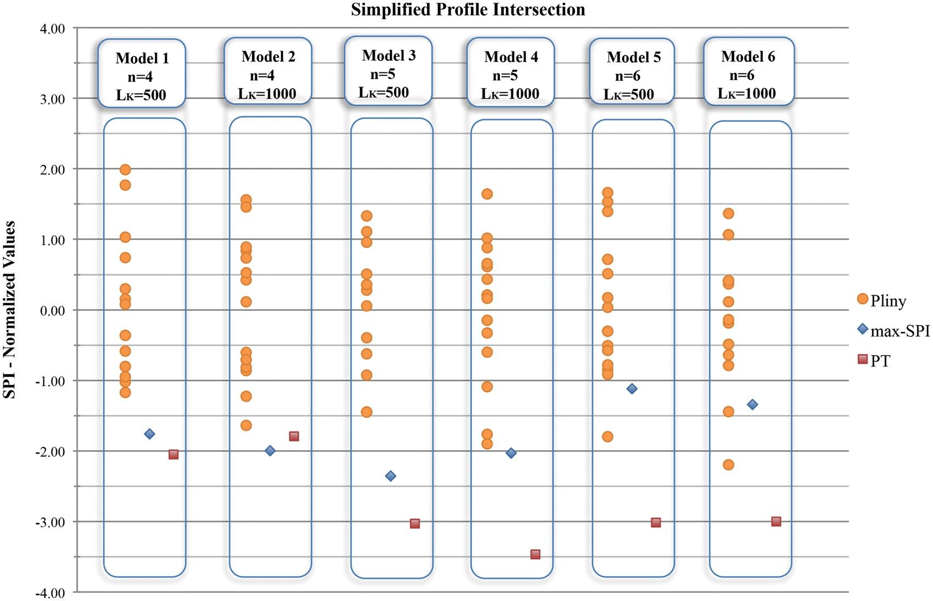
Fig. 5 SPI comparison between Book X, PT, and max-SPI
Notes:
Fig. 5 SPI comparison between Book X, PT, and max-SPI
Unless provided in the caption above, the following copyright applies to the content of this slide: © The Author 2016. Published by Oxford University Press on behalf of EADH. All rights reserved. For Permissions, please email: journals.permissions@oup.com

Slide 6
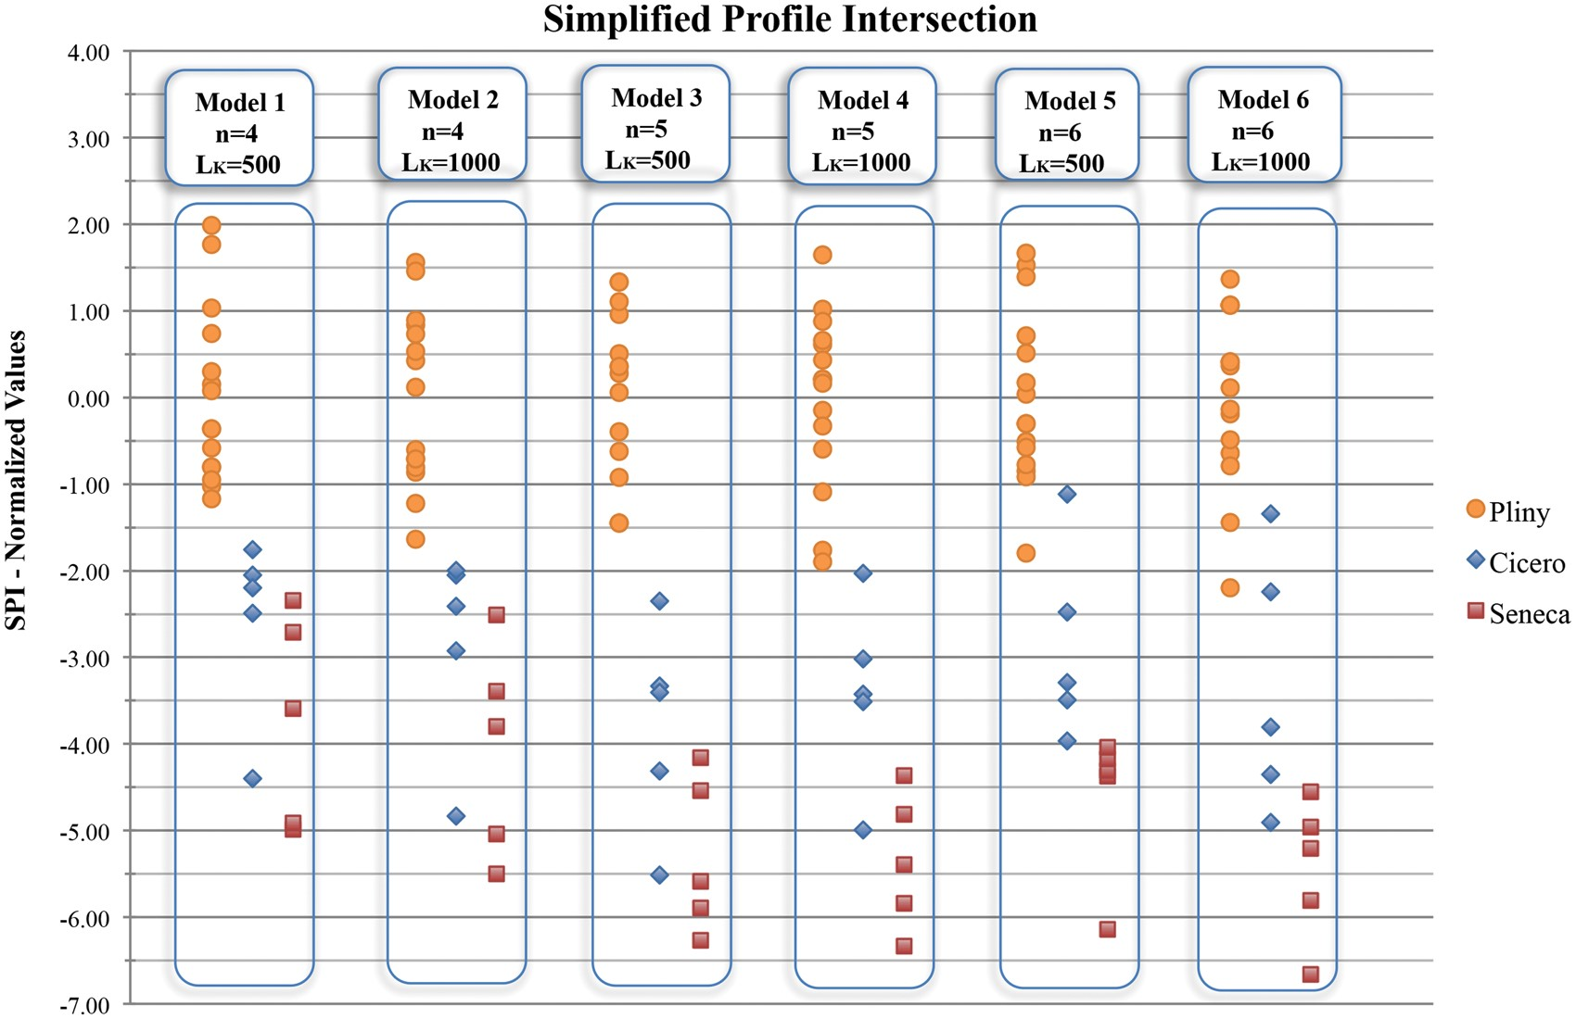
Fig. 4 SPI comparison between Book X except for PT and external sources
Notes:
Fig. 4 SPI comparison between Book X except for PT and external sources
Unless provided in the caption above, the following copyright applies to the content of this slide: © The Author 2016. Published by Oxford University Press on behalf of EADH. All rights reserved. For Permissions, please email: journals.permissions@oup.com

