Slide 1
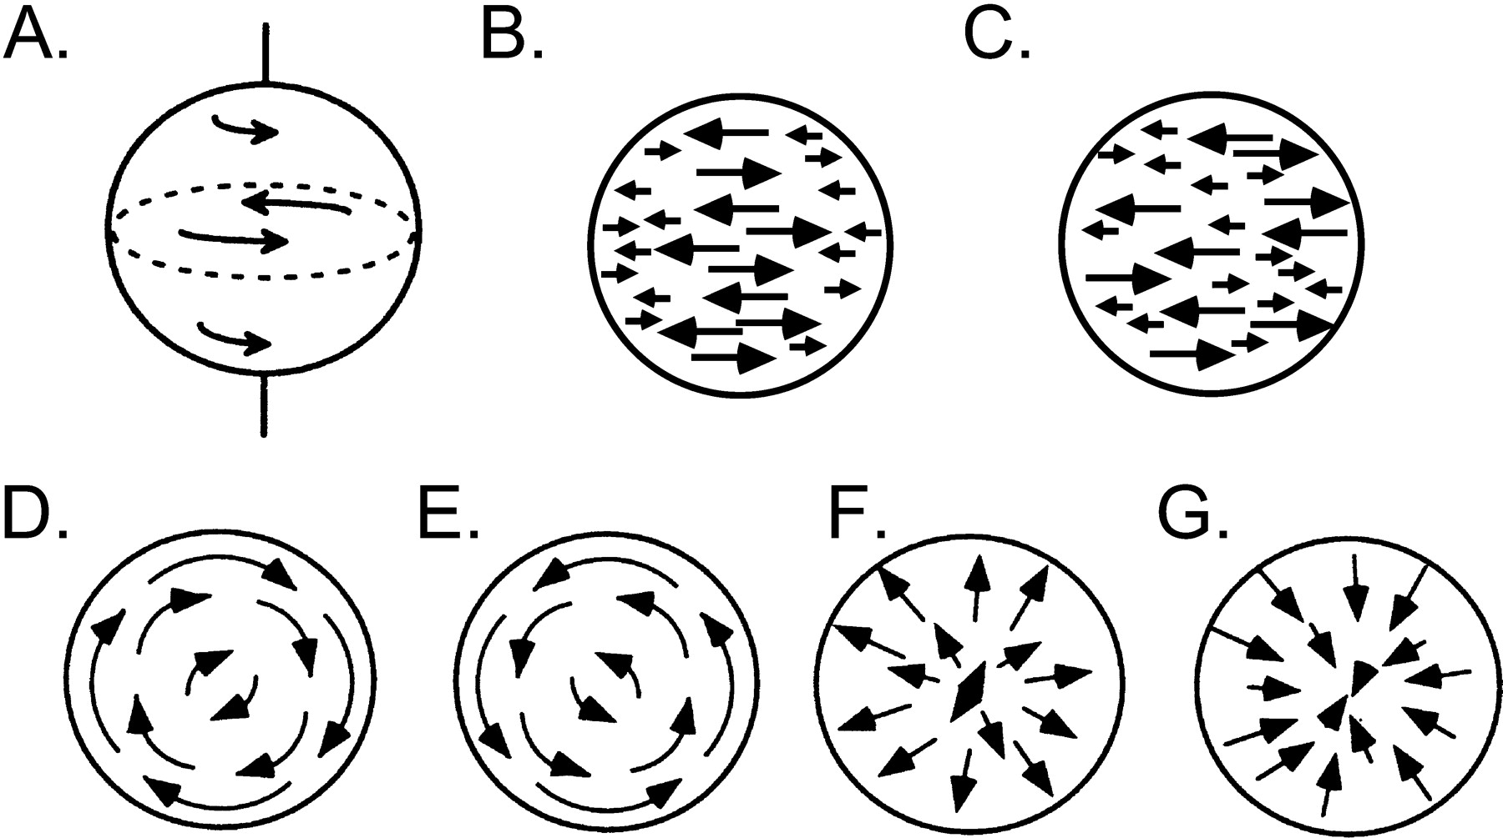
Figure 1. Stimulus displays. (A) Schematic of three-dimensional sphere with vertical axis of rotation. (B) Schematic of ...
Notes:
Figure 1. Stimulus displays. (A) Schematic of three-dimensional sphere with vertical axis of rotation. (B) Schematic of speed gradient for structured sphere. (C) Schematic of speed gradient for unstructured sphere. (D–F) Four navigational optic flow displays. (D) Clockwise rotation. (E) Counterclockwise rotation. (F) Radial expansion. (G) Radial compression. All displays were matched for the number of points and point life.
Unless provided in the caption above, the following copyright applies to the content of this slide: © Oxford University Press 2005; all rights reserved

Slide 2
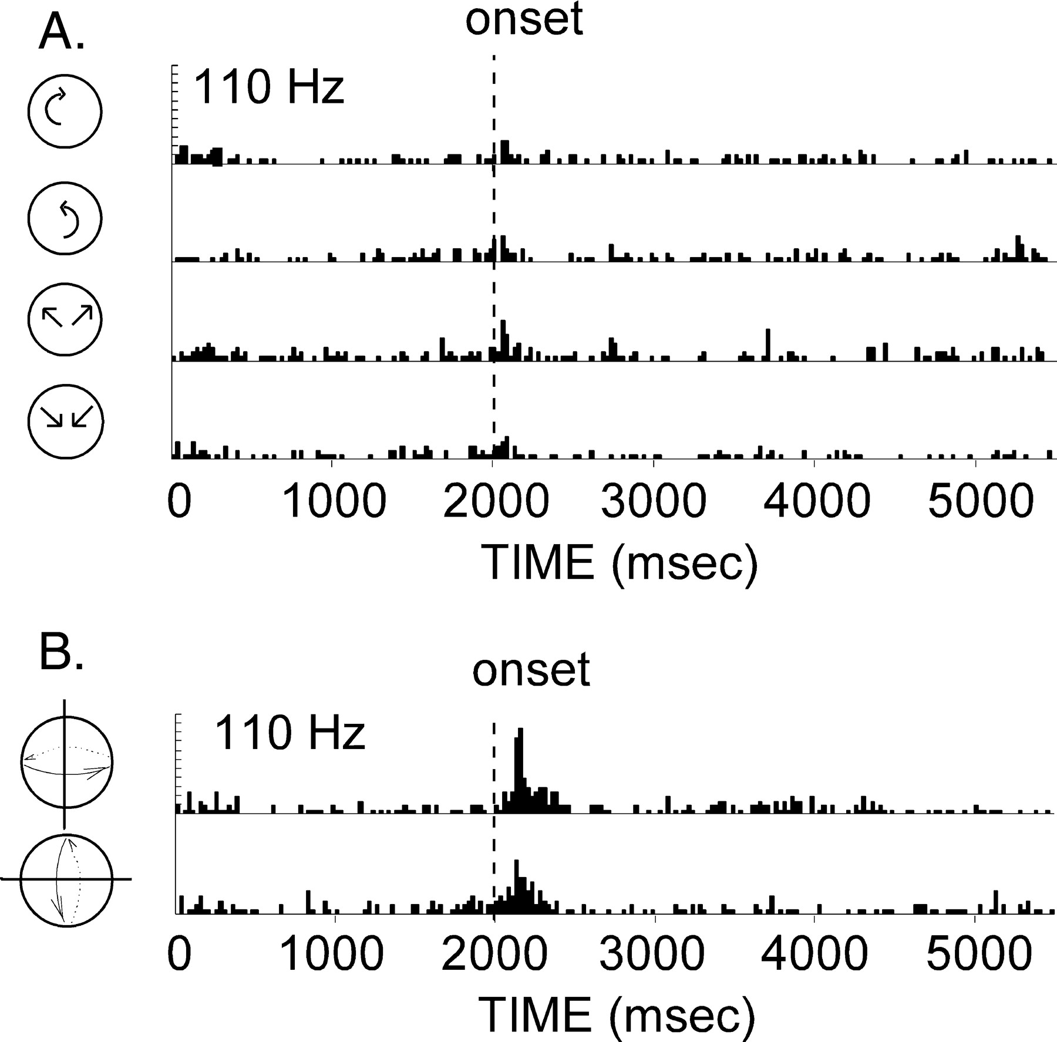
Figure 5. Comparison of response to optic flow and three-dimensional structure-from-motion. (A) This cell had a strong ...
Notes:
Figure 5. Comparison of response to optic flow and three-dimensional structure-from-motion. (A) This cell had a strong response spheres for the two sphere displays. (B) The responses to the navigational flows were much weaker. The two sets of displays were matched in size, number of points, and distribution of speeds of the motion trajectories. Bin size = 25 ms; eight repeats for each histogram.
Unless provided in the caption above, the following copyright applies to the content of this slide: © Oxford University Press 2005; all rights reserved

Slide 3
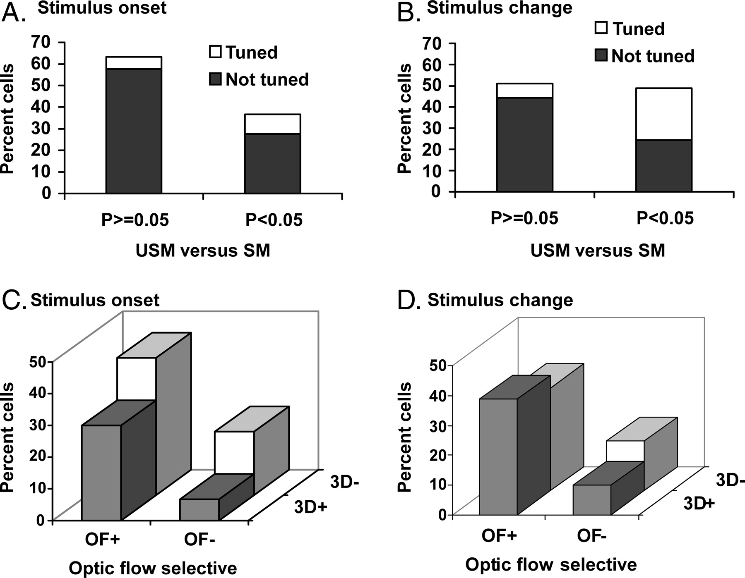
Figure 4. Population distributions of STPa neurons' response to the fraction-of-structure for 90 cells tested with both ...
Notes:
Figure 4. Population distributions of STPa neurons' response to the fraction-of-structure for 90 cells tested with both the displays that began with structured motion (FOS = 1) and those that began with unstructured motion (FOS = 0). (A) 37% of the cells tested were able to distinguish the structured from the unstructured motion at stimulus onset (P < 0.05). One-quarter of these were able to provide significant information (P 0.05), only nine were able to indicate any information about the sphere characteristics (tuned). (B) Responses at stimulus change. The proportion of cells tuned for the fraction of structure at change has increased relative to stimulus onset to almost 50%. The percentage of these cells providing information about the characteristics of the sphere increased as well. (C) Distribution of the responses of the 90 cells tested with both the three-dimensional fraction-of-structure and the optic flow displays. Fraction-of-structure selective neurons often responded to two-dimensional optic flow. Neurons that responded only to three-dimensional stimuli were less common. (D) Response for three-dimensional FOS at stimulus change as compared to the response to optic flow at stimulus change. OF+ means cells had a P < 0.05 for optic flow stimuli, OF− means P ≥ 0.05, 3D+ means P < 0.05 for three-dimensional structure-from-motion, etc.
Unless provided in the caption above, the following copyright applies to the content of this slide: © Oxford University Press 2005; all rights reserved

Slide 4
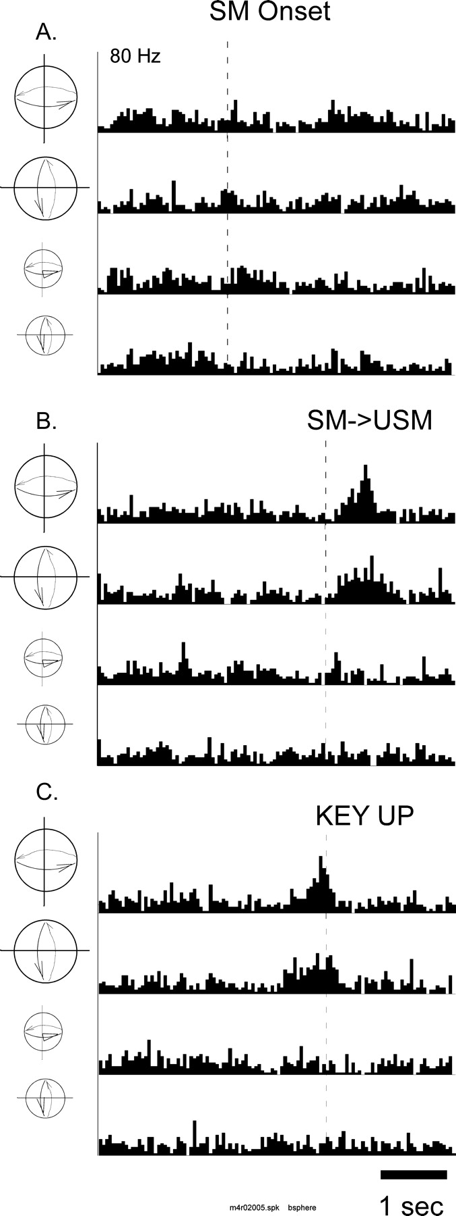
Figure 3. Effect of decreasing the fraction of structure on the response of cells. (A) This cell had no response at ...
Notes:
Figure 3. Effect of decreasing the fraction of structure on the response of cells. (A) This cell had no response at stimulus onset to the three-dimensional structured motion displays, regardless of the axis of rotation or the size of the display. (B) When the data were synchronized to the time that the stimulus changed (dotted line), there was an increase in activity that corresponded to the loss in structure. Greater activity was shown in response to the larger spheres. (C) In order to determine if the response followed the key release, the same data were synchronized to the key release for each trial. The change in activity preceded the key release (dotted line). Statistical analysis of these data only used trials for which there was behavioral control (i.e. the period following the change in the stimulus and preceding the key release on correct trials only). Eight repetitions of each stimulus condition were given.
Unless provided in the caption above, the following copyright applies to the content of this slide: © Oxford University Press 2005; all rights reserved

Slide 5
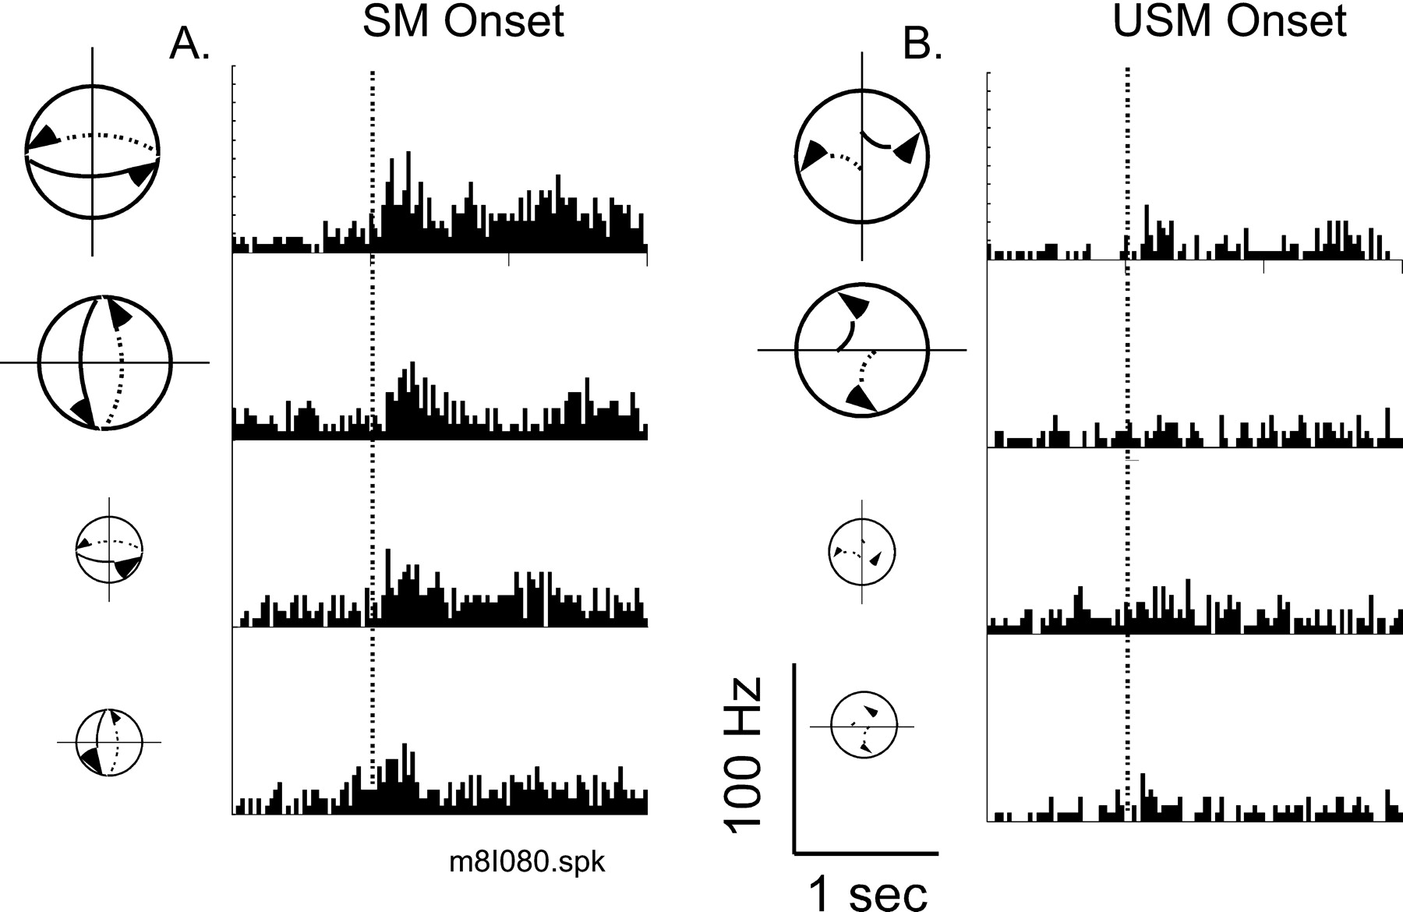
Figure 2. Differential response of an STPa neuron to the fraction-of-structure (FOS) at stimulus onset (dotted line). ...
Notes:
Figure 2. Differential response of an STPa neuron to the fraction-of-structure (FOS) at stimulus onset (dotted line). (A) Response of the cell to structured motion onset (SM Onset, FOS = 1). Under these conditions, each stimulus is a field of evenly distributed dots with the speed at each location defined by its three-dimensional position. This cell responded strongly to the onset of the structured motion stimuli (P < 0.05). Furthermore, the response significantly varied depending on the size and axis of rotation of the structured sphere displays. (B) When the displays were unstructured and all the motion trajectories are randomly shuffled, the percept of a hollow sphere is lost. There was no significant response of this neuron to the onset of the unstructured displays. The distribution of speeds is the same as for the structured spheres. Eight repetitions of each condition were presented.
Unless provided in the caption above, the following copyright applies to the content of this slide: © Oxford University Press 2005; all rights reserved

