Slide 1
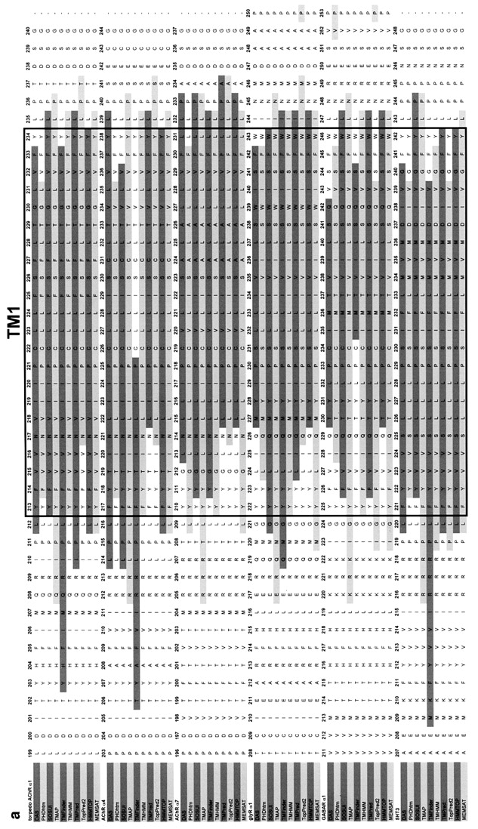
Fig. 1. Consensus sequences of TM1–TM4. The amino acid sequences of Torpedo nAChR alpha-1, and also human nAChR ...
Notes:
Fig. 1. Consensus sequences of TM1–TM4. The amino acid sequences of Torpedo nAChR alpha-1, and also human nAChR alpha-4, nAChR alpha-7, GlyR alpha-1, GABA alpha-1 and 5HT3R, were aligned using the CLUSTAL W algorithm. Then the secondary structure of each sequence was predicted using 10 algorithms specifically designed to detect transmembrane alpha helices: DAS, PHDhtm, SOSUI, TMAP, TMFinder, TMHMM, TMPred, TopPred2, HHMTOP and MEMSAT. The mean beginning and ending residues for each TM segment were calculated (Tables I and II) and used to make the black box that encloses the consensus segments. The shaded areas distinguish those residues predicted to be alpha helical by each of the algorithms. (a) Alignment of transmembrane segments 1 (TM1); (b) alignment of transmembrane segments 2 (TM2); (c) alignment of transmembrane segment 3 (TM3); (d) alignment of transmembrane segment 4 (TM4).
Unless provided in the caption above, the following copyright applies to the content of this slide: © Oxford University Press

Slide 2
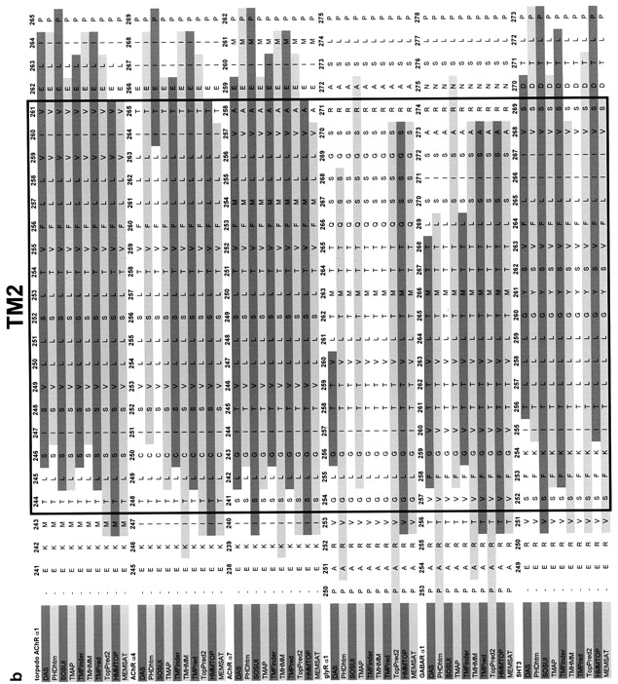
Fig. 1. Consensus sequences of TM1–TM4. The amino acid sequences of Torpedo nAChR alpha-1, and also human nAChR ...
Notes:
Fig. 1. Consensus sequences of TM1–TM4. The amino acid sequences of Torpedo nAChR alpha-1, and also human nAChR alpha-4, nAChR alpha-7, GlyR alpha-1, GABA alpha-1 and 5HT3R, were aligned using the CLUSTAL W algorithm. Then the secondary structure of each sequence was predicted using 10 algorithms specifically designed to detect transmembrane alpha helices: DAS, PHDhtm, SOSUI, TMAP, TMFinder, TMHMM, TMPred, TopPred2, HHMTOP and MEMSAT. The mean beginning and ending residues for each TM segment were calculated (Tables I and II) and used to make the black box that encloses the consensus segments. The shaded areas distinguish those residues predicted to be alpha helical by each of the algorithms. (a) Alignment of transmembrane segments 1 (TM1); (b) alignment of transmembrane segments 2 (TM2); (c) alignment of transmembrane segment 3 (TM3); (d) alignment of transmembrane segment 4 (TM4).
Unless provided in the caption above, the following copyright applies to the content of this slide: © Oxford University Press

Slide 3
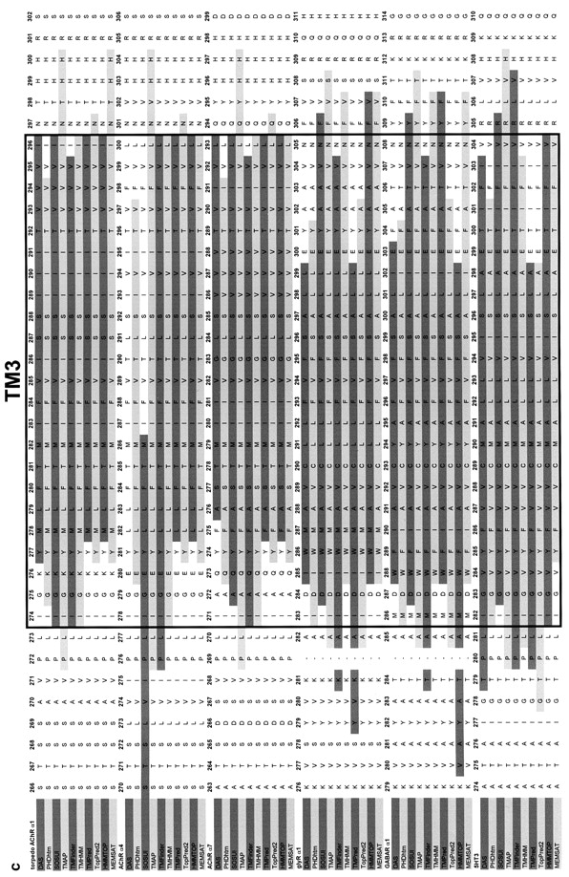
Fig. 1. Consensus sequences of TM1–TM4. The amino acid sequences of Torpedo nAChR alpha-1, and also human nAChR ...
Notes:
Fig. 1. Consensus sequences of TM1–TM4. The amino acid sequences of Torpedo nAChR alpha-1, and also human nAChR alpha-4, nAChR alpha-7, GlyR alpha-1, GABA alpha-1 and 5HT3R, were aligned using the CLUSTAL W algorithm. Then the secondary structure of each sequence was predicted using 10 algorithms specifically designed to detect transmembrane alpha helices: DAS, PHDhtm, SOSUI, TMAP, TMFinder, TMHMM, TMPred, TopPred2, HHMTOP and MEMSAT. The mean beginning and ending residues for each TM segment were calculated (Tables I and II) and used to make the black box that encloses the consensus segments. The shaded areas distinguish those residues predicted to be alpha helical by each of the algorithms. (a) Alignment of transmembrane segments 1 (TM1); (b) alignment of transmembrane segments 2 (TM2); (c) alignment of transmembrane segment 3 (TM3); (d) alignment of transmembrane segment 4 (TM4).
Unless provided in the caption above, the following copyright applies to the content of this slide: © Oxford University Press

