Slide 1
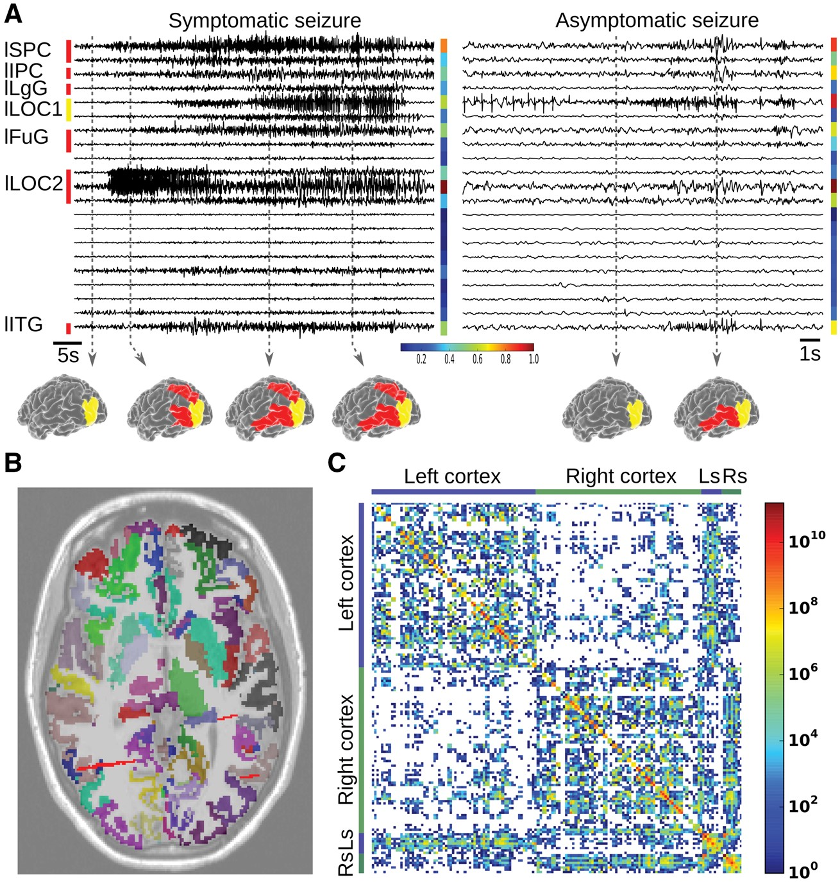
Figure 1 Stereotactic EEG data and reconstruction of virtual Patient CJ. (A) Two examples of partial seizures recorded ...
Notes:
Figure 1 Stereotactic EEG data and reconstruction of virtual Patient CJ. (A) Two examples of partial seizures recorded with stereotactic EEG in this patient. Left, the seizure propagates from the epileptogenic zone (yellow) to the propagation zone (red). Right, the seizure is limited to the epileptogenic zone. The normalized energy of each channel is shown in colour on the side, with below the corresponding colour bar. Spatiotemporal activation patterns are shown at different time points of the seizures. lSPC = left superior parietal cortex; lIPC = left inferior parietal cortex; lLgG = left lingual gyrus; lLOC1 = part 1 of the left lateral occipital cortex; lFuG = left fusiform gyrus; lLOC2 = part 2 of the left lateral occipital cortex; lITG = left inferior temporal gyrus. (B) Coregistration of the T1 MRI (levels of grey), the parcellation with 157 regions (colours) and the intracranial electrodes (red strips). (C) Connectivity matrix obtained from diffusion MRI for this parcellation. Ls = left subcortical; Rs = right subcortical.
Unless provided in the caption above, the following copyright applies to the content of this slide: © The Author (2017). Published by Oxford University Press on behalf of the Guarantors of Brain.This is an Open Access article distributed under the terms of the Creative Commons Attribution Non-Commercial License (http://creativecommons.org/licenses/by-nc/4.0/), which permits non-commercial re-use, distribution, and reproduction in any medium, provided the original work is properly cited. For commercial re-use, please contact journals.permissions@oup.com

Slide 2
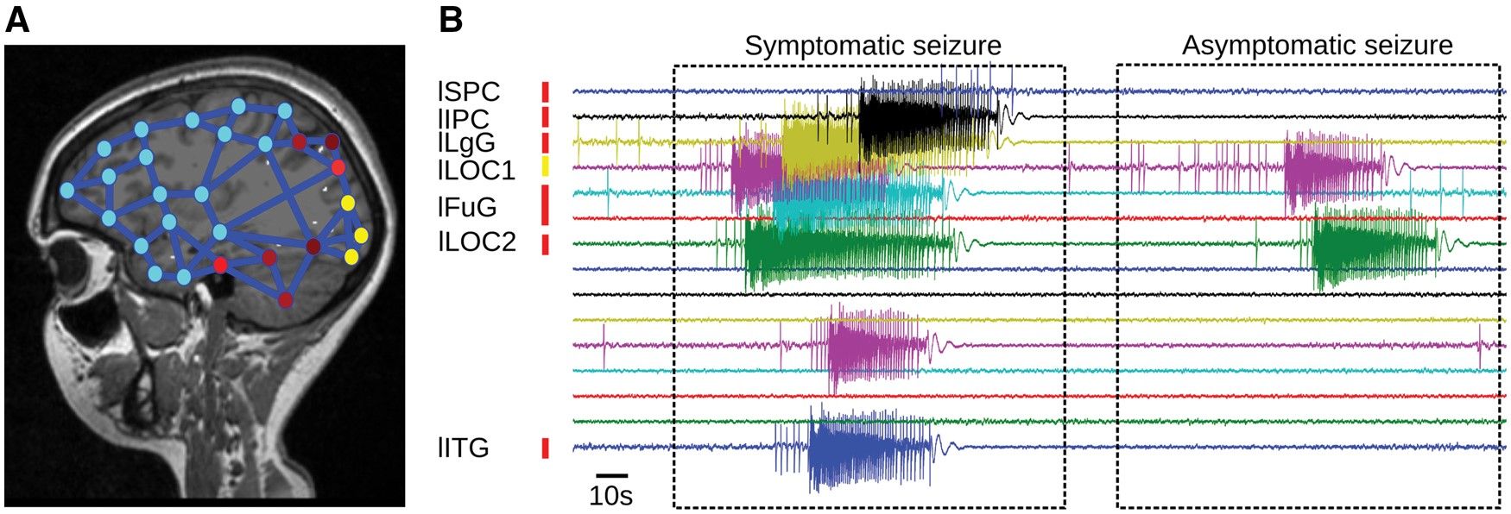
Figure 2 Simulations of the BNM for the Patient CJ. (A) A network of Epileptor models is build using the connectivity ...
Notes:
Figure 2 Simulations of the BNM for the Patient CJ. (A) A network of Epileptor models is build using the connectivity matrix. The nodes in the epileptogenic zone are epileptogenic (Δx0,i > 0, in yellow), the nodes in the propagation zone have different excitability values (0.5 > Δx0,i> −0.5, shades of red), while all the other nodes are not epileptogenic (stable state, Δx0,i< 0, in shades of blue). The blue links represent the anatomical links of the connectivity matrix. (B) Example of time series generated by the simulated BNM with the connectome of Patient CJ. Without changing any parameters, the propagation zone is not always recruited, reproducing the two seizures types of this patient as shown in Fig. 1A.
Unless provided in the caption above, the following copyright applies to the content of this slide: © The Author (2017). Published by Oxford University Press on behalf of the Guarantors of Brain.This is an Open Access article distributed under the terms of the Creative Commons Attribution Non-Commercial License (http://creativecommons.org/licenses/by-nc/4.0/), which permits non-commercial re-use, distribution, and reproduction in any medium, provided the original work is properly cited. For commercial re-use, please contact journals.permissions@oup.com

Slide 3
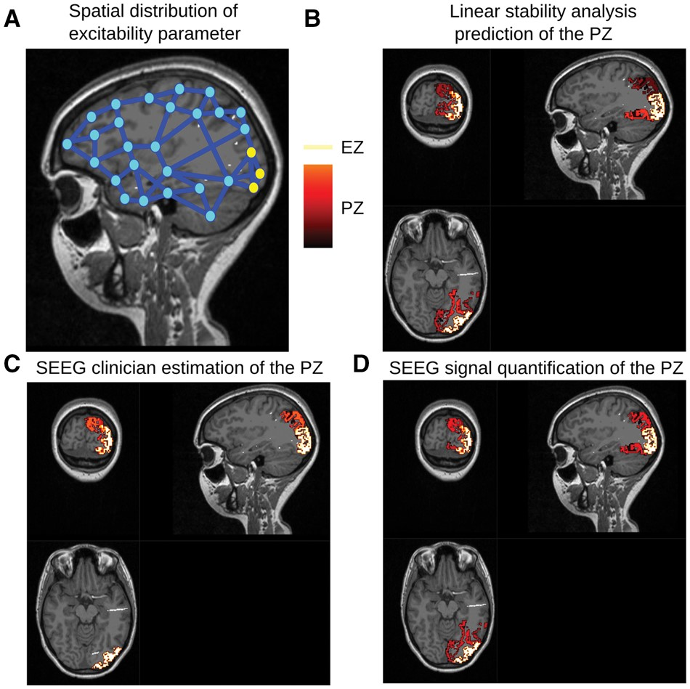
Figure 3 Prediction of the propagation zone by linear stability analysis for Patient CJ. (A) A network of Epileptor ...
Notes:
Figure 3 Prediction of the propagation zone by linear stability analysis for Patient CJ. (A) A network of Epileptor models is built using the connectivity matrix. The nodes in the epileptogenic zone (EZ) are epileptogenic (Δx0,i< 0, in yellow), while all the other nodes are equally far from the epileptogenicity threshold (Δx0,i< −0.5, in blue). Examples of the localization of the epileptogenic zone (yellow) and the propagation zone (PZ) (shade of red, as indicated by the colour bar) in Patient CJ such as found by: (B) linear stability analysis using the patient connectome; (C) stereotactic EEG clinician estimations; (D) stereotactic EEG signal quantifications. The propagation zone values are all the same for the stereotactic EEG clinician estimations. SEEG = stereotactic EEG.
Unless provided in the caption above, the following copyright applies to the content of this slide: © The Author (2017). Published by Oxford University Press on behalf of the Guarantors of Brain.This is an Open Access article distributed under the terms of the Creative Commons Attribution Non-Commercial License (http://creativecommons.org/licenses/by-nc/4.0/), which permits non-commercial re-use, distribution, and reproduction in any medium, provided the original work is properly cited. For commercial re-use, please contact journals.permissions@oup.com

Slide 4
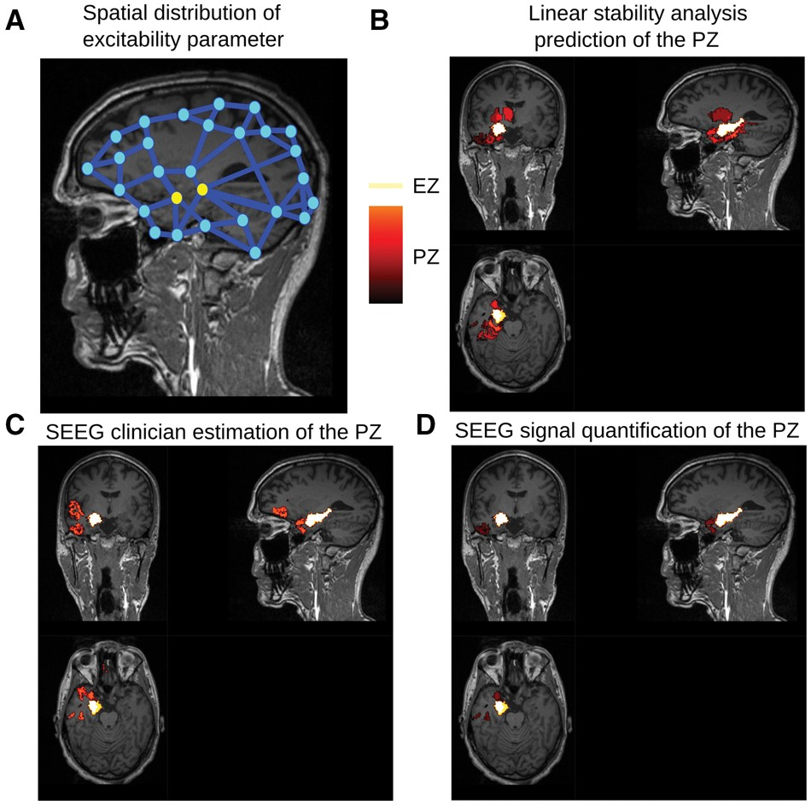
Figure 4 Prediction of the propagation zone by linear stability analysis for Patient GC. A network of Epileptor models ...
Notes:
Figure 4 Prediction of the propagation zone by linear stability analysis for Patient GC. A network of Epileptor models is built using the connectivity matrix. The nodes in the epileptogenic zone (EZ) are epileptogenic (Δx0,i< 0, in yellow), while all the other nodes are equally far from the epileptogenicity threshold (Δx0,i< −0.5, in blue). Examples of the localization of the epileptogenic zone (yellow) and the propagation zone (PZ) (shade of red, as indicated by the colour bar) in Patient CJ such as found by: (B) linear stability analysis using the patient connectome; (C) stereotactic EEG clinician estimations; (D) stereotactic EEG signal quantifications. The propagation zone values are all the same for the stereotactic EEG clinician estimations. SEEG = stereotactic EEG.
Unless provided in the caption above, the following copyright applies to the content of this slide: © The Author (2017). Published by Oxford University Press on behalf of the Guarantors of Brain.This is an Open Access article distributed under the terms of the Creative Commons Attribution Non-Commercial License (http://creativecommons.org/licenses/by-nc/4.0/), which permits non-commercial re-use, distribution, and reproduction in any medium, provided the original work is properly cited. For commercial re-use, please contact journals.permissions@oup.com

Slide 5
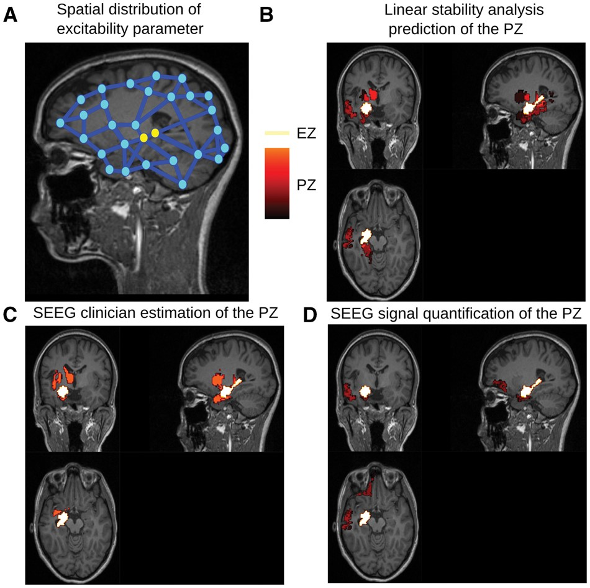
Figure 5 Prediction of the propagation zone by linear stability analysis for Patient ML. A network of Epileptor models ...
Notes:
Figure 5 Prediction of the propagation zone by linear stability analysis for Patient ML. A network of Epileptor models is build using the connectivity matrix. The nodes in the epileptogenic zone (EZ) are epileptogenic (Δx0,i< 0, in yellow), while all the other nodes are equally far from the epileptogenicity threshold (Δx0,i< −0.5, in blue). Examples of the localization of the epileptogenic zone (yellow) and the propagation zone (PZ) (shade of red, as indicated by the colour bar) in Patient CJ such as found by: (B) linear stability analysis using the patient connectome; (C) stereotactic EEG clinician estimations; (D) stereotactic EEG signal quantifications. The propagation zone values are all the same for the stereotactic EEG clinician estimations. SEEG = stereotactic EEG.
Unless provided in the caption above, the following copyright applies to the content of this slide: © The Author (2017). Published by Oxford University Press on behalf of the Guarantors of Brain.This is an Open Access article distributed under the terms of the Creative Commons Attribution Non-Commercial License (http://creativecommons.org/licenses/by-nc/4.0/), which permits non-commercial re-use, distribution, and reproduction in any medium, provided the original work is properly cited. For commercial re-use, please contact journals.permissions@oup.com

Slide 6
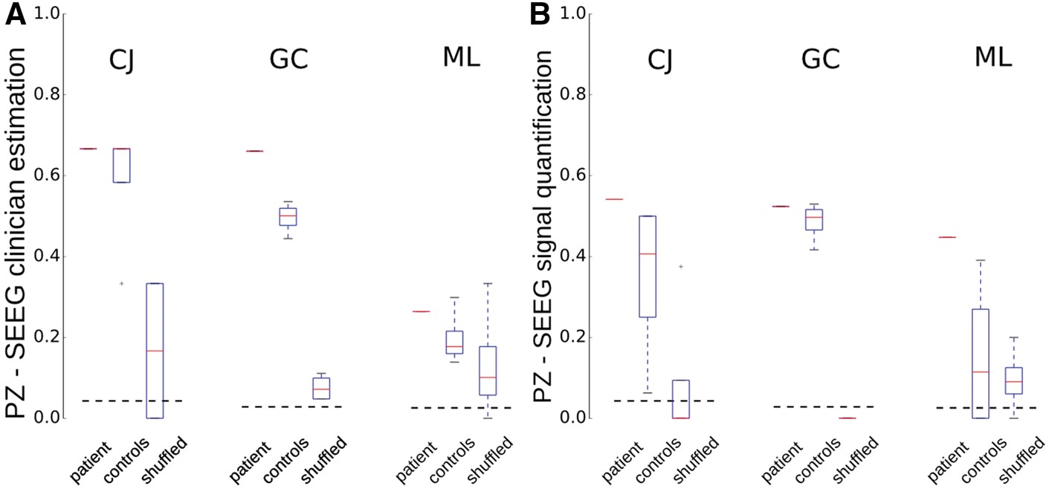
Figure 6 Prediction scores for patient, control subject and shuffled connectivity matrices. Results for Patients CJ, ...
Notes:
Figure 6 Prediction scores for patient, control subject and shuffled connectivity matrices. Results for Patients CJ, GC and ML, compared to five control subjects and to shuffled connectivity matrix, for propagation zone (PZ) location according to (A) stereotactic EEG clinician estimation, and (B) stereotactic EEG signal quantification. The dashed line indicates the level of chance. In box plots, boxes represent the 25th and 75th percentiles, centre line indicates the median and the whiskers extend to the most extreme data points not considered outliers. SEEG = stereotactic EEG.
Unless provided in the caption above, the following copyright applies to the content of this slide: © The Author (2017). Published by Oxford University Press on behalf of the Guarantors of Brain.This is an Open Access article distributed under the terms of the Creative Commons Attribution Non-Commercial License (http://creativecommons.org/licenses/by-nc/4.0/), which permits non-commercial re-use, distribution, and reproduction in any medium, provided the original work is properly cited. For commercial re-use, please contact journals.permissions@oup.com

Slide 7
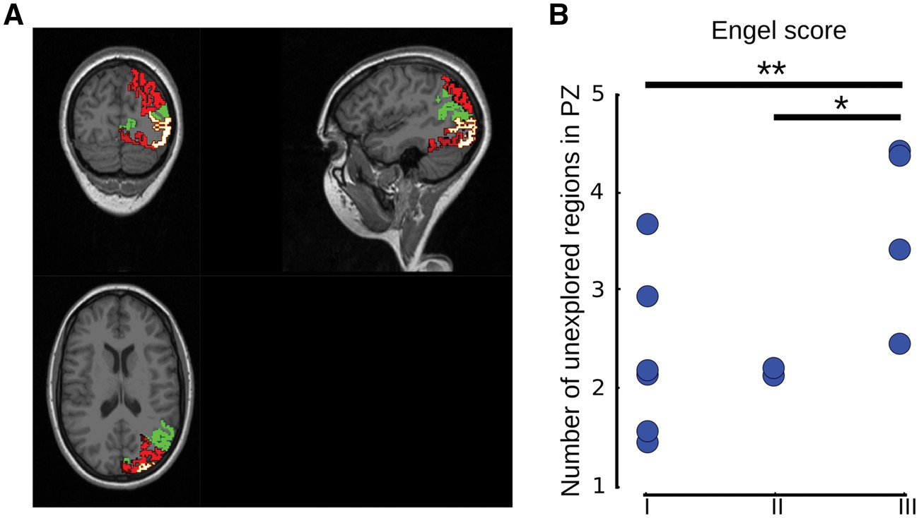
Figure 7 Prediction of the surgical outcome. (A) Example for Patient CJ showing stereotactic EEG signal quantification ...
Notes:
Figure 7 Prediction of the surgical outcome. (A) Example for Patient CJ showing stereotactic EEG signal quantification of the propagation zone (PZ) overlaid in green by the regions found in the propagation zone by the linear stability analysis but not explored by stereotactic EEG, therefore not considered in the propagation zone by the clinical expertise. (B) Comparison for all patients of the size of the unexplored regions predicted as in the propagation zone by the analytical model and the Engel classification (stereotactic EEG clinician estimation, 158 regions, distance score). Significant P-values are indicated. **P < 0.05, *P < 0.1; Mann-Whitney U-test.
Unless provided in the caption above, the following copyright applies to the content of this slide: © The Author (2017). Published by Oxford University Press on behalf of the Guarantors of Brain.This is an Open Access article distributed under the terms of the Creative Commons Attribution Non-Commercial License (http://creativecommons.org/licenses/by-nc/4.0/), which permits non-commercial re-use, distribution, and reproduction in any medium, provided the original work is properly cited. For commercial re-use, please contact journals.permissions@oup.com

