Slide 1
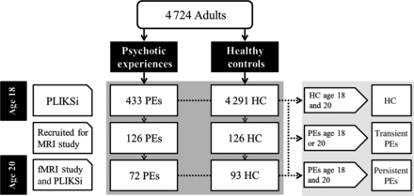
Figure 1. Flowchart depicting ALSPAC participants with regard to PLIKSi at ages 18 and 20.
Notes:
Figure 1. Flowchart depicting ALSPAC participants with regard to PLIKSi at ages 18 and 20.
Unless provided in the caption above, the following copyright applies to the content of this slide: © The Author 2015. Published by Oxford University PressThis is an Open Access article distributed under the terms of the Creative Commons Attribution License (http://creativecommons.org/licenses/by/4.0/), which permits unrestricted reuse, distribution, and reproduction in any medium, provided the original work is properly cited.

Slide 2
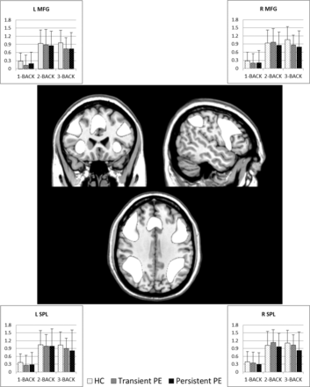
Figure 2. Center: Task-related increases in BOLD response upon collapsing both groups and conditions used as a ...
Notes:
Figure 2. Center: Task-related increases in BOLD response upon collapsing both groups and conditions used as a functionally defined working memory network. The average BOLD response to each condition has been extracted and plotted for the left middle frontal gyrus (top left), right middle frontal gyrus (top right), left superior parietal lobule (bottom left), and right superior parietal lobule (bottom right).
Unless provided in the caption above, the following copyright applies to the content of this slide: © The Author 2015. Published by Oxford University PressThis is an Open Access article distributed under the terms of the Creative Commons Attribution License (http://creativecommons.org/licenses/by/4.0/), which permits unrestricted reuse, distribution, and reproduction in any medium, provided the original work is properly cited.

Slide 3
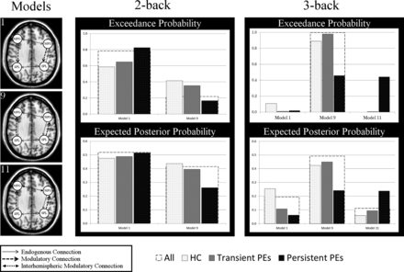
Figure 3. Illustrations of winning models (left) and the probabilities associated with these models (range 0–1) given ...
Notes:
Figure 3. Illustrations of winning models (left) and the probabilities associated with these models (range 0–1) given for the total sample and for each group on both the 2-back and 3-back conditions.
Unless provided in the caption above, the following copyright applies to the content of this slide: © The Author 2015. Published by Oxford University PressThis is an Open Access article distributed under the terms of the Creative Commons Attribution License (http://creativecommons.org/licenses/by/4.0/), which permits unrestricted reuse, distribution, and reproduction in any medium, provided the original work is properly cited.

