Slide 1
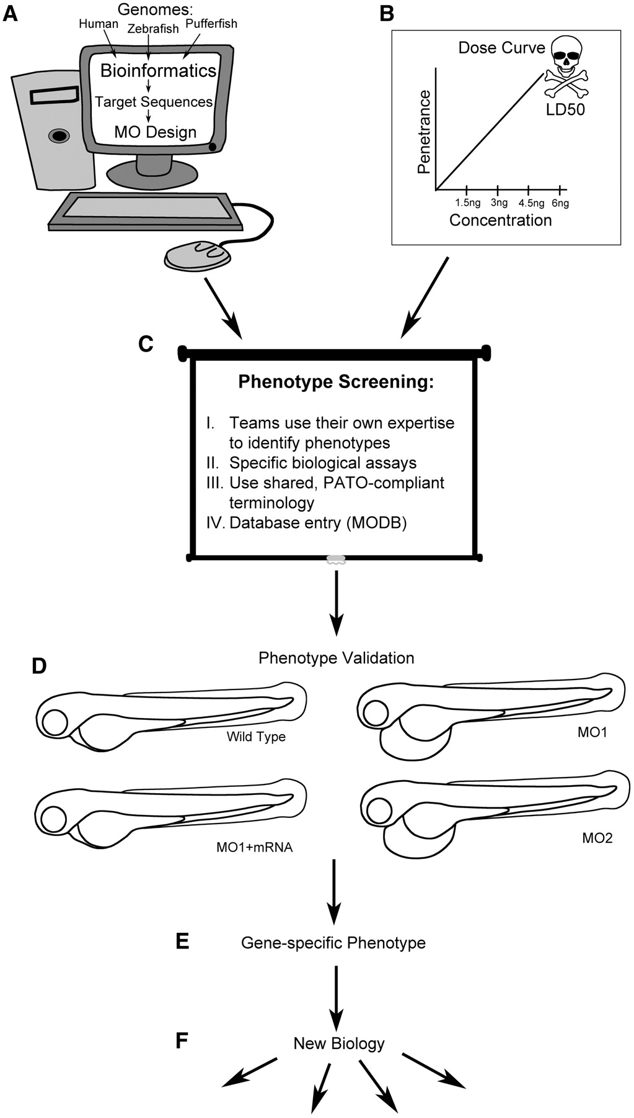
Figure 1: Workflow using morpholinos as a genetic screening tool. (A) The first step is to identify the target genes to ...
Notes:
Figure 1: Workflow using morpholinos as a genetic screening tool. (A) The first step is to identify the target genes to be screened. We identified our target sequences using bioinformatics tools and comparing human, zebrafish and pufferfish genomes. Once the likely start site was identified, the MO was designed using standard MO-mRNA target sequence binding parameters (reviewed in [4]). (B) Second, we established a standard dose curve. We designed 20 MOs against genes with known phenotypes to establish a broad calibration curve for MO effectiveness. (C) We standardized the subsequent screening process as much as possible. (I) For phenotype identification, we used a team-based approach that catered to the individual scientists’ expertise. (II) We used specific biological assays, for example microangiography, to improve the specificity of phenotypic description. (III) We standardized written phenotypic descriptions as much as possible, using PATO-compliant terminology to enhance data communication. (IV) Finally, observed phenotypes were entered into the MODB database for organization, searchability and data sharing. (D) For each phenotype observed with an initial MO, validation was essential to ensure the phenotype was gene-specific and not an off-target effect. (E and F) Once a phenotype was established as gene-specific, that MO could be used to investigate new biology.
Unless provided in the caption above, the following copyright applies to the content of this slide: © The Author(s) 2011. Published by Oxford University Press.This is an Open Access article distributed under the terms of the Creative Commons Attribution Non-Commercial License (http://creativecommons.org/licenses/by-nc/3.0), which permits unrestricted non-commercial use, distribution, and reproduction in any medium, provided the original work is properly cited.

Slide 2
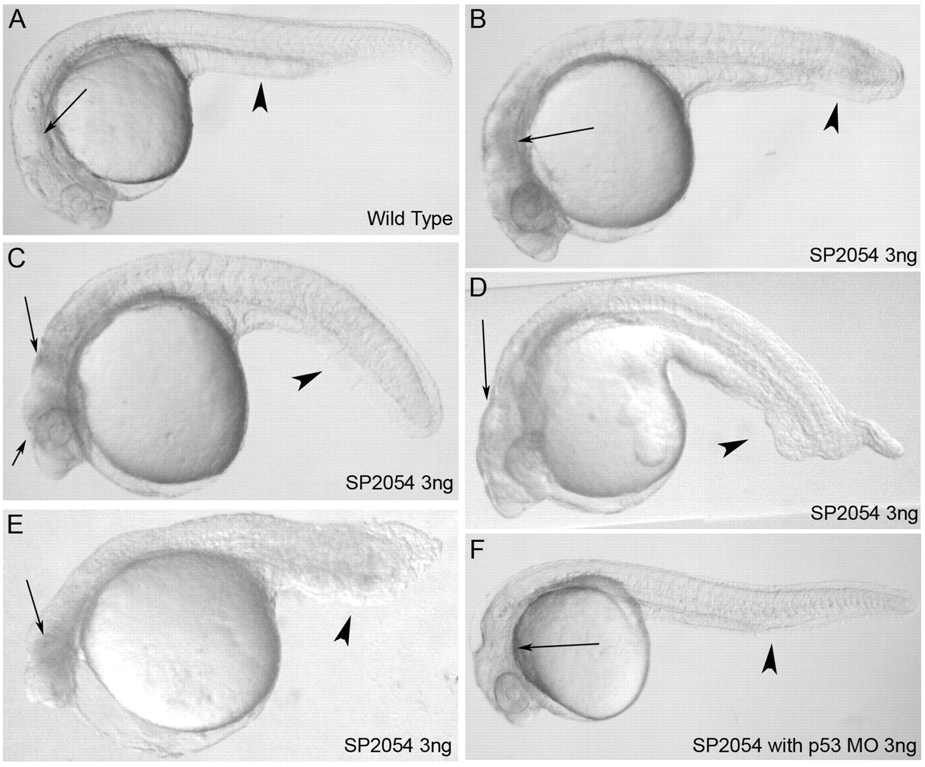
Figure 2: Examples of off-target effects of MOs. (A) A normal wild-type embryo at 24 hpf. The brain is transparent ...
Notes:
Figure 2: Examples of off-target effects of MOs. (A) A normal wild-type embryo at 24 hpf. The brain is transparent (arrow) and the tail is not bent (arrowhead). The MO used for this demonstration is targeted against SP2054 with and without p53. SP2054 MO shows a nonspecific p53 activation that does not co-localize with the endogenous expression pattern of the targeted gene [17]. (B–E) Examples of the standard toxicity seen in MO injected embryos that are not co-injected with the p53 MO. These four images are placed in order of increasing severity. (B) This embryo demonstrates some neural death, seen as a black area in the brain where it should be transparent (arrow), while the tail is somewhat bent (arrowhead). (C) This embryo shows more neural toxicity (arrows), and the tail is significantly bent (arrowhead). (D) This embryo does not show significant neural toxicity (arrow). However, gnarled tails are commonly noted due to MO toxicity (arrowhead). (E) This embryo shows a classic more severe, ‘monster’ phenotype. This embryo has p53-induced neural toxicity (arrow), but it also shows a very shortened and gnarled tail as well as small head and eyes. (F) Inhibition of p53 can attenuate common off-target effects. Shown is the same SP2054 MO as was used above co-injected with the p53 MO at 3 ng of each MO (therefore 6 ng of total MO). The brain is largely clear with little or no visible neural toxicity (arrow) while the tail remains fairly normal (arrowhead). The monster phenotype can be found in p53 MO co-injected embryos but usually to a lesser extent.
Unless provided in the caption above, the following copyright applies to the content of this slide: © The Author(s) 2011. Published by Oxford University Press.This is an Open Access article distributed under the terms of the Creative Commons Attribution Non-Commercial License (http://creativecommons.org/licenses/by-nc/3.0), which permits unrestricted non-commercial use, distribution, and reproduction in any medium, provided the original work is properly cited.

