Slide 1
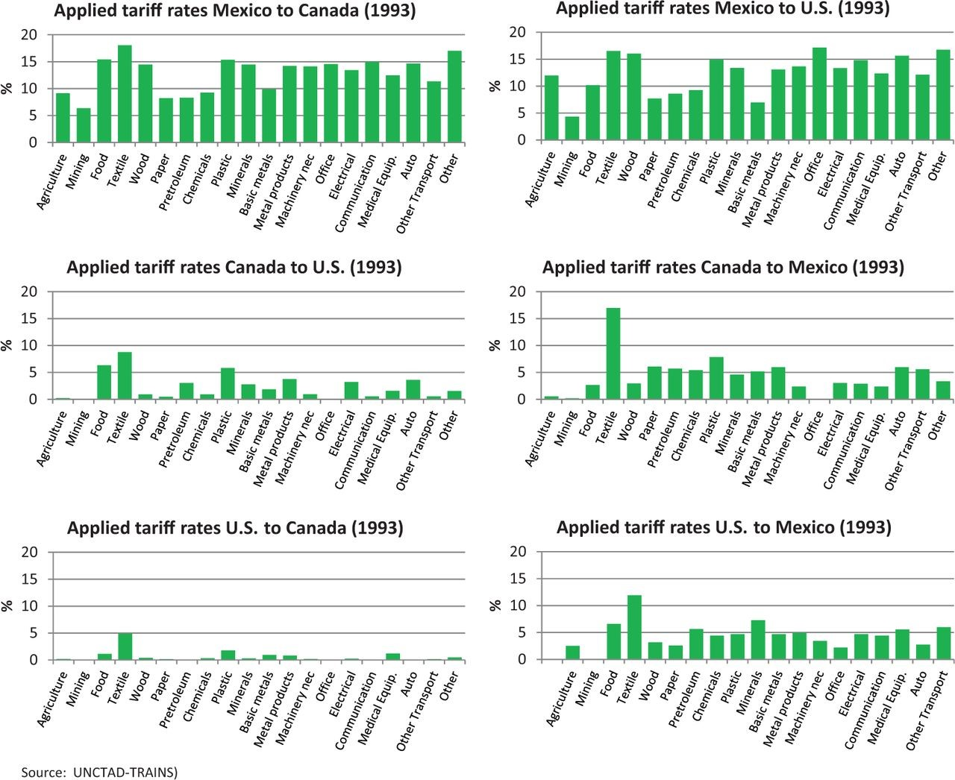
Figure A1 Effective applied tariff rates before NAFTA
Notes:
Figure A1 Effective applied tariff rates before NAFTA
Unless provided in the caption above, the following copyright applies to the content of this slide: © The Author 2014. Published by Oxford University Press on behalf of The Review of Economic Studies Limited.

