Slide 1
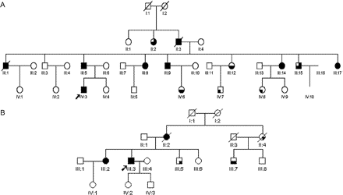
Fig. 1 (A) Family 1 Pedigree. (B) Family 2 Pedigree. Arrow = index case; Blackened: upper left quadrant = sensory ...
Notes:
Fig. 1 (A) Family 1 Pedigree. (B) Family 2 Pedigree. Arrow = index case; Blackened: upper left quadrant = sensory neuropathy on nerve conduction studies; upper right = symptoms and signs of sensory neuropathy; lower left = GOR; lower right = cough.
Unless provided in the caption above, the following copyright applies to the content of this slide: © The Author (2005). Published by Oxford University Press on behalf of the Guarantors of Brain. All rights reserved. For Permissions, please email: journals.permissions@oxfordjournals.org

Slide 2
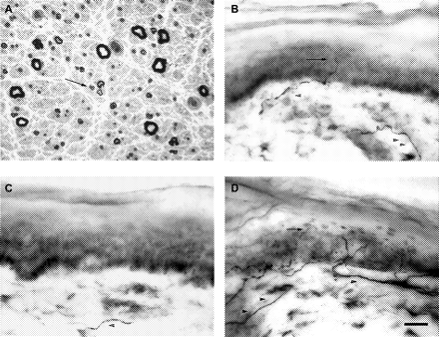
Fig. 2 (A) Sural nerve biopsy from subject 1–III:9, toluidine blue stain, ×40 magnification, demonstrating severe ...
Notes:
Fig. 2 (A) Sural nerve biopsy from subject 1–III:9, toluidine blue stain, ×40 magnification, demonstrating severe axonal loss with some cluster formation (arrow); (B-D) Skin biopsies stained with antibody to PGP 9.5, 40× magnification, showing epidermal (arrow) and dermal (arrowhead) nerve fibres. (B) Subject 1–IV:3—reduced epidermal nerve fibre density of 2.4 nerves/mm. (C) Subject 1–III:5—epidermal nerve fibre density 0.1 nerves/mm, but dermal fibre only in this section. (D) Control subject—epidermal nerve fibre density normal at 14.8 nerves/mm. Scale bar = 20 µm.
Unless provided in the caption above, the following copyright applies to the content of this slide: © The Author (2005). Published by Oxford University Press on behalf of the Guarantors of Brain. All rights reserved. For Permissions, please email: journals.permissions@oxfordjournals.org

Slide 3
Fig. 3 Ambulatory oesophageal pH study. This graph is from the 24 h study performed on subject III:5 from Family 1. ...
Notes:
Fig. 3 Ambulatory oesophageal pH study. This graph is from the 24 h study performed on subject III:5 from Family 1. Time of day is represented on the x-axis and pH on the y-axis. The subject pressed a trigger during each episode of cough, as indicated by vertical lines marked C. Episodes of cough were closely temporally related to episodes of GOR (pH <4).
Unless provided in the caption above, the following copyright applies to the content of this slide: © The Author (2005). Published by Oxford University Press on behalf of the Guarantors of Brain. All rights reserved. For Permissions, please email: journals.permissions@oxfordjournals.org

