Slide 1
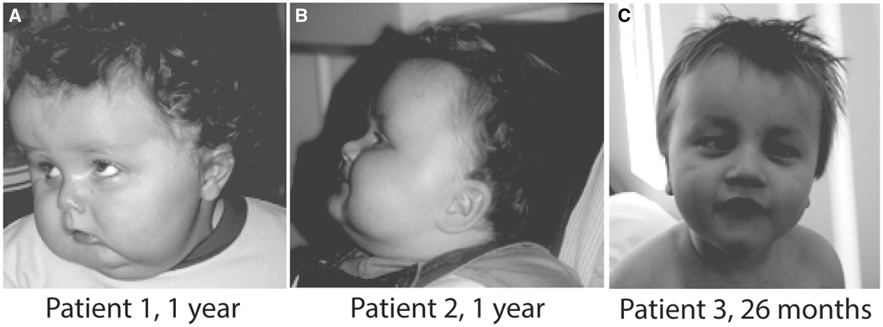
Figure 1. Clinical features of patients. Note obesity, macrocephaly, brachycephaly and eye abnormalities.
Notes:
Figure 1. Clinical features of patients. Note obesity, macrocephaly, brachycephaly and eye abnormalities.
Unless provided in the caption above, the following copyright applies to the content of this slide: © The Author 2016. Published by Oxford University Press. All rights reserved. For permissions, please e-mail: journals.permissions@oup.com

Slide 2
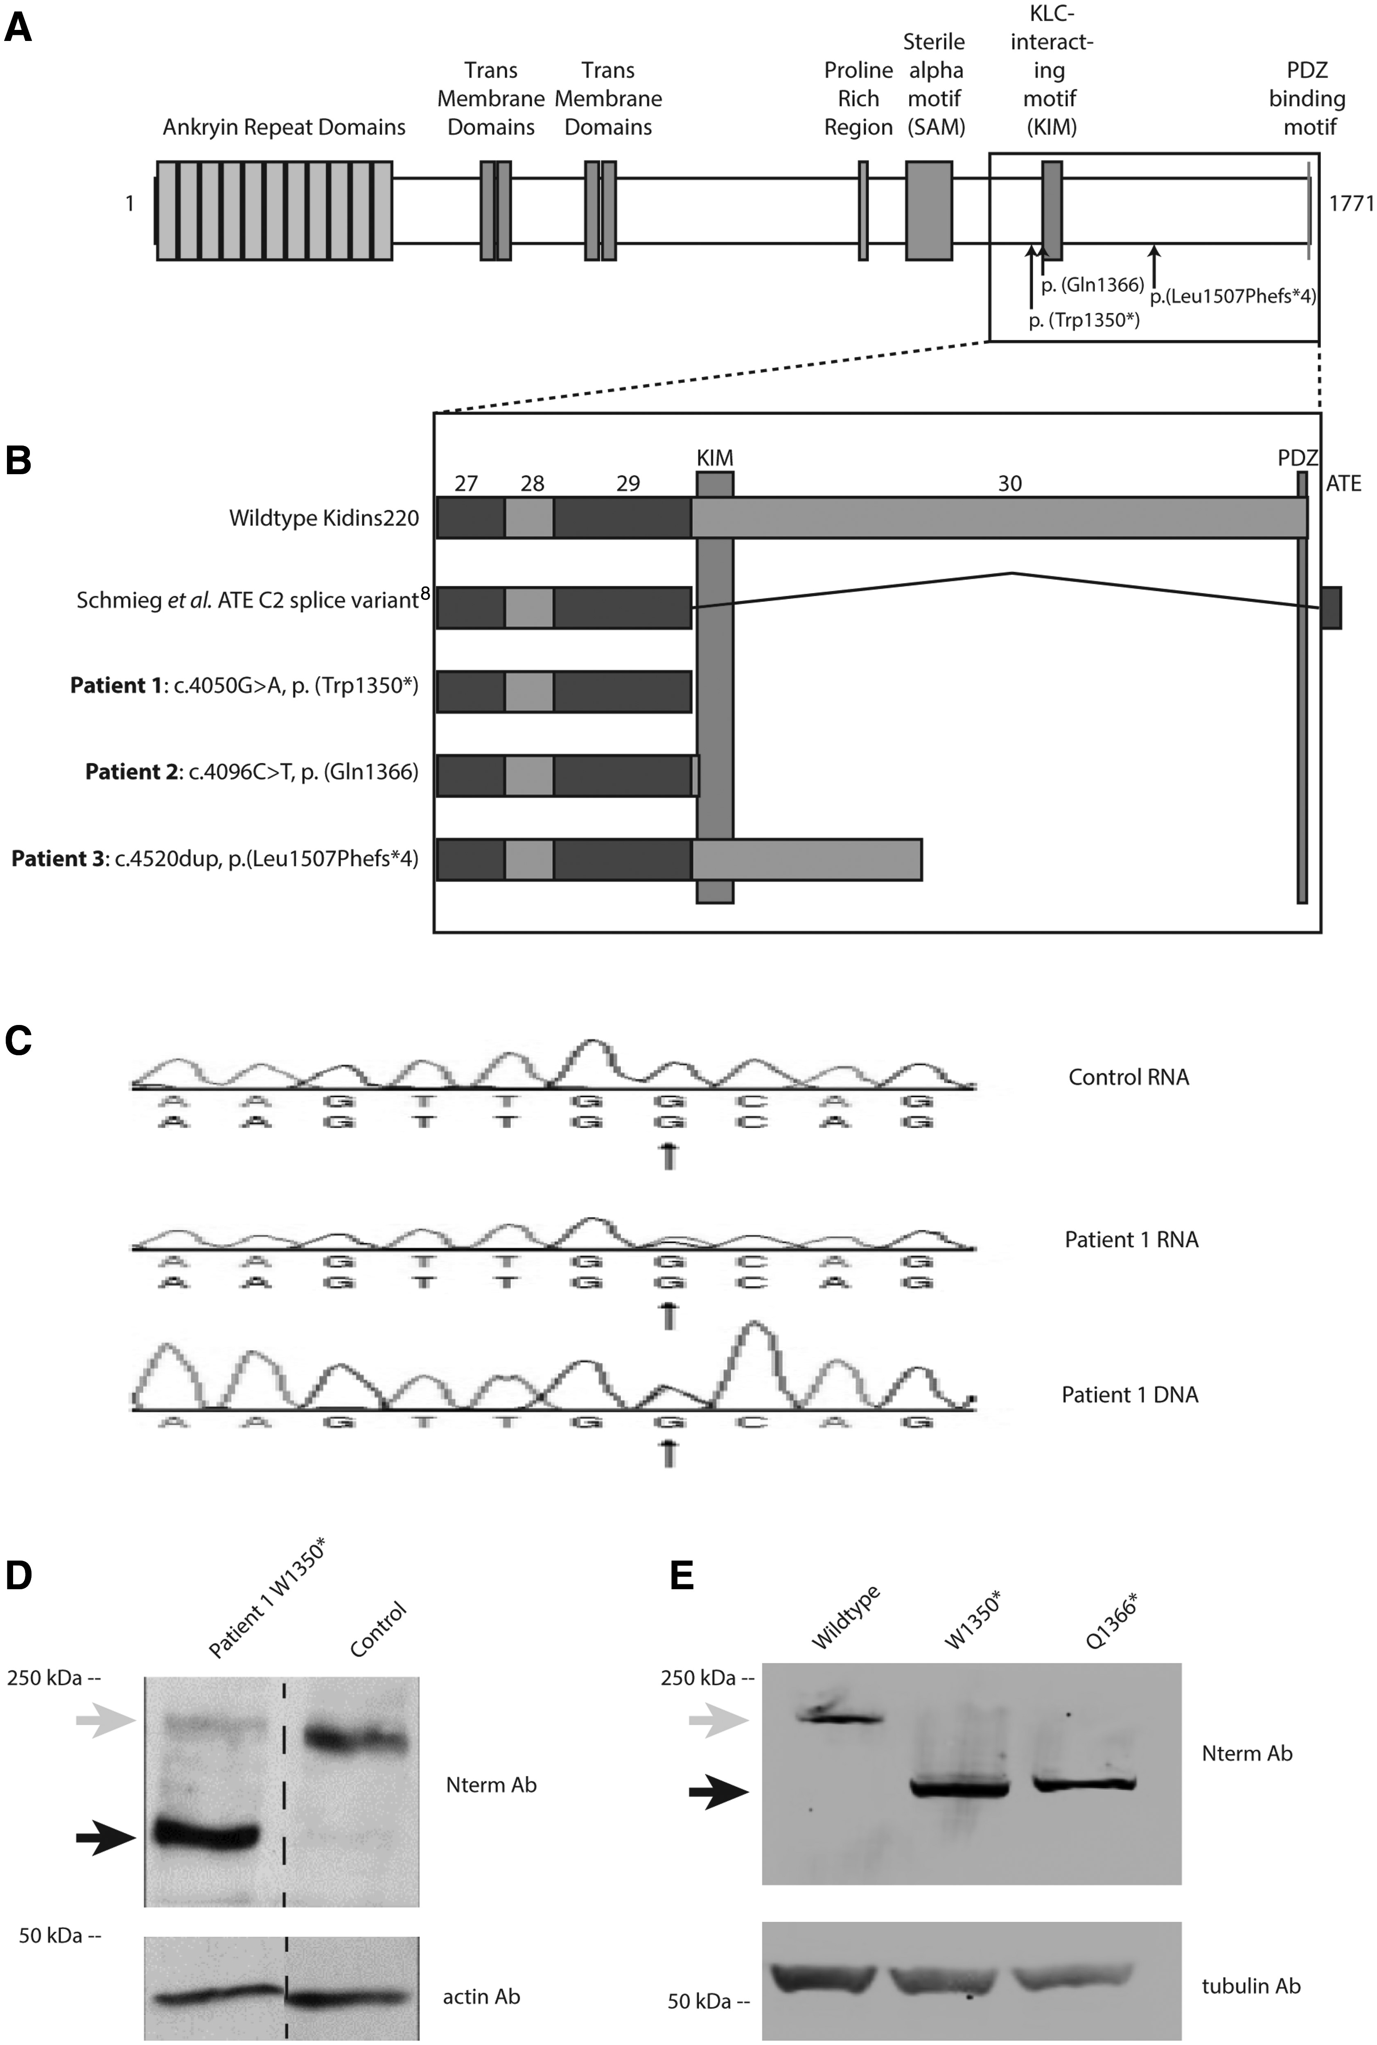
Figure 2. De novo dominant nonsense variants in KIDINS220.(A) Variants p.(Trp1350*) and p.(Gln1366*) result in ...
Notes:
Figure 2. De novo dominant nonsense variants in KIDINS220.(A) Variants p.(Trp1350*) and p.(Gln1366*) result in truncated protein without the full KIM domain, and p.(Leu1507Phefs*4) results in a slightly longer protein containing the full KIM domain. (B) Comparison of the wild-type KIDINS220 exonic structure versus an alternate terminal ending splice variant described by Schmieg et al. ( 8 ) and the three patients described in this study (C)KIDINS220 cDNA sequencing verifies that there is no mRNA NMD in patient 1. Western blot analysis of (D) total extracts from patient 1 versus a control fibroblast and (E) total HEK293T extracts expressing wild-type and variant (Trp1350* and Gln1366*) forms of KIDINS220. Expression of KIDINS220 was tested with antibodies against the N-terminal part of KIDINS220 (Nterm Ab). The truncated protein products caused by KIDINS220 variants are indicated with a black arrow and the expected full-length wild-type protein product by a grey arrow. Anti-actin was used as a loading control for the fibroblasts and anti-tubulin for the HEK293T cells.
Unless provided in the caption above, the following copyright applies to the content of this slide: © The Author 2016. Published by Oxford University Press. All rights reserved. For permissions, please e-mail: journals.permissions@oup.com

Slide 3
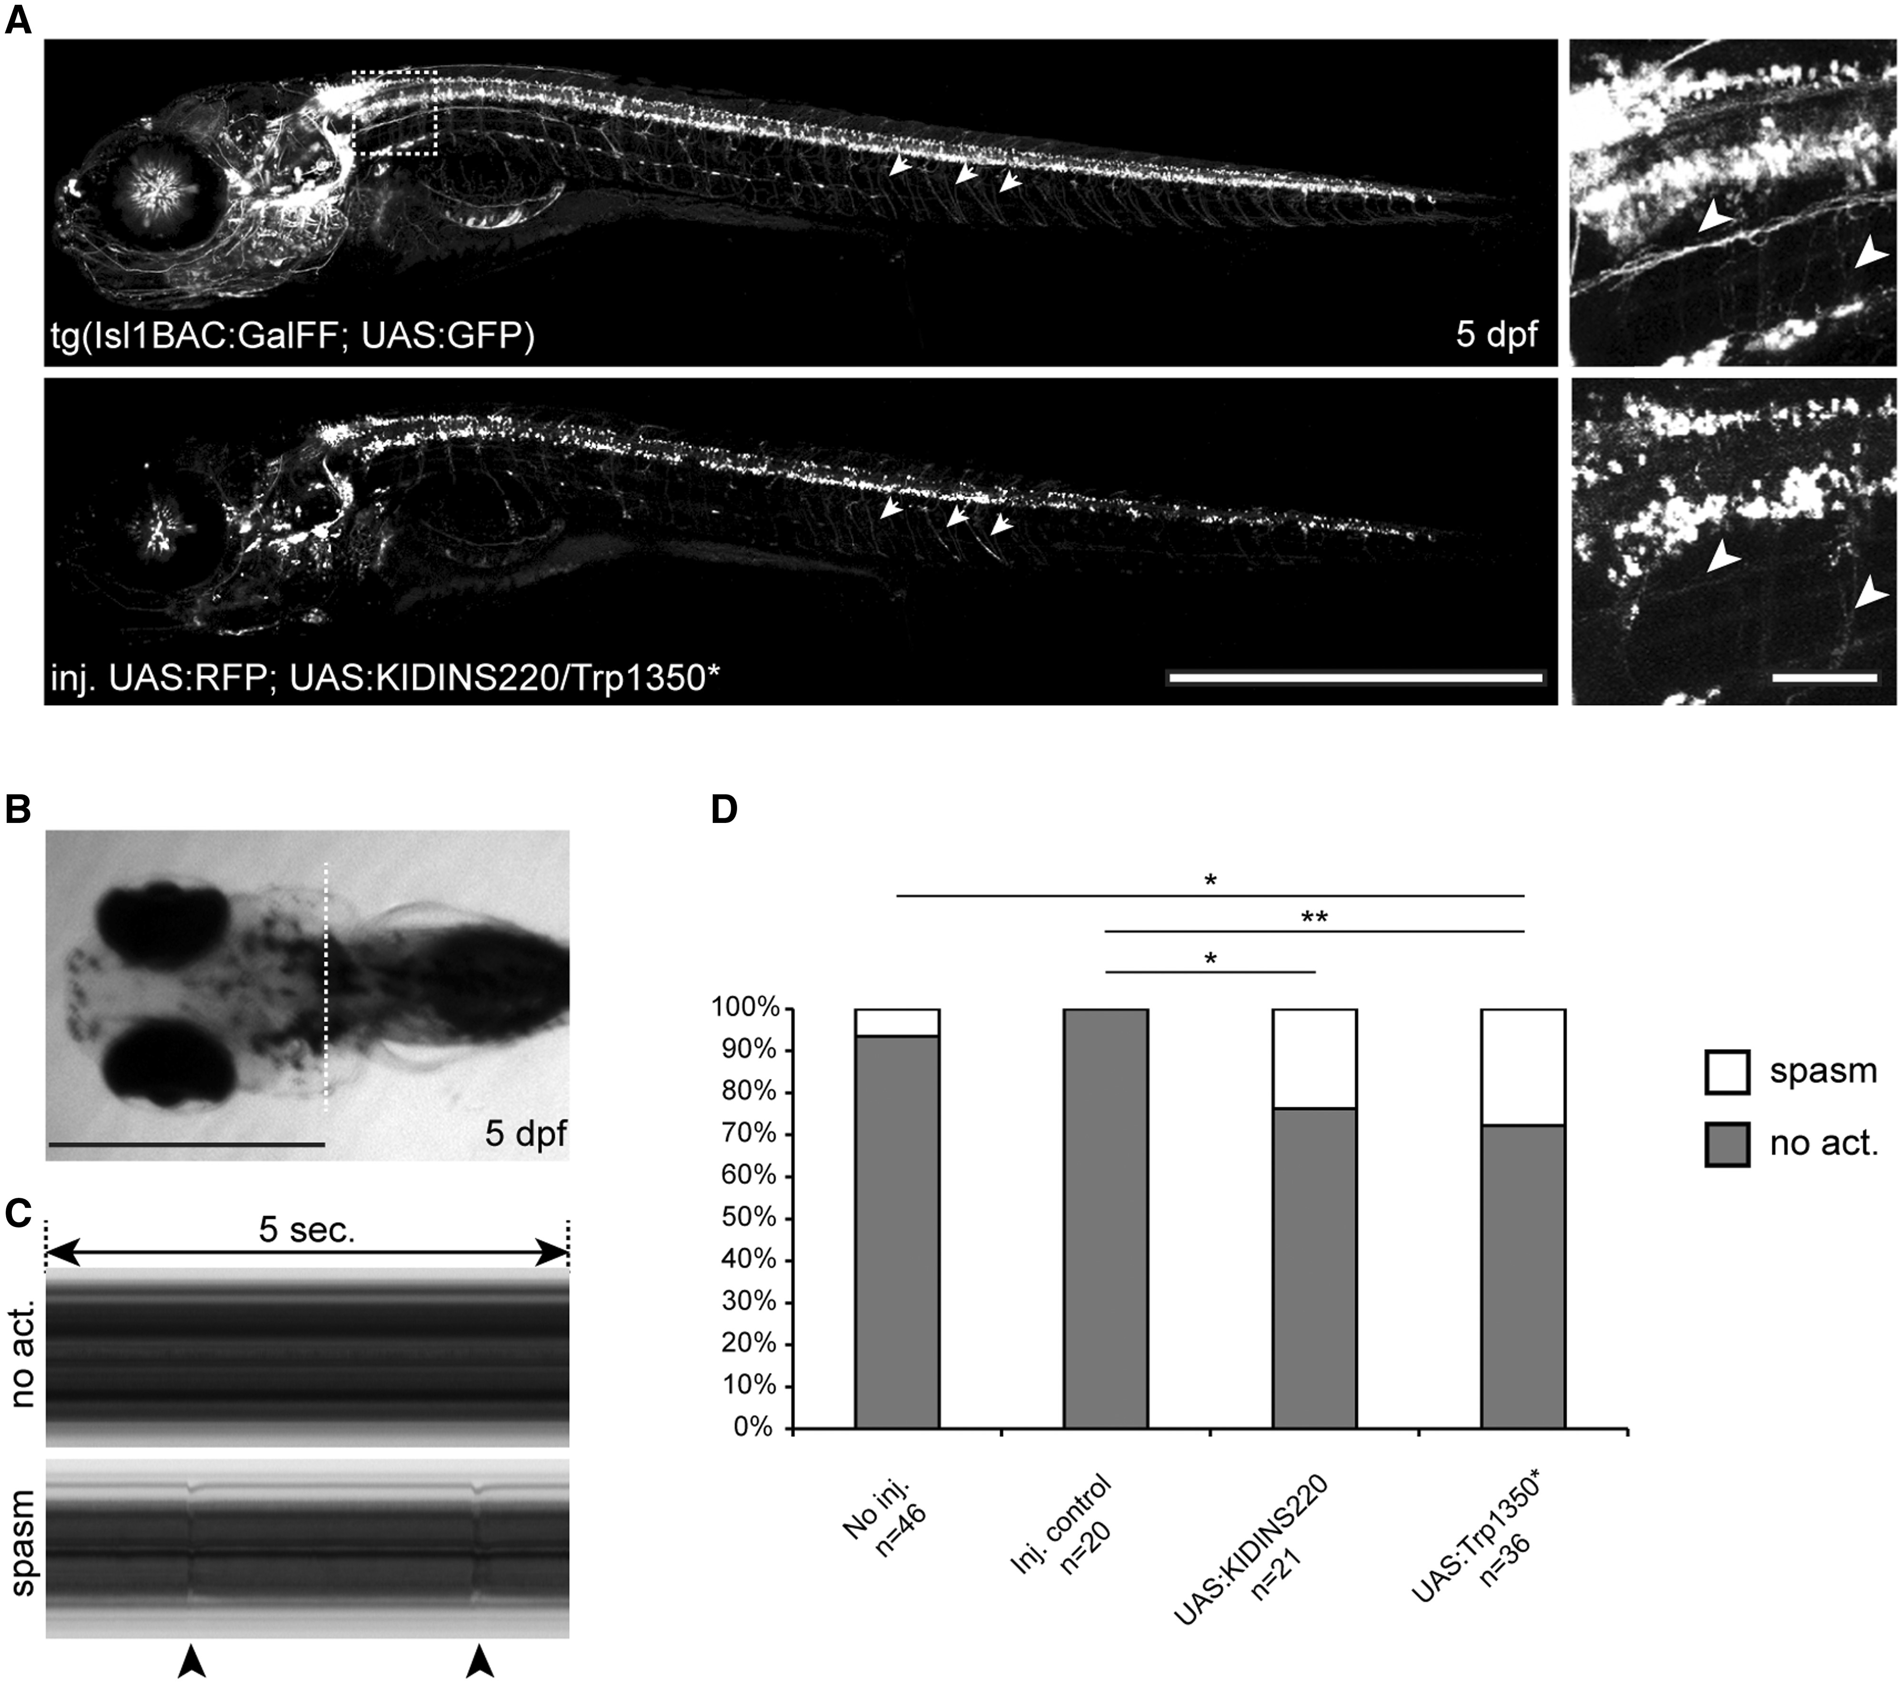
Figure 3. Effect of KIDINS220 and Trp1350* expression in zebrafish embryo motor neurons. (A) Tissue-specific ...
Notes:
Figure 3. Effect of KIDINS220 and Trp1350* expression in zebrafish embryo motor neurons. (A) Tissue-specific expression of KIDINS220 variants in 5 dpf zebrafish embryos was achieved by microinjection of UAS:KIDINS220 and UAS:Trp1350* DNA in tg(Isl1BAC:GalFF; UAS:GFP) embryos (upper panel). A DNA UAS:RFP construct was co-injected (lower panel) to evaluate the efficiency of the microinjections. White arrowheads: axonic extensions of the motor neurons. (B) 5 dpf zebrafish embryo (ventral view; anterior is left). White dotted line: position of kymographs presented in C. (C) Visualization of spastic activity on thoracic kymographs. Representative kymographs of embryos showing no spastic activity (upper panel, no act.) and spastic activity (lower panel, spasm). Black arrowheads point at spastic events as visualized on the kymograph. Representative recordings are available as supplementary Material files . (D) Quantification of spastic events in the different conditions of the study. Expression of KIDINS220 wt and Trp1350* in motor neurons results in increased spastic activity. No act., No spastic activity. * P < 0.05; ** P < 0.01; Fisher’s exact test. Scale bars: 1 mm in A (left panels), B; 50 microns in A (right panels).
Unless provided in the caption above, the following copyright applies to the content of this slide: © The Author 2016. Published by Oxford University Press. All rights reserved. For permissions, please e-mail: journals.permissions@oup.com

Slide 4
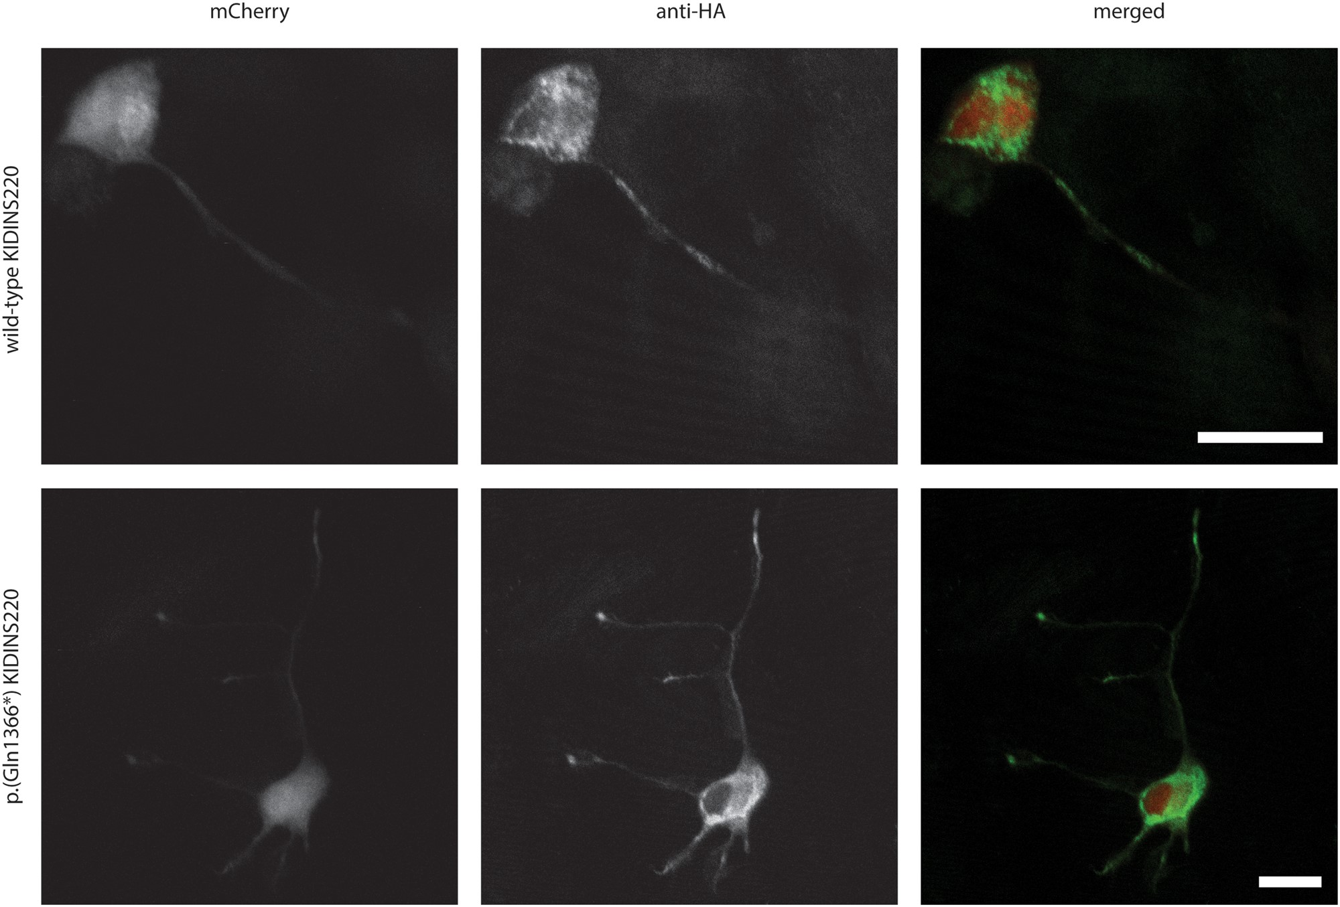
Figure 4. Kidins220 truncated variant is able to localize to neurite tips in Neuro-2A cells. Representative image of ...
Notes:
Figure 4. Kidins220 truncated variant is able to localize to neurite tips in Neuro-2A cells. Representative image of transfected KIDINS220 wild-type and variant p.(Gln1366*) in differentiated Neuro-2A cells. Immunofluorescence of cotransfected mCherry (red), anti-HA-tagged wild-type or p.(Gln1366*) KIDINS220 (green) show that the truncated KIDINS220 variant is transported to developing neurite tips. Scale bar = 20 microns
Unless provided in the caption above, the following copyright applies to the content of this slide: © The Author 2016. Published by Oxford University Press. All rights reserved. For permissions, please e-mail: journals.permissions@oup.com

