Slide 1
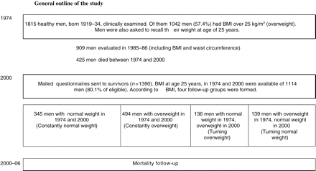
Figure 1 General outline of the study.
Notes:
Figure 1 General outline of the study.
Unless provided in the caption above, the following copyright applies to the content of this slide: Published on behalf of the European Society of Cardiology. All rights reserved. © The Author 2009. For permissions please email: journals.permissions@oxfordjournals.org

Slide 2
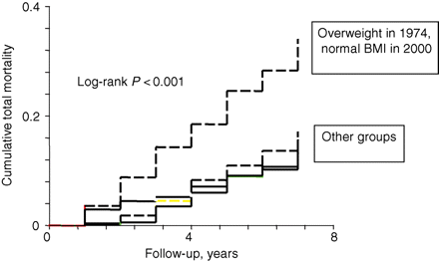
Figure 2 Total mortality of the four study groups in old age from the year 2000 up to 31 December 2006.
Notes:
Figure 2 Total mortality of the four study groups in old age from the year 2000 up to 31 December 2006.
Unless provided in the caption above, the following copyright applies to the content of this slide: Published on behalf of the European Society of Cardiology. All rights reserved. © The Author 2009. For permissions please email: journals.permissions@oxfordjournals.org

