Slide 1
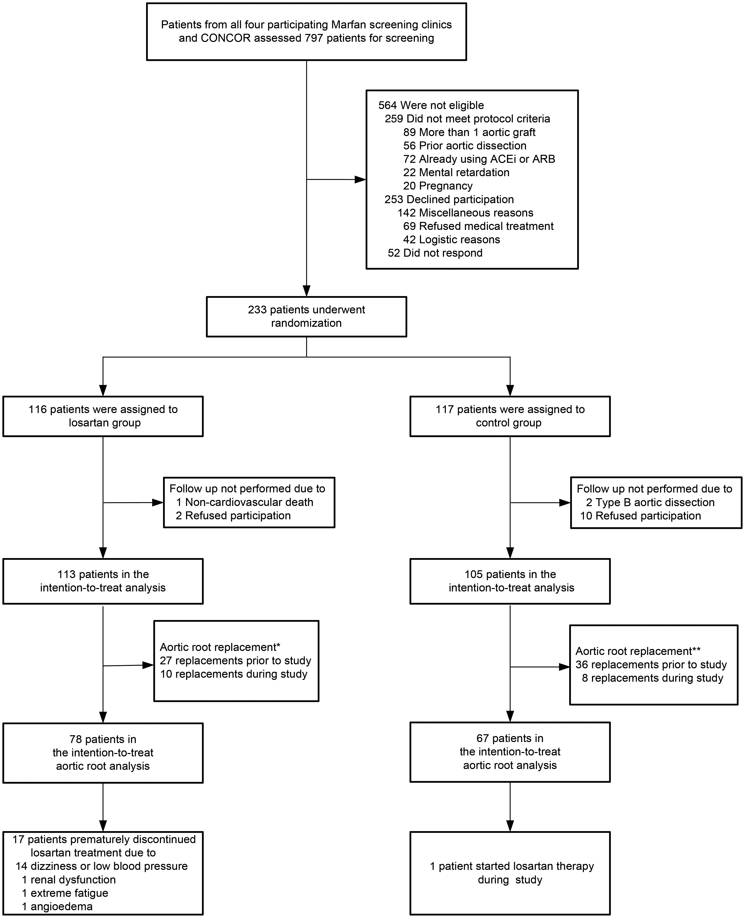
Figure 1 Randomization and follow-up for aortic diameter analysis. Patients were excluded from aortic diameter ...
Notes:
Figure 1 Randomization and follow-up for aortic diameter analysis. Patients were excluded from aortic diameter analysis due to refusal of participation in follow-up, non-cardiovascular death in the losartan group or type B aortic dissection in the control group. ACEi denotes angiotensin-converting enzyme inhibitors and ARB denotes angiotensin-II receptor blockers. *After 3 years, a total of 37 patients had an aortic root graft (27 prior to the study and 10 during the study) in the losartan group. Of these 37 patients, 2 are not included in the box ‘aortic root replacement’ due to non-cardiovascular death and refusal to participate in follow-up. **After 3 years, a total of 44 patients had an aortic root graft (36 prior to the study and 8 during the study) in the control group. Six of the 44 patients are not included in the box ‘aortic root replacement’ due to refusal to participate in follow-up.
Unless provided in the caption above, the following copyright applies to the content of this slide: Published on behalf of the European Society of Cardiology. All rights reserved. © The Author 2013. For permissions please email: journals.permissions@oup.com

Slide 2
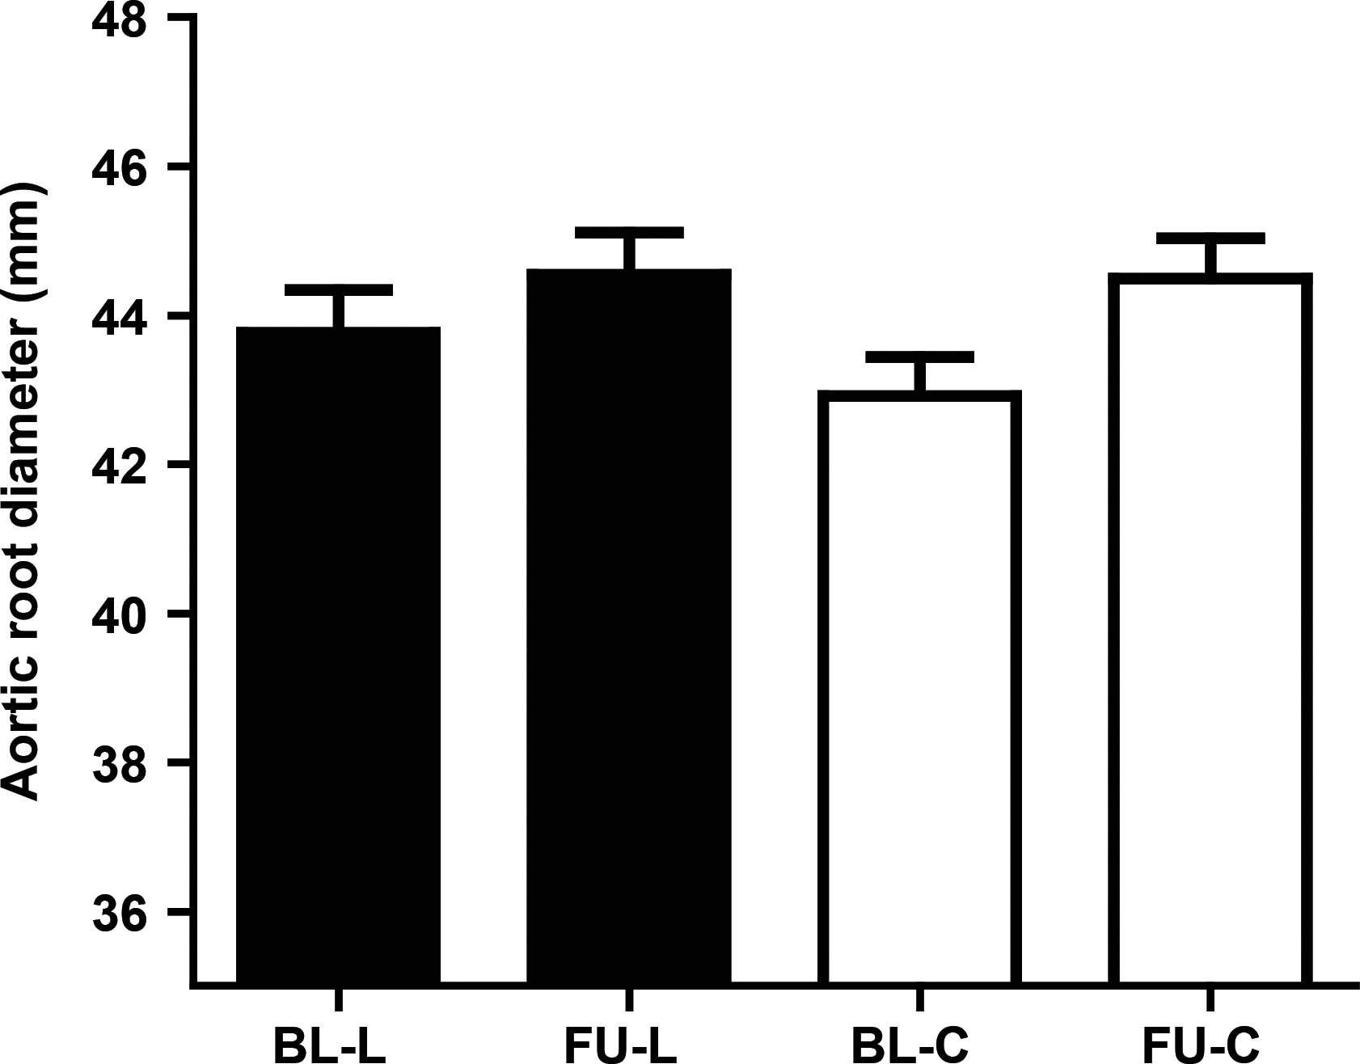
Figure 2 Aortic root dimensions at baseline and after 3 years of follow-up of both groups. BL-L denotes baseline ...
Notes:
Figure 2 Aortic root dimensions at baseline and after 3 years of follow-up of both groups. BL-L denotes baseline aortic root diameter of patients treated with losartan, FU-L denotes follow-up aortic root diameter of patients treated with losartan, BL-C denotes baseline aortic root diameter of patients without losartan therapy, FU-C denotes follow-up aortic root diameter of patients without losartan therapy. Data shown are mean ± standard error of the mean.
Unless provided in the caption above, the following copyright applies to the content of this slide: Published on behalf of the European Society of Cardiology. All rights reserved. © The Author 2013. For permissions please email: journals.permissions@oup.com

Slide 3
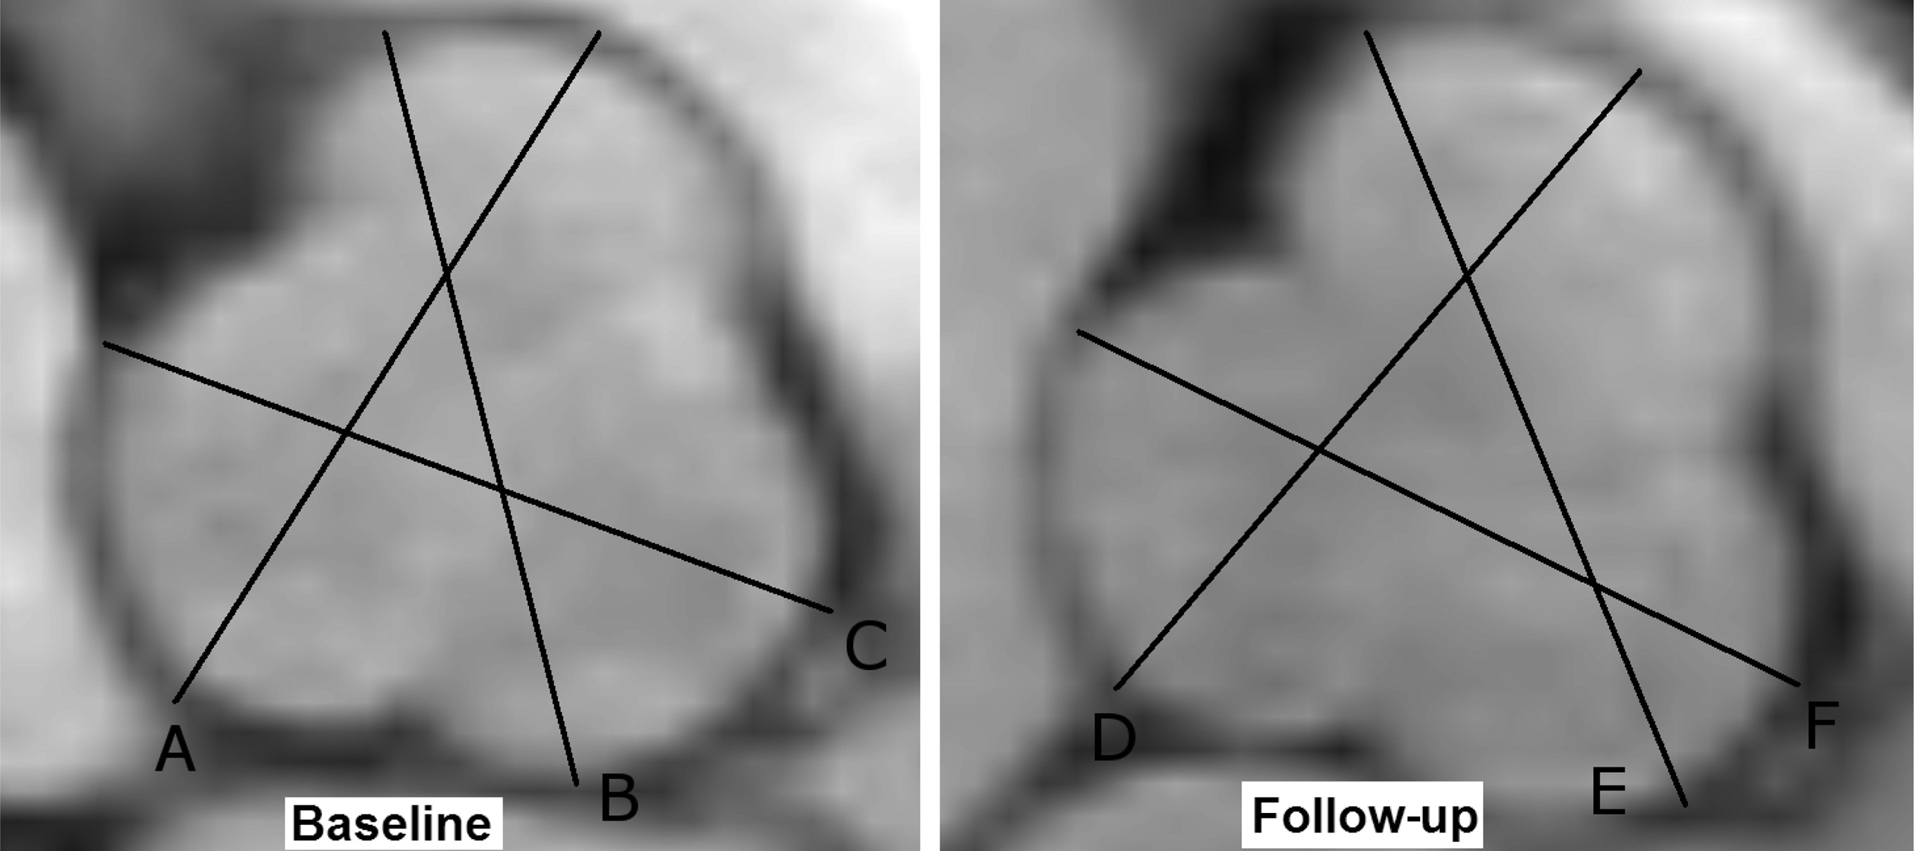
Figure 3 Magnetic resonance images showing the aortic root in short axis of a COMPARE patient with Marfan syndrome at ...
Notes:
Figure 3 Magnetic resonance images showing the aortic root in short axis of a COMPARE patient with Marfan syndrome at baseline and after 3 years of follow-up. Greatest aortic root diameter of three measured distances was used; (A and D) non coronary cusp to right coronary cusp increased from 41 to 43 mm; (B and E) right coronary cusp to left coronary cusp increased from 42 to 44 mm; (C and F) non-coronary cusp to left coronary cusp increased from 41 to 42 mm.
Unless provided in the caption above, the following copyright applies to the content of this slide: Published on behalf of the European Society of Cardiology. All rights reserved. © The Author 2013. For permissions please email: journals.permissions@oup.com

Slide 4
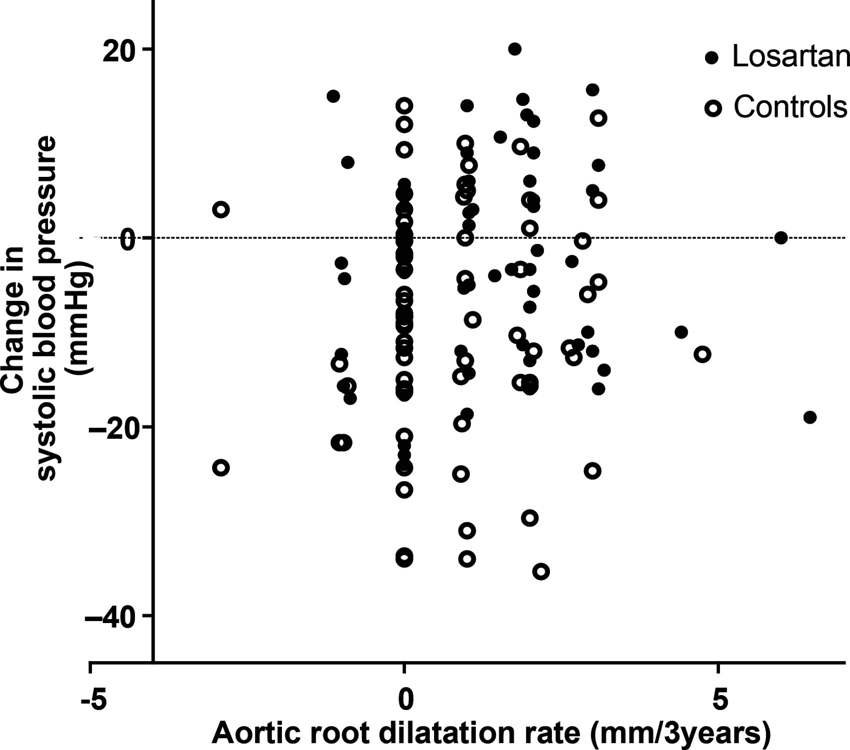
Figure 4 No correlation between systolic blood pressure change and aortic root dilatation rate in both groups. ...
Notes:
Figure 4 No correlation between systolic blood pressure change and aortic root dilatation rate in both groups. Correlation between change in systolic blood pressure and aortic root dilatation rate in patients treated with losartan (r = 0.058, P = 0.630) and in controls (r = 0.001, P = 0.993).
Unless provided in the caption above, the following copyright applies to the content of this slide: Published on behalf of the European Society of Cardiology. All rights reserved. © The Author 2013. For permissions please email: journals.permissions@oup.com

Slide 5
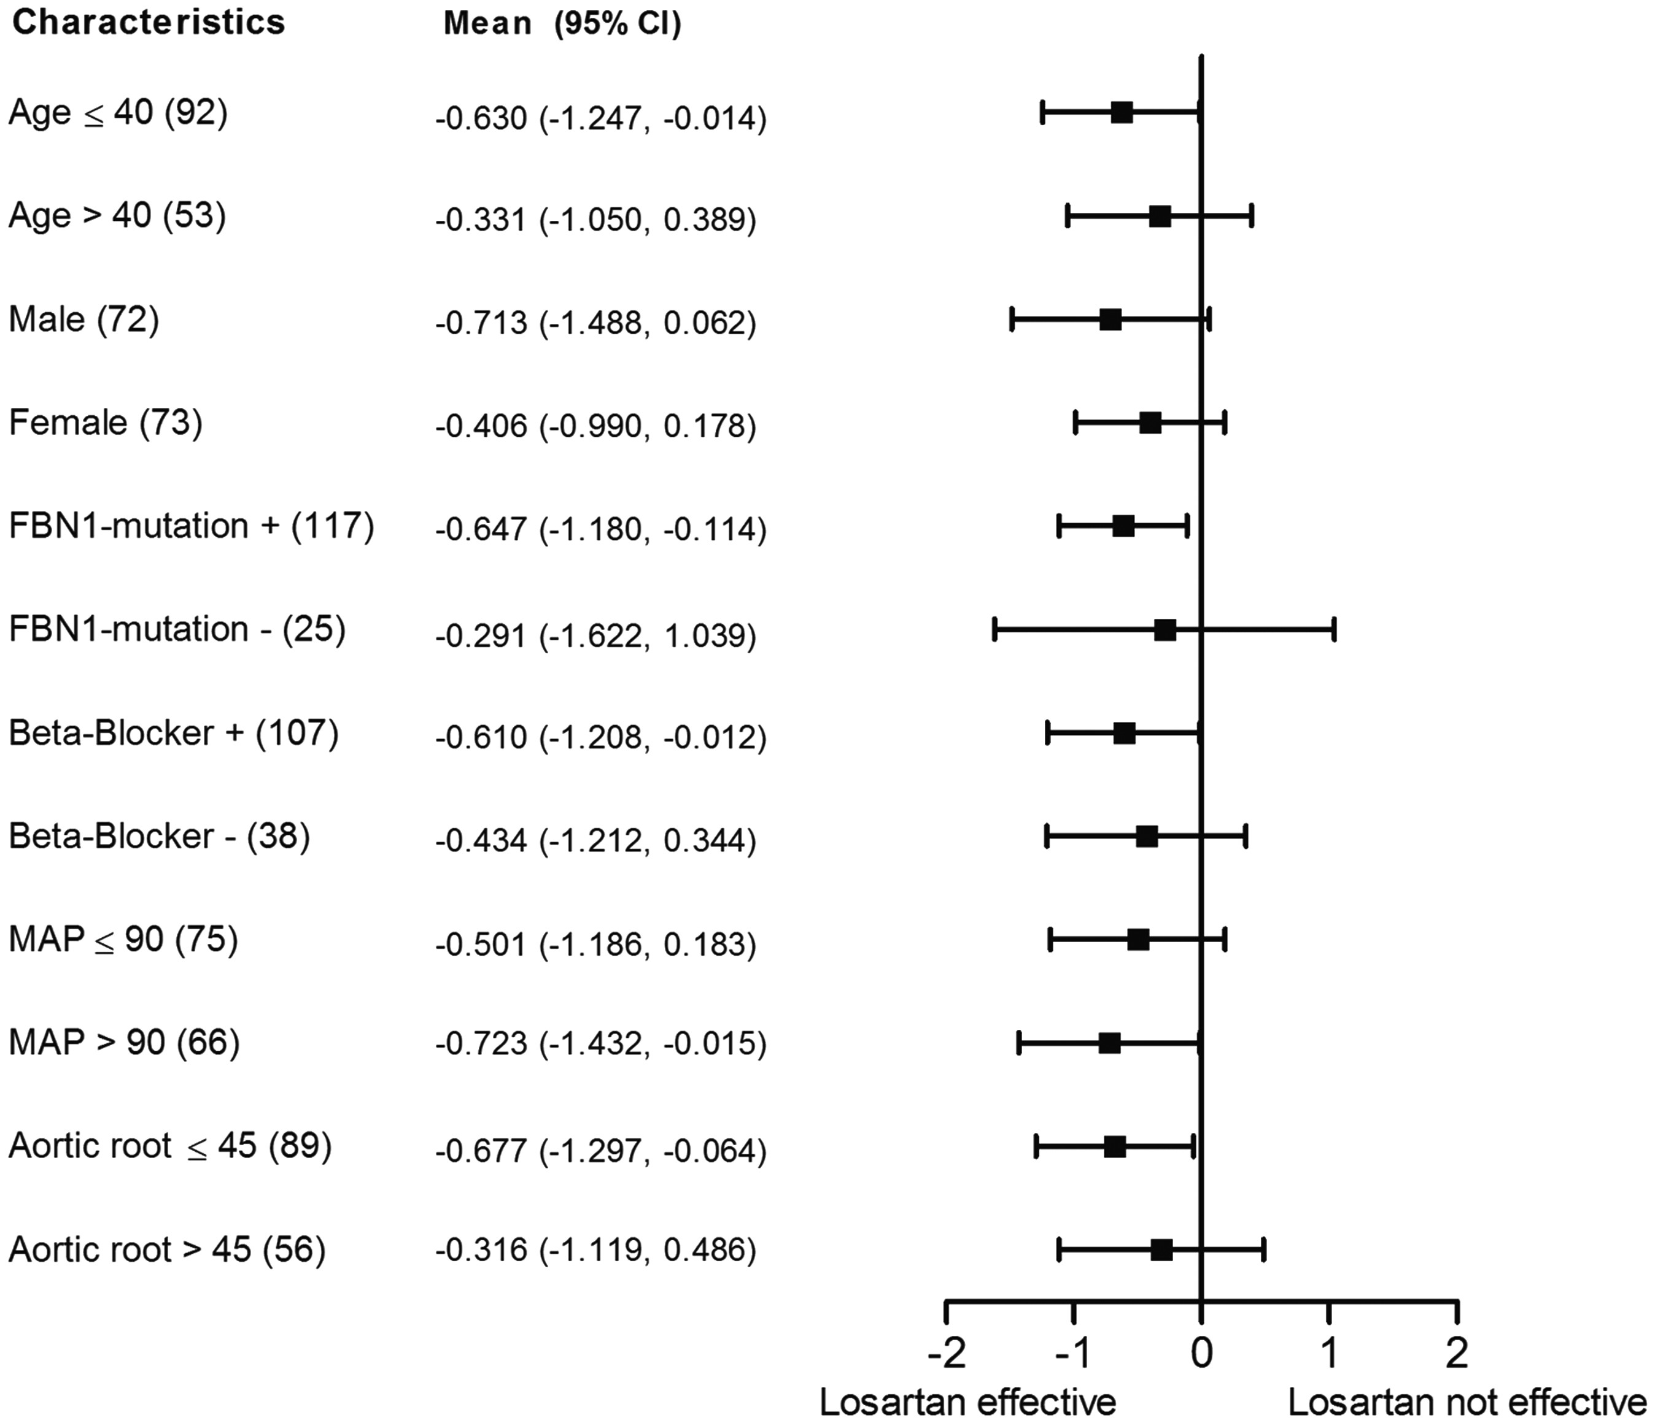
Figure 5 Effect of losartan treatment on aortic root dilatation rate in subgroups of Marfan patients. Among subgroups ...
Notes:
Figure 5 Effect of losartan treatment on aortic root dilatation rate in subgroups of Marfan patients. Among subgroups of patients, the mean differences in aortic root dilatation rate between losartan treated patients and control patients are indicated by solid squares. Horizontal lines represent 95% confidence intervals (95% CI). (n) denotes number of patients in subgroup-analysis, MAP (mean arterial pressure, mmHg), aortic root is presented in mm, age is presented in years.
Unless provided in the caption above, the following copyright applies to the content of this slide: Published on behalf of the European Society of Cardiology. All rights reserved. © The Author 2013. For permissions please email: journals.permissions@oup.com

