Slide 1
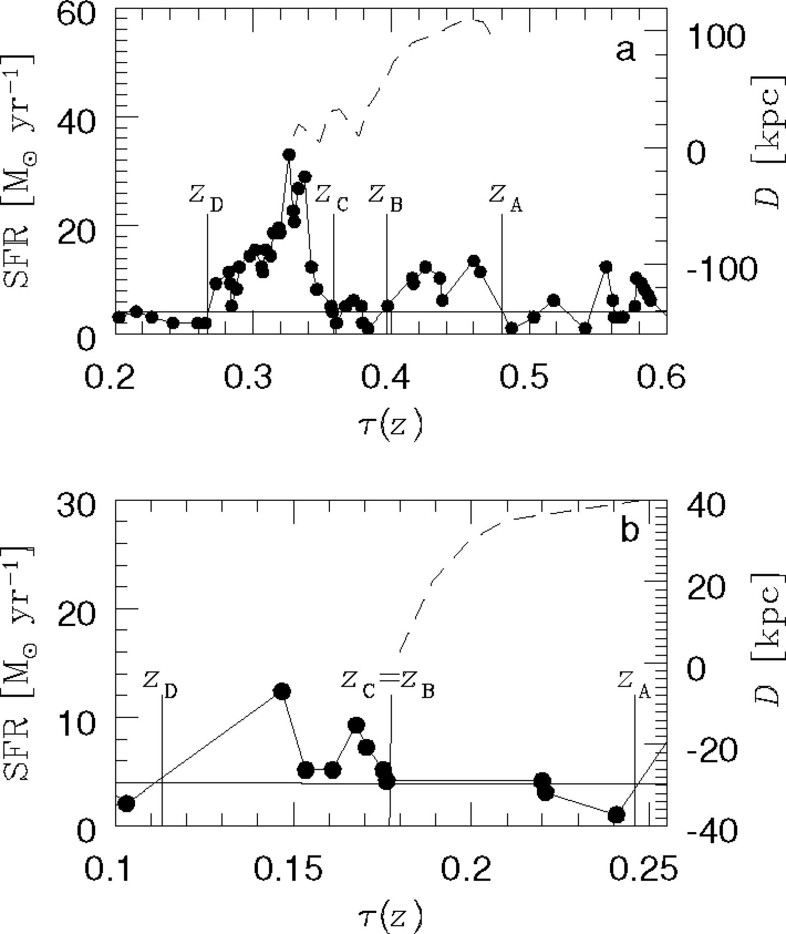
Figure 1 Star formation rate for typical galaxy-like objects during a double starburst (a) and a single one (b) as a ...
Notes:
Figure 1 Star formation rate for typical galaxy-like objects during a double starburst (a) and a single one (b) as a function of look-back time [τ(z)]. The solid lines represent the ambient star formation components and the dashed lines depict the distance between the mass centres of the progenitors and satellites (D). The four redshifts of interest during a merger event have also been plotted.
Unless provided in the caption above, the following copyright applies to the content of this slide: © © 2003 RAS 2003

Slide 2
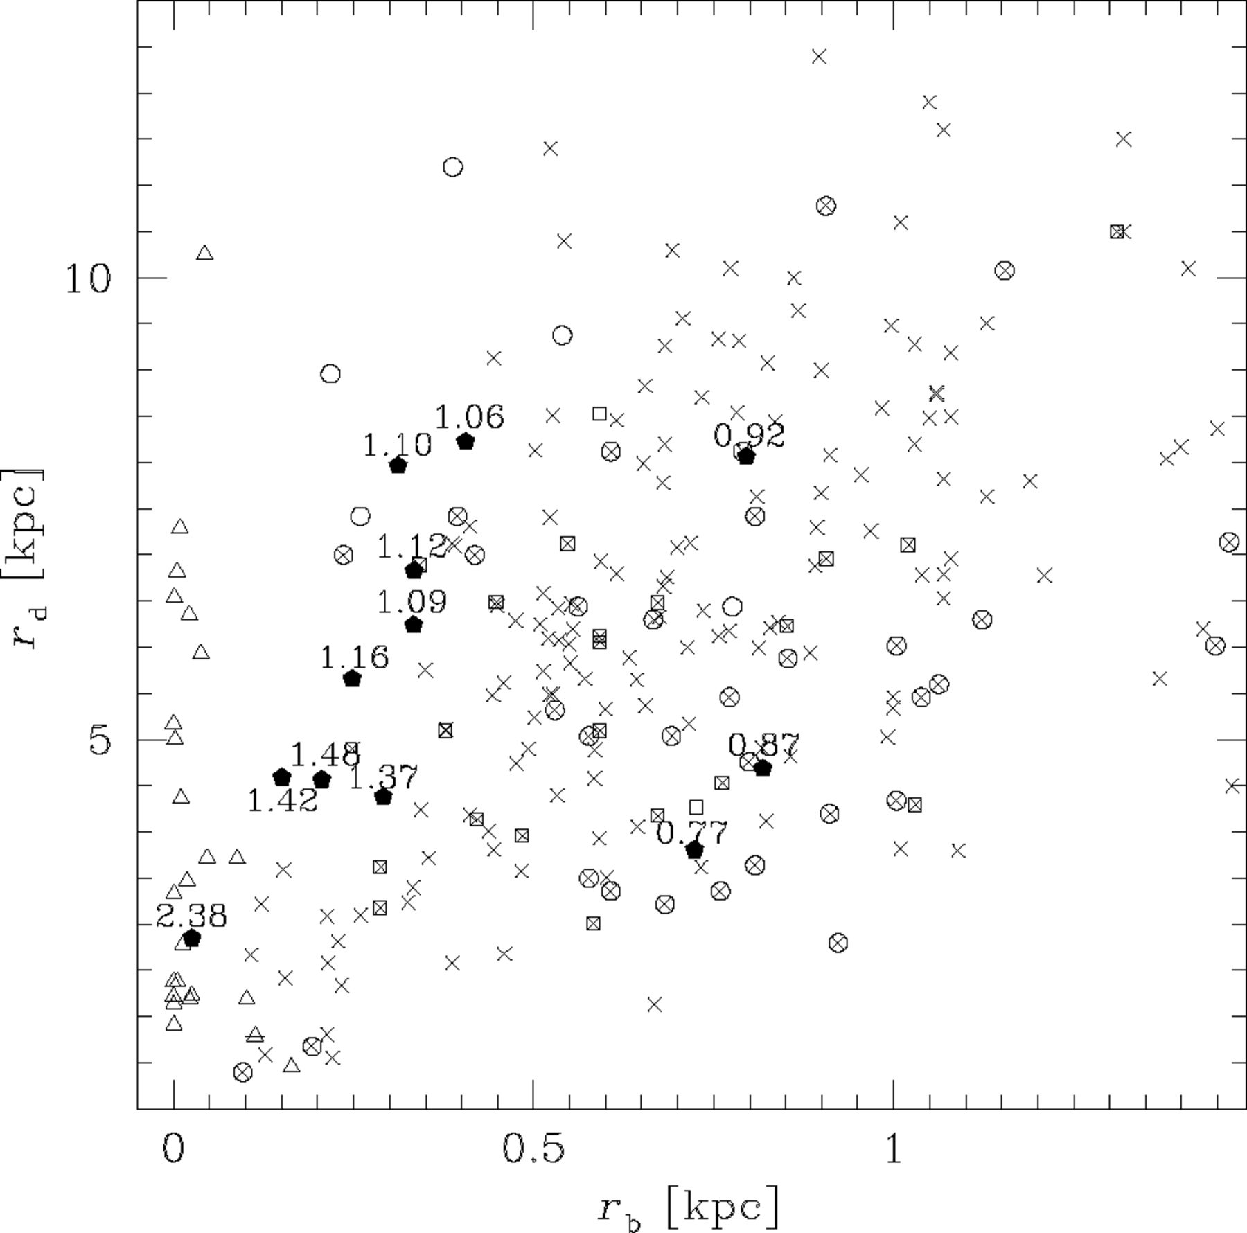
Figure 2 Disc scalelength (r_{d}) as a function of bulge scalelength (r_{b}) for simulated objects at ...
Notes:
Figure 2 Disc scalelength (rd) as a function of bulge scalelength (rb) for simulated objects at z= 0 (filled pentagons). Labels with the shape parameters (n) of the simulated bulges are shown. Observational data from CdJB96 (crosses), MGH99 (n= 1 crossed squares, n= 2: open squares), KWK00 (n⩽ 1.5: dashed triangles, n > 1.5: open triangles) and MCH02 (n⩽ 1.5: crossed circles, n > 1.5: open circles) are also included.
Unless provided in the caption above, the following copyright applies to the content of this slide: © © 2003 RAS 2003

Slide 3
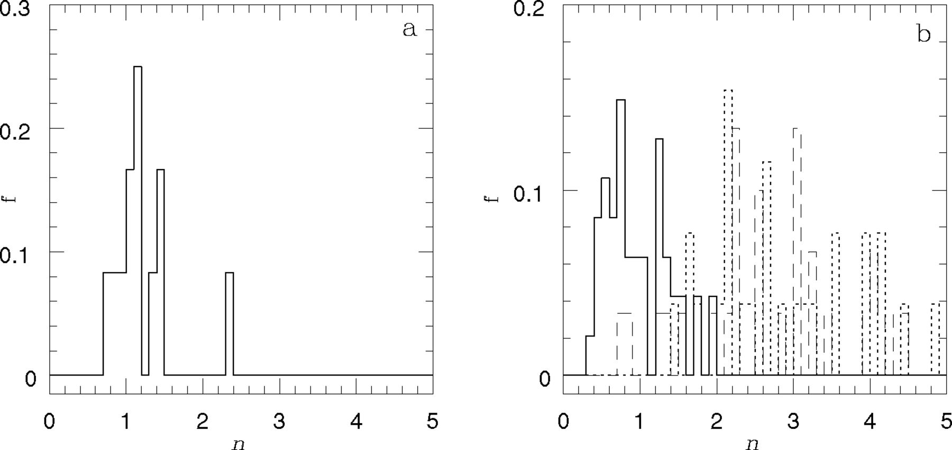
Figure 3 Histogram of the shape parameter of the bulges for simulated objects at z= 0 (a) and observations from APB95 ...
Notes:
Figure 3 Histogram of the shape parameter of the bulges for simulated objects at z= 0 (a) and observations from APB95 (dashed line), KWK00 (dotted line) and MCH02 (solid line), normalized to the total number of galaxies in each sample.
Unless provided in the caption above, the following copyright applies to the content of this slide: © © 2003 RAS 2003

Slide 4
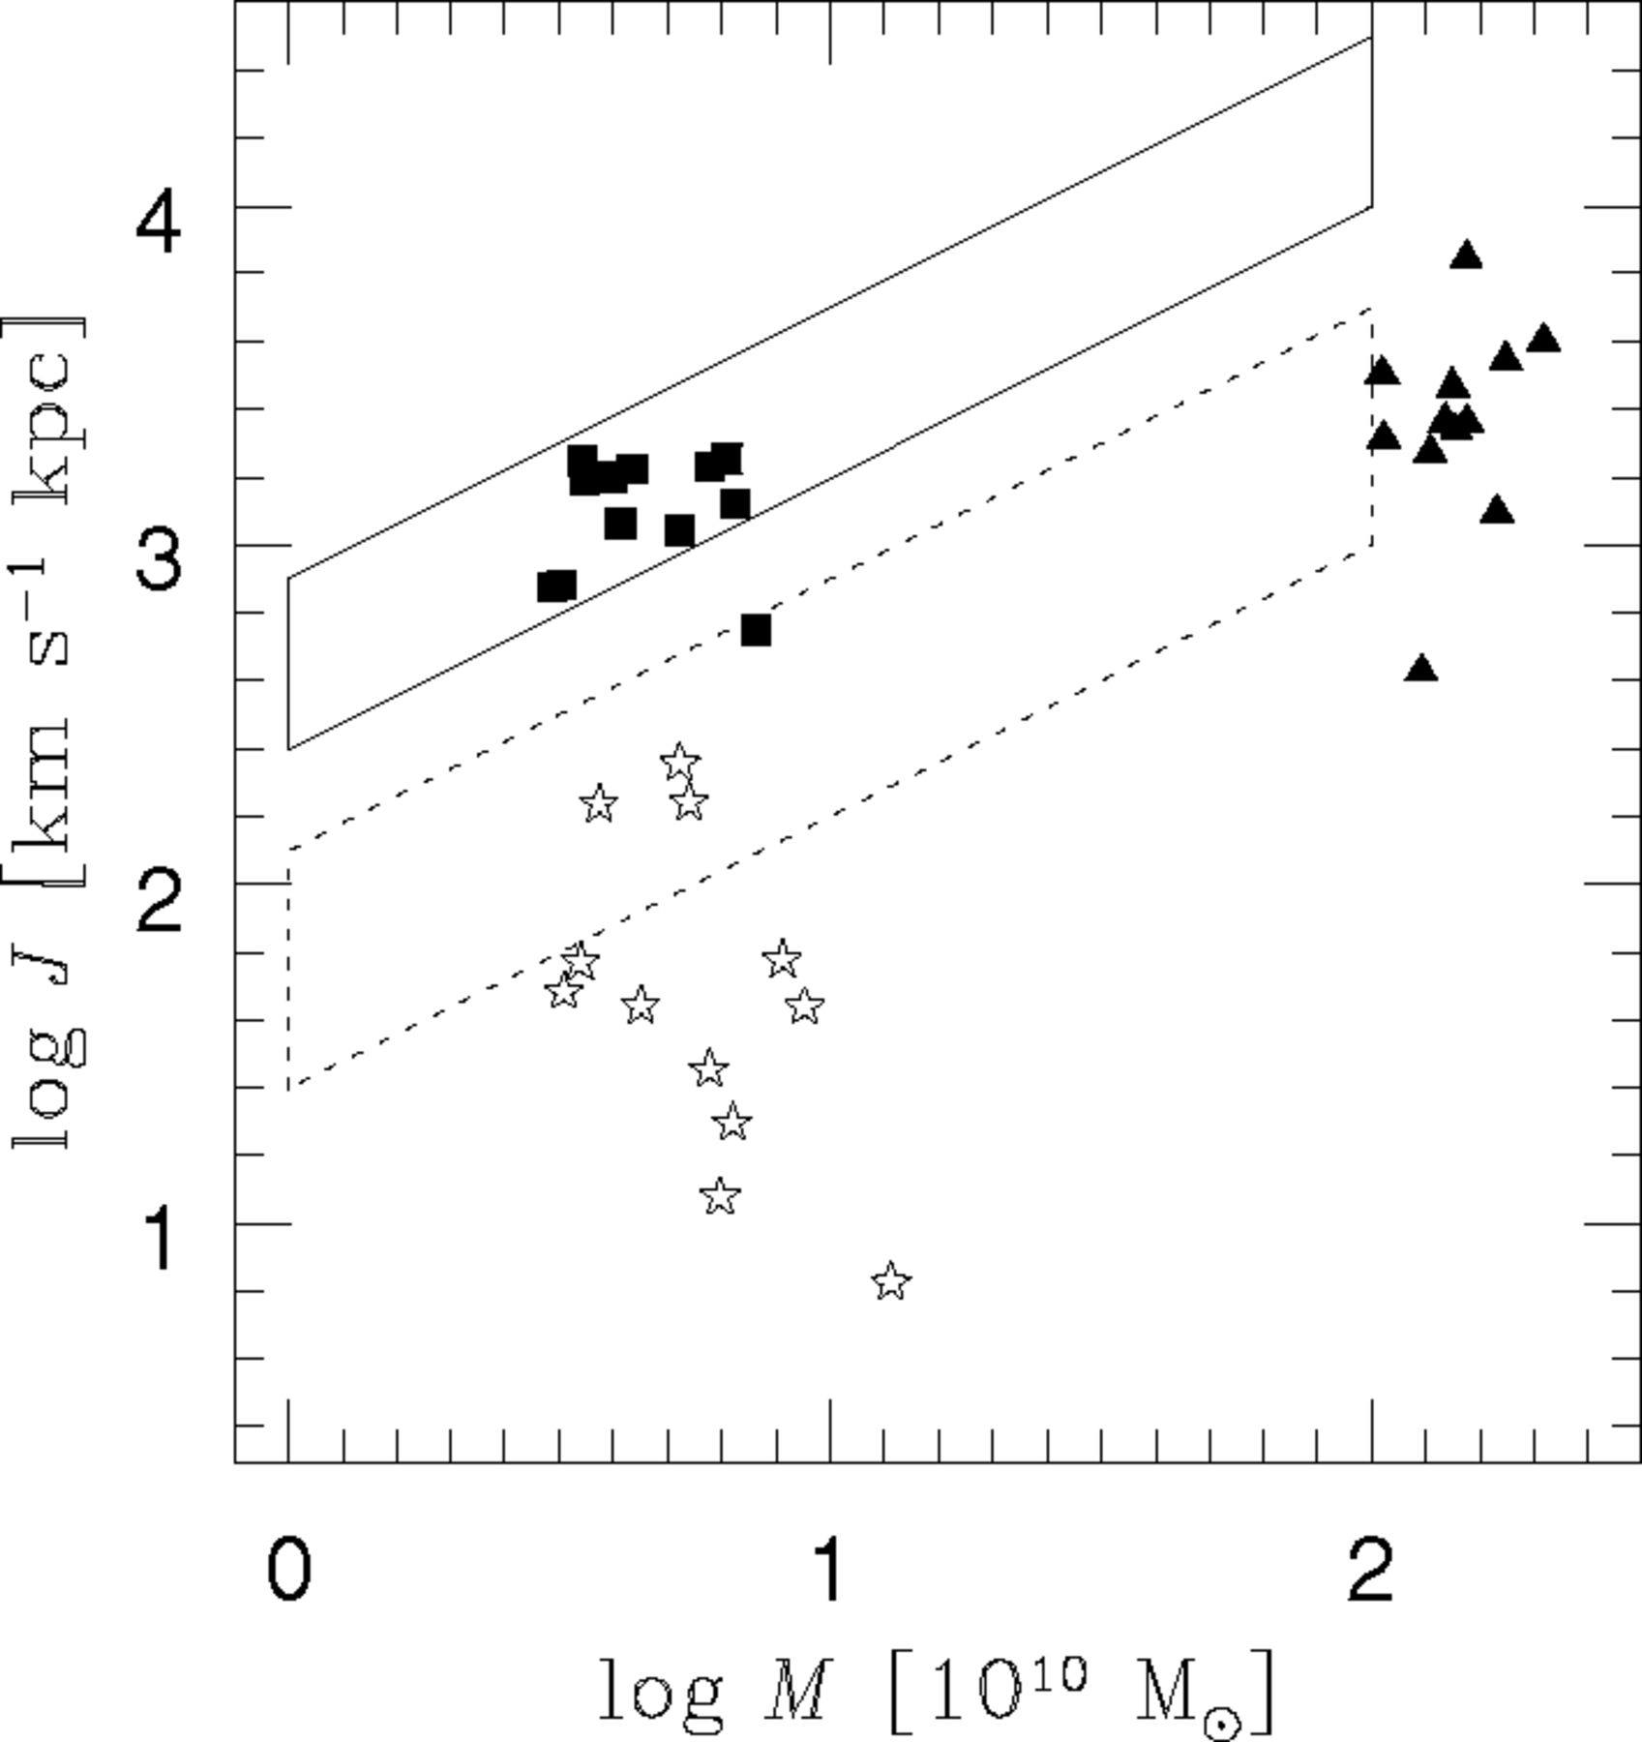
Figure 4 Specific angular momentum (J) for the gaseous discs at 3.2r_{d} (filled squares), the stellar bulges ...
Notes:
Figure 4 Specific angular momentum (J) for the gaseous discs at 3.2rd (filled squares), the stellar bulges at reff (open stars) and dark matter haloes at the virial radius (filled triangles), as a function of mass (M). The solid (dotted) box depicts the observational area for spirals (ellipticals) from Fall (1983).
Unless provided in the caption above, the following copyright applies to the content of this slide: © © 2003 RAS 2003

Slide 5
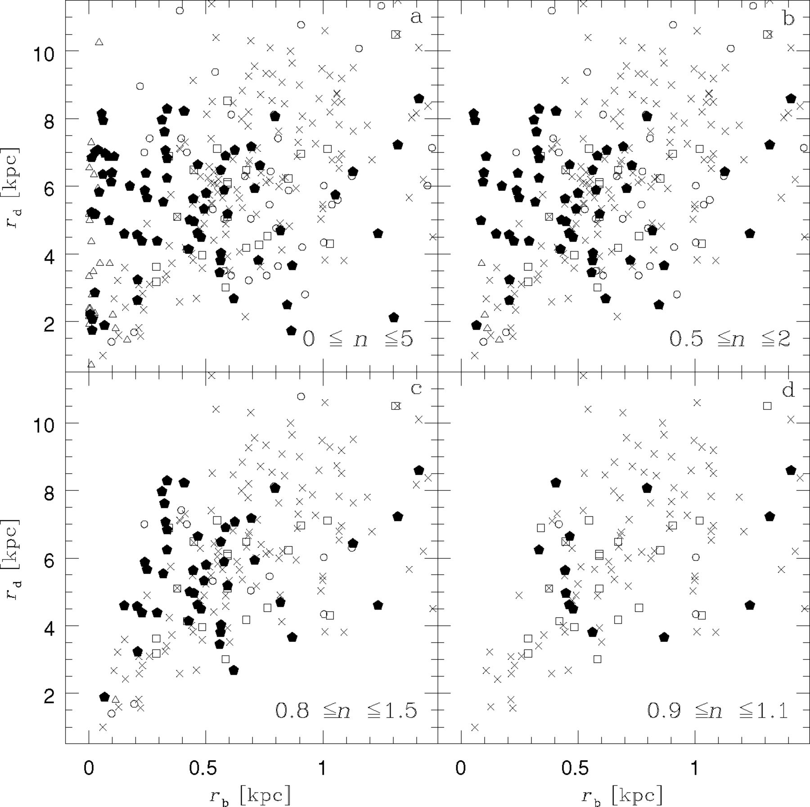
Figure 5 Disc scalelength (r_{d}) as a function of bulge scalelength (r_{b}) for simulated objects at ...
Notes:
Figure 5 Disc scalelength (rd) as a function of bulge scalelength (rb) for simulated objects at z= 0 and progenitors (filled pentagons) for which bulges are described by 0 ⩽n⩽ 5 (a), 0.5 ⩽n⩽ 2 (b), 0.8 ⩽n⩽ 1.5 (c) and 0.9 ⩽n⩽ 1.1 (d). Observational data from CdJB96 (crosses), MGH99 (open squares), KWK00 (open triangles) and MCH02 (open circles) for the same shape parameter intervals are also shown.
Unless provided in the caption above, the following copyright applies to the content of this slide: © © 2003 RAS 2003

Slide 6
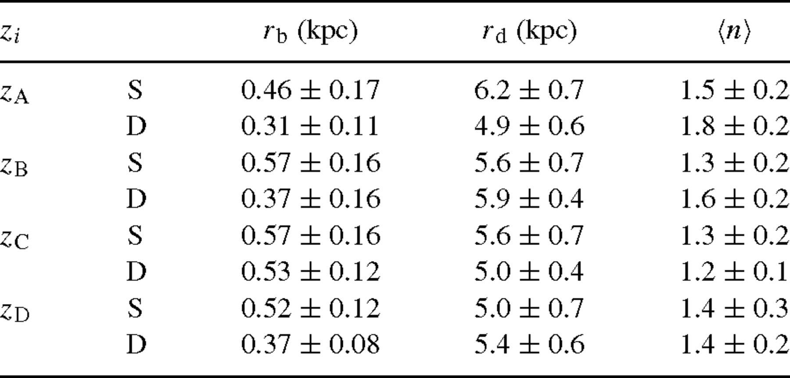
Table 1 Mean values of bulge scalelength (r_{b}), disc scalelength (r_{d}) and bulge shape parameter ...
Notes:
Table 1 Mean values of bulge scalelength (rb), disc scalelength (rd) and bulge shape parameter 〈n〉 for single (S) and double (D) SBs for the redshifts of interest.
Unless provided in the caption above, the following copyright applies to the content of this slide: © © 2003 RAS 2003

Slide 7
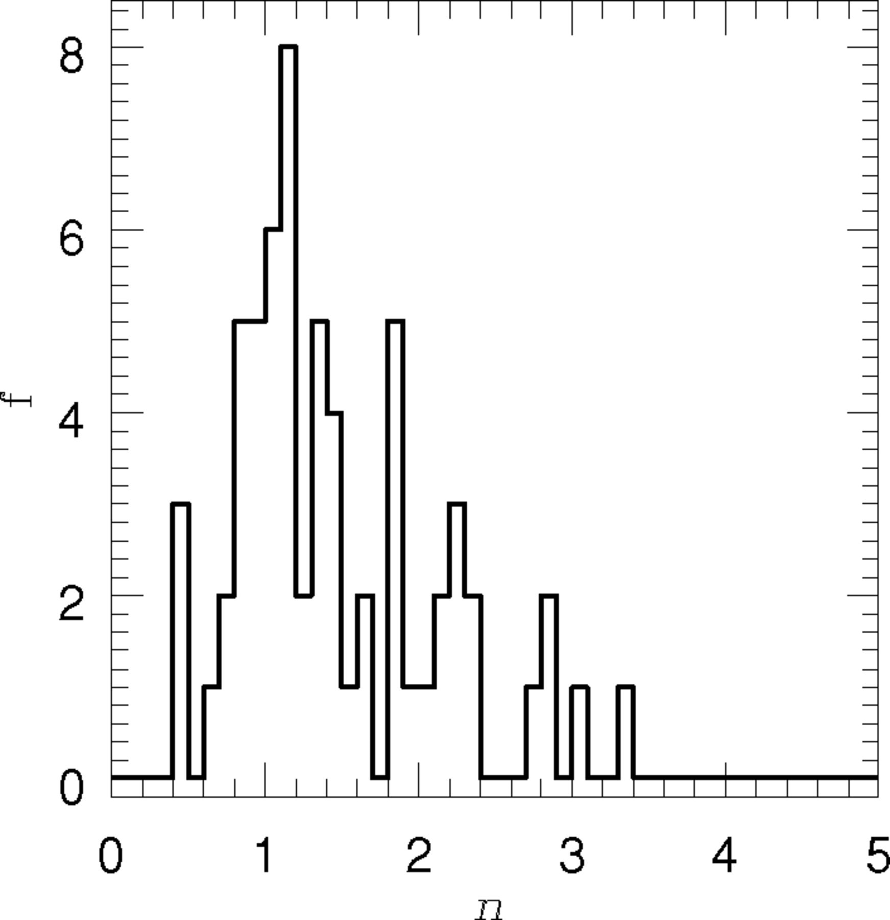
Figure 6 Total distribution of bulge shape parameters for the progenitors during merger events.
Notes:
Figure 6 Total distribution of bulge shape parameters for the progenitors during merger events.
Unless provided in the caption above, the following copyright applies to the content of this slide: © © 2003 RAS 2003

Slide 8
Table 2 Percentage of objects that increase (↑n)/decrease (↓n) their shape parameter during the ODP ...
Notes:
Table 2 Percentage of objects that increase (↑n)/decrease (↓n) their shape parameter during the ODP (zA—zC), the fusion of the baryonic clumps (zC—zD) and the whole merger process (zC—zD), for single (S) and double (D) starbursts.
Unless provided in the caption above, the following copyright applies to the content of this slide: © © 2003 RAS 2003

Slide 9
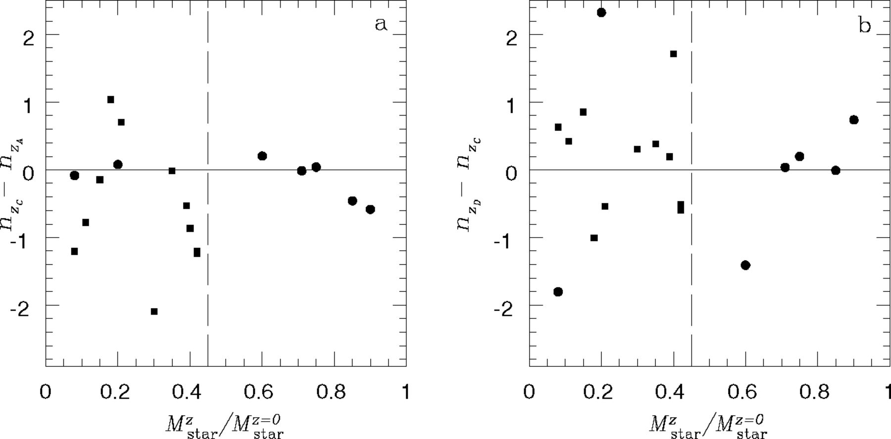
Figure 7 Variations in the shape parameter of the progenitors during the orbital decay phase (a) and during the fusion ...
Notes:
Figure 7 Variations in the shape parameter of the progenitors during the orbital decay phase (a) and during the fusion of the baryonic clumps (b) in single (filled circles) and double (filled squares) SBs, as a function of the fraction of stars already formed in the progenitors, Mstarz/Mstarz=0 when the mergers start. Mstarz/Mstarz=0= 0.45 (dashed lines) has been taken to be an indicator of the presence of a well-formed stellar bulge after T02.
Unless provided in the caption above, the following copyright applies to the content of this slide: © © 2003 RAS 2003

Slide 10
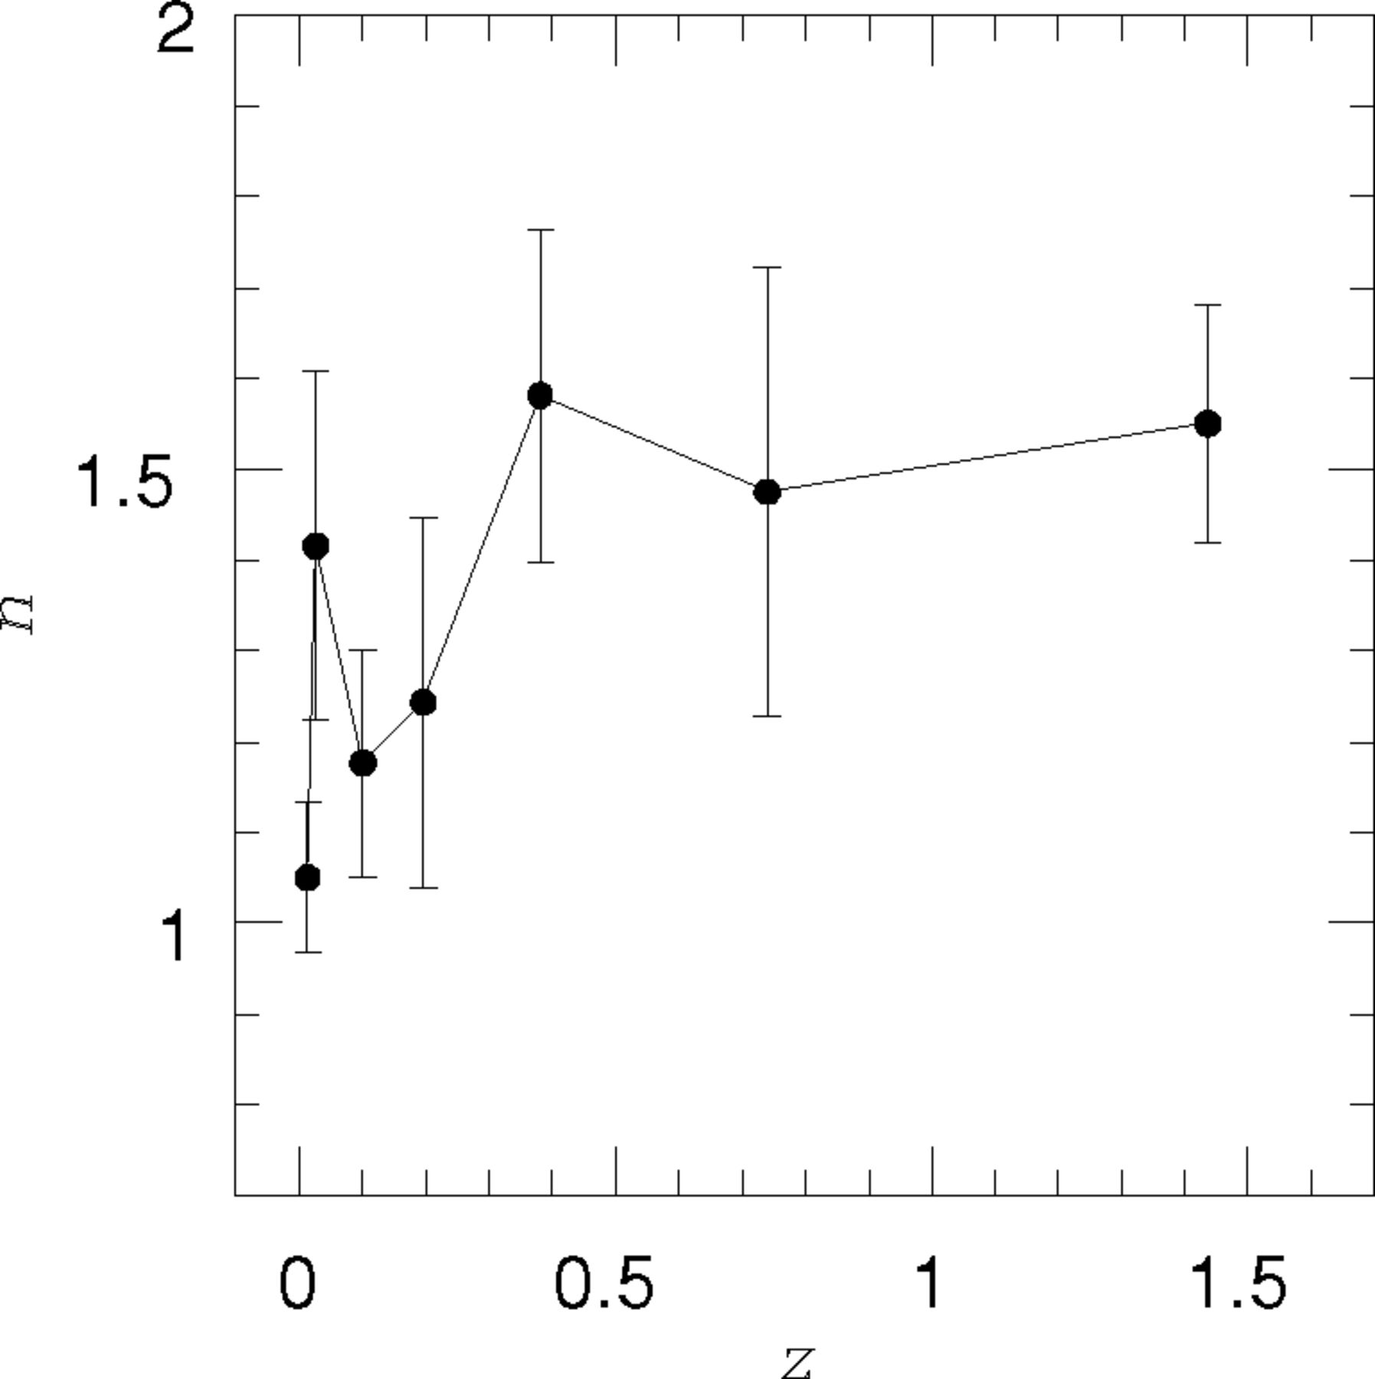
Figure 8 Average n parameters of the progenitors at different z intervals and of the GLOs at z= 0. The error bars ...
Notes:
Figure 8 Average n parameters of the progenitors at different z intervals and of the GLOs at z= 0. The error bars correspond to the bootstrap method.
Unless provided in the caption above, the following copyright applies to the content of this slide: © © 2003 RAS 2003

Slide 11
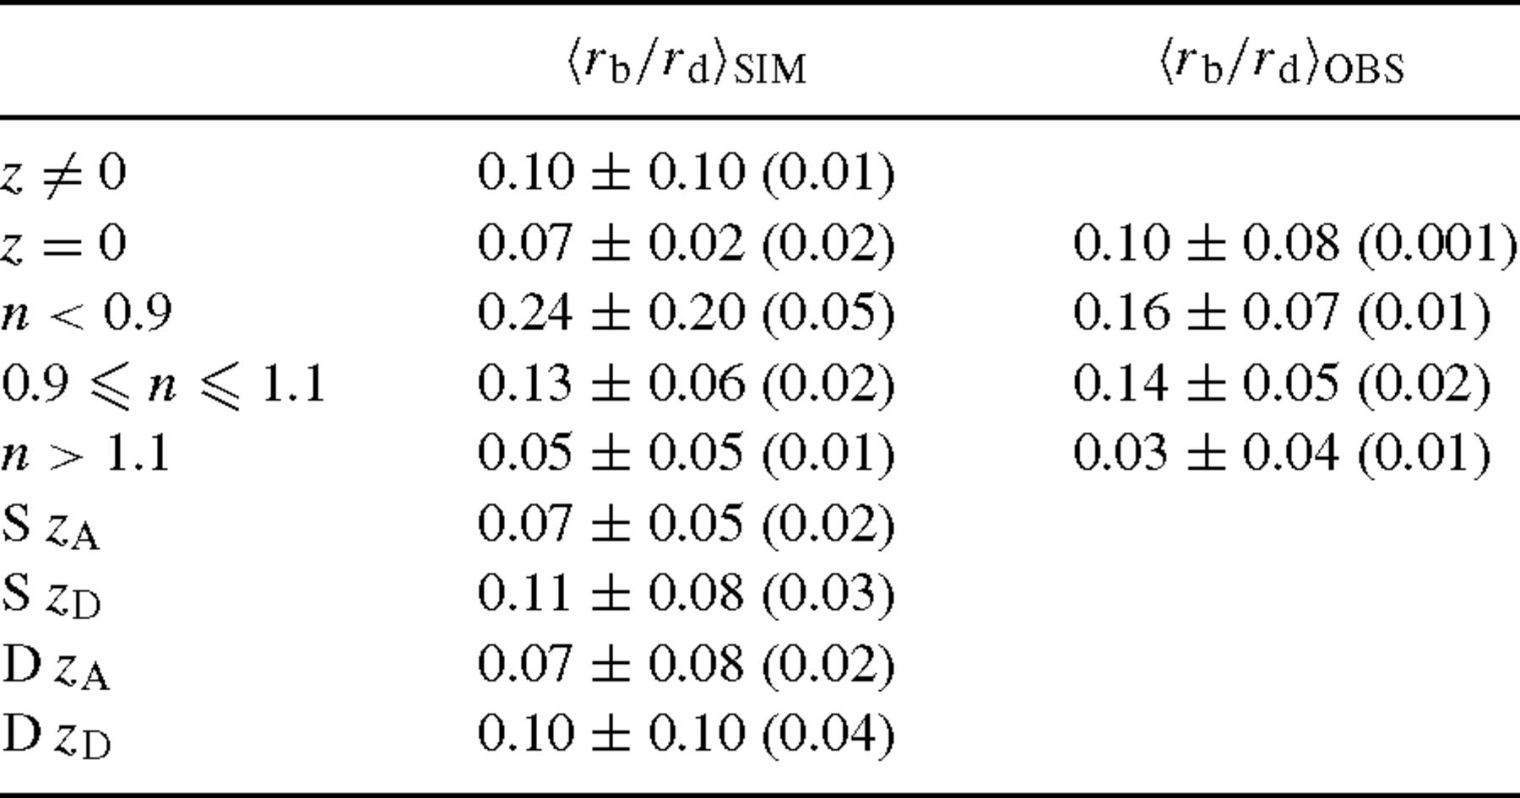
Table 3 Mean values of the ratio between bulge and disc scalelengths for simulations (SIM) and observations (OBS) for ...
Notes:
Table 3 Mean values of the ratio between bulge and disc scalelengths for simulations (SIM) and observations (OBS) for different cases. S and D denotes single and double SBs, respectively. The bootstrap errors are shown in brackets.
Unless provided in the caption above, the following copyright applies to the content of this slide: © © 2003 RAS 2003

Slide 12
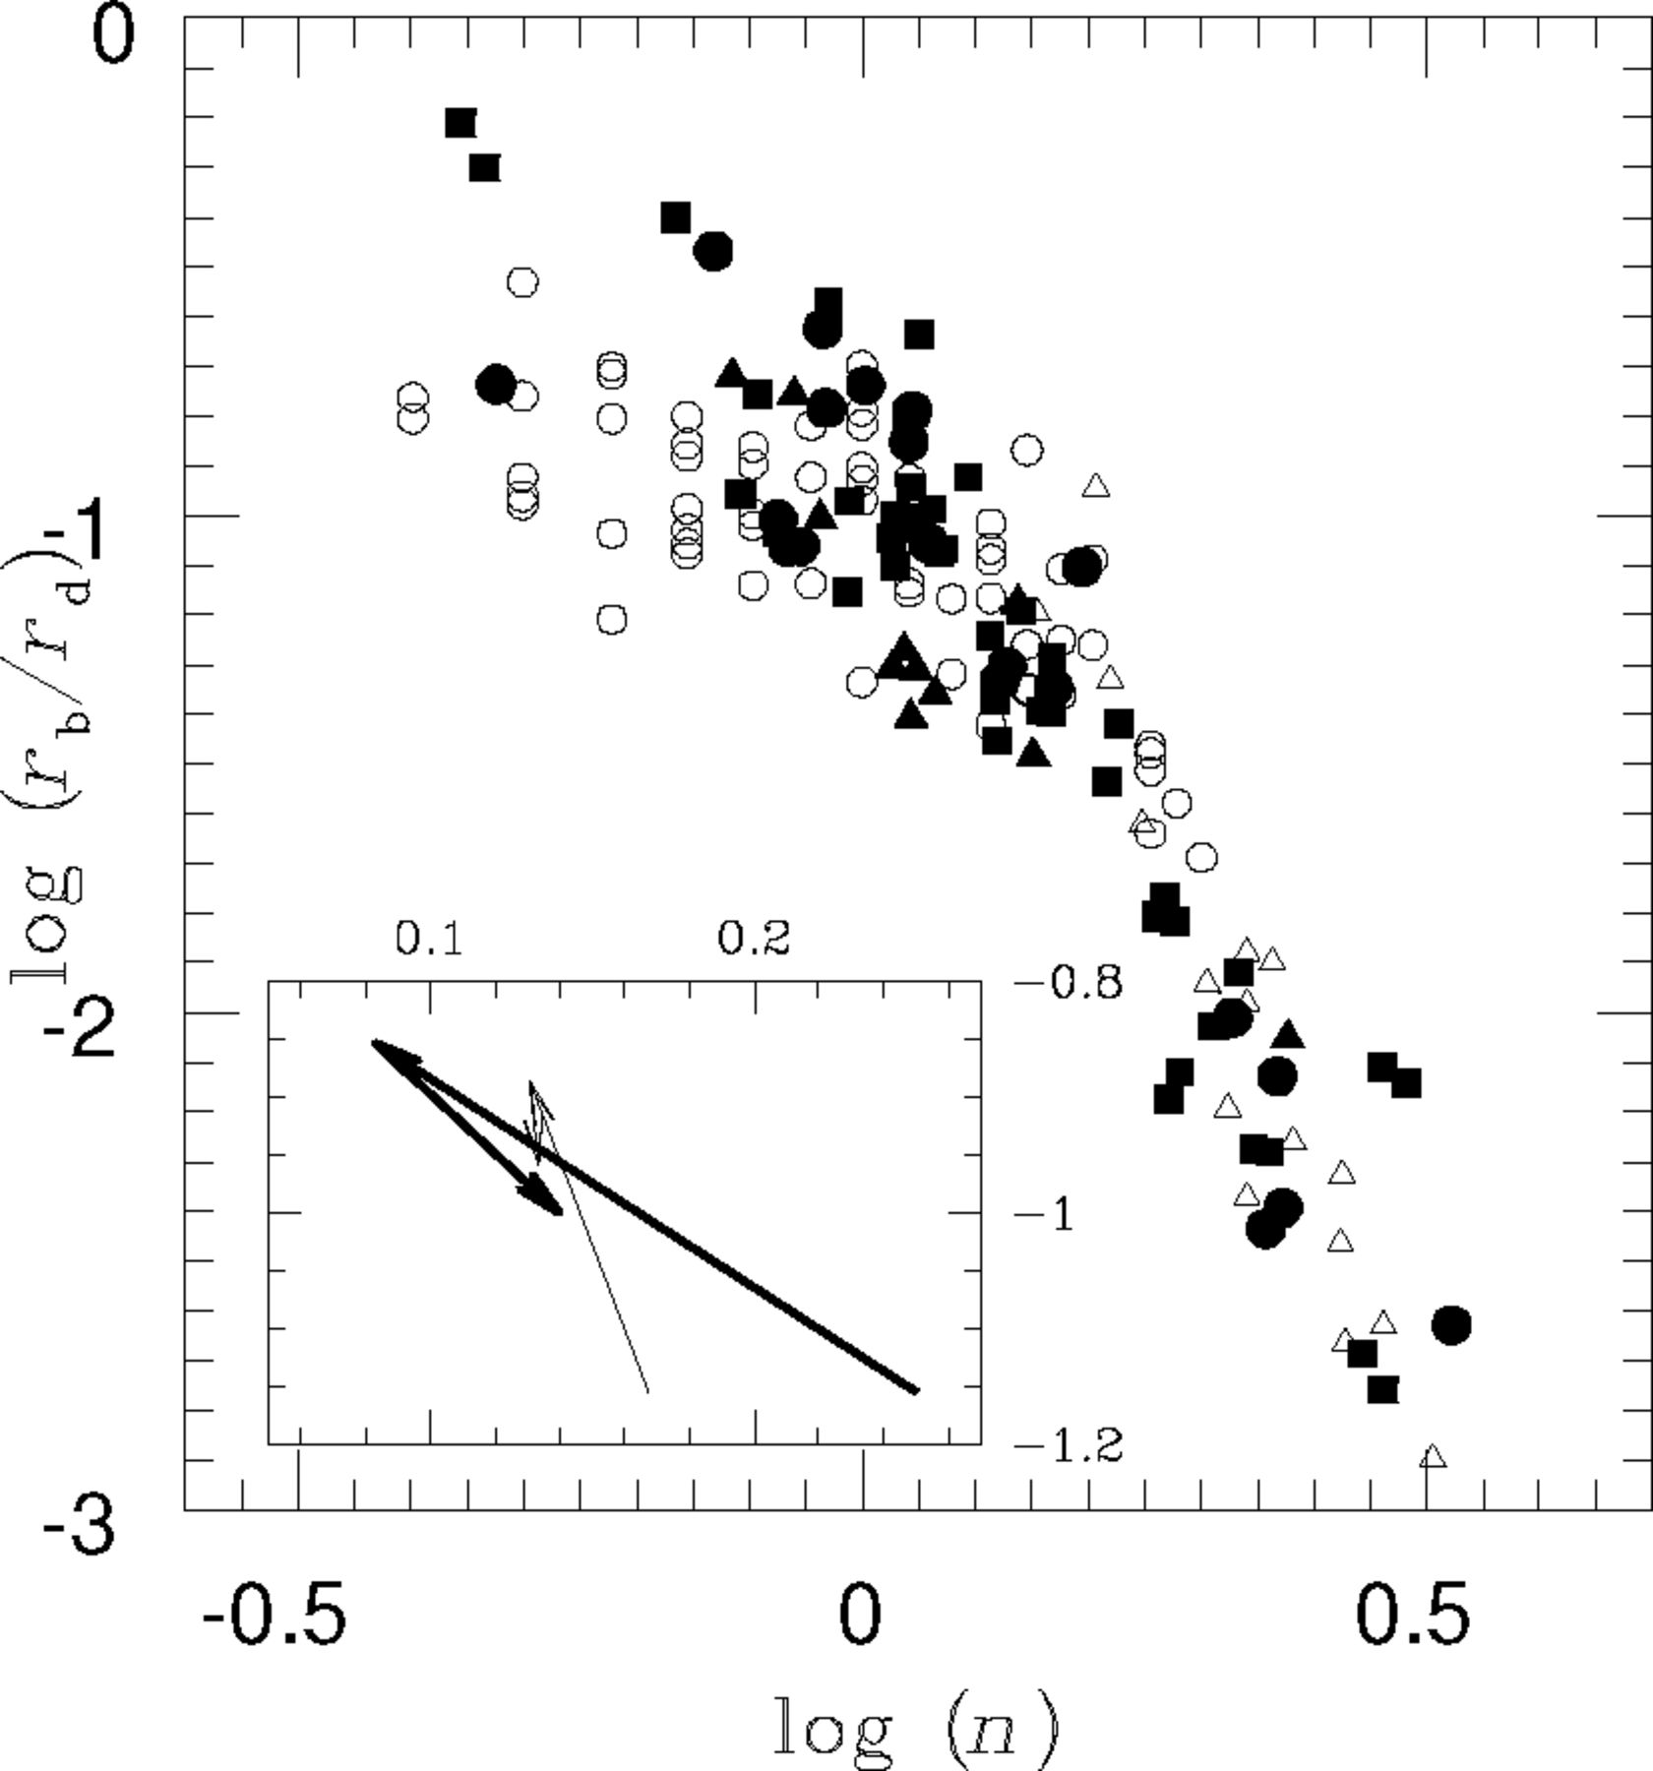
Figure 9 Ratio between the bulge and the disc scalelengths as a function of the bulge shape parameter for simulated ...
Notes:
Figure 9 Ratio between the bulge and the disc scalelengths as a function of the bulge shape parameter for simulated objects at z= 0 (filled triangles), single SBs (filled circles) and double ones (filled squares). Observational data from KWK00 (open triangles) and MCH02 (open circles) are also shown. The minor box shows the changes of the plotted parameters for single (thin line) and double (thick line) SBs during the orbital decay phase (first arrow) and the fusion of the baryonic clumps (second arrow).
Unless provided in the caption above, the following copyright applies to the content of this slide: © © 2003 RAS 2003

Slide 13
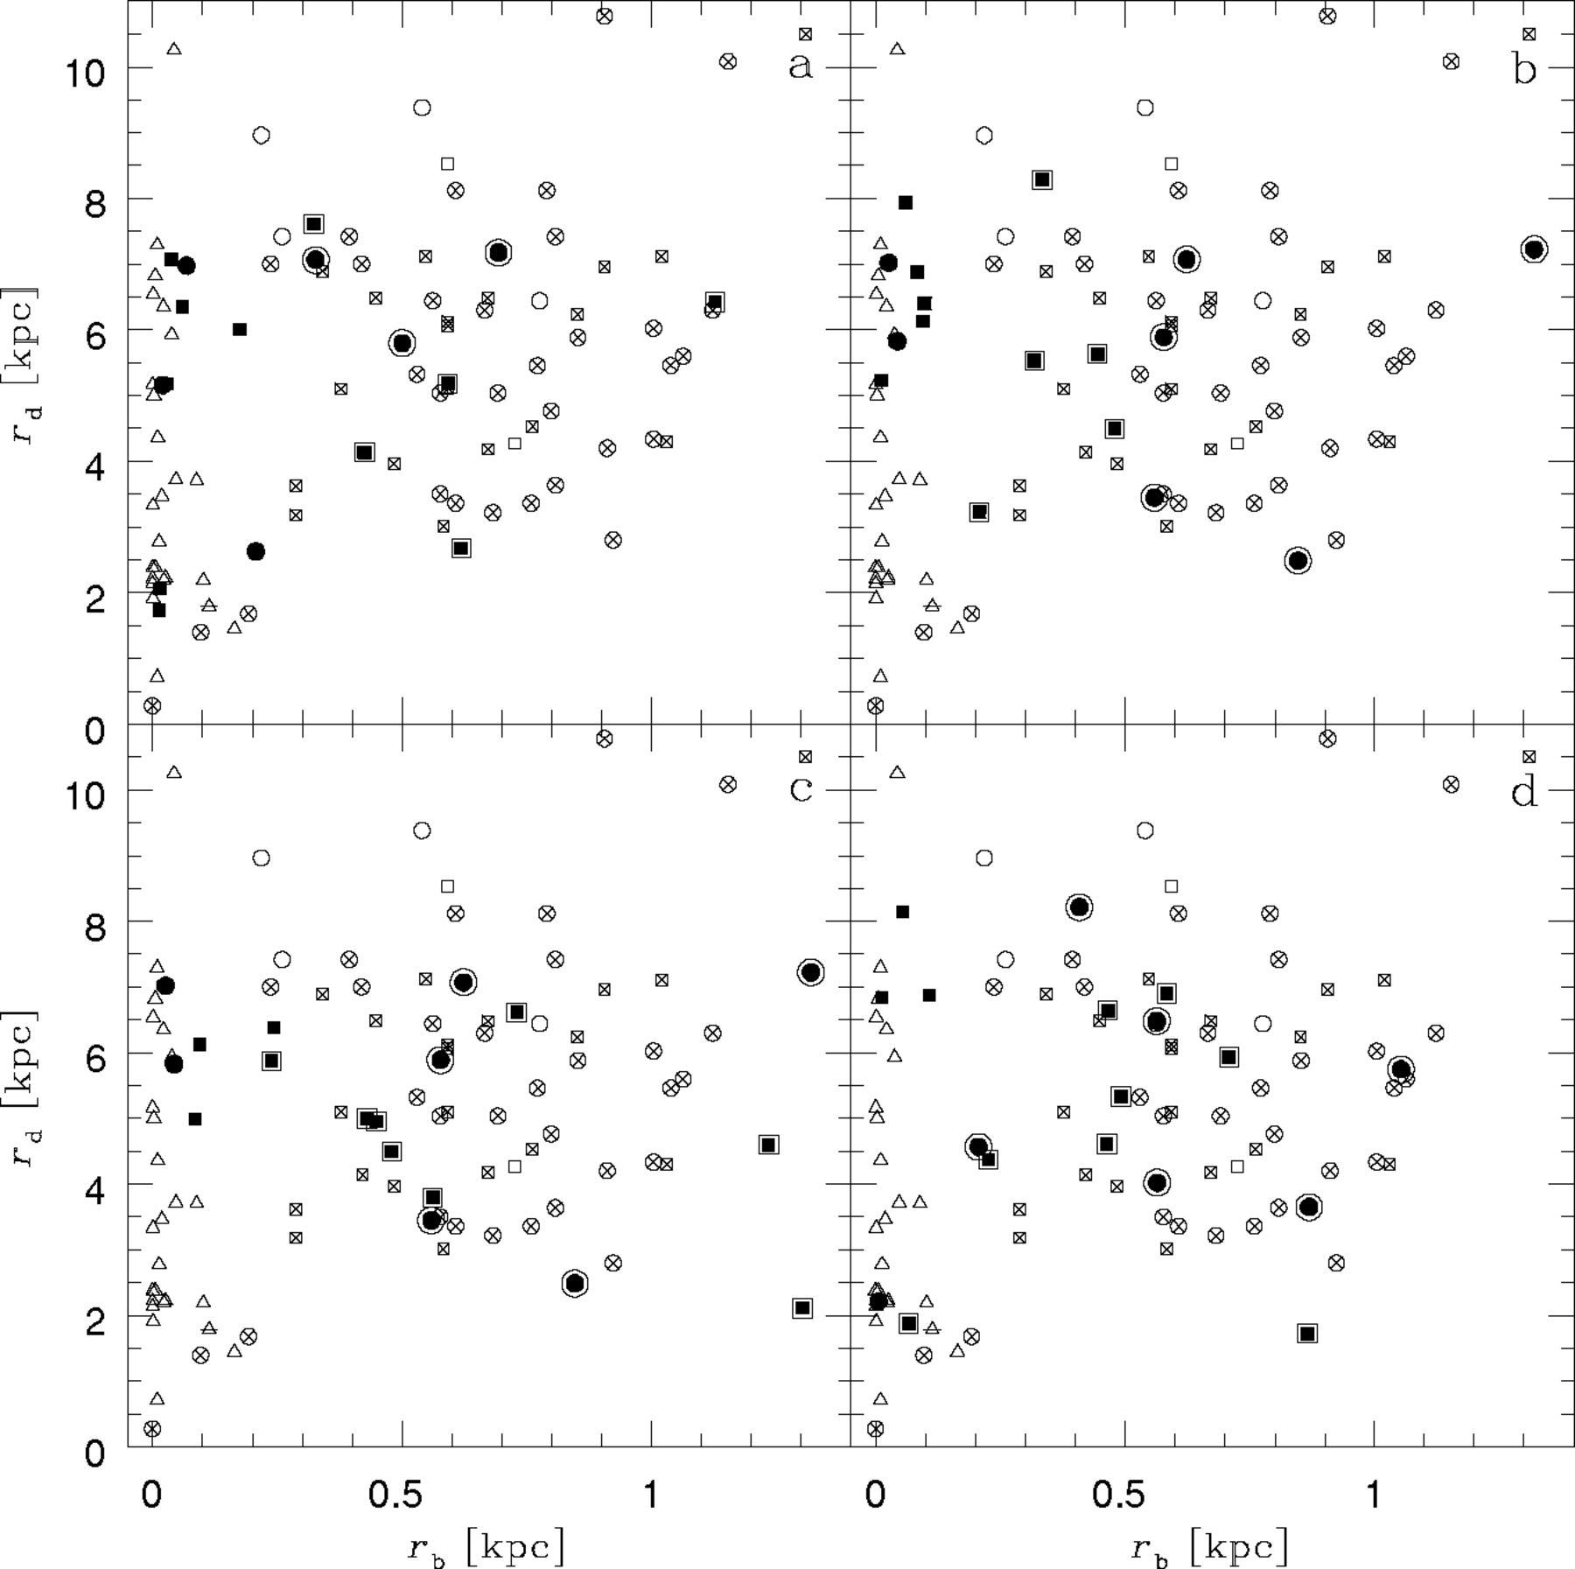
Figure 10 Distribution of bulge and disc scalelengths for the simulated galactic objects at z_{A} (a), ...
Notes:
Figure 10 Distribution of bulge and disc scalelengths for the simulated galactic objects at zA (a), zB (b), zC (c) and zD (d). Different symbols have been used to distinguish between n⩽ 1.5 (encircled symbols) and n > 1.5, and between double (filled squares) and single (filled circles) starbursts. Observational data from MGH99 (n= 1 crossed squares, n= 2: open squares), KWK00 (n⩽ 1.5: crossed-triangles, n > 1.5: open triangles) and MCH02 (n⩽ 1.5: crossed-circles, n > 1.5: open circles) are also shown.
Unless provided in the caption above, the following copyright applies to the content of this slide: © © 2003 RAS 2003

Slide 14
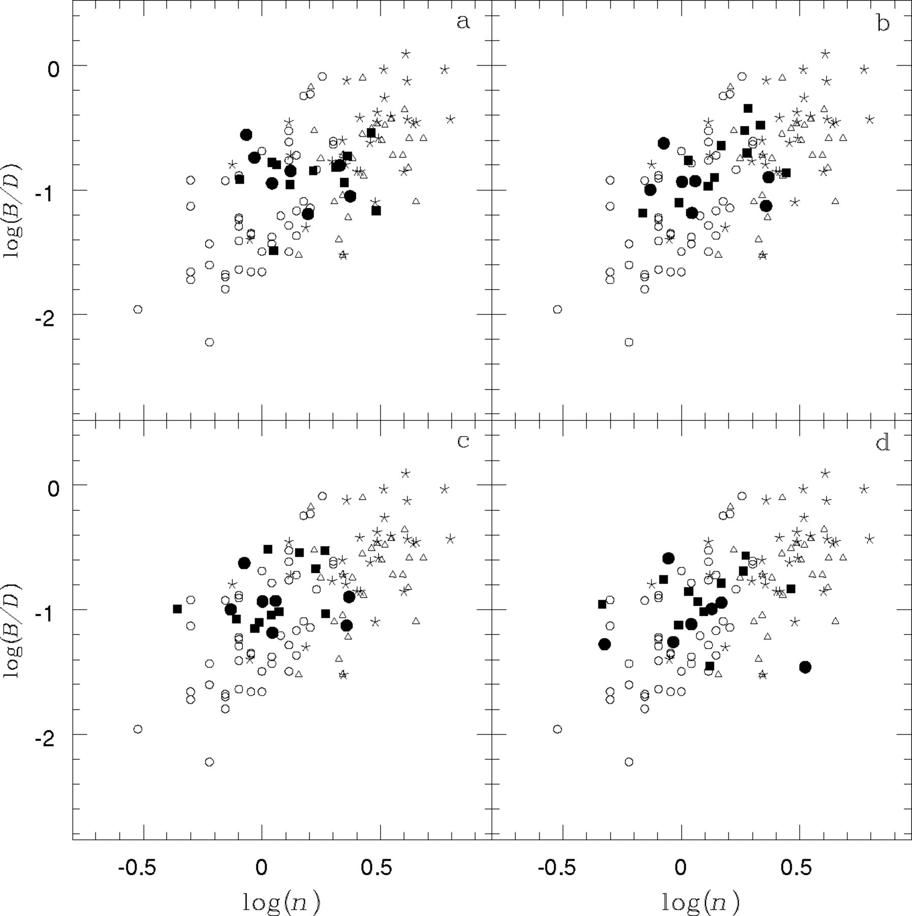
Figure 11 Luminosity bulge-to-disc ratio (B/D) as a function of the shape parameter of the progenitors during single ...
Notes:
Figure 11 Luminosity bulge-to-disc ratio (B/D) as a function of the shape parameter of the progenitors during single (filled circles) and double (filled squares) SBs at zA (a), zB (b), zC (c) and zD (d). Observational data from APB95 (asterisks), KWK00 (open triangles) and MCH02 (open circles) are also shown.
Unless provided in the caption above, the following copyright applies to the content of this slide: © © 2003 RAS 2003

Slide 15
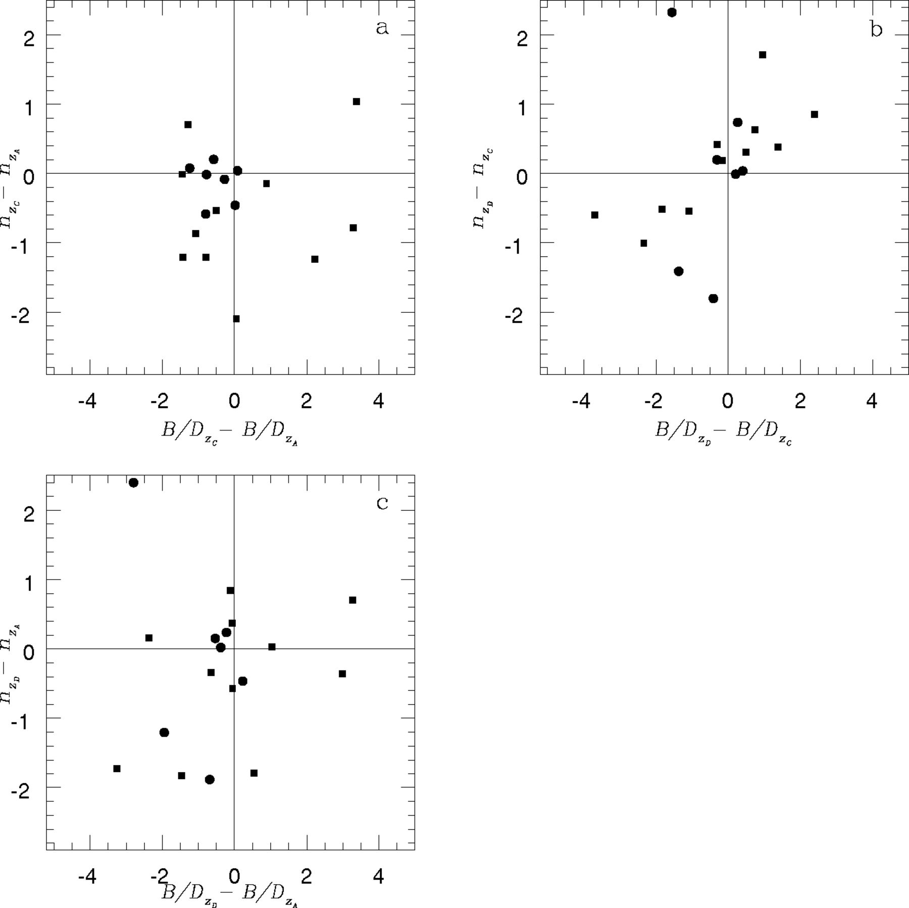
Figure 12 Variations in the shape parameters of the progenitors during the orbital decay phase (a), the fusion of the ...
Notes:
Figure 12 Variations in the shape parameters of the progenitors during the orbital decay phase (a), the fusion of the baryonic clumps (b) and the whole merger process (c) in single (filled circles) and double (filled squares) SBs as a function of the corresponding changes in the bulge-to-disc ratio, B/D.
Unless provided in the caption above, the following copyright applies to the content of this slide: © © 2003 RAS 2003

