Slide 1
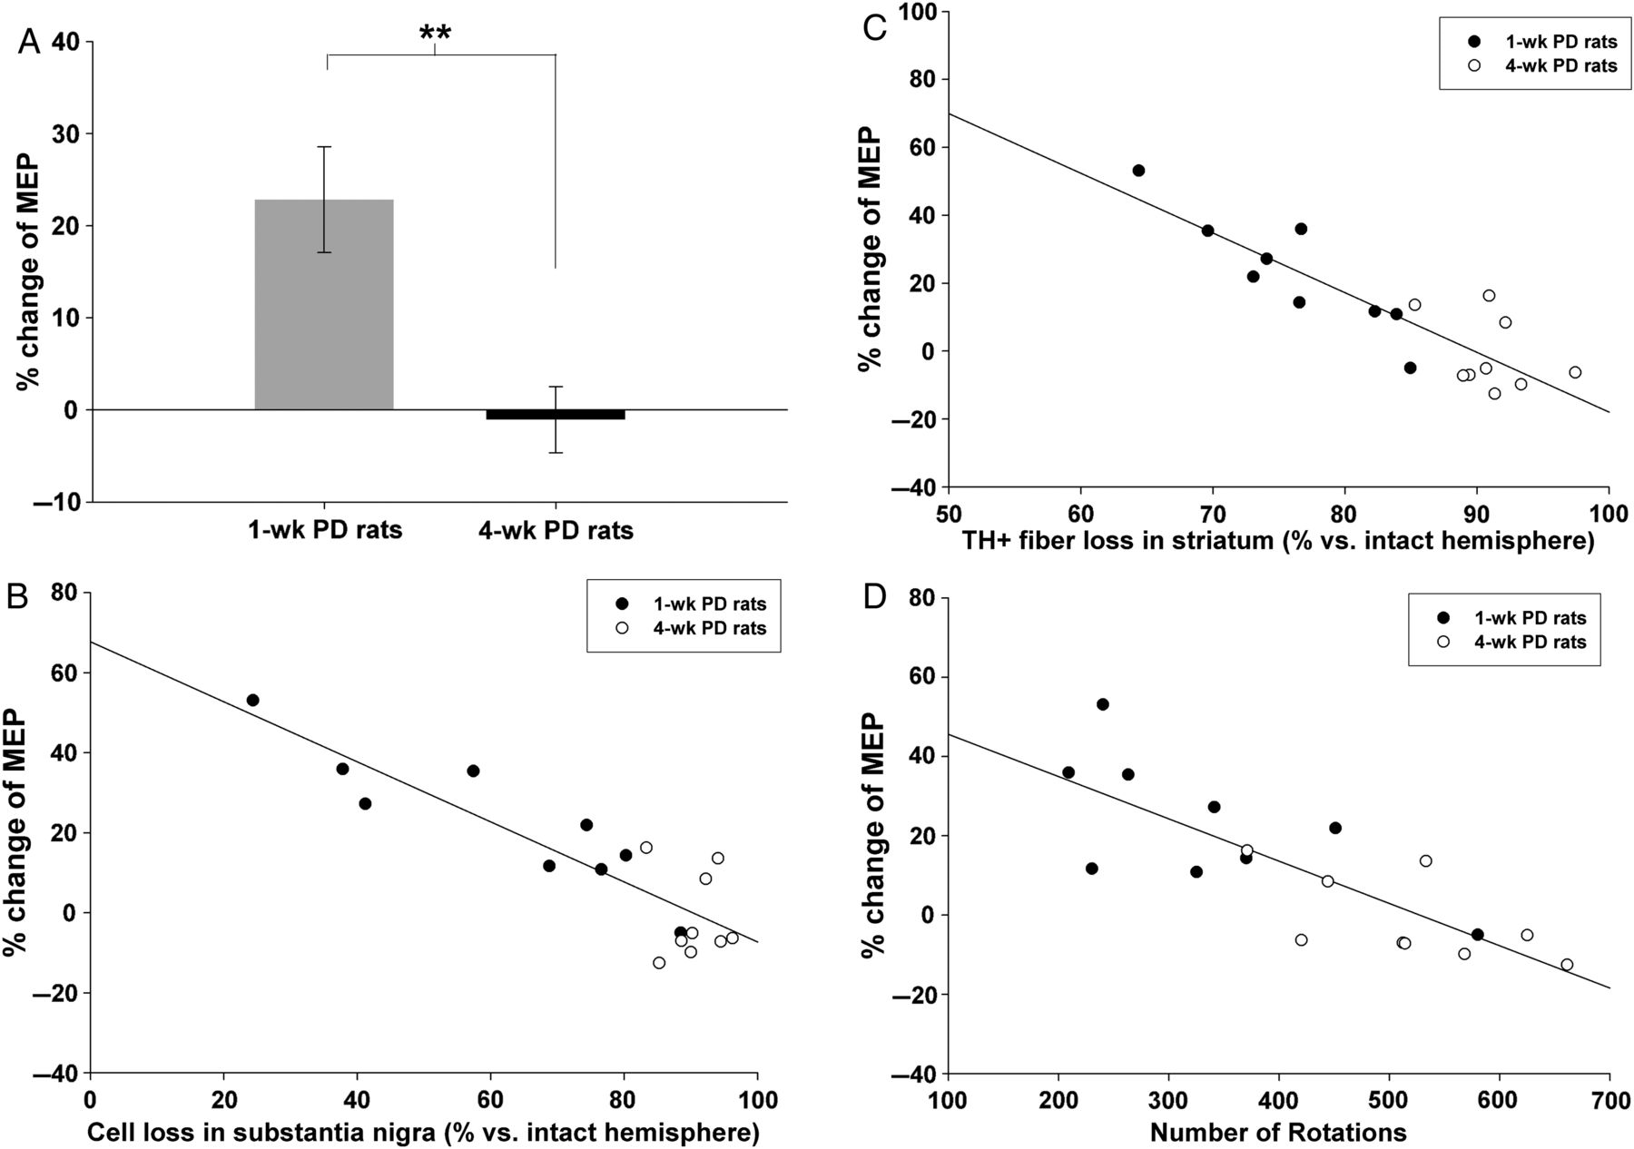
Figure 5. The correlation between the percentage change of MEP and the disease severity. iTBS was able to enhance MEPs ...
Notes:
Figure 5. The correlation between the percentage change of MEP and the disease severity. iTBS was able to enhance MEPs in 1-wk PD, but not in 4-wk PD (A). There was a significant negative correlation between the change of MEP amplitude versus the level of dopaminergic neuron loss in substantial nigra (B), versus the level of dopaminergic fiber loss in striatum (C), and versus the count of apomorphine-induced rotation (D). Asterisks indicate a significant difference (unpaired t-test, P < 0.01).
Unless provided in the caption above, the following copyright applies to the content of this slide: © The Author 2014. Published by Oxford University Press. All rights reserved. For Permissions, please e-mail: journals.permissions@oup.com

Slide 2
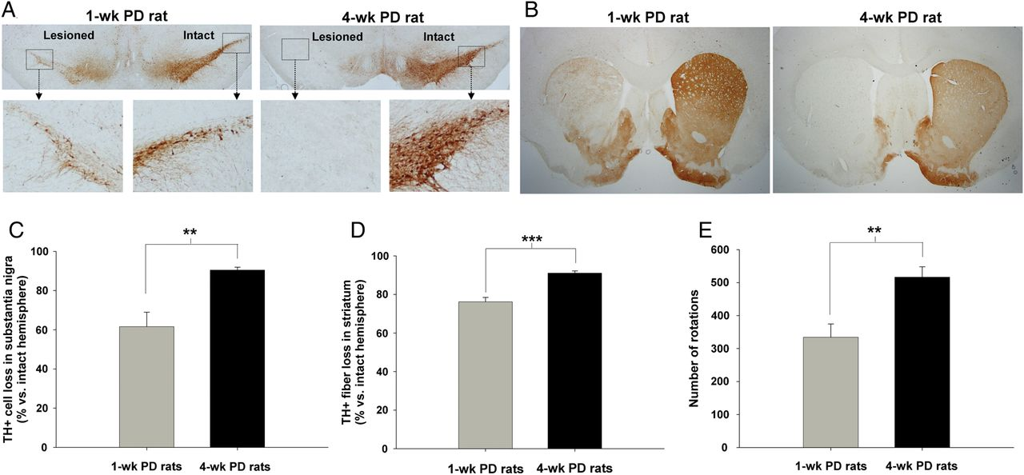
Figure 4. The histological and behavioral changes correlate with the disease stage in PD rats. Representative ...
Notes:
Figure 4. The histological and behavioral changes correlate with the disease stage in PD rats. Representative TH-immunoreactive fibers at the substantia nigra (A) and striatum (B) from animals sacrificed at 1 week and 4 weeks post-6-OHDA lesion are shown in upper row, while the quantification of TH-positive neuron loss (C), TH-positive fiber loss (D), and the count of rotational behavior (E) are shown in the lower row. **P < 0.01, ***P < 0.001 (unpaired t-test).
Unless provided in the caption above, the following copyright applies to the content of this slide: © The Author 2014. Published by Oxford University Press. All rights reserved. For Permissions, please e-mail: journals.permissions@oup.com

Slide 3
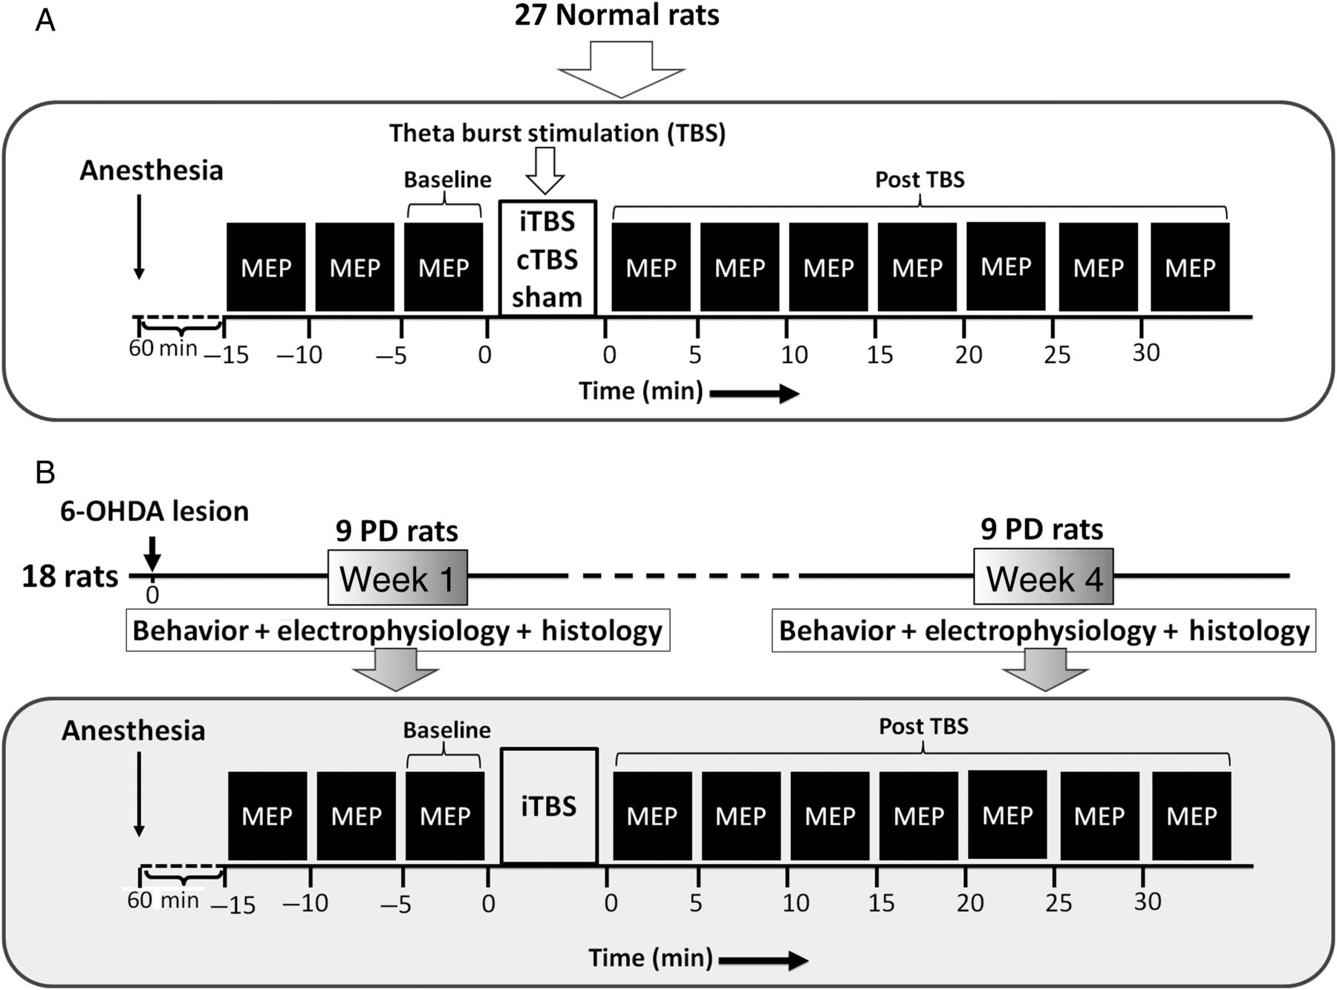
Figure 1. Experimental design. In the experiments for testing the effect of TBS on normal rats (A), 15 MEPs assessed ...
Notes:
Figure 1. Experimental design. In the experiments for testing the effect of TBS on normal rats (A), 15 MEPs assessed every 10–15 s were recorded every 5 min for 3 times before TBS and every 5 min until 30 min after the end of TBS, including iTBS, cTBS, and sham stimulation. For the PD groups (B), the MEP assessment, behavioral, and histological investigations were performed on 1-wk and 4-wk PD rats.
Unless provided in the caption above, the following copyright applies to the content of this slide: © The Author 2014. Published by Oxford University Press. All rights reserved. For Permissions, please e-mail: journals.permissions@oup.com

Slide 4
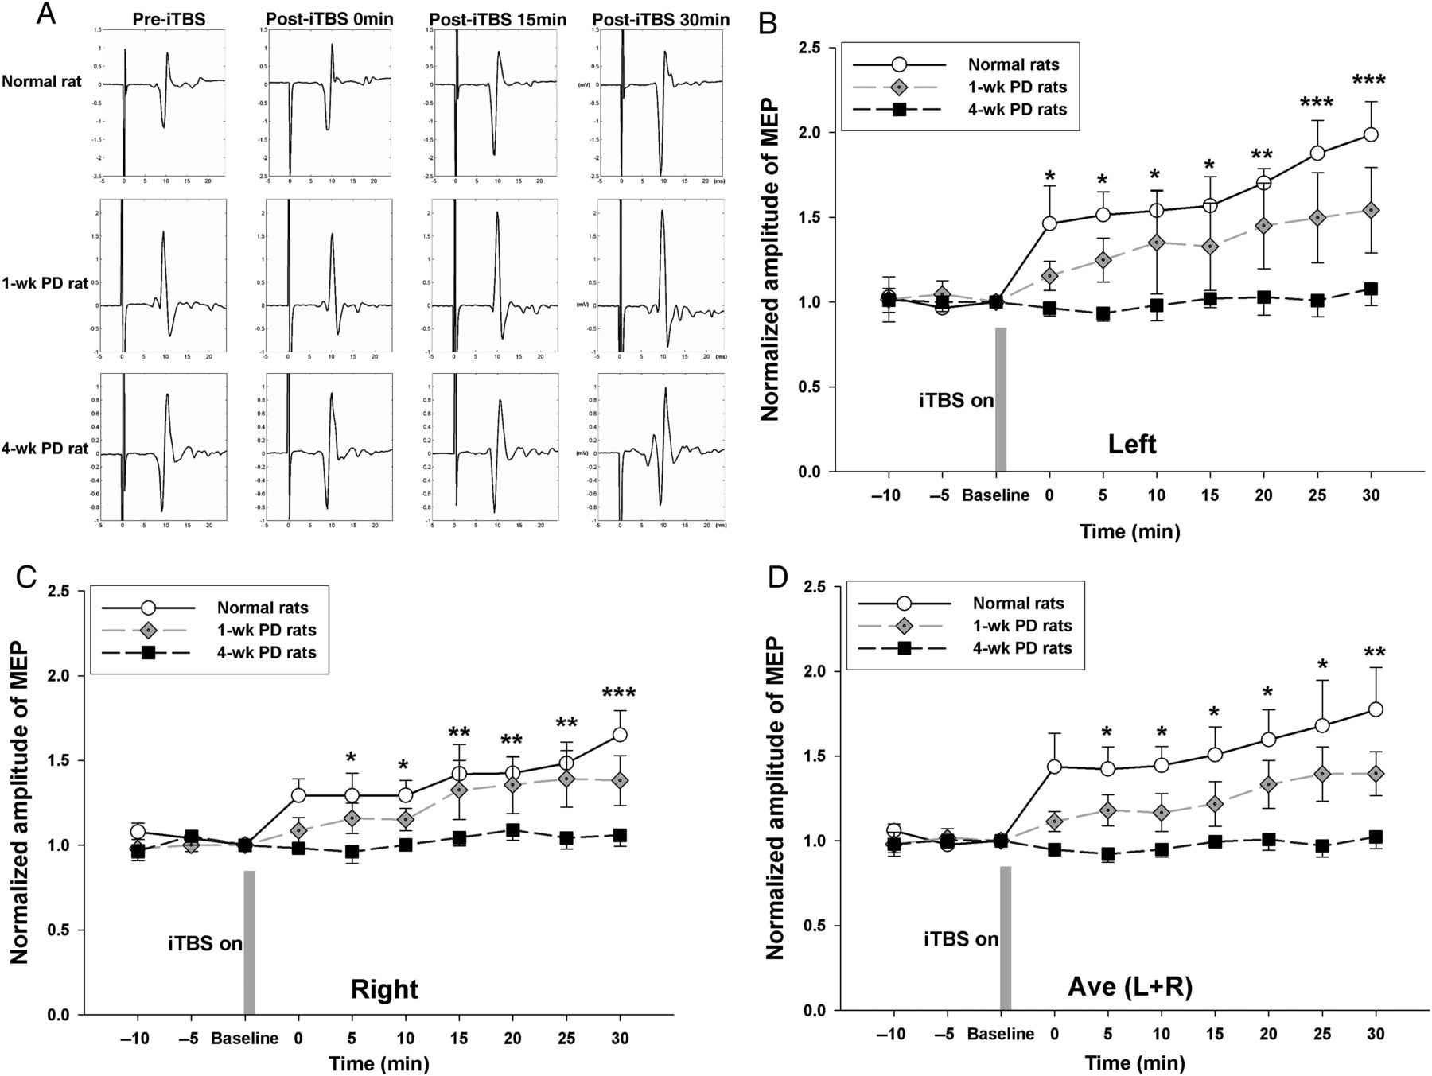
Figure 3. The effect of iTBS on MEPs in PD rats. Representative MEPs before and after iTBS in normal, 1-wk and 4-wk PD ...
Notes:
Figure 3. The effect of iTBS on MEPs in PD rats. Representative MEPs before and after iTBS in normal, 1-wk and 4-wk PD rats are shown at each measured time epoch (A). The MEP amplitude increased in the normal rat but was less facilitated in PD rats after iTBS. Time course of averaged changes in the MEP amplitude in normal, 1-wk PD and 4-wk PD rats are presented for left (B: ipsilateral side), right (C: contralateral side), and average of both sides (D). These effects of iTBS in the 3 groups were significantly different from each other. *P < 0.05, **P < 0.01, significant post hoc Fisher's LSD differences on MEP size compared between baseline and at each time point after iTBS.
Unless provided in the caption above, the following copyright applies to the content of this slide: © The Author 2014. Published by Oxford University Press. All rights reserved. For Permissions, please e-mail: journals.permissions@oup.com

Slide 5
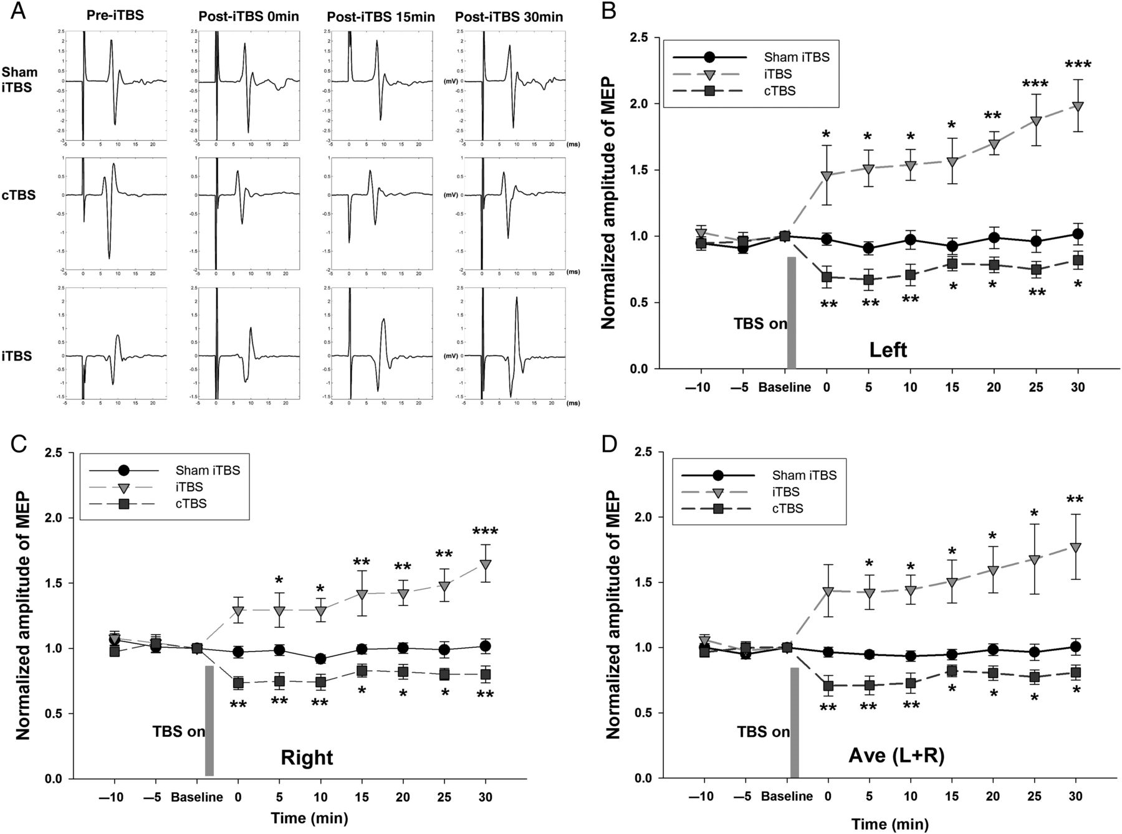
Figure 2. The effect of TBS on MEPs in healthy rats. Representative MEPs of a rat before and after sham stimulation, ...
Notes:
Figure 2. The effect of TBS on MEPs in healthy rats. Representative MEPs of a rat before and after sham stimulation, cTBS, and iTBS are shown at each measured time epoch (A). Averaged changes in the MEP amplitude after sham, cTBS, and iTBS interventions are presented for left (B), right (C), and average of both sides (D). Each point corresponds to the mean and standard error of MEP amplitude expressed as a ratio to the last block of baseline responses. *P < 0.05, **P < 0.01, significant post hoc Fisher's LSD differences on the MEP size when compared with each time point after intervention to the last block of pre-TBS baseline.
Unless provided in the caption above, the following copyright applies to the content of this slide: © The Author 2014. Published by Oxford University Press. All rights reserved. For Permissions, please e-mail: journals.permissions@oup.com

