Slide 1
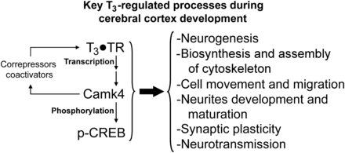
Figure 1. Involvement of Camk4 in thyroid hormone action. T₃ acting through the nuclear receptors (TR) ...
Notes:
Figure 1. Involvement of Camk4 in thyroid hormone action. T3 acting through the nuclear receptors (TR) controls the expression of many genes involved in different cellular and physiological processes. The regulation of gene expression is exerted directly by the binding of the TR to responsive elements present in the regulated genes, or through the regulated expression of Camk4, which is directly induced by T3 at the transcriptional level (Morte et al. 2010). Camk4 phosphorylates Creb and many of the genes under thyroid hormone control contain Creb-binding sites in their promoter region. On the other hand, Camk4 potentiates the transcriptional activity of the TR through interaction with coactivators and corepressors.
Unless provided in the caption above, the following copyright applies to the content of this slide: © The Author 2013. Published by Oxford University Press. All rights reserved. For Permissions, please e-mail: journals.permissions@oup.com

Slide 2
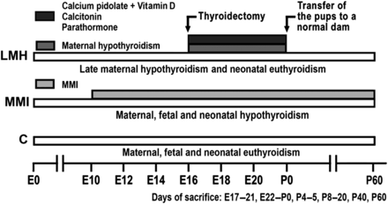
Figure 2. Experimental groups (C, MMMI, and LMH) and treatments. The length of treatments and hypothyroid periods is ...
Notes:
Figure 2. Experimental groups (C, MMMI, and LMH) and treatments. The length of treatments and hypothyroid periods is indicated by horizontal gray bars. The ages of sacrifice are shown at the bottom.
Unless provided in the caption above, the following copyright applies to the content of this slide: © The Author 2013. Published by Oxford University Press. All rights reserved. For Permissions, please e-mail: journals.permissions@oup.com

Slide 3
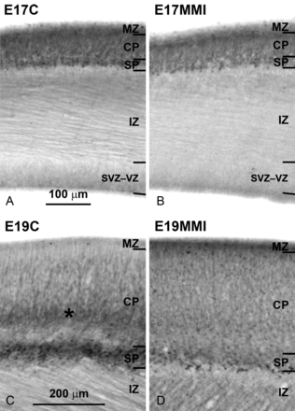
Figure 3. Photomicrographs show Camk4 immunolabeling at E17 and E19 in C and MMI fetuses. At E17, labeling was found in ...
Notes:
Figure 3. Photomicrographs show Camk4 immunolabeling at E17 and E19 in C and MMI fetuses. At E17, labeling was found in the CP and SP of C (A) and MMI (B) fetuses. In E19C fetuses, the labeling was found in SP and in an inner band of the CP, likely containing immature layer VI cells (asterisk). In E19MMI, the labeling of SP was weaker than in C fetuses, and no inner band of heavy Camk4 immunostaining in the CP was observed (D). Both on E17 and E19, as well as the other fetal ages (see also Fig. 4), no Camk4 labeling was observed in IZ and SVZ–VZ. MZ: marginal zone; CP: cortical plate; SP: subplate; IZ: intermediate zone; SVZ–VZ: subventricular and ventricular zones. Same scale for A, B and for C, D.
Unless provided in the caption above, the following copyright applies to the content of this slide: © The Author 2013. Published by Oxford University Press. All rights reserved. For Permissions, please e-mail: journals.permissions@oup.com

Slide 4
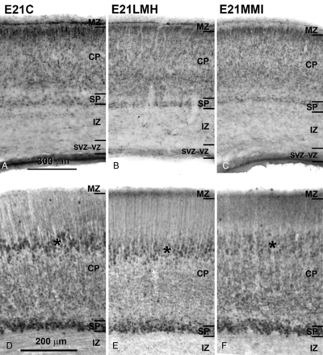
Figure 4. Photomicrographs showing Camk4 in situ hybridization (A–C) and immunolabeling (D–F) of the parietal cortex of ...
Notes:
Figure 4. Photomicrographs showing Camk4 in situ hybridization (A–C) and immunolabeling (D–F) of the parietal cortex of E21C (A and D), E21LMH (B and E), and E21MMI (C and F) fetuses. The radial distribution of Camk4 mRNA (A–C) is similar in the 3 groups, where the labeling was predominantly found in the SP and CP. However, in LMH and MMI fetuses, the labeling in the upper band of the CP, close to the MZ, was less intense than in C fetuses. As the in situ hybridization, immunolabeling (D–F) was also observed almost exclusively in the SP and CP. Immunolabeling was more intense in the SP of C, LMH, and MMI fetuses, and in an intermediate band of CP in C and LMH fetuses (asterisks in D and E). This intermediate band was weakly stained in MMI fetuses (asterisk in F). MZ: marginal zone; CP: cortical plate; SP: subplate; IZ: intermediate zone; SVZ–VZ: subventricular and ventricular zones. Same scale for A–C and for D–F.
Unless provided in the caption above, the following copyright applies to the content of this slide: © The Author 2013. Published by Oxford University Press. All rights reserved. For Permissions, please e-mail: journals.permissions@oup.com

Slide 5
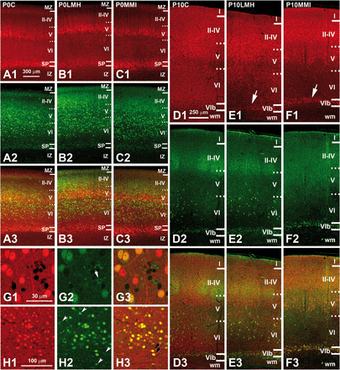
Figure 5. (A1–F3) Collages from confocal photomicrographs (taken with the ×20 objective) showing double immunolabeling ...
Notes:
Figure 5. (A1–F3) Collages from confocal photomicrographs (taken with the ×20 objective) showing double immunolabeling for Camk4 (red), Nurr1 (green), and both (yellow labeling) in the parietal cortex of P0 (A1–C3), P10 (D1–F3), and P15 (G1–H3) pups. The radial distribution of Camk4 labeling is similar in P0C (A1–A3), P0LMH (B1–B3), and P0MMI (C1–C3) pups, but the labeling is lighter in P0MMI pups. In all groups, the density of Camk4-ir neurons increases in SP and in a middle band of CP, overlapping immature layer V. Nurr1-ir cells are uniformly distributed in lower CP (immature layers V and VI; A2–C2) with increased density in SP. In P10C (D1–D3), P10LMH (E1–E3), and P10MMI (F1–F3) pups, most of Camk4-ir neurons were located in layers II–IV and upper layer V. Numerous Camk4-ir neurons can be seen in layer VIb of P10LMH and P10MMI pups (arrows in E1 and F1) compared with P10C (D1) pups. On P10, Nurr1-ir cells were mostly found in layer VI of the parietal cortex and much less than on P0. In addition, an increased immunoreactivity in the neuropile, most probably inside the barrels of layer IV, can be seen. Nurr1-ir cells in SP and layer VIb can be seen in all groups. (G1–H3) Photomicrographs show details of double labeling Camk4 and Nurr1 in layers II–III of P15C (G1–G3) and in layer VI of P15MMI (H1–H3) pups. Both Camk4-ir and nuclear Nurr1-ir heavily labeled cells in the parietal cortex and layer VIb are shown (G3 and H3; yellow labeling). Arrows in G3 show Camk4-ir/Nurr1-negative neurons. Arrowheads in G2 and in H2 points CamK4-negative/Nurr1-ir cells with cytoplasmic immunoreactivity. Arrows in H2 point CamK4-negative/Nurr1-ir cells with weak nuclear labeling. Arrows in H3 point heterotopic Camk4-ir/Nurr1-ir neurons (see also Fig. 6) in the wm. MZ: marginal zone; CP: cortical plate; SP: subplate; IZ: intermediate zone; wm: subcortical white matter; ir: immunoreactive. Same scale for A1–F3, G1–G3, and H1–H3.
Unless provided in the caption above, the following copyright applies to the content of this slide: © The Author 2013. Published by Oxford University Press. All rights reserved. For Permissions, please e-mail: journals.permissions@oup.com

Slide 6
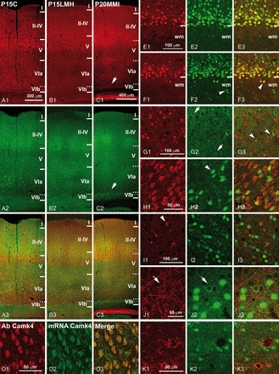
Figure 6. (A1–C3) Collages from confocal photomicrographs (taken with the ×20 objective) showing double immunolabeling ...
Notes:
Figure 6. (A1–C3) Collages from confocal photomicrographs (taken with the ×20 objective) showing double immunolabeling for Camk4 (red), Nurr1 (green), and both (yellow labeling) in the parietal cortex of P15C (A1–A3), P15LMH (B1–B3), and P20MMI (C1–C3) pups. As on P10 (Fig. 5), most of Camk4-ir neurons were located in layers II–IV and upper layer V (A1, B1, and C1). Heavy labeling in SP is still present in P20MMI pups (C1; arrow). On P15C and P15LMH, Nurr1-ir cells are scarce in the parietal cortex, and the number increases in deep layer VI. However, they are more numerous in P20MMI pups (C2; arrow). (D1–D3) Double labeling for Camk4 protein (D1; red) and mRNA (D2; green) in P19MMI pups. Note that all cells are double labeled (D3; yellow). Double immunolabeling for Camk4-ir (red) and NeuN-ir (green) in P20C (E1–E3) and P20MMI (F1–F3) pups. All Camk4-ir cells were neurons (yellow cells in E3 and F3). Arrowhead in F2 points to a heterotopic Camk4-negative neuron in the wm and in F3 to a heterotopic Camk4-ir neuron. Camk4-ir (red) and GAD67-ir (green) neurons in P8C pups (G1–G3). Arrows in G2 point to GAD67-ir/Camk4-negative neurons; arrowheads in G3 show double-labeled neurons with weak Camk4 immunoreactivity in the nucleus. Double immunolabeling for NeuN-ir (red) and Nurr1-ir (green) cells in P19C pups (H1–H3). Arrowhead in H2 points to a Nurr1-ir/NeuN-negative cell. GAD67-ir (red) and Nurr1-ir (green) cells in P20M pups (I1–I3). Arrowhead in I1 points to a Nurr1-ir/GAD67-ir neuron. CNPase-ir (red) and Nurr1-ir (green) cells in P20C pups (J1–J3). Arrows in J1 and J2 show a CNPase-ir/Nurr1-ir oligodendrocyte. Note the weak Nurr1 labeling in the cytoplasm of the oligodendrocyte. Double immunolabeling shows GFAP-ir (red) and Nurr1-ir (green) cells in P20C pups (K1–K3). No double-labeled cells were found. wm: subcortical white matter; ir: immunoreactive. Same scale for A1–B3, C1–C3, and E1–E3. Each set of 3 photomicrographs for each pair of antibodies share the scale.
Unless provided in the caption above, the following copyright applies to the content of this slide: © The Author 2013. Published by Oxford University Press. All rights reserved. For Permissions, please e-mail: journals.permissions@oup.com

Slide 7
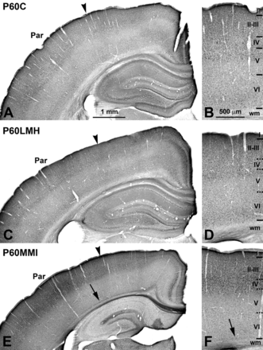
Figure 7. Collages from photomicrographs showing Camk4 immunolabeling at P60C (A and B), P60LMH (C and D), and P60MMI ...
Notes:
Figure 7. Collages from photomicrographs showing Camk4 immunolabeling at P60C (A and B), P60LMH (C and D), and P60MMI (E and F). The immunolabeling was similar in P60C and P60LMH rats. In P60MMI rats, Camk4-ir neurons were observed in an inner band of layer VI close to the subcortical white (E and F; arrows). The medial border of the parietal cortex (Par) is indicated (A, C, and E; arrowheads). Detail of the radial distribution of Camk-ir neurons (B, D, and F). The same scale for A, C, E and B, D, F.
Unless provided in the caption above, the following copyright applies to the content of this slide: © The Author 2013. Published by Oxford University Press. All rights reserved. For Permissions, please e-mail: journals.permissions@oup.com

Slide 8
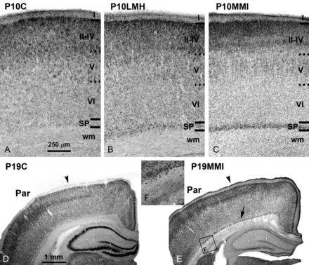
Figure 8. Photomicrographs show in situ hybridization for Camk4 in the parietal cortex of P10C, P10LMH, and P10MMI ...
Notes:
Figure 8. Photomicrographs show in situ hybridization for Camk4 in the parietal cortex of P10C, P10LMH, and P10MMI (A–C), and P19C, and P19MMI (D–F) pups. Camk4 expression in the SP is very light on P10C, compared with P10LMH and P10MMI pups. In all groups, Camk4 expression increases in upper cortical layers II–IV. Camk4 expression in deeper layer VI of P19MMI pups is still present. No differences in the radial distribution of labeling between C and LMH pups can be seen. In the inset (F), heterotopic cells are shown in the wm-expressing Camk4. SP: subplate; Par: parietal cortex; wm: subcortical white matter. Same scale for A–C and D–E.
Unless provided in the caption above, the following copyright applies to the content of this slide: © The Author 2013. Published by Oxford University Press. All rights reserved. For Permissions, please e-mail: journals.permissions@oup.com

Slide 9
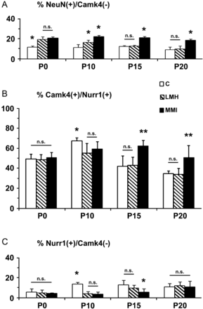
Figure 9. Histograms showing percentages for Camk4 and either NeuN (A) or Nurr1 (B and C) double immunolabeling in the ...
Notes:
Figure 9. Histograms showing percentages for Camk4 and either NeuN (A) or Nurr1 (B and C) double immunolabeling in the subplate on P0 and layer VIb on P10, P15, and P20 of C, LMH, and MMI pups. At P0, the percentage of Nurr1-ir cells that were Camk4-immunonegative (NeuN(+)/Camk4(−)) in LMH and MMI was similar and significantly higher to C values (A). In LMH pups, the percentages significantly decreased with age to reach P20C values. The percentages of Camk4-ir cells that were Nurr1-ir (Camk4(+)/Nurr1(+)) peaked at P10 in C and LMH pups (B). It was similar among ages in MMI pups. The percentage of Nurr1-ir cells that were Camk4-immunonegative (Nurr1(+)/Camk4(−)) was very low in all experimental groups among ages (C). Higher values were found in P10C pups. No statistically differences between groups were found in P0 and P20 pups. Error bars (±SD); no significant differences (n.s.); *P< 0.05 and **P < 0.001 (n = 16 for each group).
Unless provided in the caption above, the following copyright applies to the content of this slide: © The Author 2013. Published by Oxford University Press. All rights reserved. For Permissions, please e-mail: journals.permissions@oup.com

Slide 10
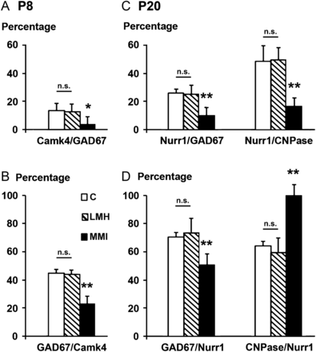
Figure 10. (A and B) Histograms showing percentages for Camk4 and GAD67 double immunolabeling in the subplate of P8C, ...
Notes:
Figure 10. (A and B) Histograms showing percentages for Camk4 and GAD67 double immunolabeling in the subplate of P8C, P8LMH, and P8MMI pups. Both the percentage of Camk4-ir cells that were GAD67-ir (Camk4/GAD67; A) and that of GAD67-ir cells that were Camk4-ir (GAD67/Camk4; B) significantly decreased in P8MMI pups. (C and D) Histograms showing percentages of Nurr1 and either GAD67 or CNPase double immunolabeling in layer VIb of P20C, P20LMH, and P20MMI pups. The percentages of Nurr1-ir cells that are either GAD67-ir (Nurr1/GAD67) or CNPase-ir (Nurr1/CNPase) decreased in P20MMI pups (C). The percentage of GAD67/Nurr1 decreased in P20MMI pups, while that of CNPase/Nurr1 increased (D). Error bars (±SD); no significant differences (n.s.); *P < 0.05 and **P < 0.001 (n = 16 for each group).
Unless provided in the caption above, the following copyright applies to the content of this slide: © The Author 2013. Published by Oxford University Press. All rights reserved. For Permissions, please e-mail: journals.permissions@oup.com

