Slide 1
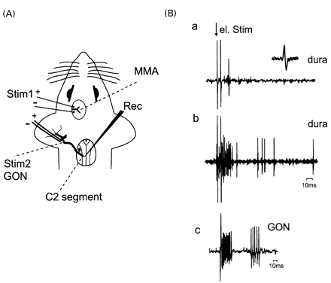
Fig. 1 Schematic drawing of the experimental set‐up, showing the location of the stimulation and recording ...
Notes:
Fig. 1 Schematic drawing of the experimental set‐up, showing the location of the stimulation and recording electrodes. (A) The supratentorial parietal dura was stimulated adjacent to the middle meningeal artery (Stim 1) whereas the GON was stimulated distally close to its peripheral terminations close to the auricle (Stim 2). The recording electrode was lowered into the dorsal horn of the C2 spinal segment (Rec). MMA = middle meningeal artery. (B, a) Original trace showing stimulation of the dura mater (double stimulus) elicited an early latency response (15 ms) within the A‐fibre range. The inset shows the superimposition of five traces for spike identification. (b) Increasing the stimulation parameters recruits further A‐fibre as well as C‐fibre latency responses. (c) Stimulation of the GON shows A‐fibre and C‐fibre latency responses.
Unless provided in the caption above, the following copyright applies to the content of this slide:

Slide 2
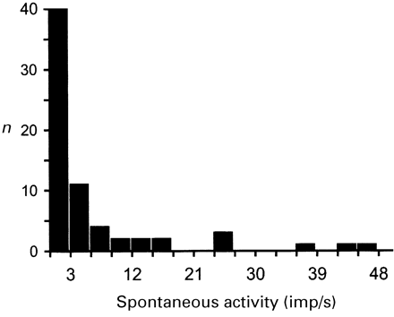
Fig. 2 Distribution of the rate of spontaneous activity in convergent C₂ dorsal horn neurones.
Notes:
Fig. 2 Distribution of the rate of spontaneous activity in convergent C2 dorsal horn neurones.
Unless provided in the caption above, the following copyright applies to the content of this slide:

Slide 3
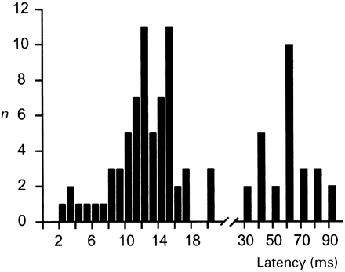
Fig. 3 Distribution of the latencies to electrical stimulation of the dura mater in nociceptive convergent ...
Notes:
Fig. 3 Distribution of the latencies to electrical stimulation of the dura mater in nociceptive convergent neurones in the trigeminocervical complex. Latencies are separated for A‐fibre (in 1‐ms intervals; n = 67) and C‐fibre latencies (in 10‐ms intervals; n = 27). Note that in 27 neurones, A‐ and C‐fibre latencies were present.
Unless provided in the caption above, the following copyright applies to the content of this slide:

Slide 4
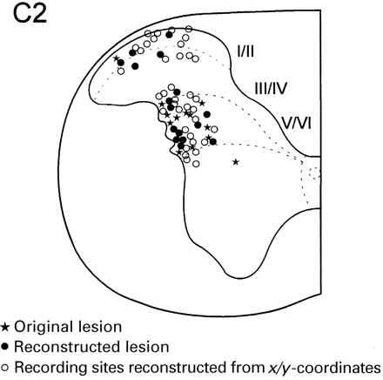
Fig. 4 Summary of the locations of the recording sites of 67 nociceptive convergent neurones receiving input ...
Notes:
Fig. 4 Summary of the locations of the recording sites of 67 nociceptive convergent neurones receiving input from the dura and the GON. Locations of all neurones are plotted on an ideal cross‐section of the C2 spinal cord segment. The different locations were determined by electrolytic lesions of the original electrode (n = 13; filled stars), reconstructed lesions by reinserting the electrode (n = 16; filled circles) or by reconstructing the recording sites according to the x‐ (distance from midline) and y‐coordinates (relative depth from surface) as read from the micropositioner (n = 38; open circles).
Unless provided in the caption above, the following copyright applies to the content of this slide:

Slide 5
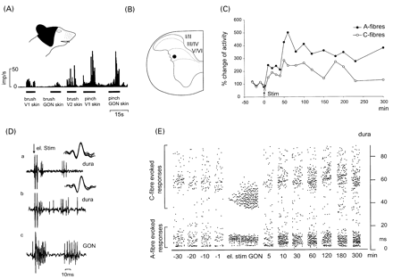
Fig. 5 Neural responses of a convergent wide‐dynamic range neurone to electrical stimulation of the GON as a ...
Notes:
Fig. 5 Neural responses of a convergent wide‐dynamic range neurone to electrical stimulation of the GON as a conditioning stimulus. (A) Illustration of the neural responses to natural stimulation of the cutaneous receptive field (black). (B) Location of the recording site within the deep layers of the C2 spinal dorsal horn. (C) Electrical stimulation of the GON over 3 min in C‐fibre strength elicited an increased excitability of dural input up to 300 min in the A‐ (filled circle) and C‐fibre (open circle) component. (D) Original trace of the neural responses to dural stimulation before (a) and after MO stimulation (b) and GON stimulation (c). The insets show the superimposition of five traces of the C‐fibre component. (E) Raster dot display (each dot represents one evoked neuronal spike) of neural responses (A‐ and C‐fibre components) to dural stimulation before and after electrical GON stimulation. Only the first 40 electrical GON stimuli are shown. Note that GON stimulation elicited a wind‐up phenomenon in the C‐fibre component within the first 20 stimuli.
Unless provided in the caption above, the following copyright applies to the content of this slide:

Slide 6
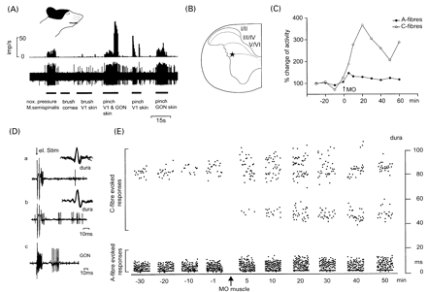
Fig. 6 Neural responses of a convergent neurone to MO injection into the m. semispinalis capitis as a ...
Notes:
Fig. 6 Neural responses of a convergent neurone to MO injection into the m. semispinalis capitis as a conditioning stimulus. (A) Neural responses to natural stimulation of the cutaneous receptive field (black). Note the response to noxious pressure to the m. semispinalis. (B) The location of the recording site was retrieved within the deep layers of the C2 dorsal horn. (C) Stimulation of muscle afferents in the GON produced an increased excitability to dural stimulation up to 60 min in the A‐ (filled circle) and C‐fibre (open circle) component. (D) Original trace of the neural responses to dural stimulation before (a) and after MO stimulation (b) and GON stimulation (c). The insets show the superimposition of five traces of the C‐fibre component. (E) Raster dot display (each dot represents one evoked neuronal spike) of neural responses (A‐ and C‐fibre components) to dural stimulation before and after MO application, showing an increase in excitability with a novel recruitment of a C‐fibre response in the latency range between 40 and 60 ms (see also D).
Unless provided in the caption above, the following copyright applies to the content of this slide:

Slide 7
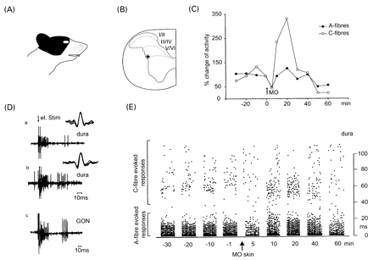
Fig. 7 Neural responses of a convergent neurone to MO application to the cutaneous receptive field of the ...
Notes:
Fig. 7 Neural responses of a convergent neurone to MO application to the cutaneous receptive field of the GON. (A) Cutaneous receptive field (black), which included the first and second trigeminal division and the C2 dermatome. (B) The location of the recording site was retrieved within the deep layers of the C2 dorsal horn. (C) Stimulation of cutaneous afferents in the GON produced an increased excitability to dural stimulation in the A‐ (filled circle) and C‐fibre (open circle) component, peaking within 30 min of MO application. (D) Original trace of the neural responses to dural stimulation before (a) and after MO stimulation (b) and GON stimulation (c). The insets show the superimposition of five traces of the C‐fibre component. (E) Raster dot display of neural responses (A‐ and C‐fibre components) to dural stimulation before and after cutaneous MO application. Note an initial inhibition of the dural responses 5 min after MO application.
Unless provided in the caption above, the following copyright applies to the content of this slide:

Slide 8
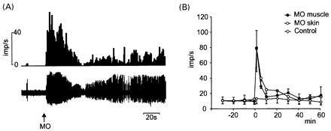
Fig. 8 (A) Neural responses to MO application. Peristimulus time histogram and original trace of a ...
Notes:
Fig. 8 (A) Neural responses to MO application. Peristimulus time histogram and original trace of a nociceptive neurone (same neurone as in Fig. 6) found to be responsive to MO injection into the m. semispinalis capitis, which led to an immediate and profound increase in spontaneous activity with a biphasic time course consisting of an initial peak of activity and a second tonic discharge. (B) Time course of the spontaneous activity in nociceptive convergent neurones receiving input to dural and GON stimulation. MO was injected into the semispinalis muscle (n = 10; filled circles) and applied to the cutaneous receptive field of the GON (n = 12; open circles). Control injection of vehicle into the semispinalis muscle (n = 5; open diamonds) measured over 60 min showed no change in ongoing activity. Activity peaked within 5 min after MO application and then gradually settled down. Results are expressed as mean ± SEM.
Unless provided in the caption above, the following copyright applies to the content of this slide:

Slide 9
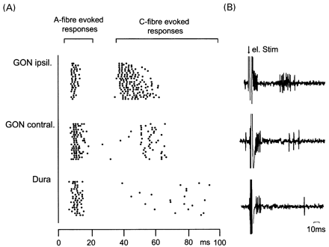
Fig. 9 Example of a nociceptive convergent neurone receiving input from the dura mater as well as from the ...
Notes:
Fig. 9 Example of a nociceptive convergent neurone receiving input from the dura mater as well as from the ipsi‐ and contralateral GON. (A) Raster dot display (each dot represents one evoked neuronal spike) showing trains of 20 stimuli and the evoked responses separated after A‐ and C‐fibre latencies. Note that ipsilateral GON stimulation demonstrates a wind‐up phenomenon. (B) Original traces to electrical stimulation.
Unless provided in the caption above, the following copyright applies to the content of this slide:

