Slide 1
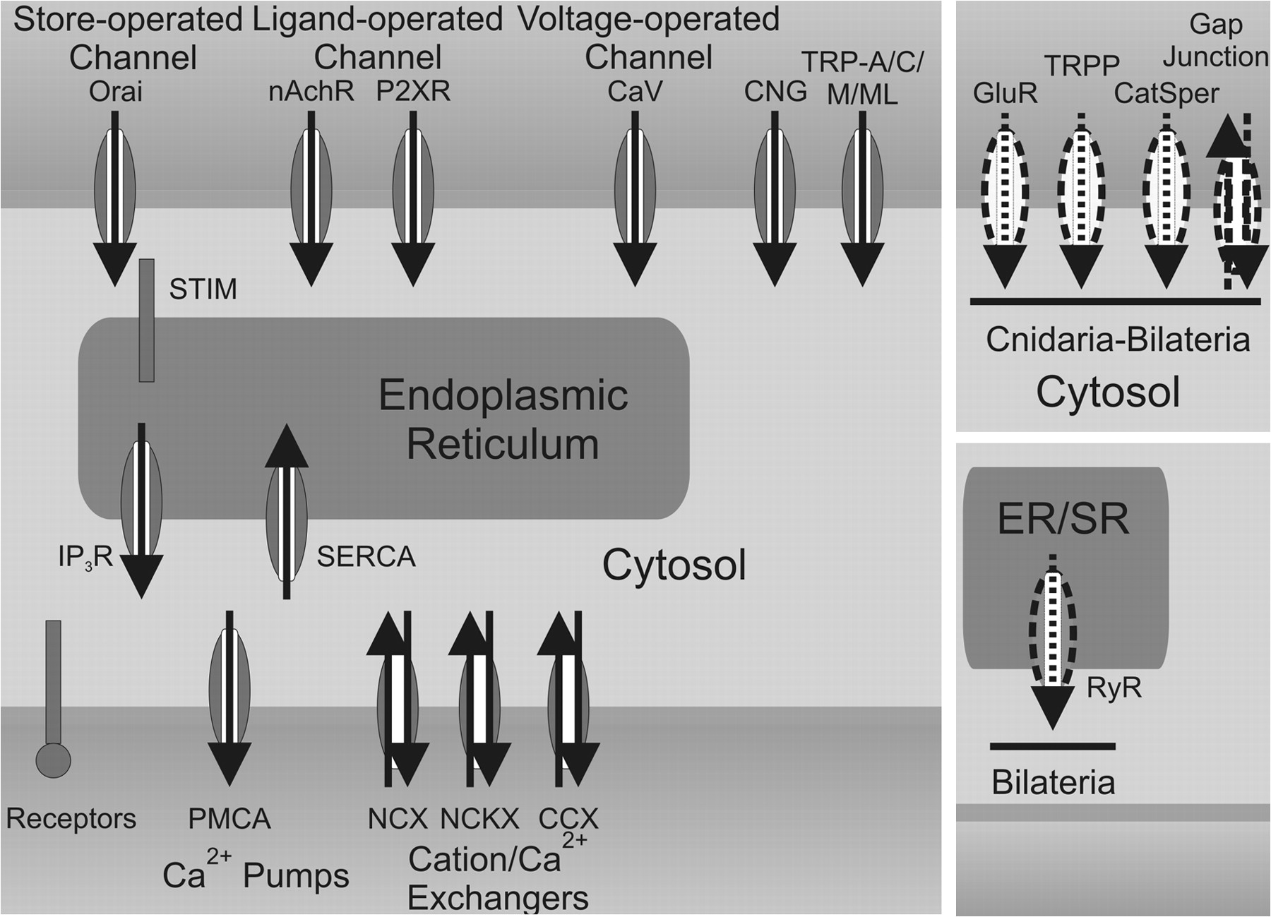
FIG. 1.— Evolution of the Ca²⁺ signaling ‘toolkit’ at the origin of animals. Left, Choanoflagellates, ...
Notes:
FIG. 1.— Evolution of the Ca2+ signaling ‘toolkit’ at the origin of animals. Left, Choanoflagellates, single-celled and colony-forming eukaryotes, appear to contain an extensive Ca2+ signaling ‘toolkit’ conserved in metazoans, including homologues of various types of Ca2+ channels, ATPases, and exchangers (blue). Right top, ionotropic glutamate receptors (GluR), TRPP, CatSper and gap junction channels (yellow) are found in the eumetazoan lineage (cnidarian–bilaterian). Right bottom, ryanodine receptors (RyRs) are present in bilaterians (purple). The black arrows indicate the directions of Ca2+ fluxes across the membranes. Exchangers not only primarily mediate Ca2+ efflux but can also induce Ca2+ influx under certain conditions. Gap junctions allow the rapid bidirectional passage of Ca2+ between adjacent cells. Color version of figure 1 is available as supplementary figure S1 (Supplementary Material online).
Unless provided in the caption above, the following copyright applies to the content of this slide: © The Author 2008. Published by Oxford University Press on behalf of the Society for Molecular Biology and Evolution. All rights reserved. For permissions, please e-mail: journals.permissions@oxfordjournals.org

Slide 2
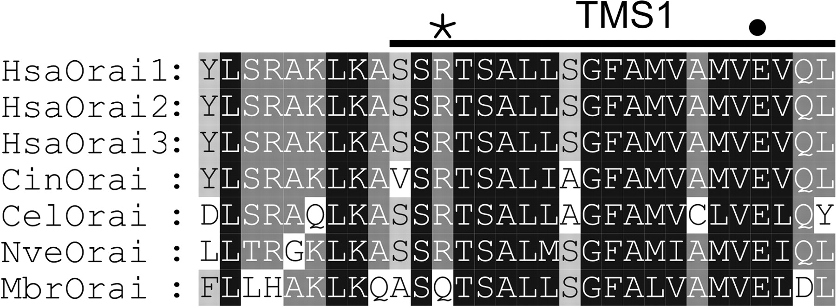
FIG. 2.— Sequence alignment of the transmembrane segment (TMS) 1 region of the Ca²⁺ release-activated ...
Notes:
FIG. 2.— Sequence alignment of the transmembrane segment (TMS) 1 region of the Ca2+ release-activated Ca2+ channel subunit Orai. Shown are sequences from human (HsaOrai 1–3), Ciona intestinalis (CinOrai), Caenorhabditis elegans (CelOrai), Cnidaria Nematostella vectensis (NveOrai), and choanoflagellates Monosiga brevicollis (MbrOrai). The putative TMS1 region of Orai proteins is overlined, and the key acidic residue in TMS1 (E106 in HsaOrai1) is indicated by a filled circle. The asterisk symbol indicates the location of R91 (HsaOrai1), whose mutation can cause a severe human genetic disease.
Unless provided in the caption above, the following copyright applies to the content of this slide: © The Author 2008. Published by Oxford University Press on behalf of the Society for Molecular Biology and Evolution. All rights reserved. For permissions, please e-mail: journals.permissions@oxfordjournals.org

Slide 3
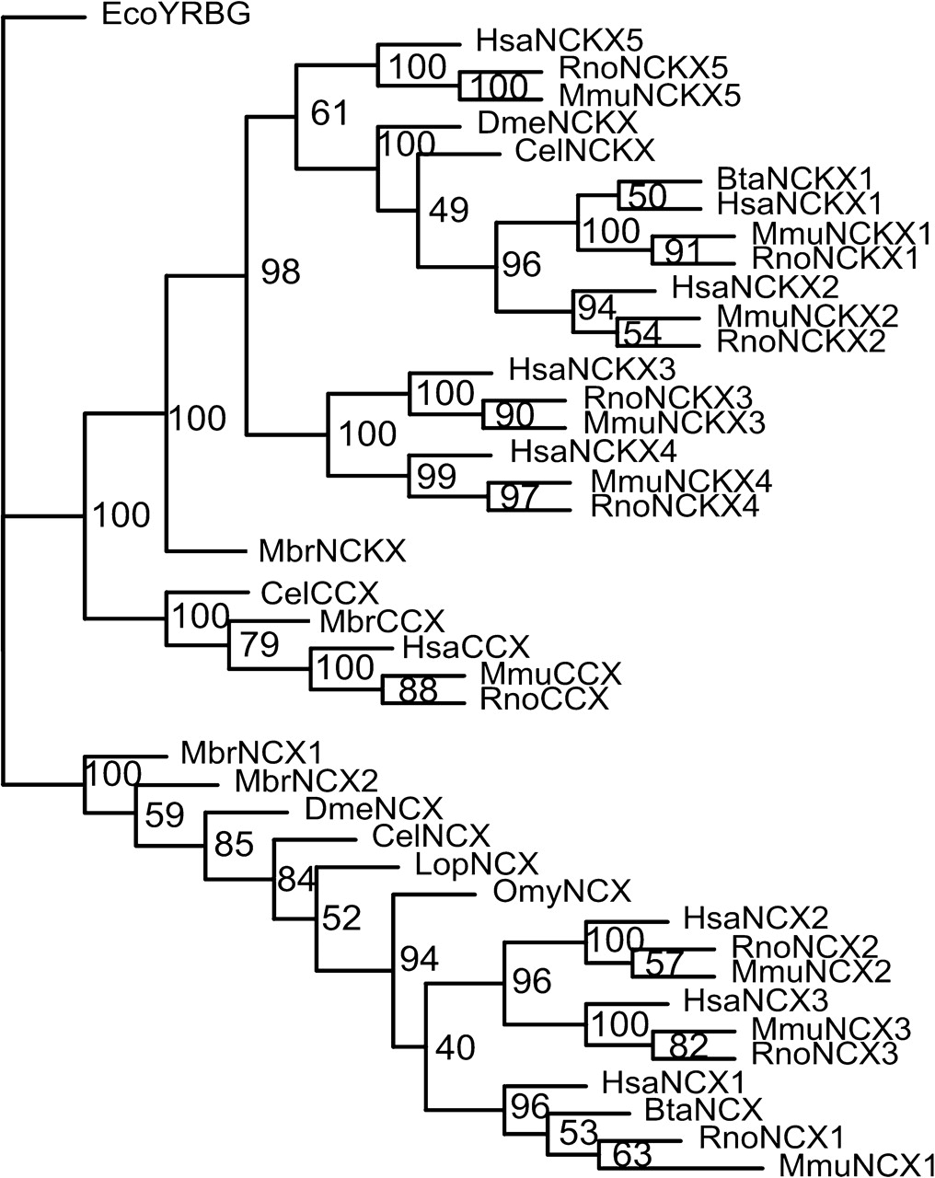
FIG. 3.— Phylogenetic tree of the animal and choanoflagellate CCXs. The bootstrapped phylogenetic tree, showing the ...
Notes:
FIG. 3.— Phylogenetic tree of the animal and choanoflagellate CCXs. The bootstrapped phylogenetic tree, showing the presence of choanoflagellate homologues of 3 animal CCX families, was constructed using the maximum likelihood method with a putative E. coli Ca2+/H+ exchanger (EcoYRBG) as an outgroup. The tree model was further confirmed by the Neighbor-Joining analysis and the maximum parsimony approach (data not shown). Bta, Bos taurus; Cel, Caenorhabditis elegans; Dme, Drosophila melanogaster; Hsa, Homo sapiens; Lop, Loligo opalescens; Mbr, Monosiga brevicollis; Mmu, Mus musculus; Omy, Oncorhynchus mykiss; and Rno, Rattus norvegicus.
Unless provided in the caption above, the following copyright applies to the content of this slide: © The Author 2008. Published by Oxford University Press on behalf of the Society for Molecular Biology and Evolution. All rights reserved. For permissions, please e-mail: journals.permissions@oxfordjournals.org

Slide 4
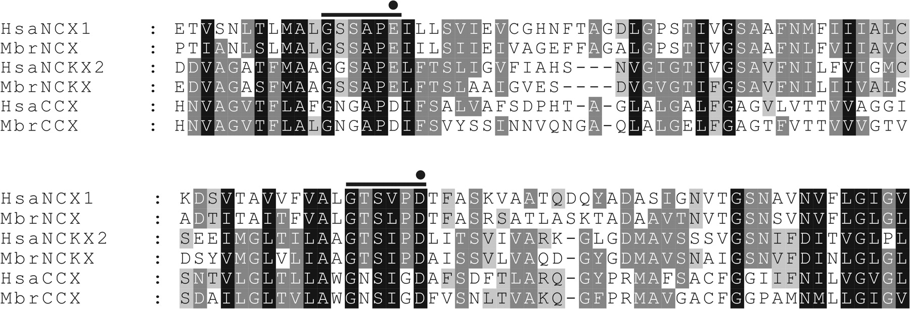
FIG. 4.— Conservation of the 2 α-repeats and signature motifs between human and choanoflagellate CCXs. Sequences of ...
Notes:
FIG. 4.— Conservation of the 2 α-repeats and signature motifs between human and choanoflagellate CCXs. Sequences of the α1-repeat (top) and α2-repeat (bottom) regions of selected exchanger molecules were aligned and manually edited to refine alignments. The signature motifs of each exchange family (Cai and Lytton 2004) are overlined. The key acidic residue in each α-repeat is indicated by a filled circle. Hsa, Homo sapiens and Mbr, Monosiga brevicollis.
Unless provided in the caption above, the following copyright applies to the content of this slide: © The Author 2008. Published by Oxford University Press on behalf of the Society for Molecular Biology and Evolution. All rights reserved. For permissions, please e-mail: journals.permissions@oxfordjournals.org

