Slide 1
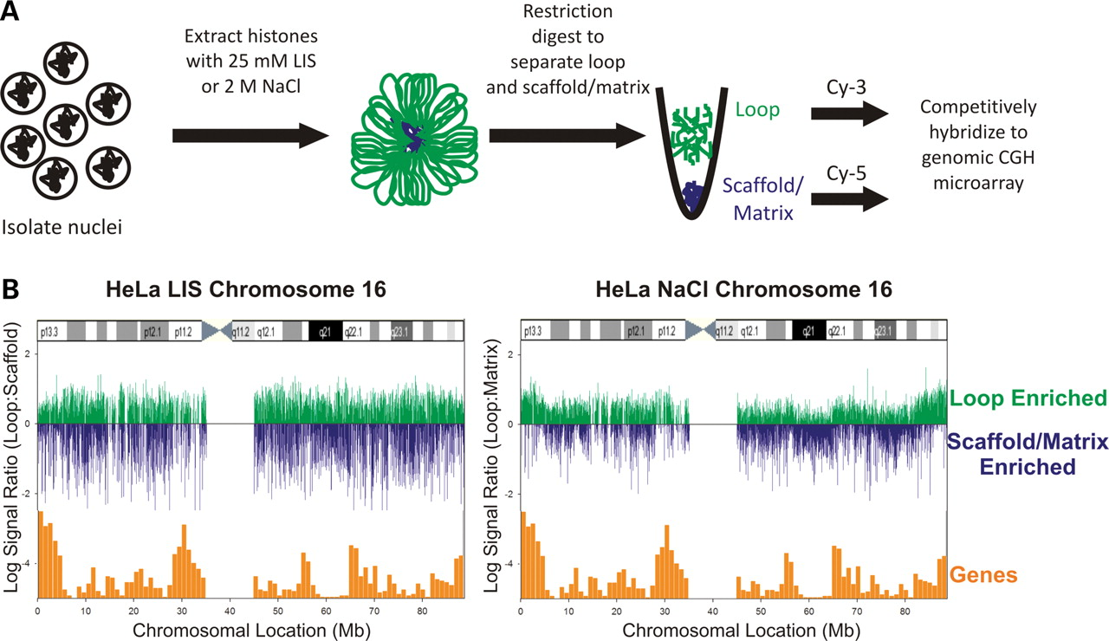
Figure 1. Nuclear Scaffold/Matrix extraction reveals isolation specific differences. (A) Isolation of loop and ...
Notes:
Figure 1. Nuclear Scaffold/Matrix extraction reveals isolation specific differences. (A) Isolation of loop and scaffold/matrix DNA. (B) HeLa log2 CGH signal ratios of LIS isolated loop:scaffold and NaCl-isolated loop:matrix fractions. The log2 CGH ratios are indicated as bars along chromosome 16. Loop regions (green) are indicated as positive signals, whereas nuclear scaffold/matrix-associated regions (blue) are represented as negative signals respective of the zero axis. Gene density (orange bars) and an ideogram representative of G-banding were then overlaid along the chromosome. The NaCl-extracted nuclear matrix revealed global chromatin organization such that gene density correlated with looping. It is apparent that the LIS-isolated nuclear scaffold organizes the chromosome in a different manner.
Unless provided in the caption above, the following copyright applies to the content of this slide: © 2008 The Author(s)This is an Open Access article distributed under the terms of the Creative Commons Attribution Non-Commercial License (http://creativecommons.org/licenses/by-nc/2.0/uk/) which permits unrestricted non-commercial use, distribution, and reproduction in any medium, provided the original work is properly cited.

Slide 2
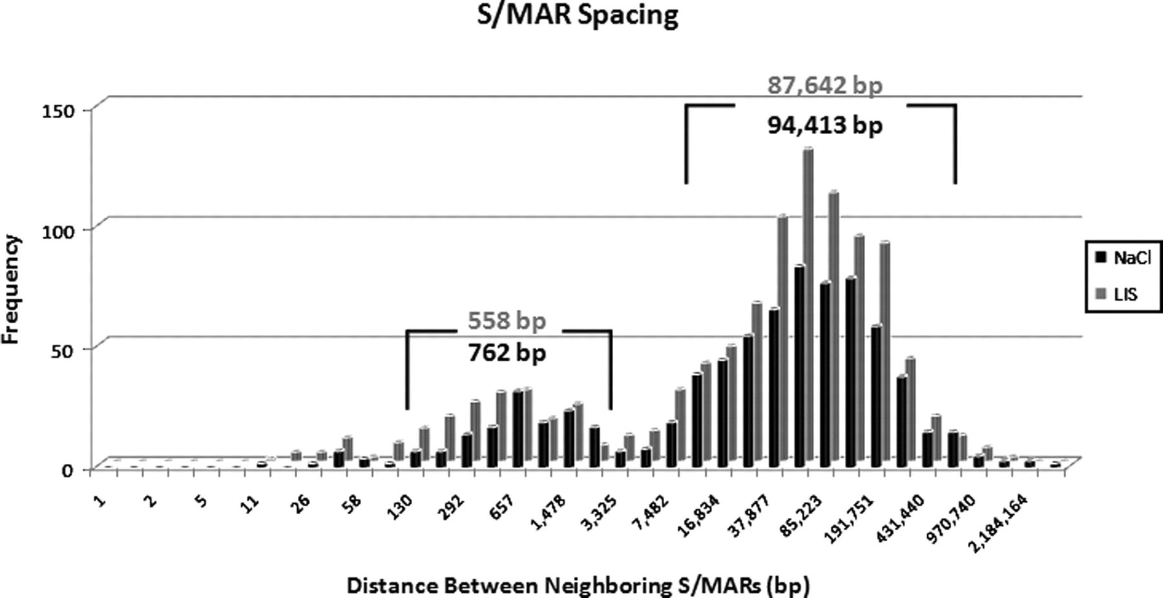
Figure 2. Spacing of S/MARs along human chromosome 16. The binned distance between S/MARs on human chromosome 16 is ...
Notes:
Figure 2. Spacing of S/MARs along human chromosome 16. The binned distance between S/MARs on human chromosome 16 is shown for nuclear scaffolds/matrices isolated by LIS or NaCl extraction with the peak distance averages for each indicated. The frequency of both SAR and MAR spacing shows a bimodal distribution with two groups of average inferred loop sizes at 558 bp and ∼88 kb for SARs and 762 bp and ∼94 kb for MARs.
Unless provided in the caption above, the following copyright applies to the content of this slide: © 2008 The Author(s)This is an Open Access article distributed under the terms of the Creative Commons Attribution Non-Commercial License (http://creativecommons.org/licenses/by-nc/2.0/uk/) which permits unrestricted non-commercial use, distribution, and reproduction in any medium, provided the original work is properly cited.

Slide 3
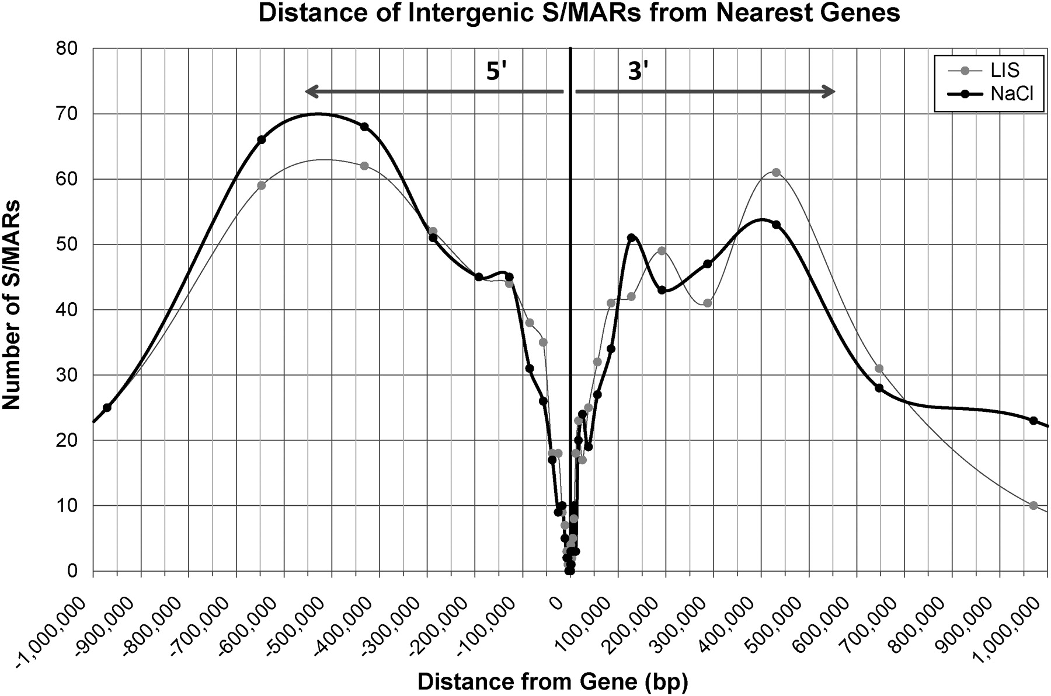
Figure 3. Intergenic nuclear scaffold/matrix attachment and expression. SARs and MARs were mapped according to their ...
Notes:
Figure 3. Intergenic nuclear scaffold/matrix attachment and expression. SARs and MARs were mapped according to their distance from both the 5′ and 3′ ends of genes on chromosome 16. Analysis of intergenic S/MAR distance from all genes reveals similar overall distributions from LIS and NaCl extractions.
Unless provided in the caption above, the following copyright applies to the content of this slide: © 2008 The Author(s)This is an Open Access article distributed under the terms of the Creative Commons Attribution Non-Commercial License (http://creativecommons.org/licenses/by-nc/2.0/uk/) which permits unrestricted non-commercial use, distribution, and reproduction in any medium, provided the original work is properly cited.

Slide 4
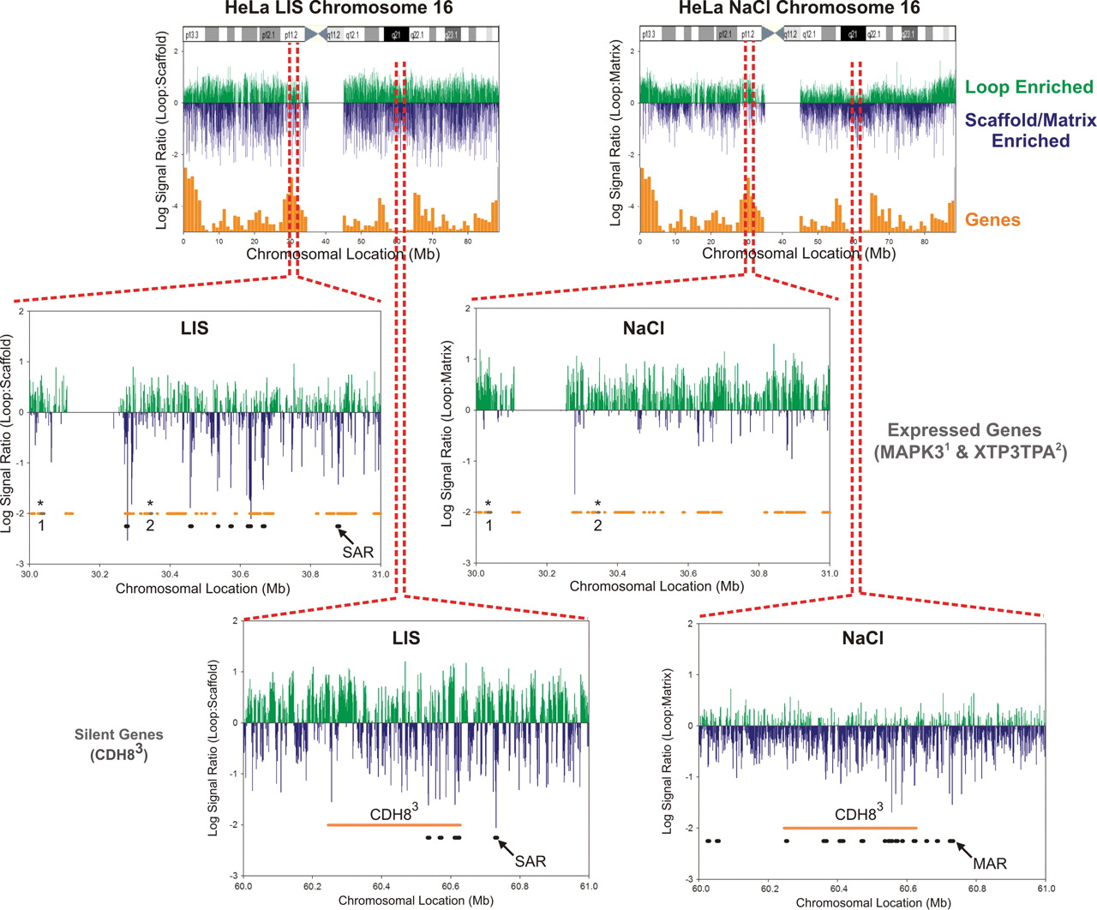
Figure 4. LIS and NaCl extractions reveal different profiles relative to gene density/expression. The nuclear ...
Notes:
Figure 4. LIS and NaCl extractions reveal different profiles relative to gene density/expression. The nuclear scaffold/matrix aCGH profiles in a 30–31 Mb, 16p11.2 gene-rich and 60–61 Mb, 16q21 gene-poor region are shown Log2 loop enrichment is indicated in green and scaffold/matrix association in blue. Regions identified as S/MARs (black bars) were compared with orange: silent and gray: expressed genes (indicated by asterisks). Gene-dense regions show little, if any nuclear matrix attachment and rather are bound to a LIS extracted nuclear scaffold. Gene-poor regions show significant nuclear matrix attachment with fewer-attachment sites to the LIS-isolated nuclear scaffold.
Unless provided in the caption above, the following copyright applies to the content of this slide: © 2008 The Author(s)This is an Open Access article distributed under the terms of the Creative Commons Attribution Non-Commercial License (http://creativecommons.org/licenses/by-nc/2.0/uk/) which permits unrestricted non-commercial use, distribution, and reproduction in any medium, provided the original work is properly cited.

Slide 5
Figure 5. SAR and MAR correlations with gene expression. The presence of S/MARs encompassing 20 kb region 5′ and 3′ of ...
Notes:
Figure 5. SAR and MAR correlations with gene expression. The presence of S/MARs encompassing 20 kb region 5′ and 3′ of a gene, as well as within genes was compared with transcript presence using chi-square analysis (95% CI, 1 df with Yate's correction). The resulting P-values are displayed for each measurement with significance <0.05 indicated in bold. A SAR within 10 kb of the 5′ end region of a gene significantly correlates with gene expression. In contrast a MAR within a gene correlates with silencing of that gene. Direction of transcription is indicated by the arrow.
Unless provided in the caption above, the following copyright applies to the content of this slide: © 2008 The Author(s)This is an Open Access article distributed under the terms of the Creative Commons Attribution Non-Commercial License (http://creativecommons.org/licenses/by-nc/2.0/uk/) which permits unrestricted non-commercial use, distribution, and reproduction in any medium, provided the original work is properly cited.

