Slide 1
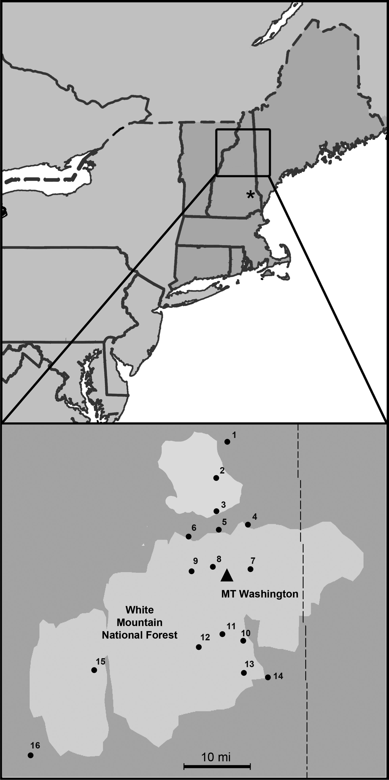
Fig. 1. Top: WMNF relative to the northeast. New England is shaded in darker gray. The asterisk marks Durham, ...
Notes:
Fig. 1. Top: WMNF relative to the northeast. New England is shaded in darker gray. The asterisk marks Durham, Strafford County, NH. Bottom: An enlargement of WMNF in light gray with black dots representing collecting locations (Table 1). The black triangle denotes the peak of Mount Washington. The dashed line shows the New Hampshire and Maine state boundary.
Unless provided in the caption above, the following copyright applies to the content of this slide: © The Authors 2017. Published by Oxford University Press on behalf of Entomological Society of America.This is an Open Access article distributed under the terms of the Creative Commons Attribution Non-Commercial License (http://creativecommons.org/licenses/by-nc/4.0/), which permits non-commercial reuse, distribution, and reproduction in any medium, provided the original work is properly cited. For commercial re-use, please contact journals.permissions@oup.com

Slide 2
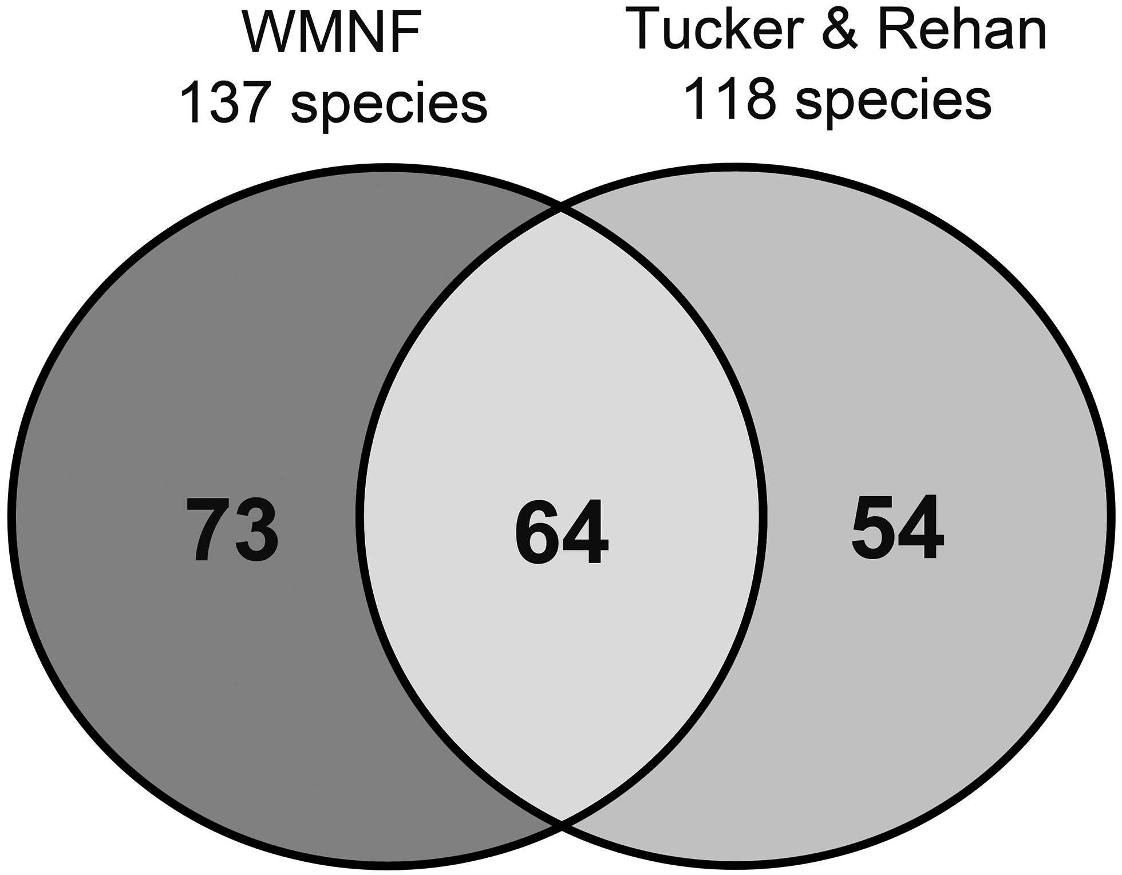
Fig. 2. Venn diagram depicting the species of overlap (light gray) between wild bees surveyed in the WMNF (dark gray) ...
Notes:
Fig. 2. Venn diagram depicting the species of overlap (light gray) between wild bees surveyed in the WMNF (dark gray) and those documented by Tucker and Rehan (2016) in the same state at a much lower elevation in Strafford County, NH (medium gray). Species checklist of all the wild bee species recorded in the WMNF in June, 2015 and previously published records for Strafford County, NH in 2014 (Tucker and Rehan 2016) FamilySpeciesSpecies authorityNew recordWMNF abundanceWMNF relative abundanceTucker and Rehan abundanceTucker and Rehan relative abundanceAndrenidaeAndrena acceptaViereck 1916yes10.1%––Andrena alleghaniensisViereck 190730.3%10.04%Andrena asterisRobertson 1891––60.26%Andrena bisalicisViereck 1908––10.04%Andrena braccataViereck 1907––30.13%Andrena brevipalpisCockerell 193020.2%––Andrena canadensisDalla Torre 189610.1%––Andrena carliniCockerell 1901––130.57%Andrena carolinaViereck 190910.1%10.04%Andrena ceanothiViereck 191720.2%––Andrena commodaSmith 1879121.2%30.13%Andrena confederataViereck 191720.2%10.04%Andrena crataegiRobertson 1893212.1%20.09%Andrena cressoniiRobertson 189150.5%80.35%Andrena distansProvancher 1888––40.17%Andrena dunningiCockerell 1898––40.17%Andrena erigeniaeRobertson 1891––60.26%Andrena erythroniiRobertson 1891––10.04%Andrena forbesiiRobertson 189120.2%––Andrena fragilisSmith 1853––10.04%Andrena frigidaSmith 1853––10.04%Andrena geraniiRobertson 1891––10.04%Andrena heracleiRobertson 1897yes10.1%––Andrena hilarisSmith 1853––10.04%Andrena hippotesRobertson 189520.2%––Andrena hirticinctaProvancher 1888––30.13%Andrena ignotaLaBerge 1967––10.04%Andrena imitatrixCresson 187230.3%10.04%Andrena kalmiaeAtwood 193410.1%––Andrena krigianaRobertson 190110.1%10.04%Andrena mandibularisRobertson 189210.1%––Andrena mariaeRobertson 189110.1%––Andrena milwaukeensisGraenicher 1903171.7%––Andrena mirandaSmith 187940.4%––Andrena miserabilisCresson 187220.2%100.44%Andrena nasoniiRobertson 1895––10.04%Andrena nigraSmith 1853yes10.1%––Andrena nigrihirta(Ashmead 1890)50.5%––Andrena nivalisSmith 185380.8%60.26%Andrena perplexaSmith 1853––50.22%Andrena regularisMalloch 191710.1%10.04%Andrena robertsoniiDalla Torre 189620.2%10.04%Andrena rudbeckiaeRobertson 1891––10.04%Andrena rufosignataCockerell 190230.3%––Andrena sigmundiCockerell 1902––20.09%Andrena simplexSmith 1853––10.04%Andrena spiraeanaRobertson 189530.3%––Andrena thaspiiGraenicher 1903111.1%––Andrena vicinaSmith 1853––20.09%Andrena w-scriptaViereck 190440.4%––Andrena wilkella*(Kirby 1802)818.0%130.57%Andrena ziziaeRobertson 189110.1%––Calliopsis andreniformisSmith 185370.7%251.09%Calliopsis nebraskensisCrawford 1902––20.09%Protandrena bancroftiDunning 1897––10.04%ApidaeAnthophora terminalisCresson 1869-–30.13%Bombus bimaculatusCresson 186380.8%482.09%Bombus borealisKirby 183720.2%––Bombus fervidus(F. 1798)10.1%10.04%Bombus griseocollis(DeGeer 1773)20.2%40.17%Bombus impatiensCresson 186350.5%42318.42%Bombus perplexusCresson 186390.9%10.04%Bombus sandersoniFranklin 1913161.6%––Bombus ternariusSay 1837333.3%––Bombus terricolaKirby 1837737.2%––Bombus vagansSmith 1854333.3%431.87%Ceratina calcarataRobertson 190040.4%331.44%Ceratina duplaSay 1837181.8%160.70%Ceratina mikmaqiRehan and Sheffield 201170.7%130.57%Ceratina strenuaSmith 187910.1%––Melissodes druriella(Kirby 1802)––40.17%Melissodes subillataLaBerge 1961––50.22%Melissodes trinodisRobertson 1901––10.04%Nomada articulataSmith 185440.4%30.13%Nomada australisMitchell 196210.1%––Nomada bellaCresson 1863––10.04%Nomada bidentate species-group30.3%––Nomada depressaCresson 186310.1%––Nomada florilegaLovell and Cockerell 1905––10.04%Nomada gracilisCresson 186310.1%––Nomada lehighensisCockerell 190310.1%––Nomada lepidaCresson 1863––20.09%Nomada maculataCresson 1863––20.09%Nomada pygmaeaCresson 186330.3%––Nomada sayiRobertson 189310.1%––Nomada validaSmith 185440.4%––Peponapis pruinosa(Say 1837)––30.13%Xylocopa virginica(L. 1771)––251.09%ColletidaeColletes inaequalisSay 1837-–10.04%Hylaeus affinis(Smith 1853)-–80.35%Hylaeus affinis/modestus(Smith 1853)/(Cockerell 1896)70.7%––Hylaeus annulatus(L. 1758)30.3%10.04%Hylaeus basalis(Smith 1853)20.2%––Hylaeus mesillae(Cockerell 1896)20.2%10.04%Hylaeus modestusSay 183790.9%30.13%H. nelumbonis(Robertson 1890)yes20.2%––HalictidaeAgapostemon sericeus(Forster 1771)80.8%––Agapostemon texanusCresson 187220.2%150.65%Agapostemon virescens(F. 1775)545.3%41017.85%Augochlora pura(Say 1837)40.4%20.09%Augochlora aurata(Smith 1853)484.8%1617.01%Augochloropsis metallica(F. 1793)––40.17%Halictus confususSmith 1853131.3%271.18%Halictus ligatusSay 1837252.5%30913.45%Halictus rubicundus(Christ 1791)70.7%261.13%Halictus tectus*Radoszkowski 1876––10.04%Lasioglossum abanci(Crawford 1932)––10.04%Lasioglossum achilleae(Mitchell 1960)––10.04%Lasioglossum acuminatumMcGinley 198620.2%––Lasioglossum admirandum(Sandhouse 1924)20.2%210.91%Lasioglossum albipenne(Robertson 1890)––100.44%Lasioglossum atwoodiGibbs 2010––10.04%Lasioglossum birkmanni(Crawford 1906)10.1%––Lasioglossum borealeSvensson, Ebmer and Sakagami 197710.1%––Lasioglossum bruneri(Crawford 1902)––20.09%Lasioglossum cinctipes(Provancher 1888)10.1%30.13%Lasioglossum coeruleus(Robertson 1893)––10.04%Lasioglossum coriaceum(Smith 1853)292.9%652.83%Lassioglossum creberrimum(Smith 1853)yes20.2%––Lassioglossum cressonii(Robertson 1890)525.1%672.92%Lasioglossum ephialtumGibbs 201080.8%––Lasioglossum fuscipenne(Smith 1853)20.2%110.48%Lassioglossum hemimelas(Cockerell 1901)yes10.1%––Lasioglossum heterognathum(Mitchell 1960)––10.04%Lasioglossum hitchensiGibbs 201210.1%20.09%Lasioglossum imitatum(Smith 1853)161.6%10.04%Lasioglossum inconditum(Cockerell 1916)20.2%––Lasioglossum laevissimum(Smith 1853)20.2%170.74%Lasioglossum leucocomum(Lovell 1908)101.0%20.09%Lassioglossum leucozonium*(Schrank 1781)101.0%50.22%Lasioglossum lineatulum(Crawford 1906)––50.22%Lasioglossum macoupinense(Robertson 1895)20.2%––Lasioglossum nigroviride(Graenicher 1911)101.0%––Lasioglossum nr. tenax(Sandhouse 1924)50.5%––Lasioglossum nymphaerum(Cockerell 1916)50.5%50.22%Lasioglossum oblongum(Lovell 1905)60.6%––Lasioglossum oenotherae(Stevens 1920)60.6%––Lasioglossum paradmirandium(Knerer and Atwood 1966)50.5%40.17%Lasioglossum pectorale(Smith 1853)171.7%60.26%Lasioglossum pilosum(Smith 1853)373.7%893.87%Lasioglossum planatum(Lovell 1905)40.4%––Lasioglossum quebecense(Crawford 1907)––20.09%Lassioglossum sagax(Sandhouse 1924)yes111.1%––Lassioglossum seilleanGibbs and Packer 2013yes10.1%––Lasioglossum smilacinae(Robertson 1897)10.1%––Lasioglossum sp.80.8%60.26%Lasioglossum subversans(Mitchell 1960)50.5%––Lasioglossum subviridatum(Cockerell 1938)10.1%––Lasioglossum tayloraeGibbs 201020.2%––Lasioglossum tegulare(Robertson 1890)171.7%693.00%Lasioglossum truncatum(Robertson 1901)––10.04%Lasioglossum versans(Lovell 1905)90.9%30.13%Lasioglossum versatum(Robertson 1902)50.5%843.66%Lasioglossum viridatum(Lovell 1905)20.2%––Lasioglossum zonulum*(Smith 1848)––10.04%Sphecodes antennariaeRobertson 1891––10.04%Sphecodes clematidisRobertson 1897––20.09%Sphecodes coronusMitchell 1956yes20.2%––Sphecodes cressonii(Robertson 1903)10.1%––Sphecodes johnsoniiLovell 1909––20.09%Sphecodes levisLovell and Cockerell 190720.2%10.04%Sphecodes minorRobertson 189810.1%––Sphecodes prosphorusLovell and Cockerell 190710.1%––Sphecodes sp.–10.1%10.04%Sphecodes species_A–10.1%––Sphecodes species_D–10.1%––MegachilidaeAnthidium manicatum*(L. 1758)10.1%10.04%Anthidium oblongatum*(Illiger 1806)30.3%80.35%Coelioxys porteraeCockerell 190010.1%––Coelioxys sayiRobertson 189710.1%––Coelioxys sodalisCresson 187830.3%––Heriades carinataCresson 186410.1%20.09%Hoplitis producta(Cresson 1864)131.3%––Hoplitis simplex(Cresson 1864)yes10.1%––Hoplitis spoliata(Provancher 1888)10.1%10.04%Hoplitis truncata(Cresson 1878)20.2%––Megachile centuncularis(L. 1758)––20.09%Megachile gemulaCresson 187880.8%––Megachile inermisProvancher 1888––40.17%Megachile latimanusSay 182320.2%––Megachile melanophaeaSmith 1853121.2%––Megachile relativaCresson 187860.6%10.04%Osmia albiventrisCresson 186410.1%––Osmia atriventrisCresson 186430.3%30.13%Osmia bucephalaCresson 186420.2%––Osmia collinsiaeRobertson 190510.1%––Osmia cornifrons*(Radoszkowski 1887)––10.04%Osmia proximaCresson 186450.5%––Osmia georgicaCresson 1878––10.04%Osmia inermis(Zetterstedt 1838)––90.39%Osmia inspergensLovell and Cockerell 1907––60.26%Osmia pumilaCresson 186420.2%––Osmia tersulaCockerell 191210.1%––Osmia taurus*Smith 1873––10.04%MelittidaeMelllita eickwortiSnelling and Stage 1995––10.04%New records are the first documentation of a species for the state of New Hampshire. Species with asterisk are introduced species.
Unless provided in the caption above, the following copyright applies to the content of this slide: © The Authors 2017. Published by Oxford University Press on behalf of Entomological Society of America.This is an Open Access article distributed under the terms of the Creative Commons Attribution Non-Commercial License (http://creativecommons.org/licenses/by-nc/4.0/), which permits non-commercial reuse, distribution, and reproduction in any medium, provided the original work is properly cited. For commercial re-use, please contact journals.permissions@oup.com

