Slide 1
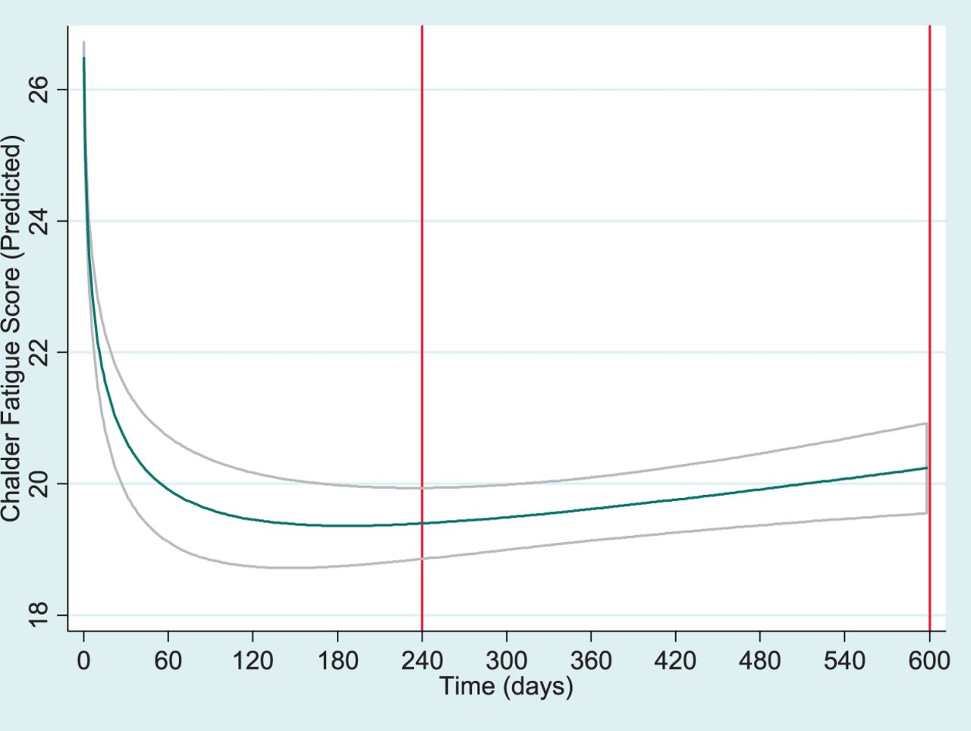
Figure 1 Predicted values of fatigue against time from generalized estimating equation regression model incorporating ...
Notes:
Figure 1 Predicted values of fatigue against time from generalized estimating equation regression model incorporating a fractional term for time (time½) (N = 882). Vertical lines indicate follow-up interval adopted for this study (8–20 months).
Unless provided in the caption above, the following copyright applies to the content of this slide: © The Author 2013. Published by Oxford University Press on behalf of the Association of Physicians.This is an Open Access article distributed under the terms of the Creative Commons Attribution Non-Commercial License (http://creativecommons.org/licenses/by-nc/3.0/), which permits unrestricted non-commercial use, distribution, and reproduction in any medium, provided the original work is properly cited.

