Slide 1
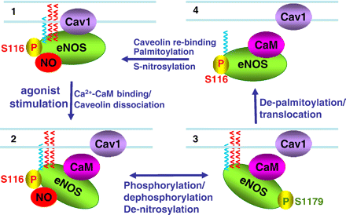
Fig. 1 Dynamic relationship between key eNOS post-translational modifications: This figure demonstrates some of the ...
Notes:
Fig. 1 Dynamic relationship between key eNOS post-translational modifications: This figure demonstrates some of the inter-relationships of caveolin binding, calmodulin binding, acylation, and phosphorylation on eNOS activity. Panel 1 shows quiescent eNOS anchored to caveolae by myristoylation and palmitoylation (blue and red chains respectively); in this state eNOS is inhibited by caveolin binding, inhibitory phosphorylation at serine 116, and nitrosylation at cysteines 96 and 101. Panel 2 shows displacement of caveolin binding by calcium–calmodulin. De-nitrosylation plus stimulatory phosphorylation at serine 1179 enhance enzyme activity in panel 3, accompanied by hsp90 binding. After prolonged agonist stimulation, eNOS becomes de-palmitoylated and translocates from peripheral to internal membranes. eNOS is inactivated by calmodulin dissociation allowing re-binding of caveolin, accompanied by re-nitrosylation of the enzyme and de-phosphorylation of eNOS at its stimulatory phosphorylation sites. See text for details.
Unless provided in the caption above, the following copyright applies to the content of this slide: Copyright © 2007, European Society of Cardiology

