Slide 1
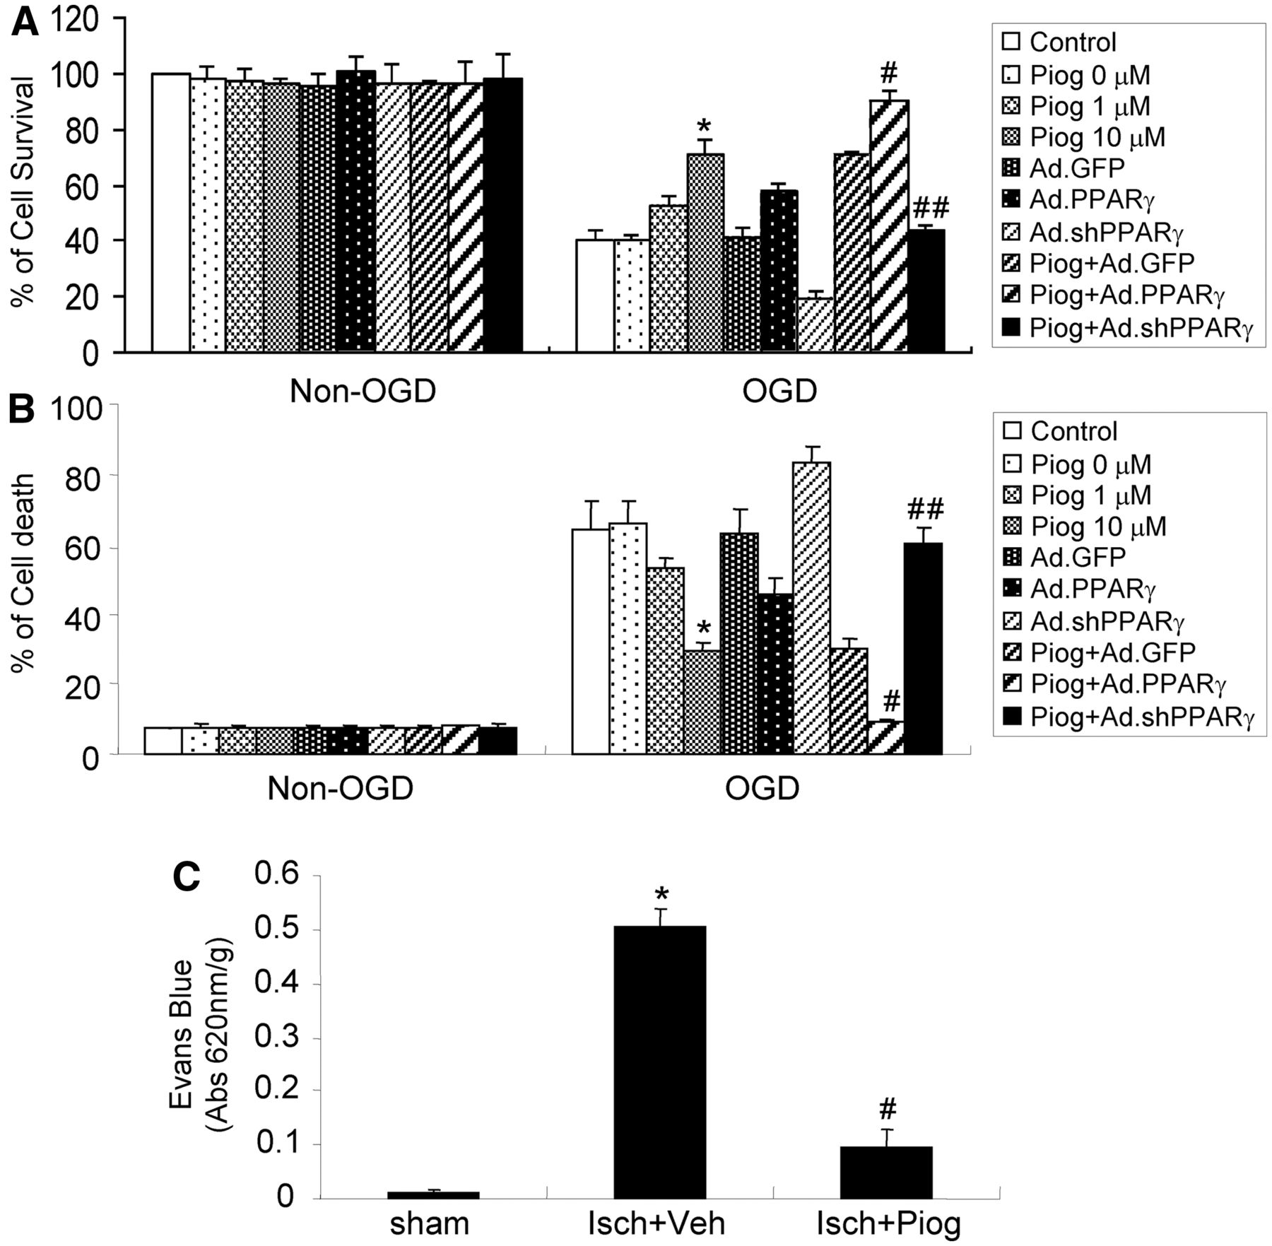
Figure 1 Pioglitazone provides vasoprotection in vitro and in vivo. (A and B) Mouse cerebral vascular endothelial ...
Notes:
Figure 1 Pioglitazone provides vasoprotection in vitro and in vivo. (A and B) Mouse cerebral vascular endothelial cells were treated with pioglitazone (Piog) at different doses with or without infection of an adenovirus carrying PPARγ, small-hairpin PPARγ (shPPARγ) or GFP for 48 h, and then subjected to 16 h oxygen–glucose deprivation (OGD) exposure. Cell viability was determined by MTT assays (A) and the lactate dehydrogenase method (B). Pioglitazone significantly reduced oxygen–glucose deprivation-induced cerebral vascular endothelial cell death in a dose-dependent manner. Gain of PPARγ function by infection of an adenovirus (Ad) carrying PPARγ in cerebral vascular endothelial cells potentiated pioglitazone-mediated cytoprotection after 16 h of oxygen–glucose deprivation exposure, whereas loss of PPARγ function by adenovirus-mediated PPARγ RNA interference reversed this effect. (C) Mice were treated with pioglitazone (intraperitoneally 2 mg/kg) at the start of 24 h of middle cerebral artery reperfusion after 1 h of middle cerebral artery occlusion (n = 6). Cerebrovascular permeability was determined by Evans blue extravasation. Pioglitazone significantly attenuated ischaemia-triggered increases in cerebrovascular permeability. Data are expressed as mean ± SEM. *P < 0.05 versus oxygen–glucose deprivation or Sham group. #P < 0.05 versus oxygen–glucose deprivation + pioglitazone + Ad.GFP; ##P < 0.05 versus ischemia + vehicle (Isch + Veh) group.
Unless provided in the caption above, the following copyright applies to the content of this slide: © The Author (2013). Published by Oxford University Press on behalf of the Guarantors of Brain. All rights reserved. For Permissions, please email: journals.permissions@oup.com

Slide 2
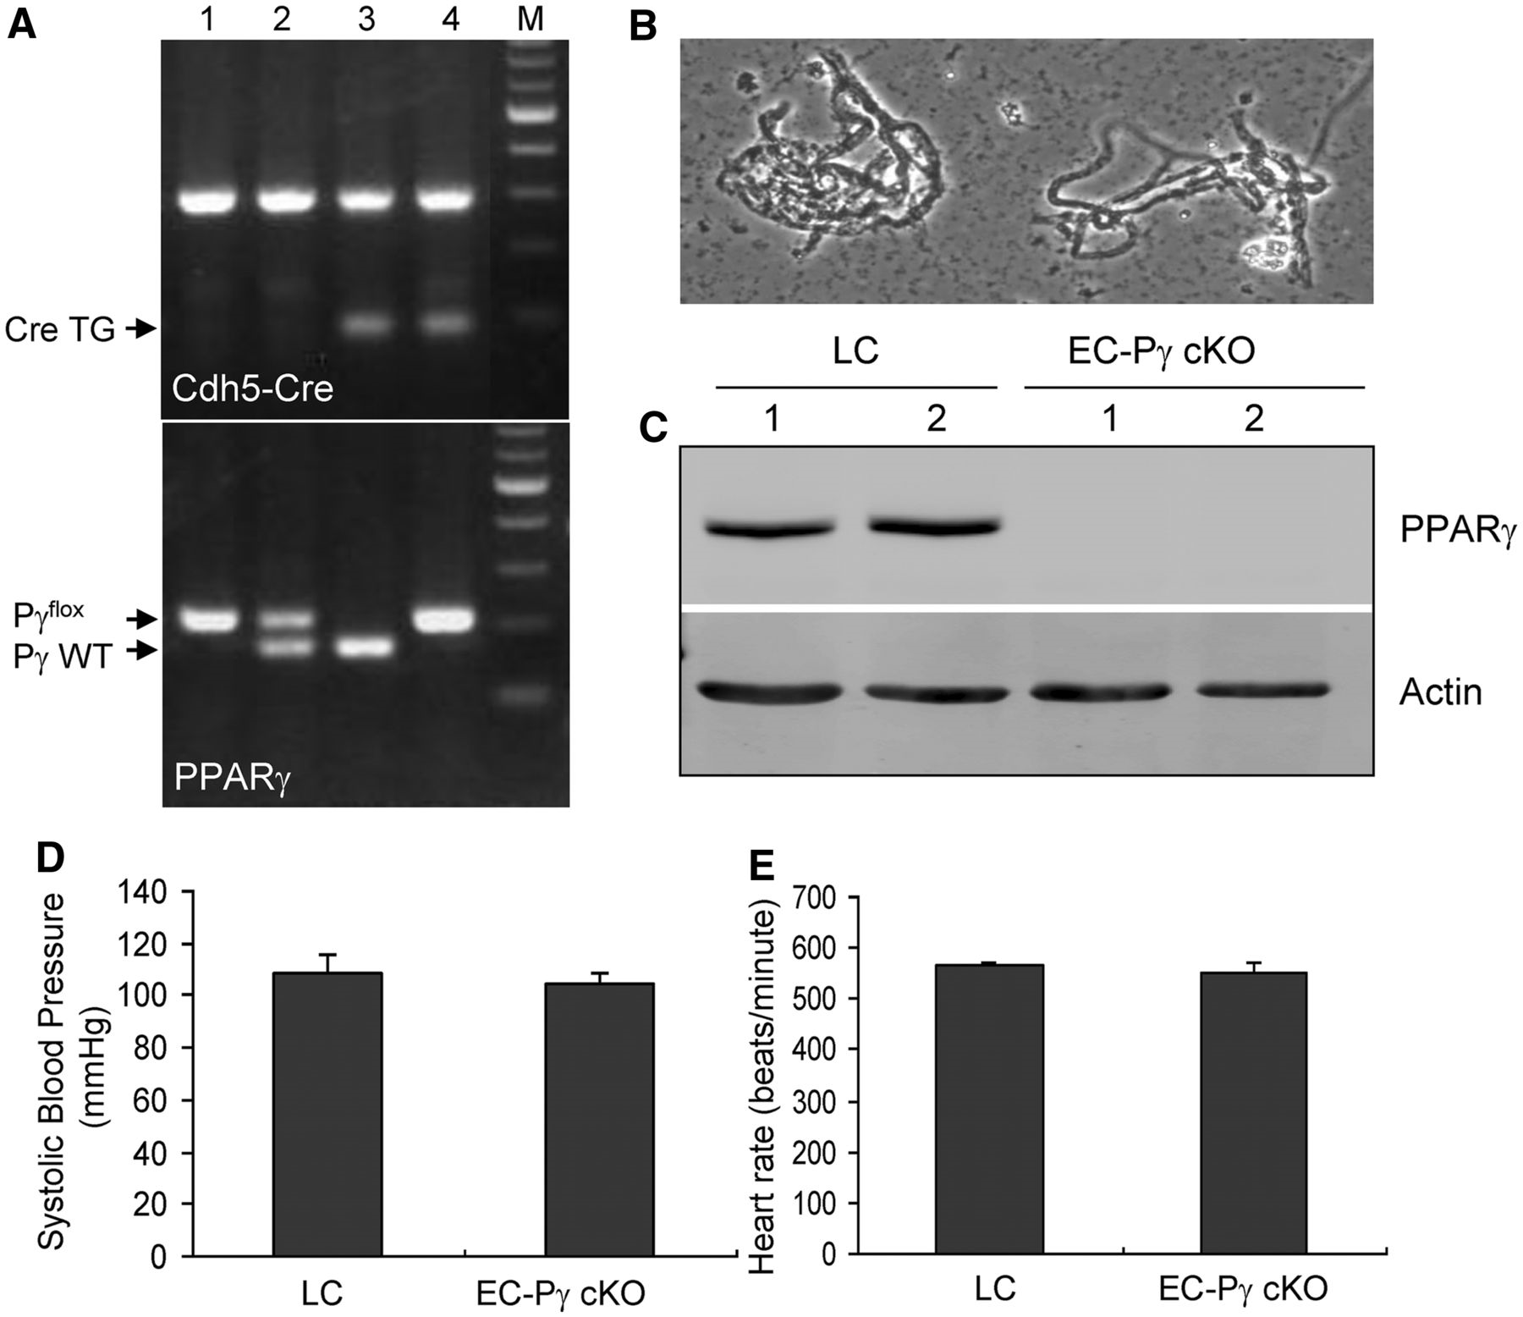
Figure 2 Generation and identification of endothelial cell-selective PPARγ conditional knockout mice. (A) Genomic PCR ...
Notes:
Figure 2 Generation and identification of endothelial cell-selective PPARγ conditional knockout mice. (A) Genomic PCR genotyping showed that endothelial cell-selective PPARγ conditional knockout (EC-Pγ cKO, lane 4) mice and littermate control mice (LC, lane 1) were generated by crossing cdh5-Cre transgenic mice (Cre TG) with PPARγflox/flox mice. (B) Microscopic view of isolated cerebral microvessels. (C) Western blot analysis showing PPARγ expression in lysates from cerebral vessels of EC-Pγ cKO and littermate control mice. Cre-mediated recombination in endothelial cells resulted in a lack of PPARγ expression in the cerebral vessels of EC-Pγ cKO mice. There is no statistical significance in blood pressure (D) and heart rate (E) between EC-Pγ cKO mice and littermate control mice. Results shown are representative of three separate experiments with similar results.
Unless provided in the caption above, the following copyright applies to the content of this slide: © The Author (2013). Published by Oxford University Press on behalf of the Guarantors of Brain. All rights reserved. For Permissions, please email: journals.permissions@oup.com

Slide 3
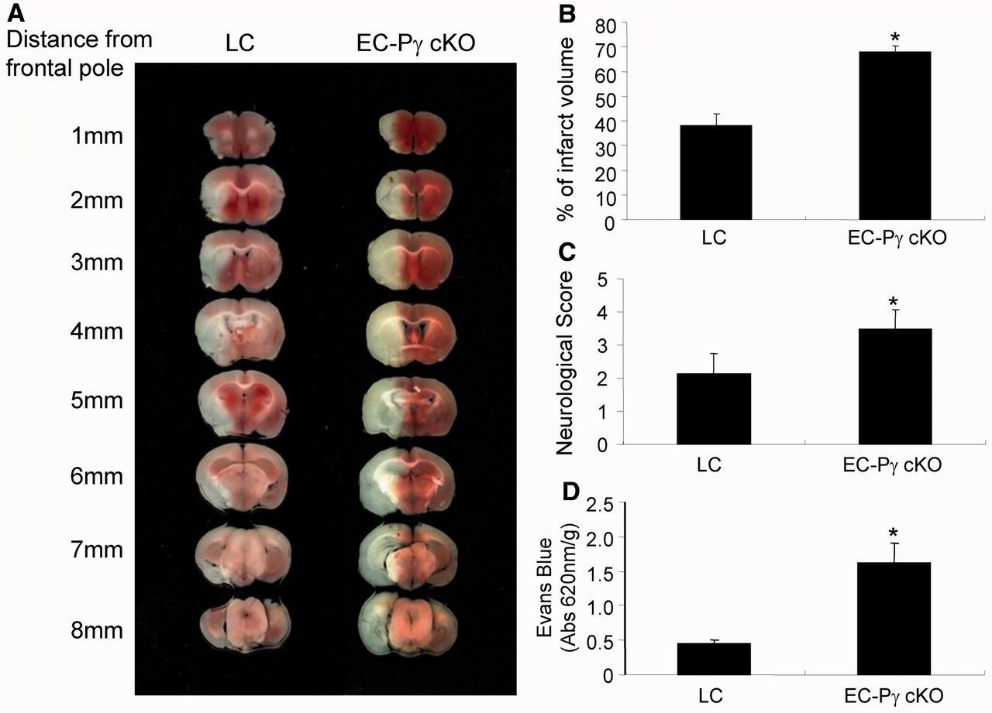
Figure 3 The effect of endothelial cell PPARγ on ischaemia-induced brain infarction and cerebrovascular permeability. ...
Notes:
Figure 3 The effect of endothelial cell PPARγ on ischaemia-induced brain infarction and cerebrovascular permeability. Endothelial cell-selective PPARγ conditional knockout (EC-Pγ cKO) and littermate control (LC) mice were subjected to 30 min middle cerebral artery occlusion and 24 h reperfusion. Two per cent 2,3,5-triphenyltetrazolium chloride-stained coronal sections are shown at different brain levels posterior to the frontal pole (A). Quantitative analysis was performed on infarct volume (B) and neurological deficits (C) in mice after stroke. Quantitative analysis of cerebrovascular permeability was determined 1 h after Evans blue injection (D). Compared with littermate control mice, EC-Pγ cKO mice show potentiated ischaemia-induced brain infarction (n = 8), worsened neurological outcomes (n = 8) and decreased cerebrovascular permeability (n = 7). Data are expressed as mean ± SD. *P < 0.05 versus the littermate control group.
Unless provided in the caption above, the following copyright applies to the content of this slide: © The Author (2013). Published by Oxford University Press on behalf of the Guarantors of Brain. All rights reserved. For Permissions, please email: journals.permissions@oup.com

Slide 4
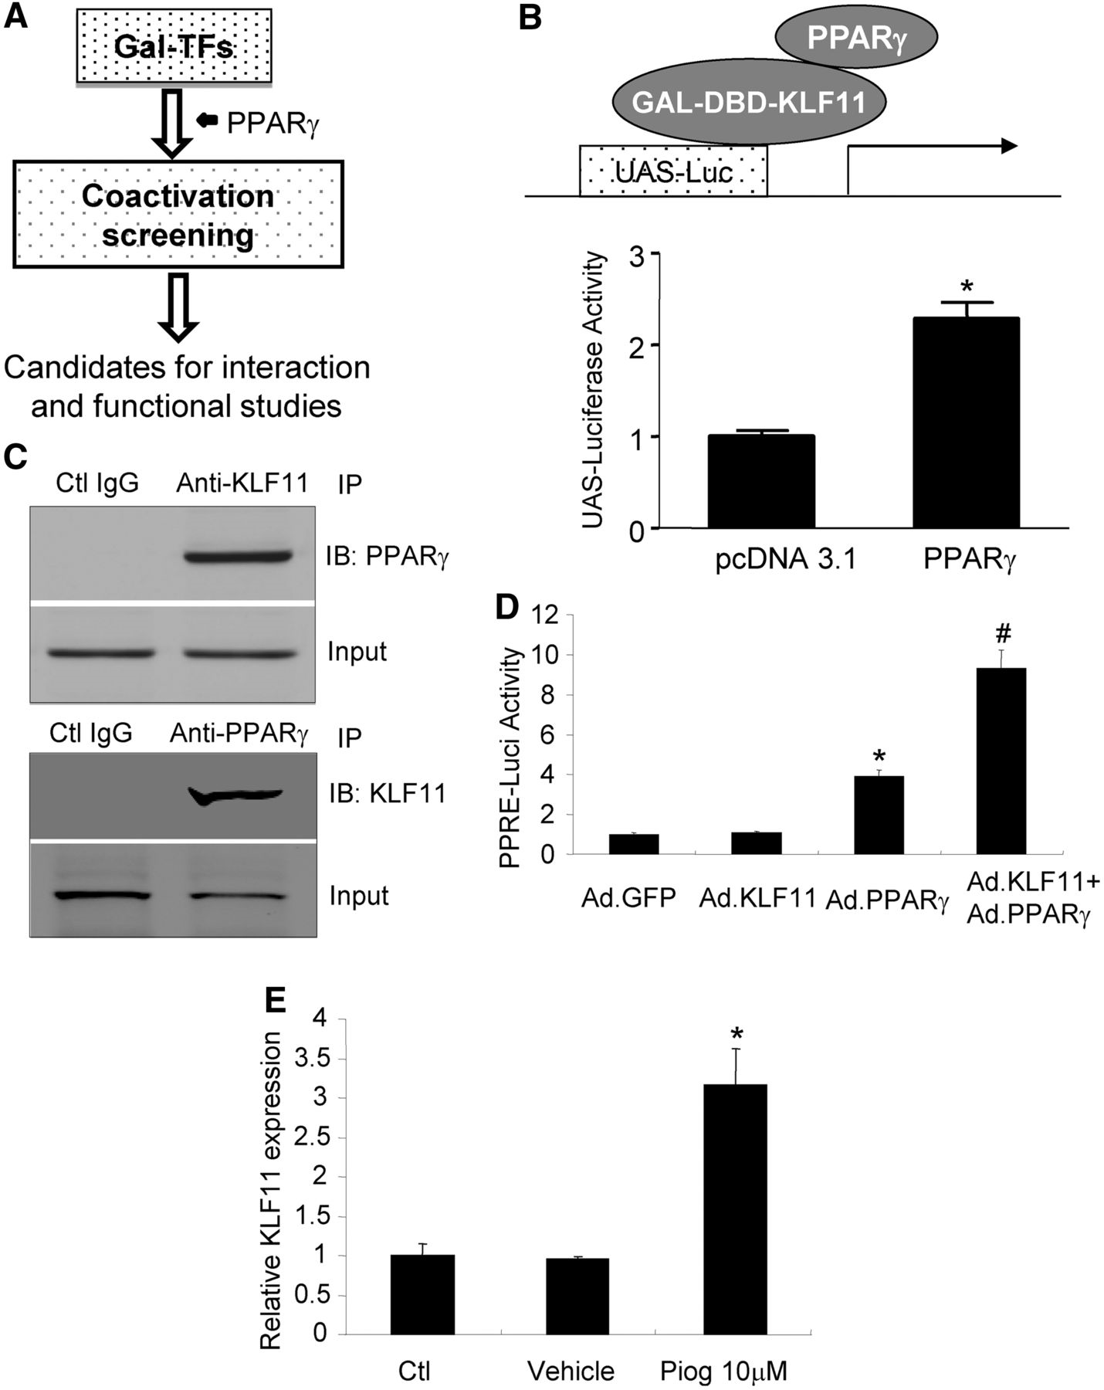
Figure 4 Identification of KLF11 as a novel PPARγ co-regulator. (A) Schema of genome-wide co-activation analysis. (B) ...
Notes:
Figure 4 Identification of KLF11 as a novel PPARγ co-regulator. (A) Schema of genome-wide co-activation analysis. (B) UAS–luc, KLF11–Gal4–DBD and PPARγ expression vectors were co-transfected into HEK293 cells, and then luciferase activity was determined. (C) Total protein was isolated from mouse cerebral vascular endothelial cells, and then a co-immunoprecipitation assay was performed for KLF11–PPARγ interaction. KLF11 strongly binds to PPARγ in mouse cerebral vascular endothelial cells. (D) The 3 × PPRE–luc and adenoviral KLF11 vectors were co-transfected into mouse cerebral vascular endothelial cells in the presence of adenoviral GFP or PPARγ, and PPRE transcriptional activity was determined. KLF11 does not affect PPRE activity at basal levels, but it increases PPARγ adenoviral-mediated PPRE transcriptional activity in mouse cerebral vascular endothelial cells. (E) Mouse cerebral vascular endothelial cell cultures were treated with vehicle or pioglitazone at indicated doses, and total RNA was isolated for real-time PCR. Activation of PPARγ by its agonist, pioglitazone, significantly elevated KLF11 messenger RNA expression levels. Data are expressed as mean ± SEM. *P < 0.05 versus pcDNA 3.1 or Ad.GFP or vehicle control group. #P < 0.05 versus Ad.PPARγ group. IB = immunoblotting; IP = immunoprecipitation.
Unless provided in the caption above, the following copyright applies to the content of this slide: © The Author (2013). Published by Oxford University Press on behalf of the Guarantors of Brain. All rights reserved. For Permissions, please email: journals.permissions@oup.com

Slide 5
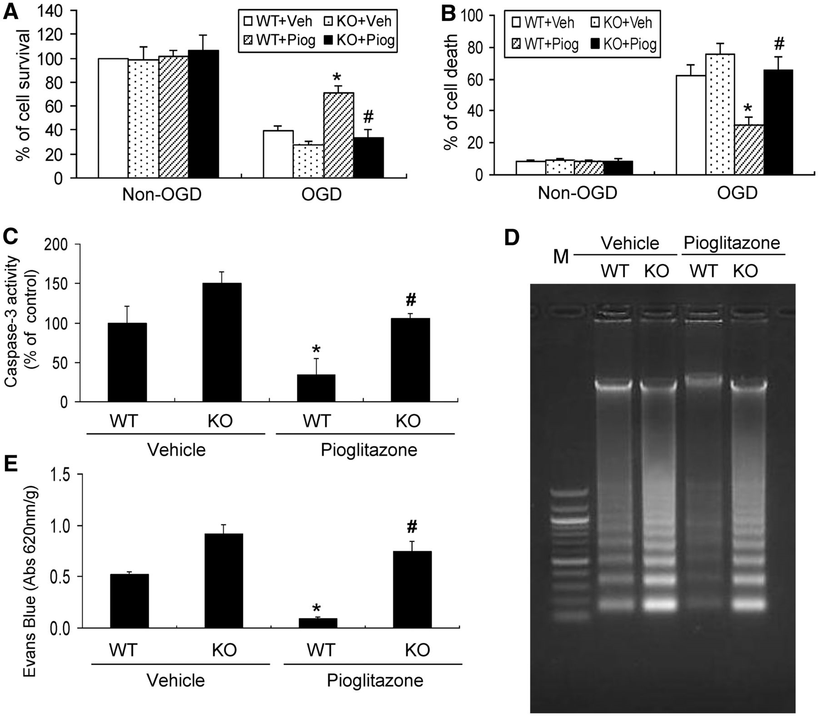
Figure 5 The effect of KLF11 genetic deficiency on pioglitazone-mediated endothelial protection in cerebral vascular ...
Notes:
Figure 5 The effect of KLF11 genetic deficiency on pioglitazone-mediated endothelial protection in cerebral vascular endothelial cell cultures and the cerebral vasculature after ischaemic insults. Primary mouse cerebral vascular endothelial cells were cultured from KLF11 knockout or wild-type mice and then treated with 10 µM pioglitazone overnight before 16 h of oxygen–glucose deprivation exposure. Cell viability was determined by MTT assays (A) and the lactate dehydrogenase method (B). Kruppel-like factor knockout or wild-type mice (n = 6) were treated with pioglitazone (intraperitoneal 2 mg/kg) immediately after 30 min middle cerebral artery occlusion. After 24 h middle cerebral artery reperfusion, cerebral microvessels were isolated from the brain and then subjected to measurement of caspase 3 activity (C) and DNA fragmentation (D) as described in the ‘Materials and methods’ section. Cerebrovascular permeability was also determined 1 h after injection from Evans blue extravasation (n = 6) in mice after stroke (E). Pioglitazone treatment significantly attenuates caspase 3 activation and DNA fragmentation in the cerebral microvasculature and improves cerebrovascular permeability in wild-type mice after middle cerebral artery occlusion. However, pioglitazone-mediated vasoprotection was abolished in KLF11 knockout mice. Data are expressed as mean ± SD. *P < 0.05 versus wild-type (WT) + vehicle group. #P < 0.05 versus WT + pioglitazone group.
Unless provided in the caption above, the following copyright applies to the content of this slide: © The Author (2013). Published by Oxford University Press on behalf of the Guarantors of Brain. All rights reserved. For Permissions, please email: journals.permissions@oup.com

Slide 6
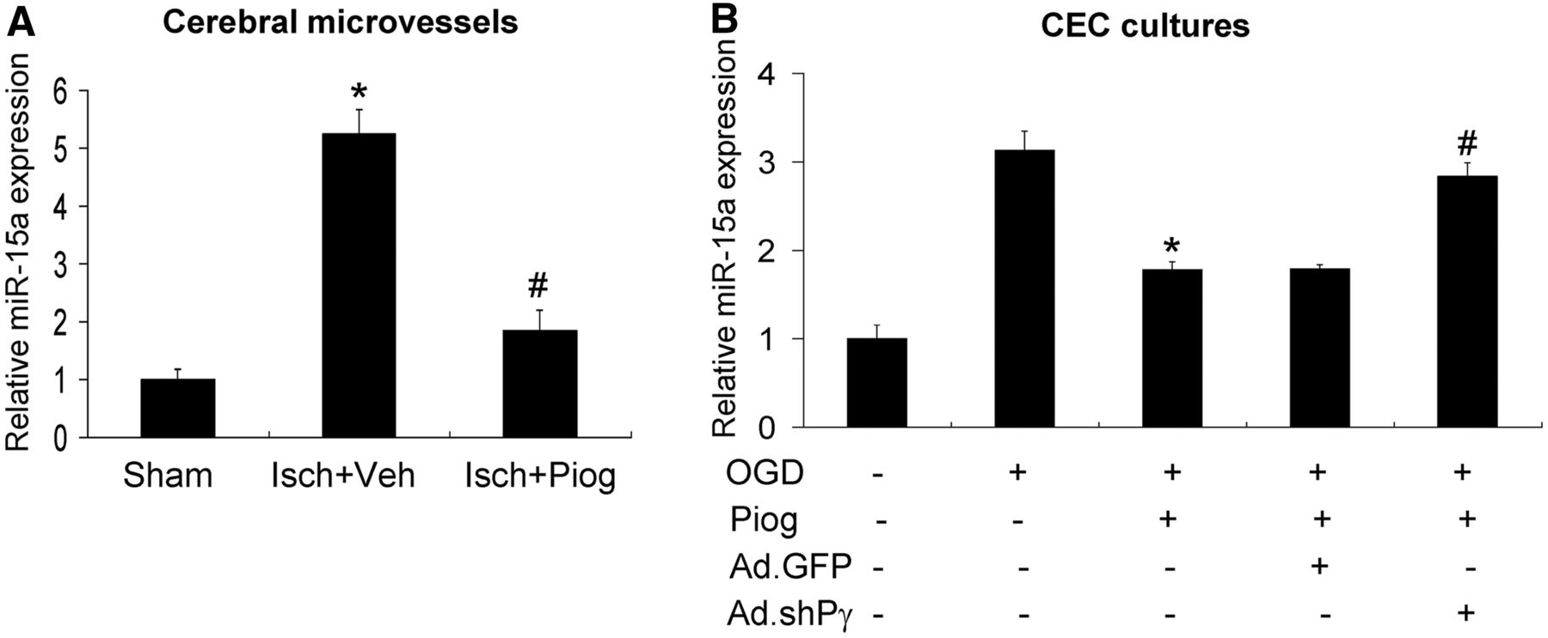
Figure 6 Potential targets of PPARγ activation in the cerebral vasculature after ischaemic insults. (A) Mice were ...
Notes:
Figure 6 Potential targets of PPARγ activation in the cerebral vasculature after ischaemic insults. (A) Mice were treated with pioglitazone (intraperitoneal 2 mg/kg) after 30 min middle cerebral artery occlusion. After 24 h middle cerebral artery reperfusion, cerebral microvessels were isolated from the brain, and total RNA was extracted for real-time PCR. Cerebral ischaemia resulted in a significant increase in miR-15a expression, and this effect was almost completely abolished by treatment with pioglitazone. (B) Mouse cerebral vascular endothelial cell (CEC) cultures were treated with 10 µM pioglitazone for 24 h with or without infection of an adenovirus (Ad) carrying small-hairpin PPARγ or GFP for 48 h. Total RNA was then isolated, and miR-15a levels were examined by real-time PCR. Data are expressed as mean ± SEM. *P < 0.05 versus oxygen–glucose deprivation (OGD) or sham group. #P < 0.05 versus oxygen–glucose deprivation + pioglitazone + Ad.GFP or ischaemia + vehicle group.
Unless provided in the caption above, the following copyright applies to the content of this slide: © The Author (2013). Published by Oxford University Press on behalf of the Guarantors of Brain. All rights reserved. For Permissions, please email: journals.permissions@oup.com

Slide 7
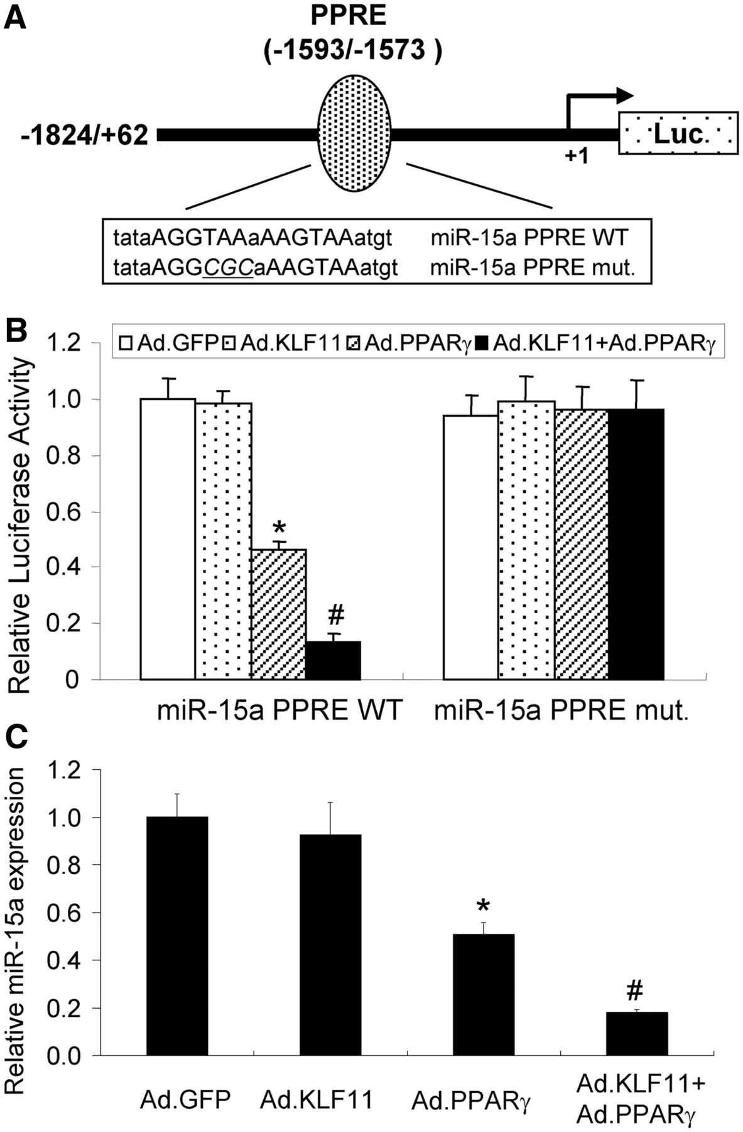
Figure 7 KLF11 enhances PPARγ transcriptional repression of miR-15a in mouse cerebral vascular endothelial cells. (A) ...
Notes:
Figure 7 KLF11 enhances PPARγ transcriptional repression of miR-15a in mouse cerebral vascular endothelial cells. (A) Schematic representation of a pGL 4.10 luciferase reporter plasmid containing ∼1.9 kb of the 5′ upstream promoter sequence of the mouse miR-15a gene. A putative PPRE binding site was demonstrated in the promoter of miR-15a at locations of −1593/−1573 bp (PPRE). The transcription start site is numbered as +1. (B) Luciferase reporter assays were performed by transfecting mouse cerebral vascular endothelial cells with a pGL 4.10 luciferase plasmid carrying either a miR-15a wild-type promoter (miR-15a PPRE Wt) or a miR-15a promoter with a mutated PPRE (miR-15a PPRE mut.). Transcriptional activity is reduced in the miR-15a wild-type promoter, but not in the PPRE mutant promoter, on adenoviral gain of PPARγ function. Of note, adenoviral gain of KLF11 function itself has no effect on miR-15a expression, but it significantly enhances PPARγ transcriptional suppression of miR-15a. (C) Mouse cerebral vascular endothelial cells were infected or co-infected with an adenovirus carrying PPARγ, KLF11 or GFP for 48 h. Total RNA was then isolated, and miR-15a levels were examined by real-time PCR. Data are expressed as mean ± SEM. *P < 0.05 versus Ad.GFP group. #P < 0.05 versus Ad.PPARγ group. Results shown are representative of three separate experiments with similar results.
Unless provided in the caption above, the following copyright applies to the content of this slide: © The Author (2013). Published by Oxford University Press on behalf of the Guarantors of Brain. All rights reserved. For Permissions, please email: journals.permissions@oup.com

