Slide 1
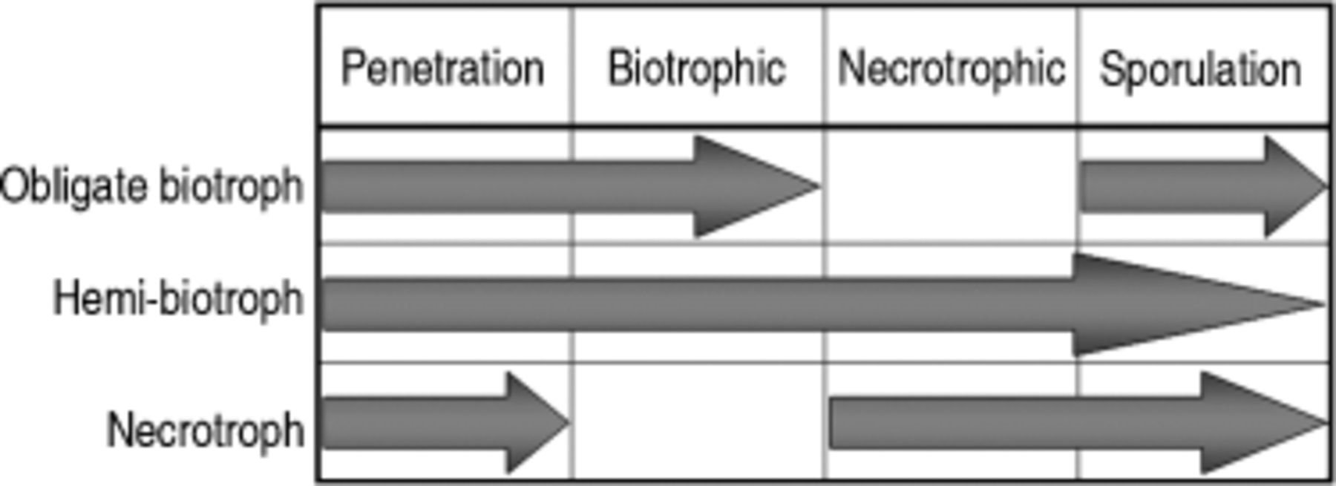
1 Infectious phases in phytopathogenic fungi that are relevant to nutrition acquisition strategies during ...
Notes:
1 Infectious phases in phytopathogenic fungi that are relevant to nutrition acquisition strategies during fungal infection of plants. The penetration and sporulation phases are common to all fungi. Hemibiotrophs are distinguished by going through successive biotrophic and necrotrophic phases. Necrotrophs do not have a biotrophic phase, whereas obligate biotrophs complete their life cycle in this phase, without proceeding to necrotrophic stage.
Unless provided in the caption above, the following copyright applies to the content of this slide: © 2006 Federation of European Microbiological Societies

Slide 2
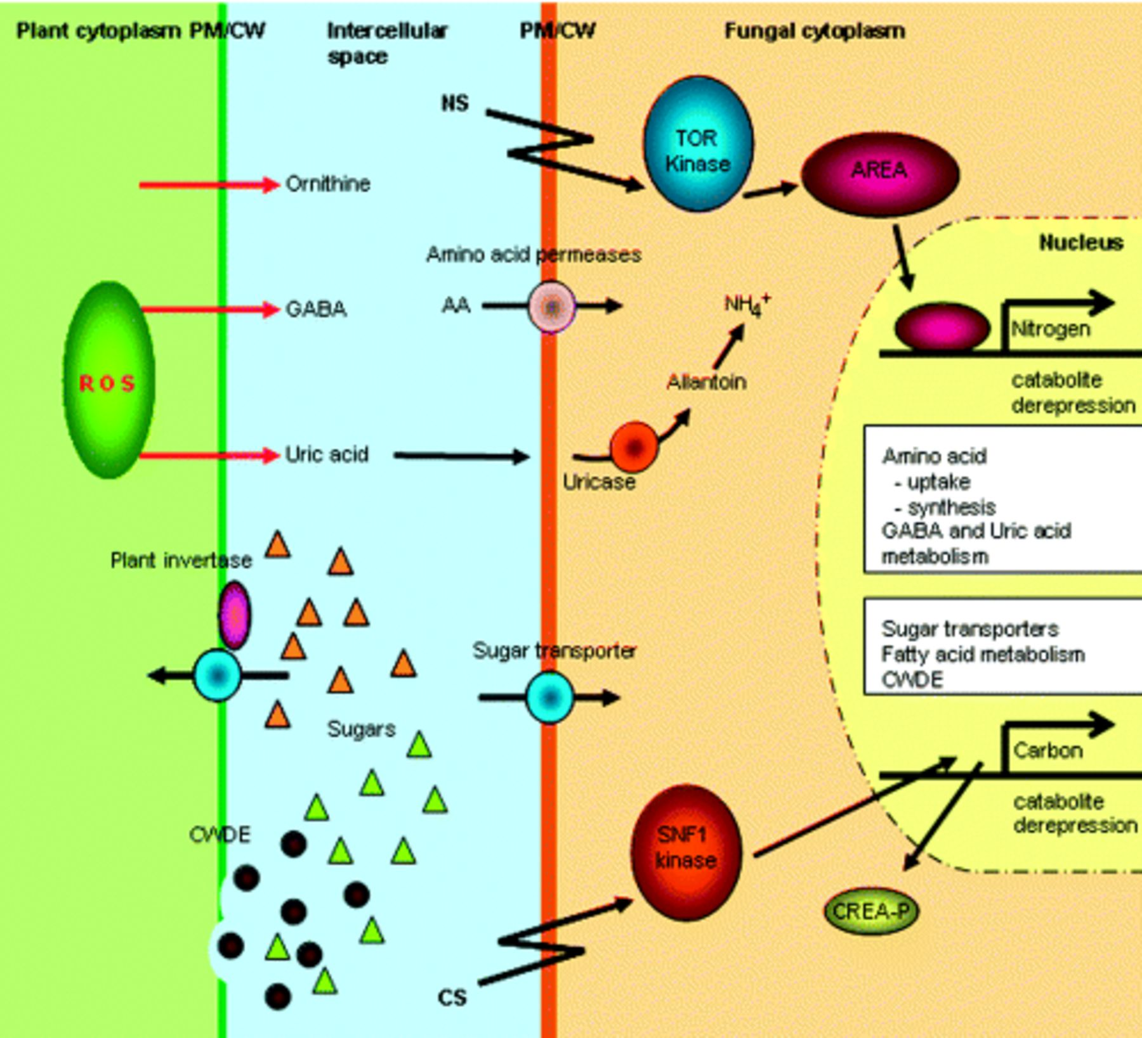
2 Examples of the entrainment of plant metabolism by phytopathogenic fungi. Sensing of nitrogen or carbon ...
Notes:
2 Examples of the entrainment of plant metabolism by phytopathogenic fungi. Sensing of nitrogen or carbon availability (NS, CS; flash arrow), or the absence of preferable nutrient sources, triggers signal transduction pathways that initiate transcription of transporters and pathway-specific metabolic enzymes. The de-repression of these pathways is regulated by de-phosphorylation and binding of AREA to nitrogen catabolite-regulated gene promoters (Ravagnani et al., 1997; Beck & Hall, 1999), and by SNF1-dependent phosphorylation and release of CREA repressor from carbon catabolite-regulated gene promoters (DeVit et al., 1997; Gancedo, 1998). Plant resistance responses (red arrows), involving ornithine or ROS scavengers such as GABA, are taken up through amino acid (AA) permeases and metabolized by the fungus (Oliver & Solomon, 2004; Guldener et al., 2006). Uric acid, the product of disease-induced enhanced catabolic processes in the plant, can serve as a fungal nutrient by conversion to allantoin by uricase and subsequent recovery of ammonia (Divon et al., 2005). Plant invertases that are induced by the plant to fuel its cellular defence needs, as well as CWDE secreted by the pathogen, will produce depolymerized sugars that the fungus can utilize (Ospina-Giraldo et al., 2003; Biemelt & Sonnewald, 2006). PM, plasma membrane; CW, cell wall.
Unless provided in the caption above, the following copyright applies to the content of this slide: © 2006 Federation of European Microbiological Societies

Slide 3
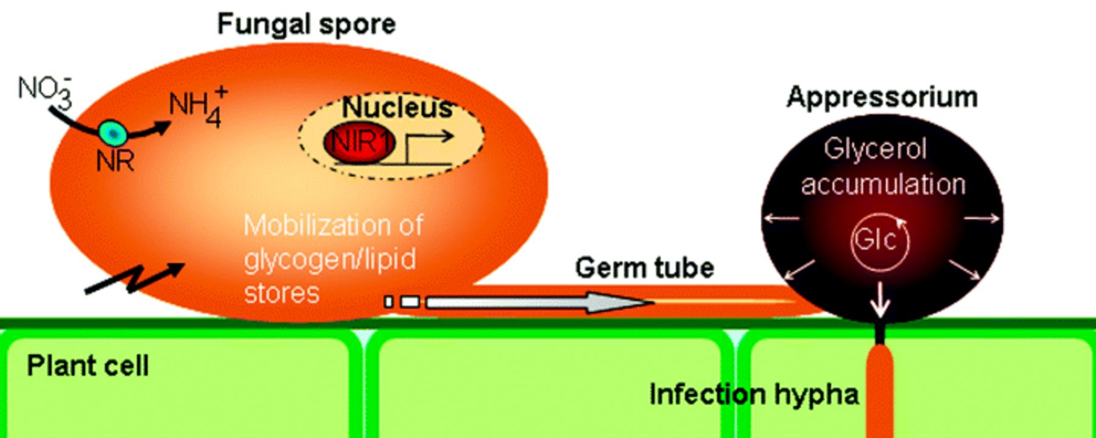
3 Nutrition-related processes that take place during appressorium-mediated penetration. MAP kinase- and ...
Notes:
3 Nutrition-related processes that take place during appressorium-mediated penetration. MAP kinase- and cAMP-dependent PKA signalling pathways are involved in mobilization of glycogen and lipid stores from the spore. Turgor generation is accomplished by compartmentalization and rapid degradation of lipid and glycogen reserves in the appressorium (Thines et al., 2000). The glyoxylate cycle (Glc) is involved in turgor generation, but also in replenishing intermediates to the TCA cycle from acetyl-CoA generated in fatty acid oxidation (Kimura et al., 2001; Idnurm & Howlett, 2002; Wang et al., 2003; Solomon et al., 2004a). An NirA-like transcription factor, Nir1, is required for transcription of nitrate reductase (NR), necessary for nitrate assimilation in Colletotrichum acutatum, but is also involved in additional processes related to appressorium formation (Horowitz et al., 2006). The grey/white arrow in the germ tube indicates transport of glycogen and lipid metabolic products; the flash arrow indicates sensing mechanism(s); and the small white arrows in the appressorium signify turgor generation.
Unless provided in the caption above, the following copyright applies to the content of this slide: © 2006 Federation of European Microbiological Societies

