Slide 1
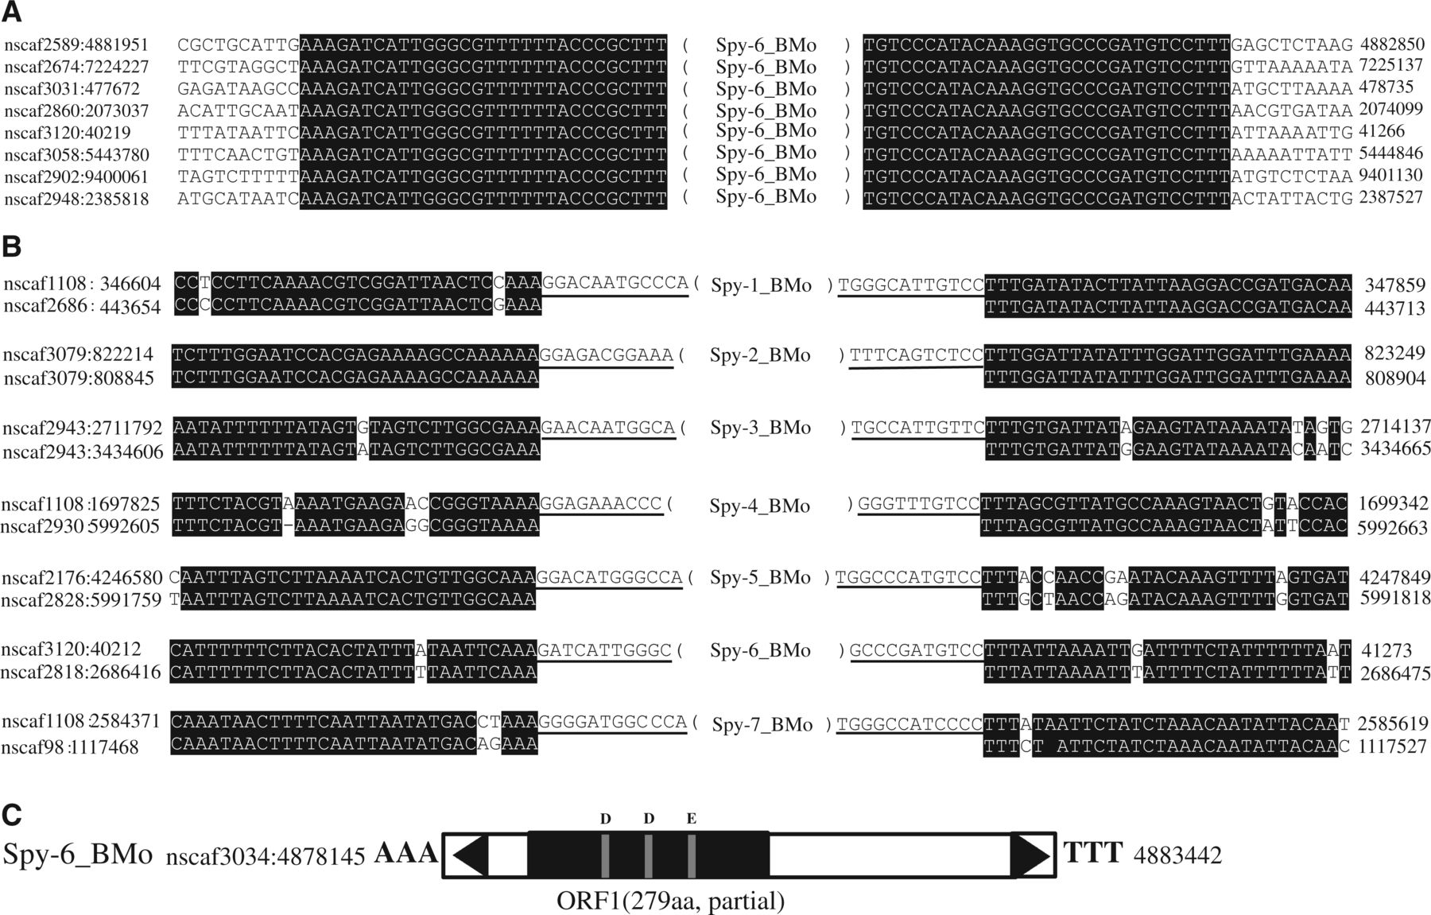
Fig. 1.— Characters of silkworm Spy transposons. (A) Sequence alignments for Spy-6_BMo family. The TIRs and flanking ...
Notes:
Fig. 1.— Characters of silkworm Spy transposons. (A) Sequence alignments for Spy-6_BMo family. The TIRs and flanking sequences are shown. (B) Seven examples of alignments of the flanking sequences of Spy insertions with a paralogous sequences found within the same genome but devoid of the transposon. The TIRs of the element is underlined. (C) Structure of Spy-6_BMo. Black triangles represent the TIRs. ORFs are depicted as solid black boxes and the position of the DDE triad is shown.
Unless provided in the caption above, the following copyright applies to the content of this slide: © The Author(s) 2014. Published by Oxford University Press on behalf of the Society for Molecular Biology and Evolution.This is an Open Access article distributed under the terms of the Creative Commons Attribution Non-Commercial License (http://creativecommons.org/licenses/by-nc/3.0/), which permits non-commercial re-use, distribution, and reproduction in any medium, provided the original work is properly cited. For commercial re-use, please contact journals.permissions@oup.com

Slide 2
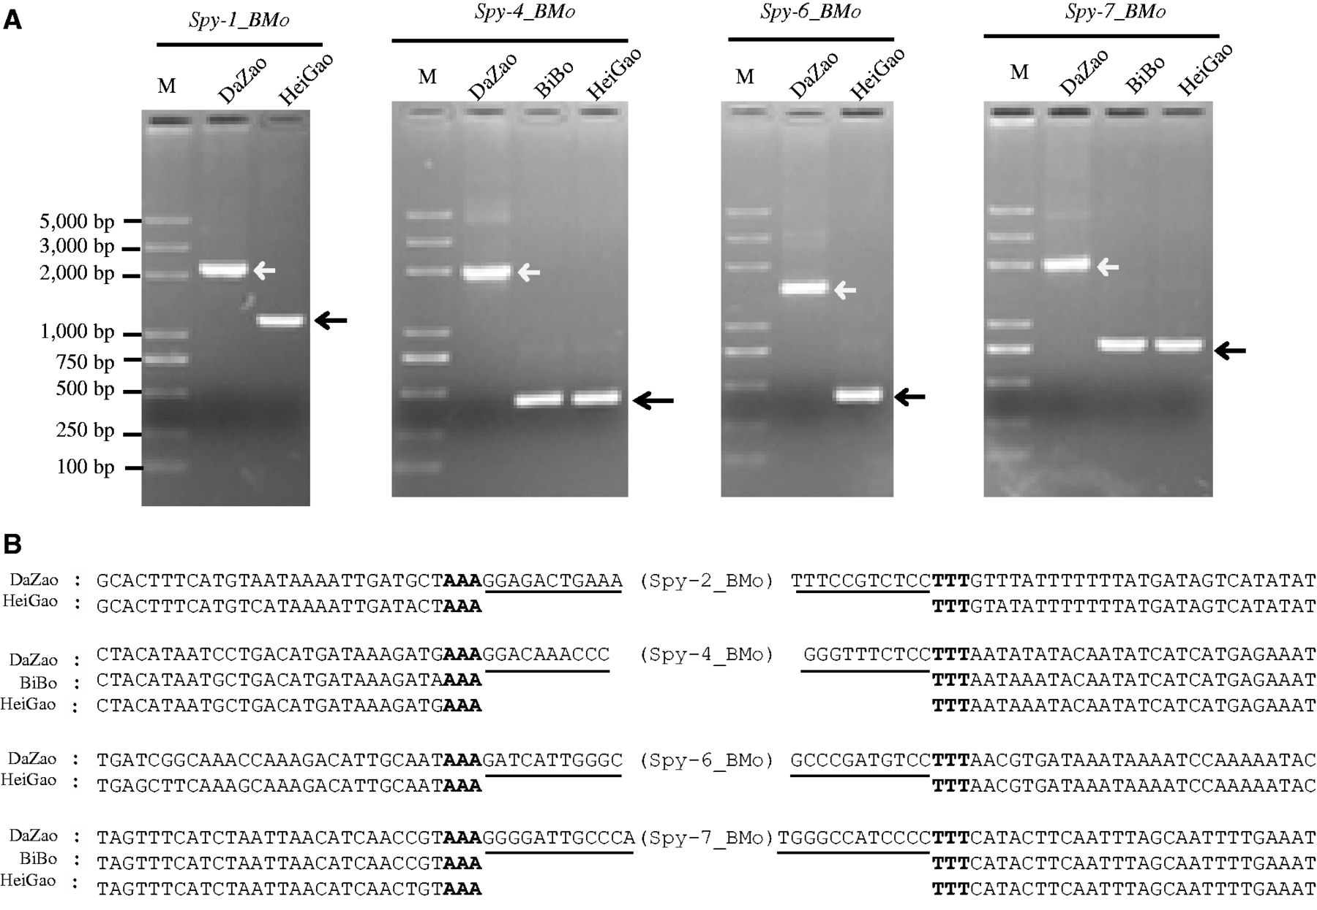
Fig. 2.— Target sites of the Spy family were tested using PCR and sequencing. (A) Results of PCR search for indel ...
Notes:
Fig. 2.— Target sites of the Spy family were tested using PCR and sequencing. (A) Results of PCR search for indel silkworm strains (DaZao, BiBo, and HeiGao) among four insertion sites of four silkworm Spy families (Spy-2, -4, -6, and -7_BMo). The black arrow points to the corresponding Spy lack at this genomic location. The white arrow represents the corresponding Spy occupied at this genomic location. (B) Results of sequencing for above locations. The target sequences are marked with black bold font, TIRs are marked with underline, and flank sequences are in blank.
Unless provided in the caption above, the following copyright applies to the content of this slide: © The Author(s) 2014. Published by Oxford University Press on behalf of the Society for Molecular Biology and Evolution.This is an Open Access article distributed under the terms of the Creative Commons Attribution Non-Commercial License (http://creativecommons.org/licenses/by-nc/3.0/), which permits non-commercial re-use, distribution, and reproduction in any medium, provided the original work is properly cited. For commercial re-use, please contact journals.permissions@oup.com

Slide 3
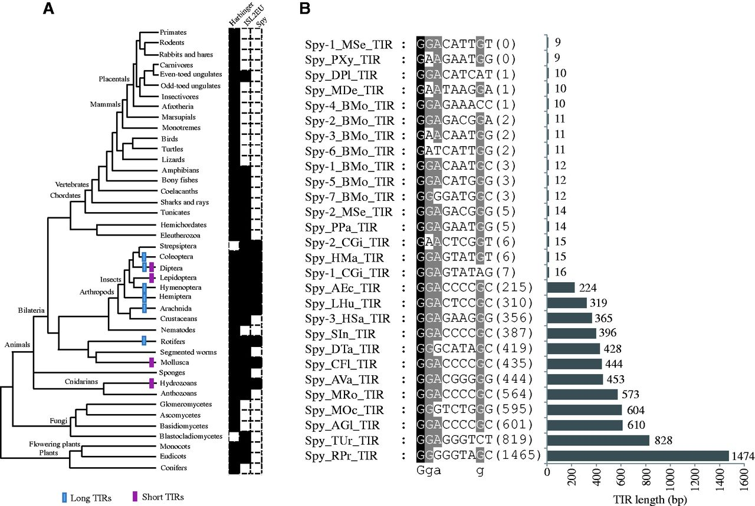
Fig. 3.— Taxonomic distribution of the Spy, PIF/Harbinger, and ISL2EU transposons as well as character of Spy TIRs. ...
Notes:
Fig. 3.— Taxonomic distribution of the Spy, PIF/Harbinger, and ISL2EU transposons as well as character of Spy TIRs. (A) Taxonomic distribution of three groups across the eukaryotic tree of life. Black and white boxes indicated presence and absence, respectively. (B) TIRs of all Spy identified in this study. Sequences are major-rule consensus derived from the alignment of multiple copies of each family.
Unless provided in the caption above, the following copyright applies to the content of this slide: © The Author(s) 2014. Published by Oxford University Press on behalf of the Society for Molecular Biology and Evolution.This is an Open Access article distributed under the terms of the Creative Commons Attribution Non-Commercial License (http://creativecommons.org/licenses/by-nc/3.0/), which permits non-commercial re-use, distribution, and reproduction in any medium, provided the original work is properly cited. For commercial re-use, please contact journals.permissions@oup.com

Slide 4
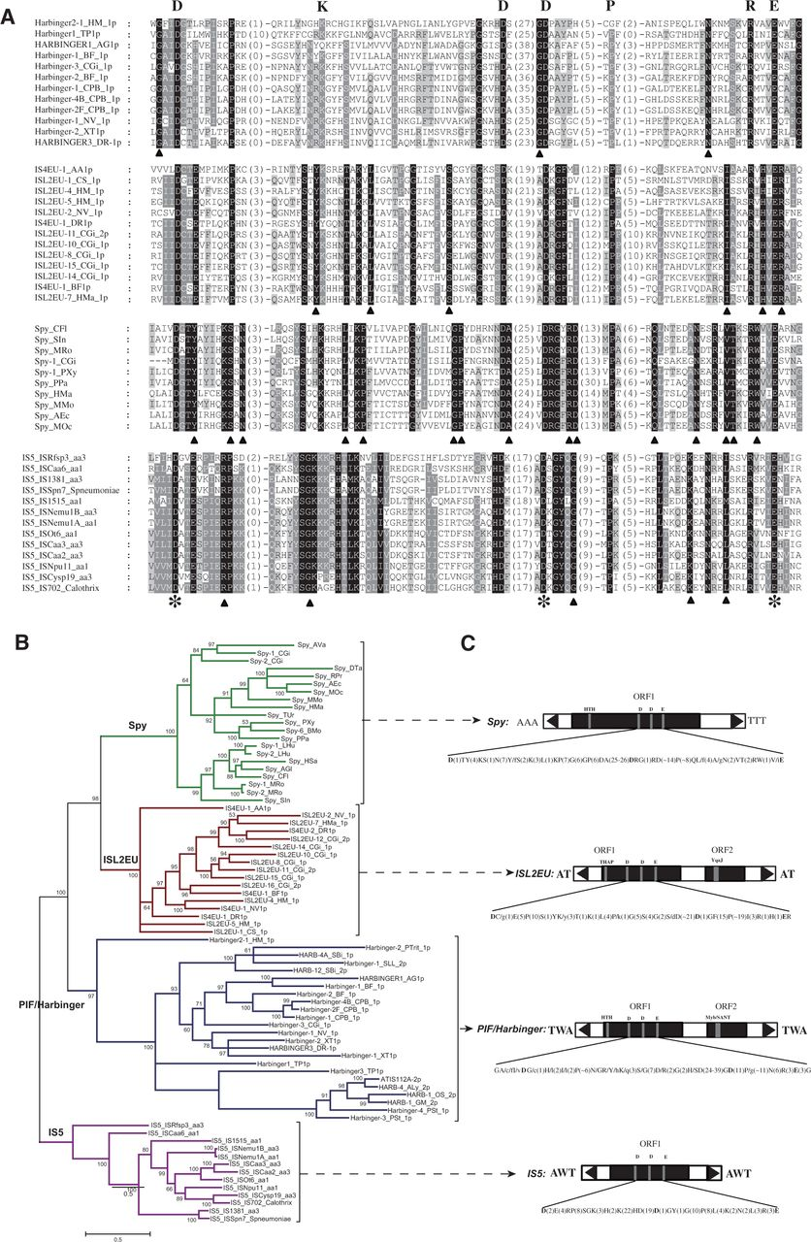
Fig. 4.— The results of phylogenetic analysis, coding capacity, and conserved transposase motifs of IS5, Spy, ISL2EU, ...
Notes:
Fig. 4.— The results of phylogenetic analysis, coding capacity, and conserved transposase motifs of IS5, Spy, ISL2EU, and PIF/Harbinger. (A) The alignment of DDE domain of each superfamily after redundancy elimination. Distances between the conserved blocks are indicated in the number of amino acid residues. Conserved residues within each superfamily are highlight in black or gray. The DDE triad identified here is marked with asterisks below alignments. Common conserved residues among four superfamilies are marked with letter above the alignments. Unique conserved residues of each superfamily are marked with blank triangle below the alignment. (B) Phylogenetic tree based on DDE domain sequences of each superfamily. In front of the colon represents corresponding IS5, Spy, ISL2EU, or PIF/Harbinger elements name; behind the colon represents species. (C) Structure of each superfamily. Black triangles represent the TIRs. ORFs are depicted as solid black boxes, and the position of the DDE triad and additional domains is shown above. Target sequences are shown in flank.
Unless provided in the caption above, the following copyright applies to the content of this slide: © The Author(s) 2014. Published by Oxford University Press on behalf of the Society for Molecular Biology and Evolution.This is an Open Access article distributed under the terms of the Creative Commons Attribution Non-Commercial License (http://creativecommons.org/licenses/by-nc/3.0/), which permits non-commercial re-use, distribution, and reproduction in any medium, provided the original work is properly cited. For commercial re-use, please contact journals.permissions@oup.com

Slide 5
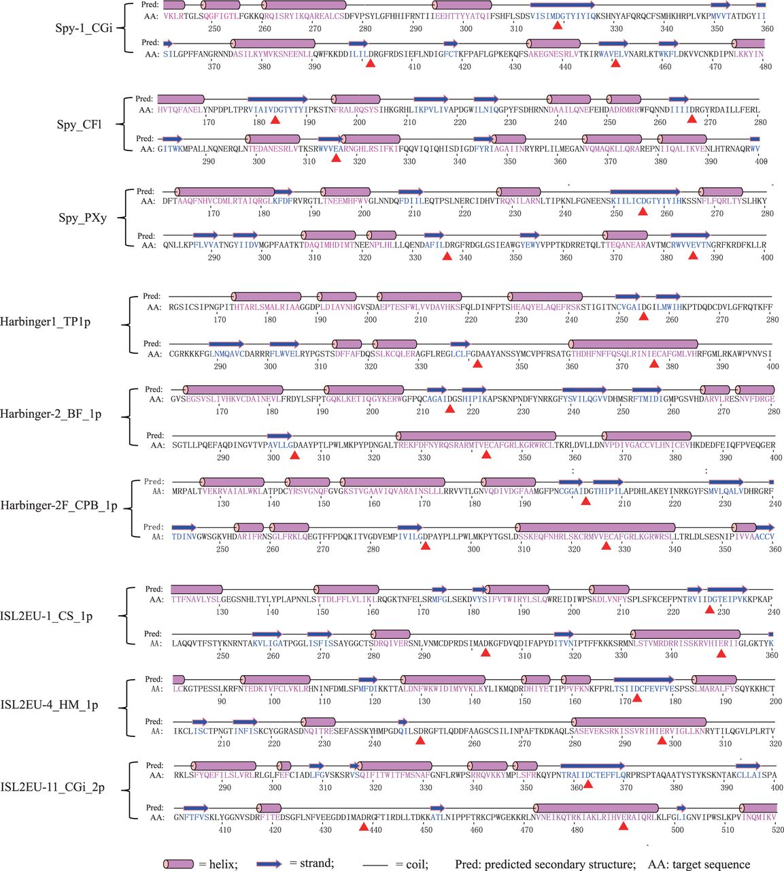
Fig. 5.— The secondary structure of DDE domain-containing transposase for Spy, ISL2EU, and PIF/Harbinger elements. The ...
Notes:
Fig. 5.— The secondary structure of DDE domain-containing transposase for Spy, ISL2EU, and PIF/Harbinger elements. The DDE triad is marked with red triangles below sequence.
Unless provided in the caption above, the following copyright applies to the content of this slide: © The Author(s) 2014. Published by Oxford University Press on behalf of the Society for Molecular Biology and Evolution.This is an Open Access article distributed under the terms of the Creative Commons Attribution Non-Commercial License (http://creativecommons.org/licenses/by-nc/3.0/), which permits non-commercial re-use, distribution, and reproduction in any medium, provided the original work is properly cited. For commercial re-use, please contact journals.permissions@oup.com

