Slide 1
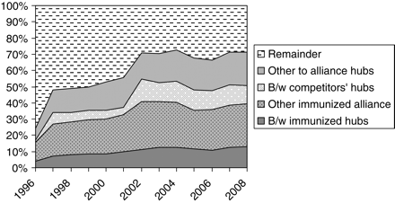
Figure 1. Market share of services involving hubs of alliances with antitrust immunity
Notes:
Figure 1. Market share of services involving hubs of alliances with antitrust immunity Note: Market shares are based on “frequency of service”; market shares based on “number of passengers carried” and “seats offered” are similar.41
Unless provided in the caption above, the following copyright applies to the content of this slide: © The Author (2011). Published by Oxford University Press. All rights reserved. For Permissions, please email: journals.permissions@oup.com

Slide 2
Figure 2. Simple complementary airline network
Notes:
Figure 2. Simple complementary airline network
Unless provided in the caption above, the following copyright applies to the content of this slide: © The Author (2011). Published by Oxford University Press. All rights reserved. For Permissions, please email: journals.permissions@oup.com

Slide 3
Figure 3. Simple partially overlapping airline network
Notes:
Figure 3. Simple partially overlapping airline network
Unless provided in the caption above, the following copyright applies to the content of this slide: © The Author (2011). Published by Oxford University Press. All rights reserved. For Permissions, please email: journals.permissions@oup.com

Slide 4
Figure 4. Airline network with choice of alliance partner
Notes:
Figure 4. Airline network with choice of alliance partner
Unless provided in the caption above, the following copyright applies to the content of this slide: © The Author (2011). Published by Oxford University Press. All rights reserved. For Permissions, please email: journals.permissions@oup.com

Slide 5
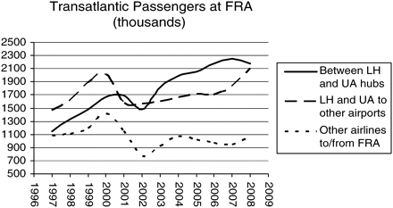
Figure 5. Non-stop transatlantic passenger traffic at Frankfurt Airport
Notes:
Figure 5. Non-stop transatlantic passenger traffic at Frankfurt Airport Note: Computed from T-100 dataset of the US DOT. See supra note 41. “LH” refers to Lufthansa; “UA” refers to United. The two airlines have had antitrust immunity since 1996. Services between UA and LH hubs include non-stop flights to Washington Dulles, Chicago O'Hare, Denver, and San Francisco by United or Lufthansa.
Unless provided in the caption above, the following copyright applies to the content of this slide: © The Author (2011). Published by Oxford University Press. All rights reserved. For Permissions, please email: journals.permissions@oup.com

Slide 6
Figure 6. Simple airline network with two alliances
Notes:
Figure 6. Simple airline network with two alliances
Unless provided in the caption above, the following copyright applies to the content of this slide: © The Author (2011). Published by Oxford University Press. All rights reserved. For Permissions, please email: journals.permissions@oup.com

