Slide 1
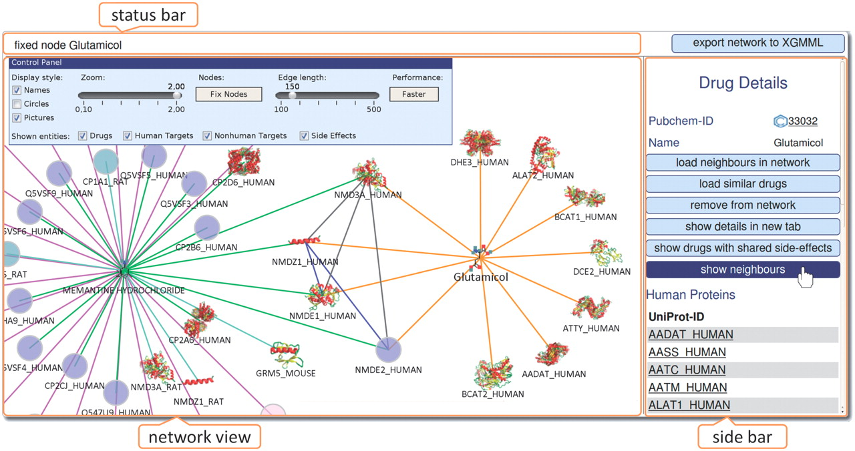
Fig. 1. Screenshot of Cobweb used by PROMSICUOUS to visualize drug–target–side-effect data ...
Notes:
Fig. 1. Screenshot of Cobweb used by PROMSICUOUS to visualize drug–target–side-effect data (http://bioinformatics.charite.de/promiscuous). In the side bar, the various options to interact with the network are shown as blue buttons. These are context sensitive as they depend on the selected node.
Unless provided in the caption above, the following copyright applies to the content of this slide: © The Author 2011. Published by Oxford University Press. All rights reserved. For Permissions, please email: journals.permissions@oup.com

