Slide 1
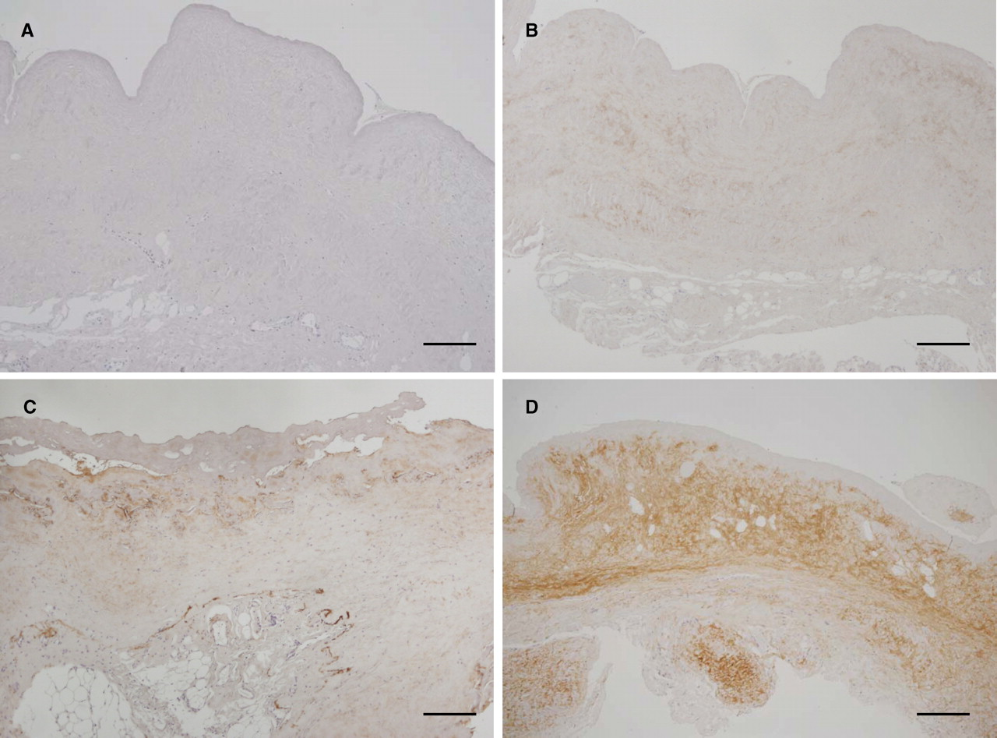
Fig. 1 Standards of semi-quantification of histochemical staining, ×100. ( A ) Negative; no expression. ( B ) Weak; ...
Notes:
Fig. 1 Standards of semi-quantification of histochemical staining, ×100. ( A ) Negative; no expression. ( B ) Weak; low expression in the peritoneum. ( C ) Moderate; distinct and local expression in the peritoneum. ( D ) Strong; intense and diffuse expression in the peritoneum. Bars = 100 μm.
Unless provided in the caption above, the following copyright applies to the content of this slide: © Oxford University Press 2009

Slide 2
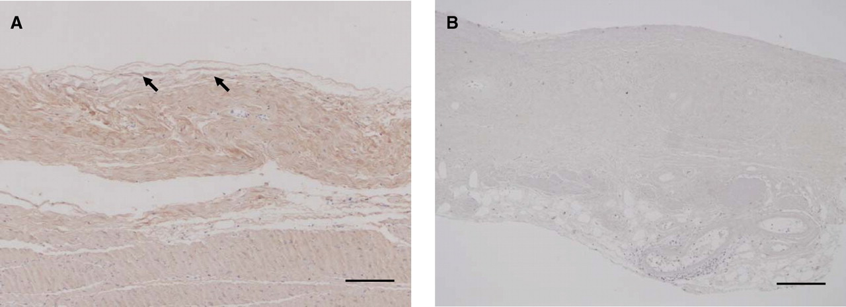
Fig. 2 Immunostaining of decorin. ( A ) Decorin was detected in submesothelial and muscle layers of normal ...
Notes:
Fig. 2 Immunostaining of decorin. ( A ) Decorin was detected in submesothelial and muscle layers of normal peritoneum, and ( B ) sporadically in the uraemic peritoneum at initiation of PD. Original magnification: ×200 Bars = 50 μm.
Unless provided in the caption above, the following copyright applies to the content of this slide: © Oxford University Press 2009

Slide 3
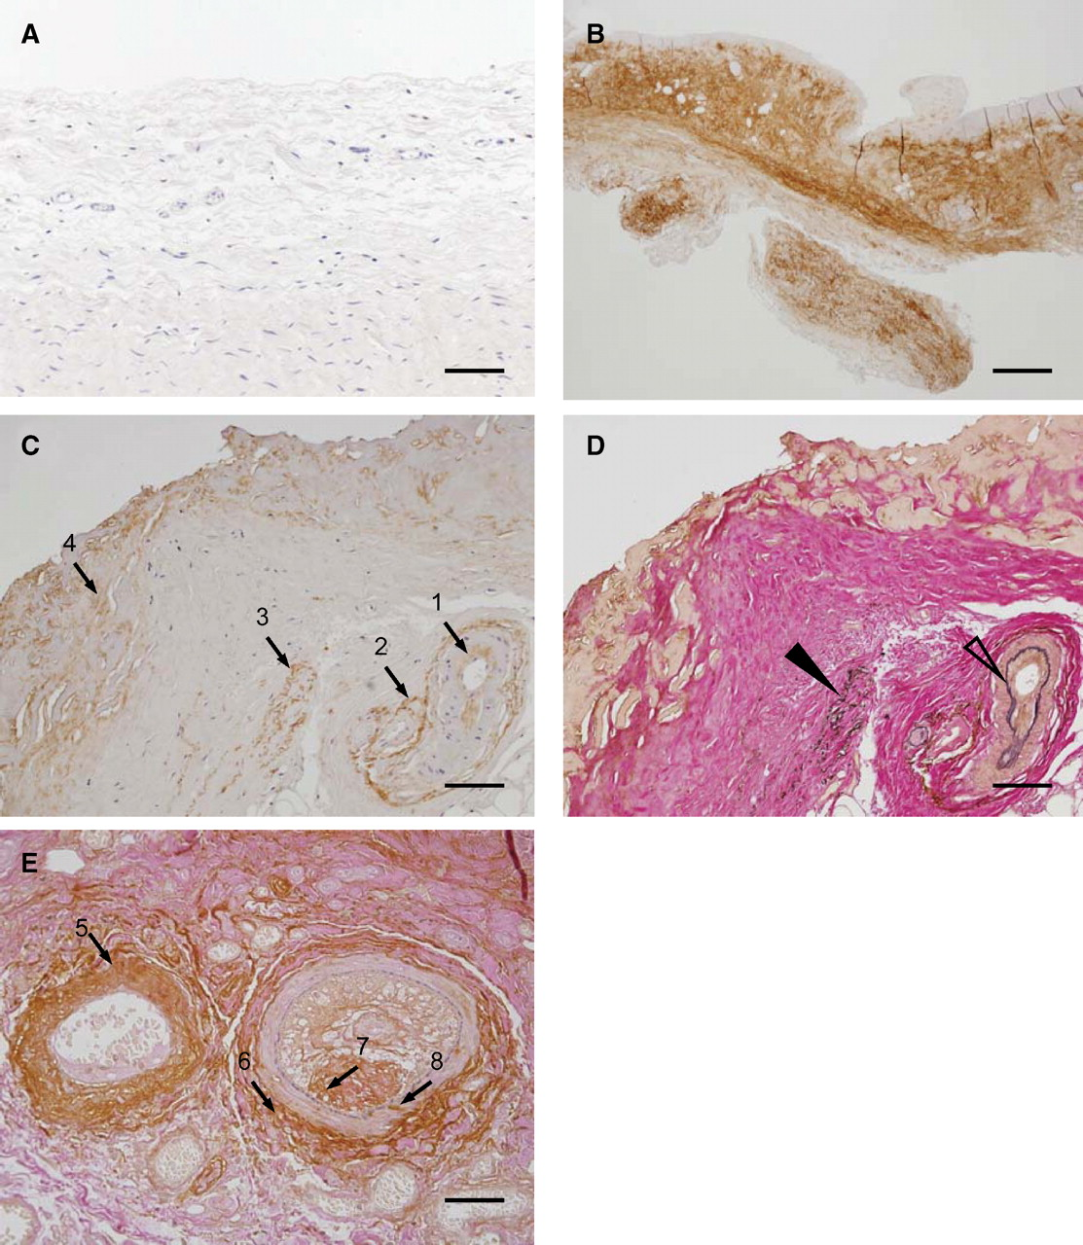
Fig. 3 Immunostaining of versican. ( A ) Versican was not detected in the submesothelium of normal peritoneum. ( B ...
Notes:
Fig. 3 Immunostaining of versican. ( A ) Versican was not detected in the submesothelium of normal peritoneum. ( B ) In long-term PD patients with peritonitis, versican was detected in the diffuse thickened submesothelial compact zone. ( C ) In the submesothelial compact zone of long-term PD patients, versican was observed in the intima of the small arteries (arrow 1), adventitia and perivascular fibrous tissues (arrow 2), the split peritoneal elastic fibre (arrow 3) and interstitium intermingled with the collagen fibre (arrow 4). ( D and E ) Elastic fibre, collagen fibre and fibrin were shown by EVG staining after immunostaining of versican. ( D ) The closed arrowhead points to the split elastic lamina of peritoneum, and the open arrowhead points to the intimal elastic lamina of the small arteries. ( D ) Versican was not observed in the intimal elastic lamina of the small arteries. ( E ) Versican was intensely observed in venous walls (arrow 5), adventitia of the arteries and perivascular fibrous areas (arrow 6), and partially detected in the thickened intima (arrow 7) and media (arrow 8) of stenotic arteries. ( E ) EVG staining demonstrated that the intimal elastic fibre of the small arteries was well maintained, unlike the peritoneal elastic fibre. Original magnification: ( A – D ) ×200, bars = 50 μm; ( E ) ×400, bars = 20 μm.
Unless provided in the caption above, the following copyright applies to the content of this slide: © Oxford University Press 2009

Slide 4
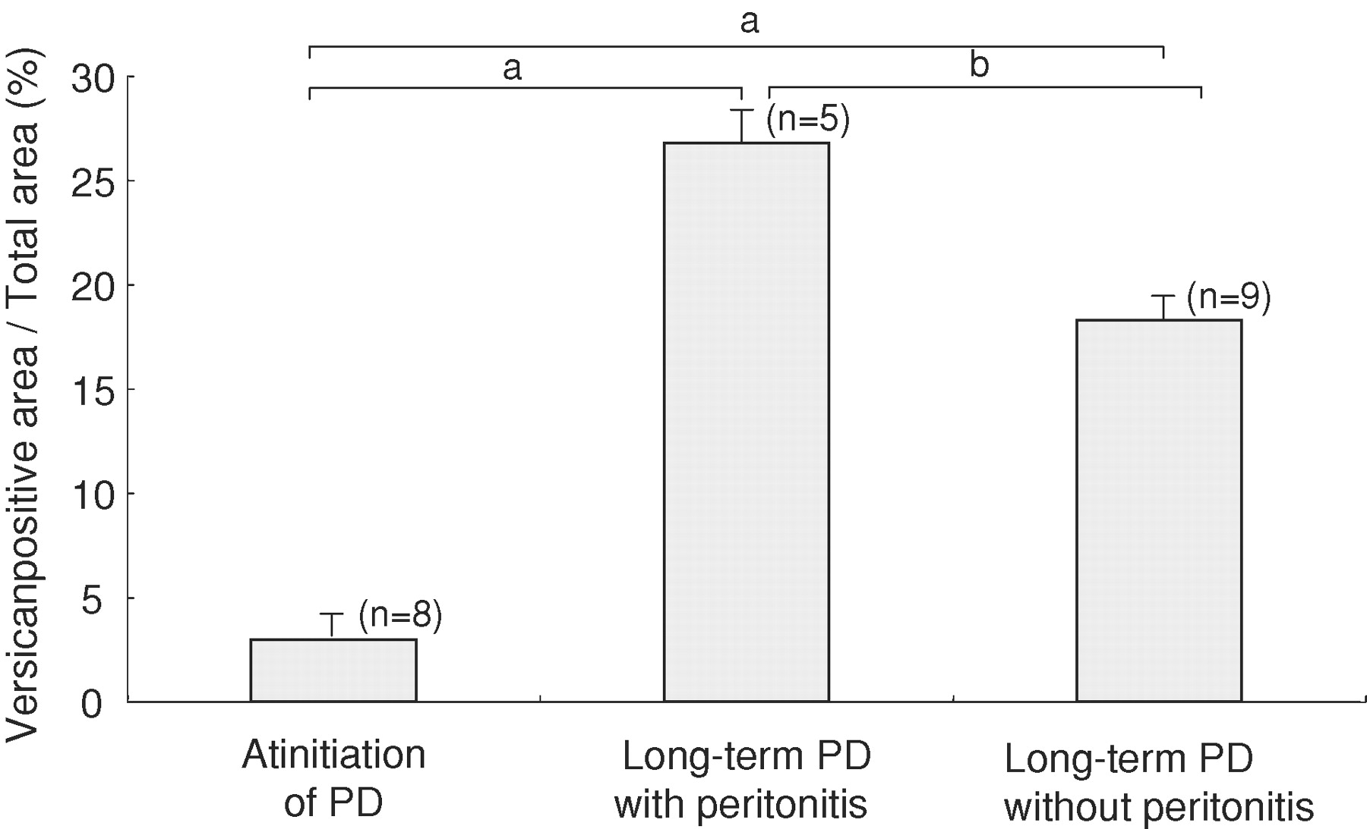
Fig. 4 Quantification of immunostaining of versican. The ratio of versican-immunopositive dimensions to the ...
Notes:
Fig. 4 Quantification of immunostaining of versican. The ratio of versican-immunopositive dimensions to the submesothelial compact zone was significantly increased in long-term PD patients with or without peritonitis. (a) P < 0.01, (b) P < 0.05.
Unless provided in the caption above, the following copyright applies to the content of this slide: © Oxford University Press 2009

Slide 5
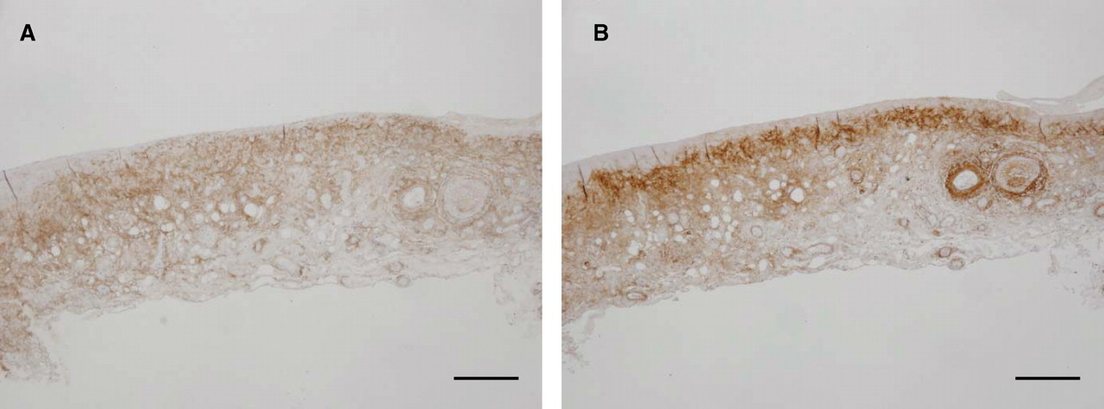
Fig. 5 Hyaluronan ( A ) and versican ( B ) expressions in long-term PD patients with peritonitis. ( A ) Hyaluronan ...
Notes:
Fig. 5 Hyaluronan ( A ) and versican ( B ) expressions in long-term PD patients with peritonitis. ( A ) Hyaluronan was observed widely and homogenously in the submesothelial compact zone. ( B ) Versican was especially detected in the shallow layer of the submesothelium, perivascular sites and vascular wall on the adjacent section of ( A ). Original magnification: ( A and B ) ×100, bars = 100 μm.
Unless provided in the caption above, the following copyright applies to the content of this slide: © Oxford University Press 2009

Slide 6
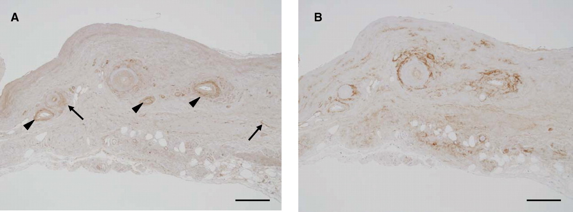
Fig. 6 Immunostaining of MMP-2 ( A ) and versican ( B ) in long-term PD patients with peritonitis. ( A ) MMP-2 ...
Notes:
Fig. 6 Immunostaining of MMP-2 ( A ) and versican ( B ) in long-term PD patients with peritonitis. ( A ) MMP-2 expression was observed in perivascular sites and adventitia (arrowheads), and showed a patchy distribution in fibroblasts (arrows) in peritonitis patients. ( B ) Versican expression was mainly observed in perivascular sites and vascular walls on the adjacent section of ( A ). Original magnification: ( A and B ) ×100, bars = 100 μm.
Unless provided in the caption above, the following copyright applies to the content of this slide: © Oxford University Press 2009

Slide 7
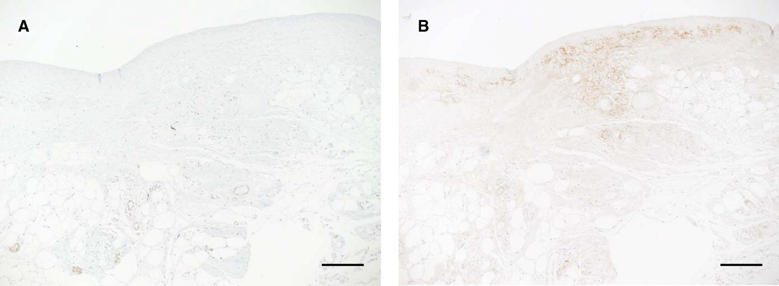
Fig. 7 Immunostaining of alfa SMA ( A ) and versican ( B ) in long-term PD patients with peritonitis. ( A ) Alfa ...
Notes:
Fig. 7 Immunostaining of alfa SMA ( A ) and versican ( B ) in long-term PD patients with peritonitis. ( A ) Alfa SMA was observed in blood vessels, pericytes and myofibroblasts in the fibrous-thickened peritoneum. In specimens with many αSMA-positive cells, versican showed a high expression. The αSMA-expressing cells did not always correspond to the versican-expressing area on the adjacent section of ( A ), except the vascular area. Original magnification: ( A and B ) ×100, bars = 100 μm.
Unless provided in the caption above, the following copyright applies to the content of this slide: © Oxford University Press 2009

Slide 8
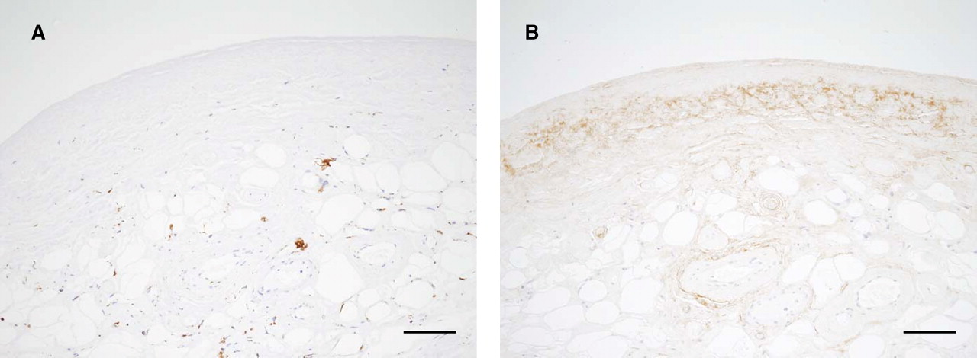
Fig. 8 Immunostaining of CD68 ( A ) and versican ( B ) in long-term PD patients with peritonitis. ( A ) CD68 was ...
Notes:
Fig. 8 Immunostaining of CD68 ( A ) and versican ( B ) in long-term PD patients with peritonitis. ( A ) CD68 was observed in the fibrous-thickened peritoneum. In specimens with many CD68-positive cells, versican showed a high expression level. Original magnification: ( A and B ) ×100, bars = 100 μm.
Unless provided in the caption above, the following copyright applies to the content of this slide: © Oxford University Press 2009

