Slide 1
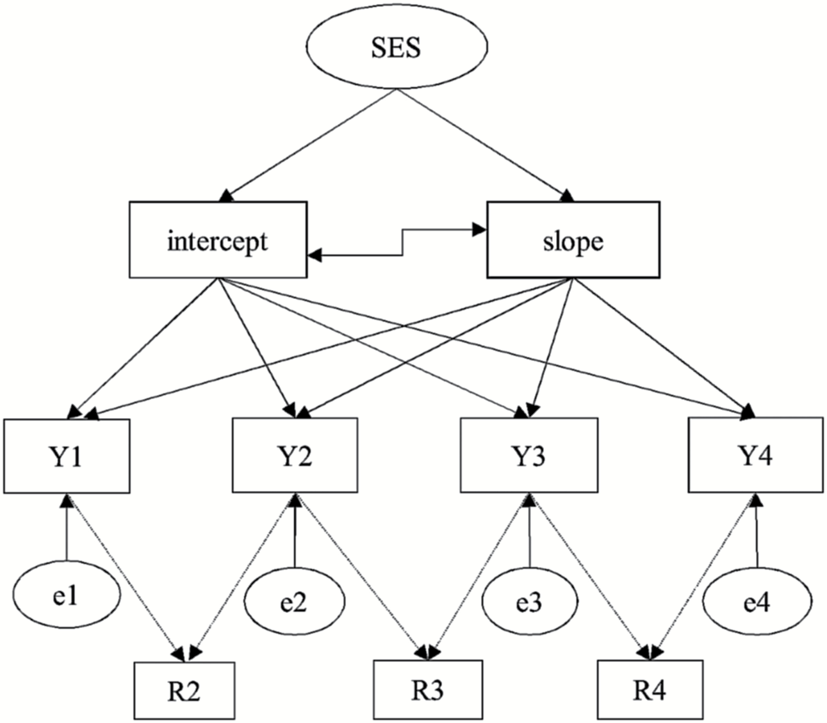
Figure 1. Path diagram of selection model for the trajectory of physical functioning of Chinese elderly people based on ...
Notes:
Figure 1. Path diagram of selection model for the trajectory of physical functioning of Chinese elderly people based on Enders (2011). Y1–Y4 are outcome variables (ADL/IADL); R2–R4 are missing data indicators (dummy variable indicating whether participates were observed or lost to follow-up); e1–e4 are time-specific residuals.
Unless provided in the caption above, the following copyright applies to the content of this slide: © The Author(s) 2017. Published by Oxford University Press on behalf of The Gerontological Society of America. All rights reserved. For permissions, please e-mail: journals.permissions@oup.com.This article is published and distributed under the terms of the Oxford University Press, Standard Journals Publication Model (https://academic.oup.com/journals/pages/open_access/funder_policies/chorus/standard_publication_model)

