Slide 1
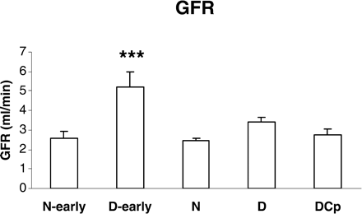
Fig. 1. Glomerular filtration rate (GFR) measured as the clearance of inulin. In the first two groups, i.e. the ...
Notes:
Fig. 1. Glomerular filtration rate (GFR) measured as the clearance of inulin. In the first two groups, i.e. the normal early (N-early, n = 9) and the diabetic early (D-early, n = 7) groups, GFR was measured 4 weeks after diabetes onset without any treatment. In the main study groups, i.e. the normal placebo-treated group (N group, n = 9), the diabetic placebo-treated group (D group, n = 11) and the diabetic C-peptide-treated group (DCp, n = 11), GFR was measured 8 weeks after diabetes onset, thus, 4 weeks after start of treatment. Asterisks indicate statistical difference compared with the N-early group after 4 weeks and the N group after 8 weeks: ***P<0.001.
Unless provided in the caption above, the following copyright applies to the content of this slide: © The Author [2005]. Published by Oxford University Press on behalf of ERA-EDTA. All rights reserved. For Permissions, please email: journals.permissions@oupjournals.org

Slide 2
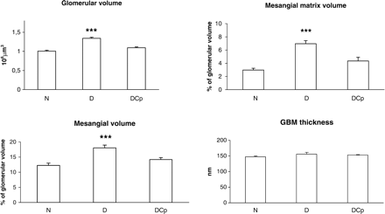
Fig. 2. Glomerular volume, mesangial volume fraction, mesangial matrix volume fraction and glomerular basement ...
Notes:
Fig. 2. Glomerular volume, mesangial volume fraction, mesangial matrix volume fraction and glomerular basement membrane thickness after 8 weeks (4 weeks after treatment start) in each study group: the normal placebo-treated group (N group, n = 9), the diabetic placebo-treated group (D group, n = 11) and the diabetic C-peptide-treated group (DCp, n = 11). ANOVA followed by Tukey's post hoc test was used for the statistical analysis. Asterisks indicate statistically significant differences from the N group: ***P<0.001.
Unless provided in the caption above, the following copyright applies to the content of this slide: © The Author [2005]. Published by Oxford University Press on behalf of ERA-EDTA. All rights reserved. For Permissions, please email: journals.permissions@oupjournals.org

Slide 3
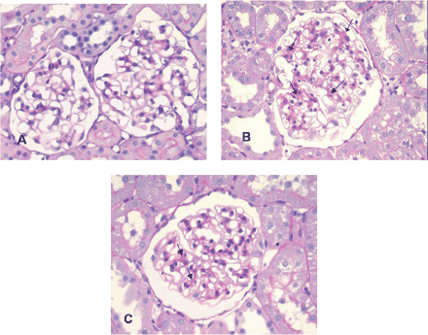
Fig. 3. PAS-stained glomeruli of normal placebo treated rat (N group, A), diabetic placebo-treated rat (D group, B) ...
Notes:
Fig. 3. PAS-stained glomeruli of normal placebo treated rat (N group, A), diabetic placebo-treated rat (D group, B) and C-peptide-treated rat (DCp group, C). Note the widened mesangial areas (arrows) in the D rat (B) containing PAS-positive mesangial matrix. This matrix expansion is partially prevented in the DCp rat (C).
Unless provided in the caption above, the following copyright applies to the content of this slide: © The Author [2005]. Published by Oxford University Press on behalf of ERA-EDTA. All rights reserved. For Permissions, please email: journals.permissions@oupjournals.org

