Slide 1
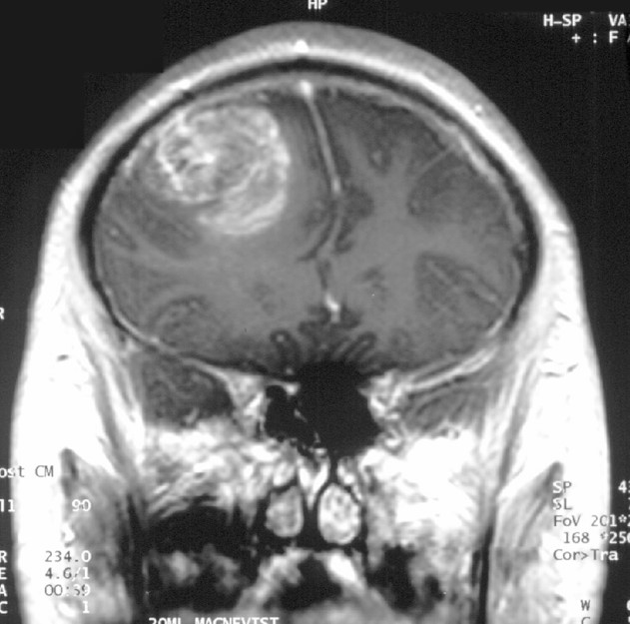
Notes:
Unless provided in the caption above, the following copyright applies to the content of this slide: Copyright © 2011 by the Congress of Neurological Surgeons

