Slide 1
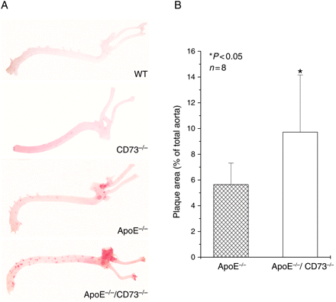
Figure 1 Plaque formation in the aorta of WT, CD73^{−/−}, ApoE^{−/−}, and ...
Notes:
Figure 1 Plaque formation in the aorta of WT, CD73−/−, ApoE−/−, and ApoE−/−/CD73−/− mice as visualized by Oil Red O in mice of 26 weeks. (A) Representative examples of each experimental group. (B) Quantification of plaque area in n = 8 animals in each group (*P < 0.05).
Unless provided in the caption above, the following copyright applies to the content of this slide: Published on behalf of the European Society of Cardiology. All rights reserved. © The Author 2011. For permissions please email: journals.permissions@oup.com

Slide 2
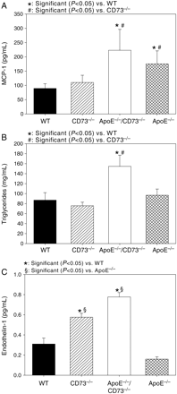
Figure 6 Analysis of (A) plasma MCP-1 by ELISA, (B) serum TG, and (C) plasma endothelin-1 in WT, CD73^{−/−}, ...
Notes:
Figure 6 Analysis of (A) plasma MCP-1 by ELISA, (B) serum TG, and (C) plasma endothelin-1 in WT, CD73−/−, ApoE−/−, and ApoE−/−/CD73−/− mice of 6 months (each group n = 5–8).
Unless provided in the caption above, the following copyright applies to the content of this slide: Published on behalf of the European Society of Cardiology. All rights reserved. © The Author 2011. For permissions please email: journals.permissions@oup.com

Slide 3
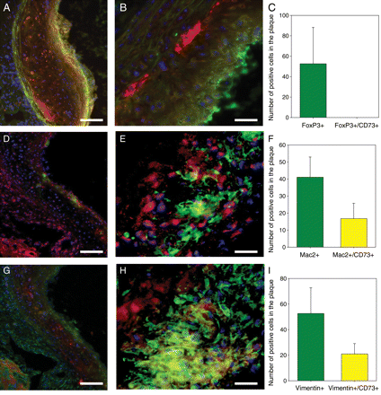
Figure 5 Immunofluorescence double staining of aortic sinus of ApoE^{−/−} mice. (A–C) CD73 (red) vs. foxP3 ...
Notes:
Figure 5 Immunofluorescence double staining of aortic sinus of ApoE−/− mice. (A–C) CD73 (red) vs. foxP3 (green). (D–F) CD73 (red) vs. Mac2 (green). (G–I) CD73 (red) vs. vimentin (green). CD73-positive cells are found preferentially in the plaque area and only few in the surrounding tissue. No CD73/foxP3 double-positive cells could be detected in the plaque area (A–C). There are numerous CD73/Mac2 double-positive cells (D–F) and CD73/vimentin double-positive cells (G–I). DAPI staining for nuclei was used to identify cells in regions of general high autofluorescence. (C, F, and I) Blots of semi-quantitative evaluation (n = 5–6 each, 4 counts per n): green bar: number of foxP3 or Mac2 or vimentin-positive cells within the plaque area; yellow bar: number of double-positive cells. Bars = 100 µm (A, D, and G), 25 µm (B, E, and H).
Unless provided in the caption above, the following copyright applies to the content of this slide: Published on behalf of the European Society of Cardiology. All rights reserved. © The Author 2011. For permissions please email: journals.permissions@oup.com

Slide 4
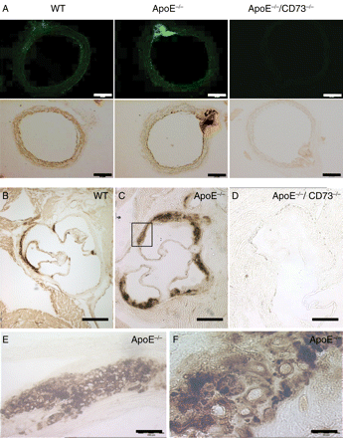
Figure 4 (A) CD73 expression (anti-CD73 staining, top) and activity (lead phosphate precipitation, bottom) in ...
Notes:
Figure 4 (A) CD73 expression (anti-CD73 staining, top) and activity (lead phosphate precipitation, bottom) in cross-sections of aortae from WT, ApoE−/−, and ApoE−/−/CD73−/− mice at 6 months. (B–F) Activity of CD73 in cross-sections of the aortic sinus of WT (B), ApoE−/− (C), and ApoE−/−/CD73−/− (D) mice. CD73 activity is increased in ApoE−/− mice; (E) and (F) demonstrate that single cells are responsible for the pronounced CD73 activity in the ApoE−/− mice. Bars = 500 µm (A), 250 µm (B–D), 50 µm (E), and 10 µm (F).
Unless provided in the caption above, the following copyright applies to the content of this slide: Published on behalf of the European Society of Cardiology. All rights reserved. © The Author 2011. For permissions please email: journals.permissions@oup.com

Slide 5
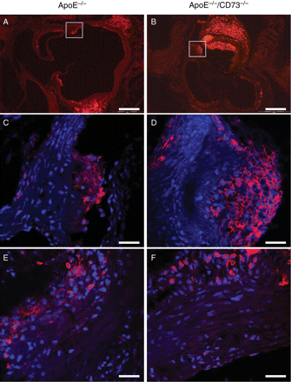
Figure 3 Infiltration of monocytes/macrophages (A–D) and lymphocytes (E and F) into the plaque area of aortic sinus of ...
Notes:
Figure 3 Infiltration of monocytes/macrophages (A–D) and lymphocytes (E and F) into the plaque area of aortic sinus of ApoE−/− and ApoE−/−/CD73−/− mice. Immunohistological detection of CD11b (A and B) and magnified confocal image with DAPI-stained nuclei (C and D). Immunohistological magnified confocal image of CD4 with DAPI-stained nuclei (E and F). Bars = 250 µm (A and B) and 25 µm (C–F).
Unless provided in the caption above, the following copyright applies to the content of this slide: Published on behalf of the European Society of Cardiology. All rights reserved. © The Author 2011. For permissions please email: journals.permissions@oup.com

Slide 6
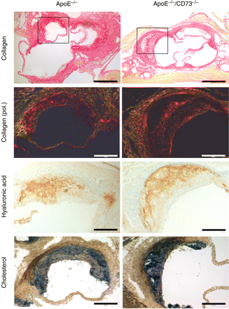
Figure 2 Plaque composition in cross-sections of the aortic sinus from ApoE^{−/−} and ...
Notes:
Figure 2 Plaque composition in cross-sections of the aortic sinus from ApoE−/− and ApoE−/−/CD73−/− mice. Sirius red staining for collagen (trace 1, bar = 500 µm) with a magnified view under polarized light (trace 2, bar = 250 µm), immunohistological detection of hyaluronic acid (trace 3, bar = 250 µm), and cholesterol staining according to Smith Dietrich (trace 4, bar = 250 µm); shown are representative stainings of four different animals from the two genotypes.
Unless provided in the caption above, the following copyright applies to the content of this slide: Published on behalf of the European Society of Cardiology. All rights reserved. © The Author 2011. For permissions please email: journals.permissions@oup.com

