Slide 1
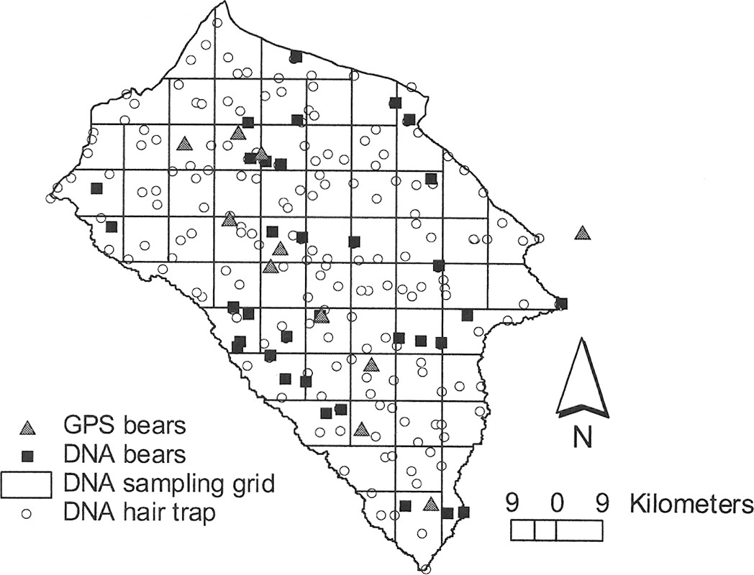
Fig. 1 Map of the Foothills Model Forest study area, Alberta, Canada, where grizzly bears were studied in 1999. Each ...
Notes:
Fig. 1 Map of the Foothills Model Forest study area, Alberta, Canada, where grizzly bears were studied in 1999. Each grid cell is 9 × 9 km. Each circle is a hair trap, which was placed in each grid cell for 1 sample session. Mean capture locations for bears only sampled using DNA methods are indicated by black boxes and initial capture location (for collaring) for GPS collared bears are indicated by gray triangles.
Unless provided in the caption above, the following copyright applies to the content of this slide: © 2004 American Society of Mammalogists

Slide 2
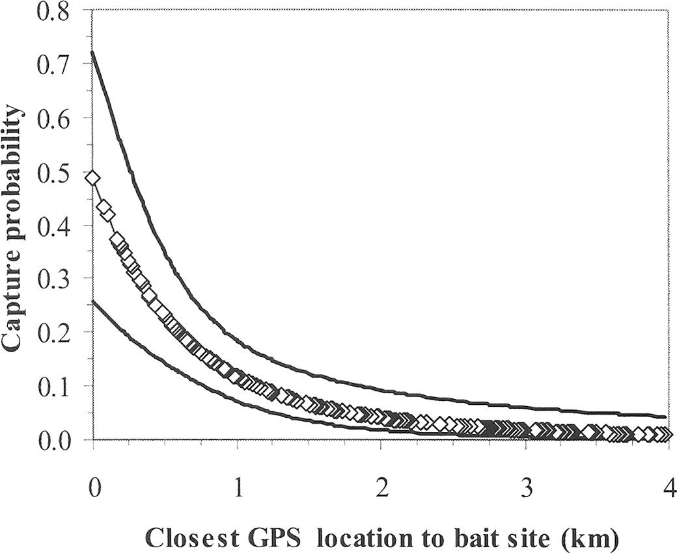
Fig. 2 Probability of capture as a function of closest observed distance to bait sites as estimated from GPS ...
Notes:
Fig. 2 Probability of capture as a function of closest observed distance to bait sites as estimated from GPS collared bears. Each bait site was surrounded by barbed wire to obtain DNA hair from grizzly bears in the Foothills Models Forest Study area, Alberta, Canada in 1999. Estimated points (from Model 1 in Table 3) are shown as diamonds to describe the distribution of distances used to fit the logistic model. Confidence intervals (95%) are shown on either side of the predicted line.
Unless provided in the caption above, the following copyright applies to the content of this slide: © 2004 American Society of Mammalogists

