Slide 1
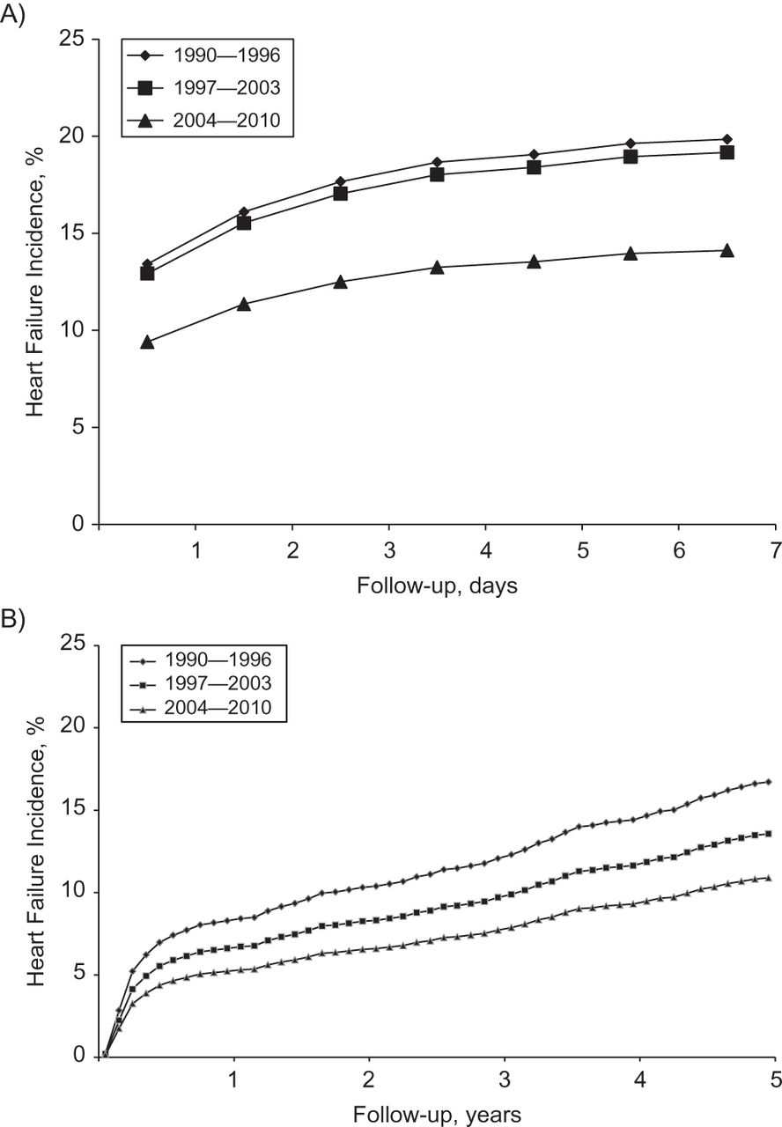
Figure 1. Temporal trends in the cumulative incidence rates of heart failure after myocardial infarction in Olmsted ...
Notes:
Figure 1. Temporal trends in the cumulative incidence rates of heart failure after myocardial infarction in Olmsted County, Minnesota, 1990–2010. The curves represent year categories of index myocardial infarction. Using the direct adjustment method, adjustment was made for age and sex, with death considered a competing event. Follow-up is divided into A) early risk (0–7 days after myocardial infarction) and B) late risk (0–5 years among those who survived 7 or more days after myocardial infarction) periods.
Unless provided in the caption above, the following copyright applies to the content of this slide: © The Author 2013. Published by Oxford University Press on behalf of the Johns Hopkins Bloomberg School of Public Health. All rights reserved. For permissions, please e-mail: journals.permissions@oup.com.

Slide 2
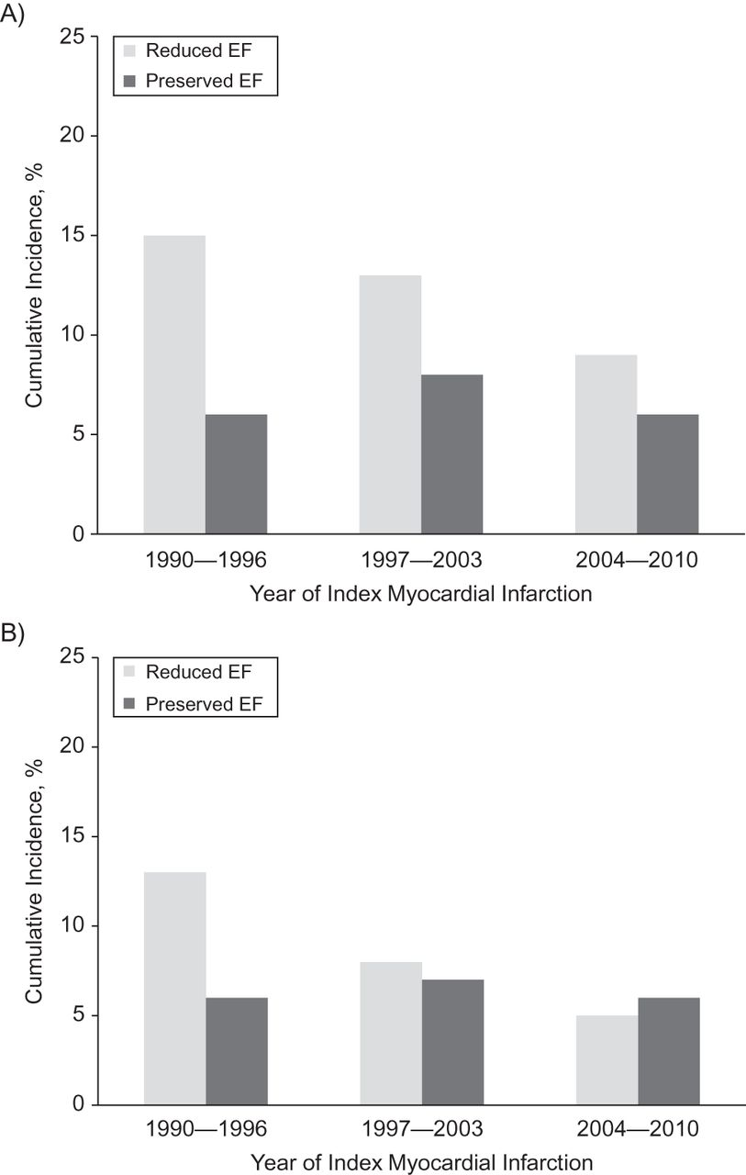
Figure 2. Temporal trends in the cumulative incidence rates of type of heart failure after myocardial infarction in ...
Notes:
Figure 2. Temporal trends in the cumulative incidence rates of type of heart failure after myocardial infarction in Olmsted County, Minnesota, 1990–2010. The bars represent categories of index myocardial infarction year and consist of heart failure with either reduced or preserved ejection fraction (EF). Adjustment was made for age and sex using the direct adjustment method, with death considered a competing event. Rates are divided into A) early risk (0–7 days after myocardial infarction) and B) late risk (8 days–5 years after myocardial infarction) incidence periods.
Unless provided in the caption above, the following copyright applies to the content of this slide: © The Author 2013. Published by Oxford University Press on behalf of the Johns Hopkins Bloomberg School of Public Health. All rights reserved. For permissions, please e-mail: journals.permissions@oup.com.

