Slide 1
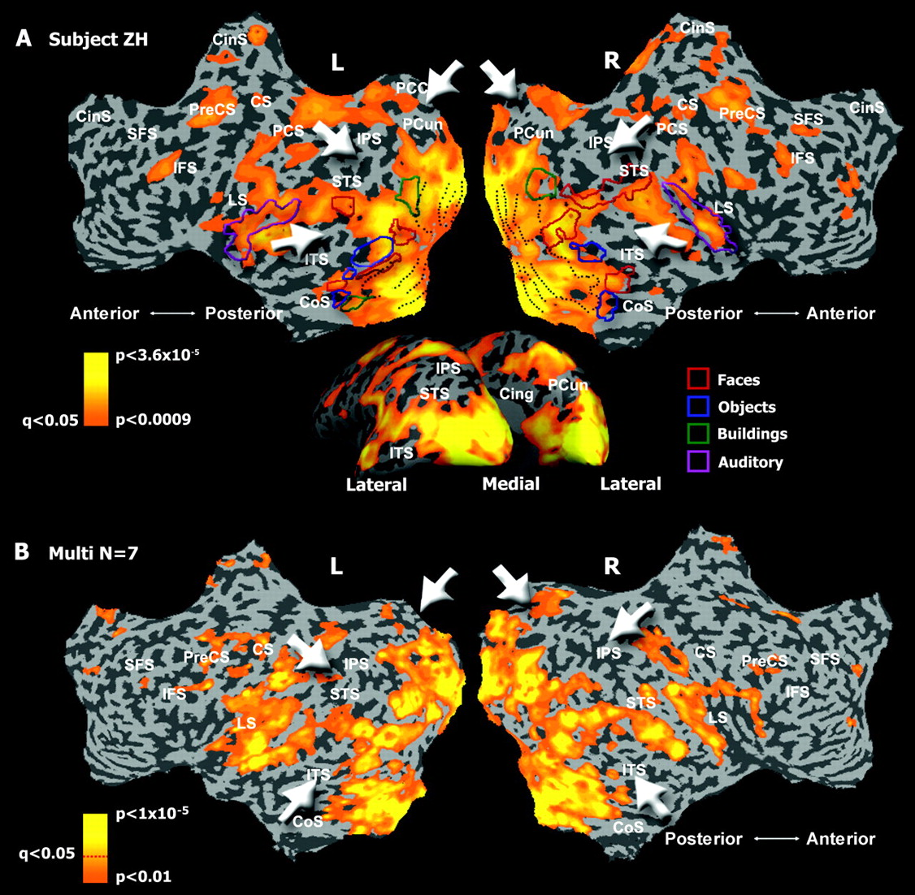
Figure 1. Neuroanatomical organization of movie-related activity. (A) Single-subject analysis. Neuroanatomical ...
Notes:
Figure 1. Neuroanatomical organization of movie-related activity. (A) Single-subject analysis. Neuroanatomical distribution of voxel-by-voxel intrasubject correlation of activity during repeated movie presentation. Correlation maps are presented on unfolded (top) and inflated (bottom) left (L) and right (R) hemispheres. The color indicates correlation coefficient of each voxel's activity across 2 movie presentations (0.2 < r < 0.7, q(FDR) < 0.05). White arrows indicate areas in the posterior cortex that showed low levels of correlation. The borders of auditory cortex as well as different category-related visual areas are also delineated. Note that these sensory regions exhibit a high level of intrasubject correlation. (B) Group analysis. Neuroanatomical distribution of intrasubject correlation as revealed by multi-subject (N = 7) groupwise t-test analysis (P < 0.01, q(FDR) < 0.15, the significance level of q(FDR) < 0.05 is marked on the color bar). The color indicates t-value significance. CoS, collateral sulcus; ITS, inferior temporal sulcus; STS, superior temporal sulcus; IPS, inferior parietal sulcus; LS, lateral sulcus; PCun, precuneus; CS, central sulcus; PreCS, precentral sulcus; PCS, postcentral sulcus; CinS, cingulate sulcus; IFS, inferior frontal sulcus; SFS, superior frontal sulcus.
Unless provided in the caption above, the following copyright applies to the content of this slide: © The Author 2006. Published by Oxford University Press. All rights reserved. For permissions, please e-mail: journals.permissions@oxfordjournals.org

Slide 2
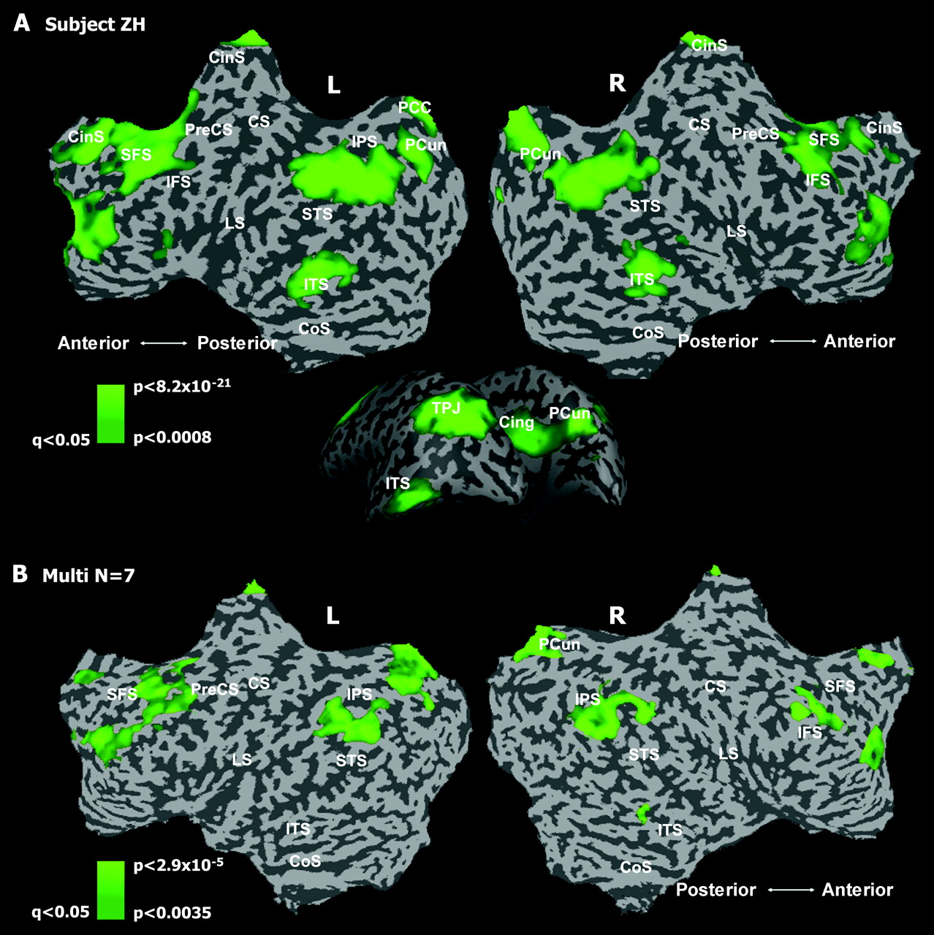
Figure 2. Neuroanatomical organization of functional connectivity analysis in the repeated movie paradigm. (A) ...
Notes:
Figure 2. Neuroanatomical organization of functional connectivity analysis in the repeated movie paradigm. (A) Single-subject seed ROI analysis. Single-subject map showing correlation of every voxel in one of the hemispheres with the average seed time course from the opposite hemisphere. Seed ROIs consisted of ∼10 contiguous voxels in the IPC that exhibited the minimal level of intrasubject correlation. The analysis was done for both hemispheres and averaged across 2 movie presentations per subject. The color scale indicates t-value significance level (left [L] hemisphere: P < 0.0008, q(FDR) < 0.05; right [R] hemisphere: P < 0.0007, q(FDR) < 0.05). (B) Group analysis. Neuroanatomical distribution of regions showing functional connectivity as revealed by multi-subject (N = 7), random-effect GLM analysis (L hemisphere: P < 0.0035, q(FDR) < 0.05; R hemisphere: P < 0.0037, q(FDR) < 0.05). Anatomical abbreviations are as in Figure 1.
Unless provided in the caption above, the following copyright applies to the content of this slide: © The Author 2006. Published by Oxford University Press. All rights reserved. For permissions, please e-mail: journals.permissions@oxfordjournals.org

Slide 3
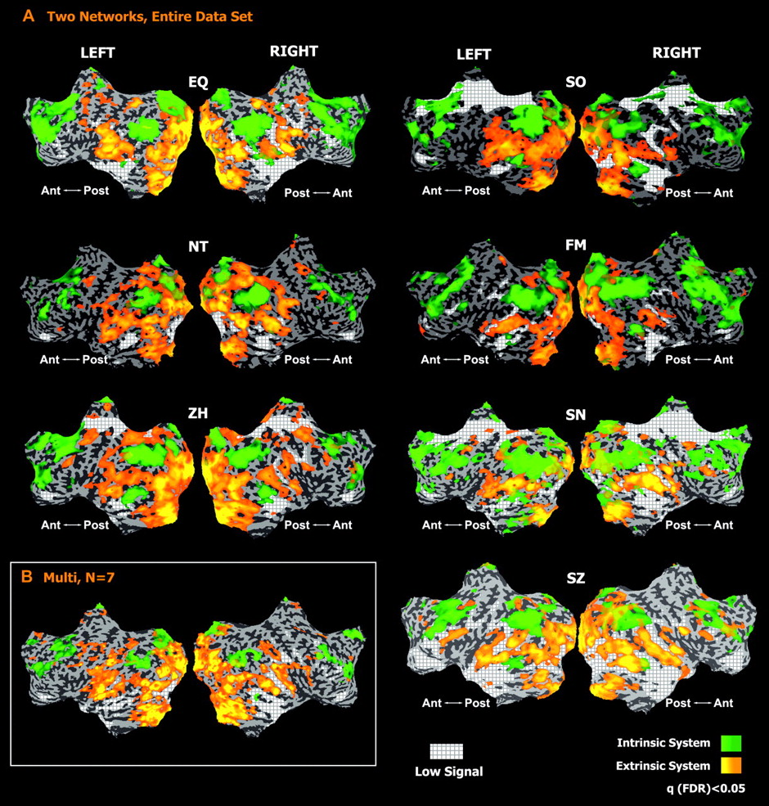
Figure 3. Neuroanatomical distribution of the extrinsic and intrinsic networks. The extrinsic network of areas (orange ...
Notes:
Figure 3. Neuroanatomical distribution of the extrinsic and intrinsic networks. The extrinsic network of areas (orange to yellow, see Fig. 1) exhibited correlated neuronal dynamics across repeated movie presentations. The activity of the intrinsic network (light-green to green, Fig. 2) was decoupled from external stimulation. In addition, regions in which the BOLD signal was low due to magnet limitations (gray plaid) were added to the map. Note that the 2 networks largely complement each other and together cover almost the entire extent of the posterior cortex. (A) Single subjects (q(FDR) < 0.05). (B) Multi-subject (N = 7) groupwise t-statistics image (extrinsic: q(FDR) < 0.15, intrinsic: q(FDR) < 0.05).
Unless provided in the caption above, the following copyright applies to the content of this slide: © The Author 2006. Published by Oxford University Press. All rights reserved. For permissions, please e-mail: journals.permissions@oxfordjournals.org

Slide 4
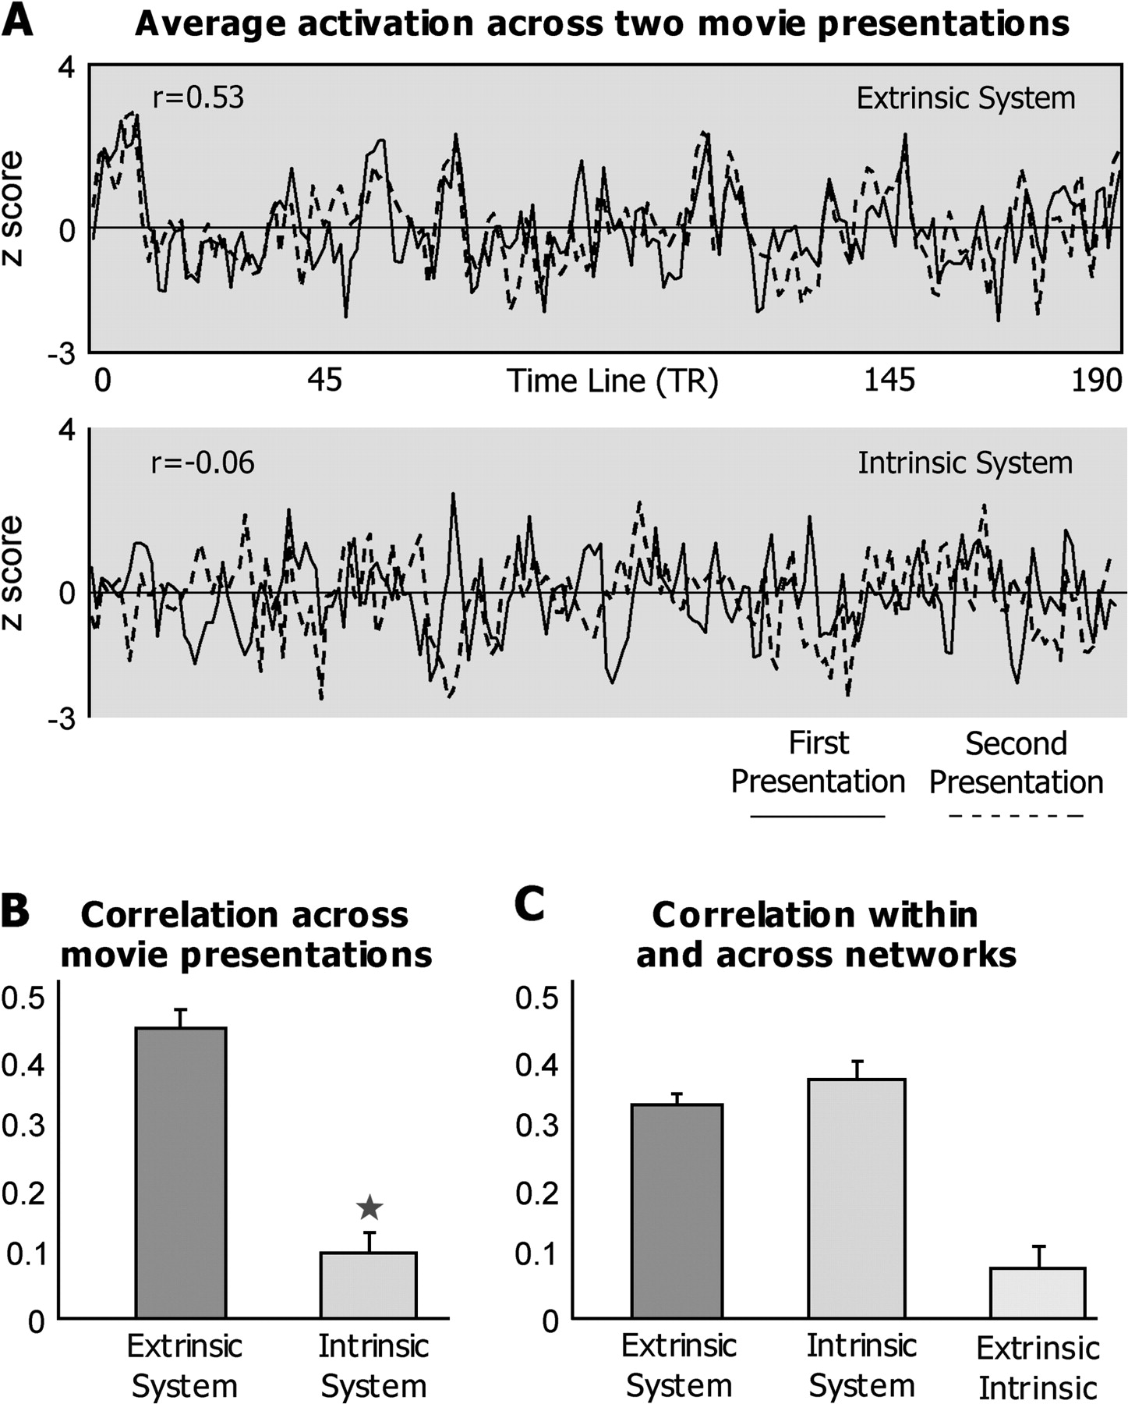
Figure 4. Activity profiles in the extrinsic and intrinsic networks. (A) Average activity in the extrinsic and ...
Notes:
Figure 4. Activity profiles in the extrinsic and intrinsic networks. (A) Average activity in the extrinsic and intrinsic systems during 2 movie presentations. Note that the average activity in the extrinsic system was much more time locked to the movie (r = 0.53) compared with the average activity in the intrinsic system (r = −0.06). (B) Average intrasubject correlation. When averaged across subjects, the correlation across 2 movie presentations was significantly higher in the extrinsic network (r = 0.44 ± 0.03) than in the intrinsic network (r = 0.1 ± 0.03, P < 0.0005 paired t-test). Shown are the mean correlation coefficients of the average activity in the 2 systems. (C) Correlations within and across networks. Extrinsic and intrinsic denote mean correlation of activity within the extrinsic and the intrinsic systems, respectively. Extrinsic/intrinsic denotes mean correlation of activity across these 2 networks. As can be seen, there was no correlation across the time course of activity in these 2 systems (r = 0.09 ± 0.04, P < 0.067), whereas the correlation among different voxel's signals within these systems was similar (P < 0.1).
Unless provided in the caption above, the following copyright applies to the content of this slide: © The Author 2006. Published by Oxford University Press. All rights reserved. For permissions, please e-mail: journals.permissions@oxfordjournals.org

Slide 5
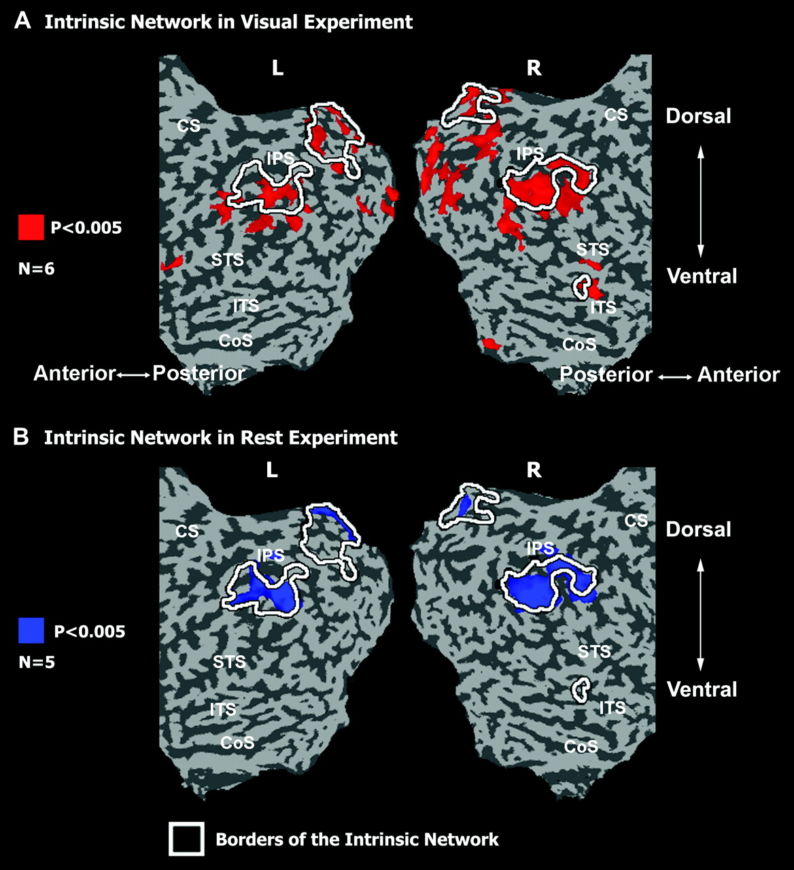
Figure 5. (A) Intrinsic network in standard visual experiment. (B) Intrinsic network during rest experiment. Functional ...
Notes:
Figure 5. (A) Intrinsic network in standard visual experiment. (B) Intrinsic network during rest experiment. Functional connectivity patterns are presented on the posterior part of an unfolded cortex. Functional connectivity maps were calculated as in Figure 2, using the same seed ROIs in the IPC (random effect, P < 0.005, uncorrected). White lines mark the boundaries of the intrinsic network as defined in the repeated movie paradigm. Notice that the neuroanatomy of the intrinsic network appears to be roughly consistent across different experimental conditions. No consistent negatively correlated areas were detected in these analyses. Anatomical abbreviations are as in Figure 1.
Unless provided in the caption above, the following copyright applies to the content of this slide: © The Author 2006. Published by Oxford University Press. All rights reserved. For permissions, please e-mail: journals.permissions@oxfordjournals.org

Slide 6
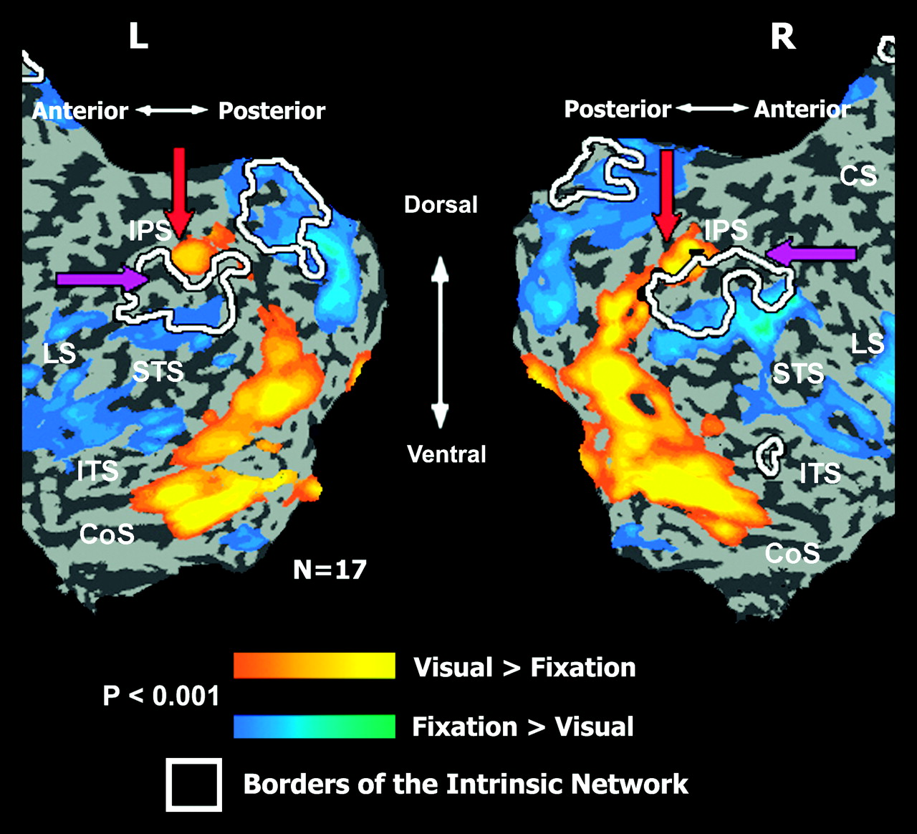
Figure 6. Deactivations in the posterior cortex during visual stimulation. Average activation (orange-yellow) and ...
Notes:
Figure 6. Deactivations in the posterior cortex during visual stimulation. Average activation (orange-yellow) and deactivation (blue-green) maps in visual, block-designed experiment (random-effect GLM, 17 subjects, P < 0.001, uncorrected) presented on the posterior part of an unfolded cortex. White lines mark the boundaries of the intrinsic network as defined in the repeated movie paradigm. Many deactivation patches could be found within the boundaries of the intrinsic network. Purple arrows mark the anterior region of the intrinsic region in IPC, which was not significantly deactivated by visual input. Notice the remarkable interdigitation in the parietal cortex (marked by red arrows), between the intrinsic patches and the visually driven areas. Anatomical abbreviations are as in Figure 1.
Unless provided in the caption above, the following copyright applies to the content of this slide: © The Author 2006. Published by Oxford University Press. All rights reserved. For permissions, please e-mail: journals.permissions@oxfordjournals.org

Slide 7
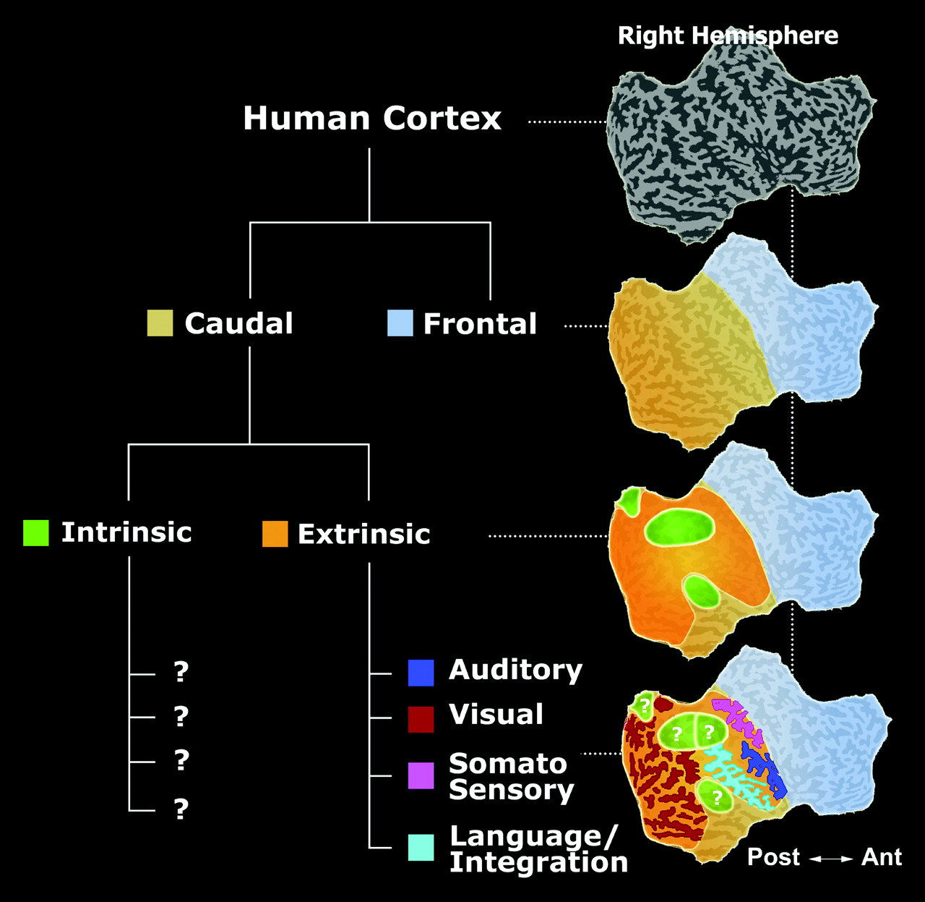
Figure 7. Neuroanatomical partition of the posterior cortex into extrinsic and intrinsic systems. A global schematic ...
Notes:
Figure 7. Neuroanatomical partition of the posterior cortex into extrinsic and intrinsic systems. A global schematic framework of subdivisions is proposed. The suggested large-scale dividing line defines a bipartite organization of the posterior cortex into a system of regions related to sensory processing—the extrinsic network and the intrinsic network of regions that likely relate to internal processing but whose exact functional nature is still enigmatic.
Unless provided in the caption above, the following copyright applies to the content of this slide: © The Author 2006. Published by Oxford University Press. All rights reserved. For permissions, please e-mail: journals.permissions@oxfordjournals.org

