Slide 1
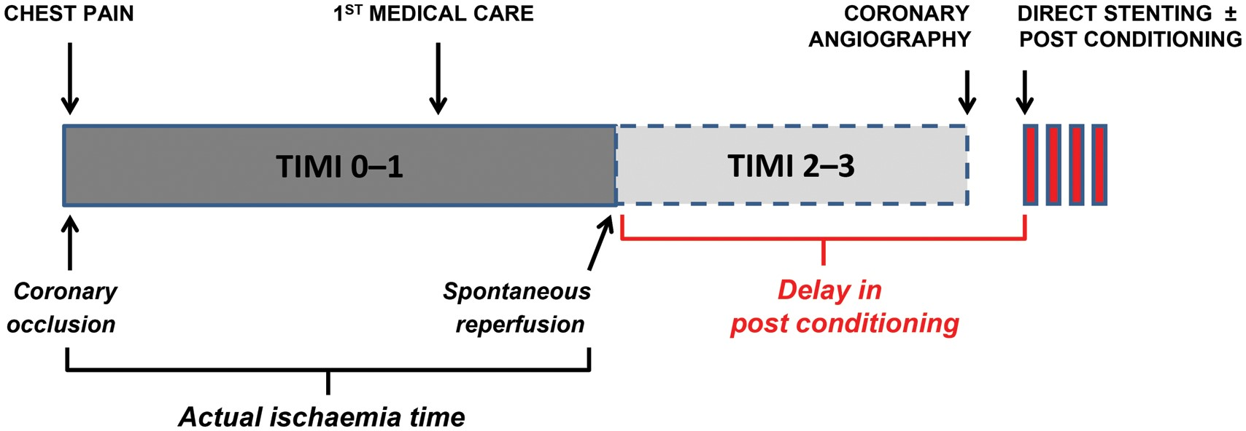
Figure 1 Natural clinical setting of delayed post-conditioning. ST-elevation myocardial infarction patients with a ...
Notes:
Figure 1 Natural clinical setting of delayed post-conditioning. ST-elevation myocardial infarction patients with a thrombolysis in myocardial infarction 2–3 flow grade at coronary angiography have necessarily undergone spontaneous reperfusion prior to hospital admission. This early reflow caused lethal reperfusion injury well before PostC could be applied. These clinical settings can be considered as a ‘natural’ model of delayed PostC.
Unless provided in the caption above, the following copyright applies to the content of this slide: Published on behalf of the European Society of Cardiology. All rights reserved. © The Author 2014. For permissions please email: journals.permissions@oup.com.

Slide 2
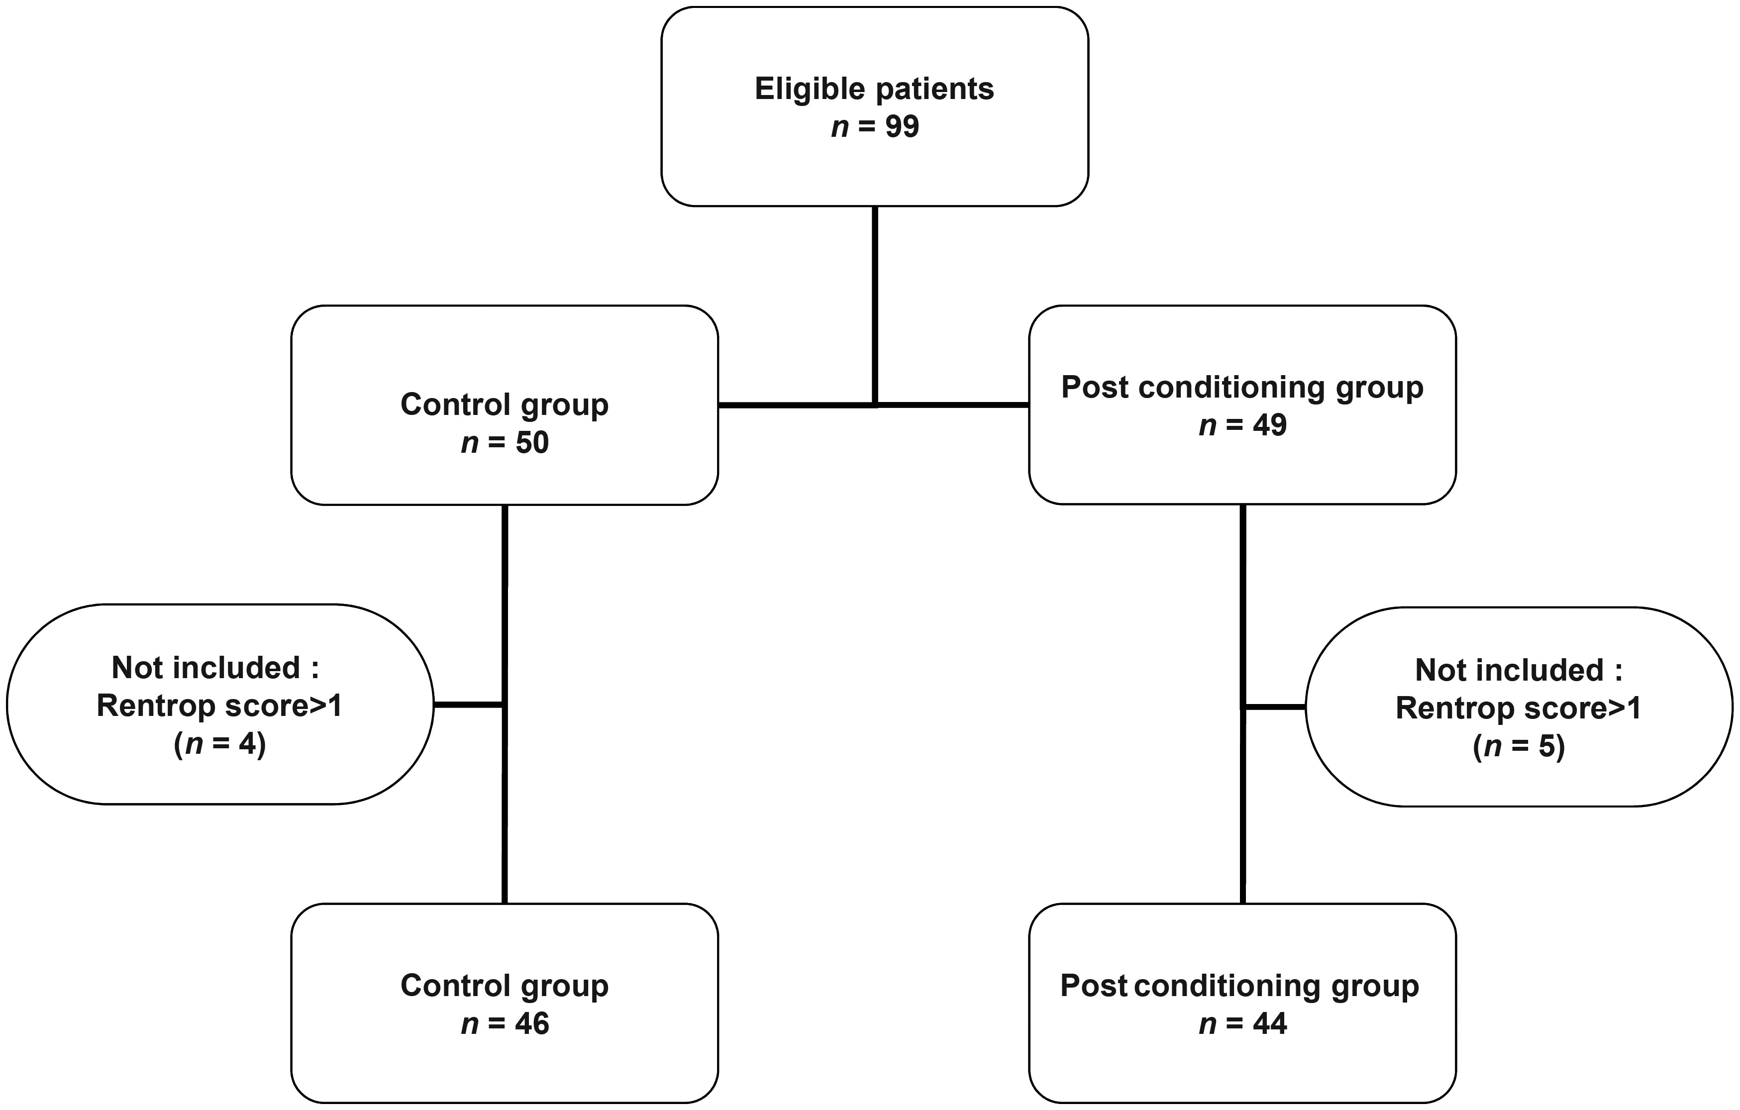
Figure 2 Consort diagram of the study. Among 99 eligible patients, 9 were not included, mainly on account of ...
Notes:
Figure 2 Consort diagram of the study. Among 99 eligible patients, 9 were not included, mainly on account of significant collateral flow evidenced on coronary angiogram (4 in the Control and 5 in the PostC groups). Then, 46 and 44 patients were included in the control and PostC groups, respectively.
Unless provided in the caption above, the following copyright applies to the content of this slide: Published on behalf of the European Society of Cardiology. All rights reserved. © The Author 2014. For permissions please email: journals.permissions@oup.com.

Slide 3
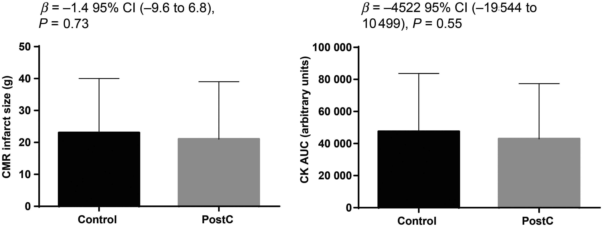
Figure 3 Infarct size as assessed by cardiac magnetic resonance scan and cardiac enzymes release. Left: mean cardiac ...
Notes:
Figure 3 Infarct size as assessed by cardiac magnetic resonance scan and cardiac enzymes release. Left: mean cardiac magnetic resonance infarct size was comparable between the two groups, averaging 23 ± 17 and 21 ± 18 g in the control and PostC groups, respectively (P = 0.64). Right: assessment of the infarct size by using the enzymatic release method through the area under the curve of creatine kinase revealed no significant difference between groups (47 424 ± 36 246 vs. 42 901 ± 34 463 in the control and PostC groups, respectively, P = 0.49).
Unless provided in the caption above, the following copyright applies to the content of this slide: Published on behalf of the European Society of Cardiology. All rights reserved. © The Author 2014. For permissions please email: journals.permissions@oup.com.

