Slide 1
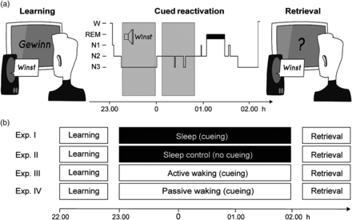
Figure 1. Experimental procedure. (a and b) Participants studied 120 Dutch–German word pairs in the evening. Afterward, ...
Notes:
Figure 1. Experimental procedure. (a and b) Participants studied 120 Dutch–German word pairs in the evening. Afterward, participants of the main and the control sleep groups slept for 3 h, whereas 2 other groups stayed awake. During the retention interval, 90 Dutch words (30 prior remembered, 30 prior not remembered and 30 new words) were repeatedly presented again. Cueing of vocabulary occurred during NonREM sleep, during performance of a working memory task, or during rest. The control sleep group did not receive any cues during sleep. After the retention interval, participants were tested on the German translation of the Dutch words using a cued recall procedure.
Unless provided in the caption above, the following copyright applies to the content of this slide: © The Author 2014. Published by Oxford University Press. All rights reserved. For Permissions, please e-mail: journals.permissions@oup.com

Slide 2
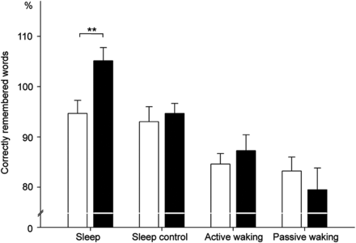
Figure 2. Behavioral results. In the main sleep group, memory for cued word pairs (black bar) was significantly ...
Notes:
Figure 2. Behavioral results. In the main sleep group, memory for cued word pairs (black bar) was significantly improved when compared with uncued pairs (white bar). Recall of uncued word pairs in the main sleep group was comparable with recall performance of word pairs in the control sleep group, which did not receive any cues during sleep. No enhancing effects of cueing on later memory retrieval occurred in both waking control groups. Retrieval performance is indicated as percentage of recalled German translations with performance before sleep set to 100%. Values are mean ± SEM. **P ≤ 0.01.
Unless provided in the caption above, the following copyright applies to the content of this slide: © The Author 2014. Published by Oxford University Press. All rights reserved. For Permissions, please e-mail: journals.permissions@oup.com

Slide 3
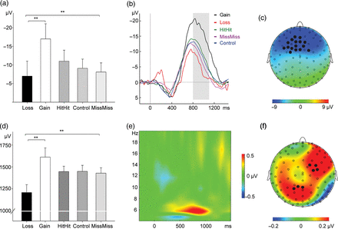
Figure 3. Electrophysiological results. ERPs and oscillatory theta power recorded during cueing in the sleep group were ...
Notes:
Figure 3. Electrophysiological results. ERPs and oscillatory theta power recorded during cueing in the sleep group were computed for words, for which cueing during sleep led to a change in memory performance. “Gains” reflect cued words not remembered in the presleep test but correctly recalled in the postsleep test. “Losses” refer to cued words remembered in the presleep test but not in the postsleep test. Words remembered before and after the retention interval were labeled “HitHit” and words not remembered both before and after the retention interval were labeled “MissMiss.” The new 30 Dutch words formed the “Control” condition. (a and b) Successful cueing was associated with a more pronounced negativity at frontal electrode sites (representative electrode Fz). The rectangle illustrates the time window used for waveform quantification. (c) Scalp map representing the topographical distribution for the difference between “Gains” and “Losses” in the time window between 800 and 1100 ms, indicating a pronounced frontal distribution (all electrodes entered the analysis; black dots indicate significant electrodes at P < 0.05, false discovery rate) corrected for multiple comparisons). The following electrodes were significant: E4, E5, E6, E11, E12, E13, E16, E19, E20, E23, E24, E28, E29, E35, E112 (see Supplementary Fig. 2 for the exact electrode positions). (d and e) Induced theta power for the difference between “Gains” and “Losses” (electrode FC6), indicating a distinct increase in induced theta power associated with successful cueing. (f) Scalp map depicting the distribution of theta power increase for “Gains” relative to “Losses” in the time window between 700 and 900 ms. The following electrodes were significant: E53, E60, E61, E62, E111, E117 (FC6), E118). **P ≤ 0.01.
Unless provided in the caption above, the following copyright applies to the content of this slide: © The Author 2014. Published by Oxford University Press. All rights reserved. For Permissions, please e-mail: journals.permissions@oup.com

