Slide 1
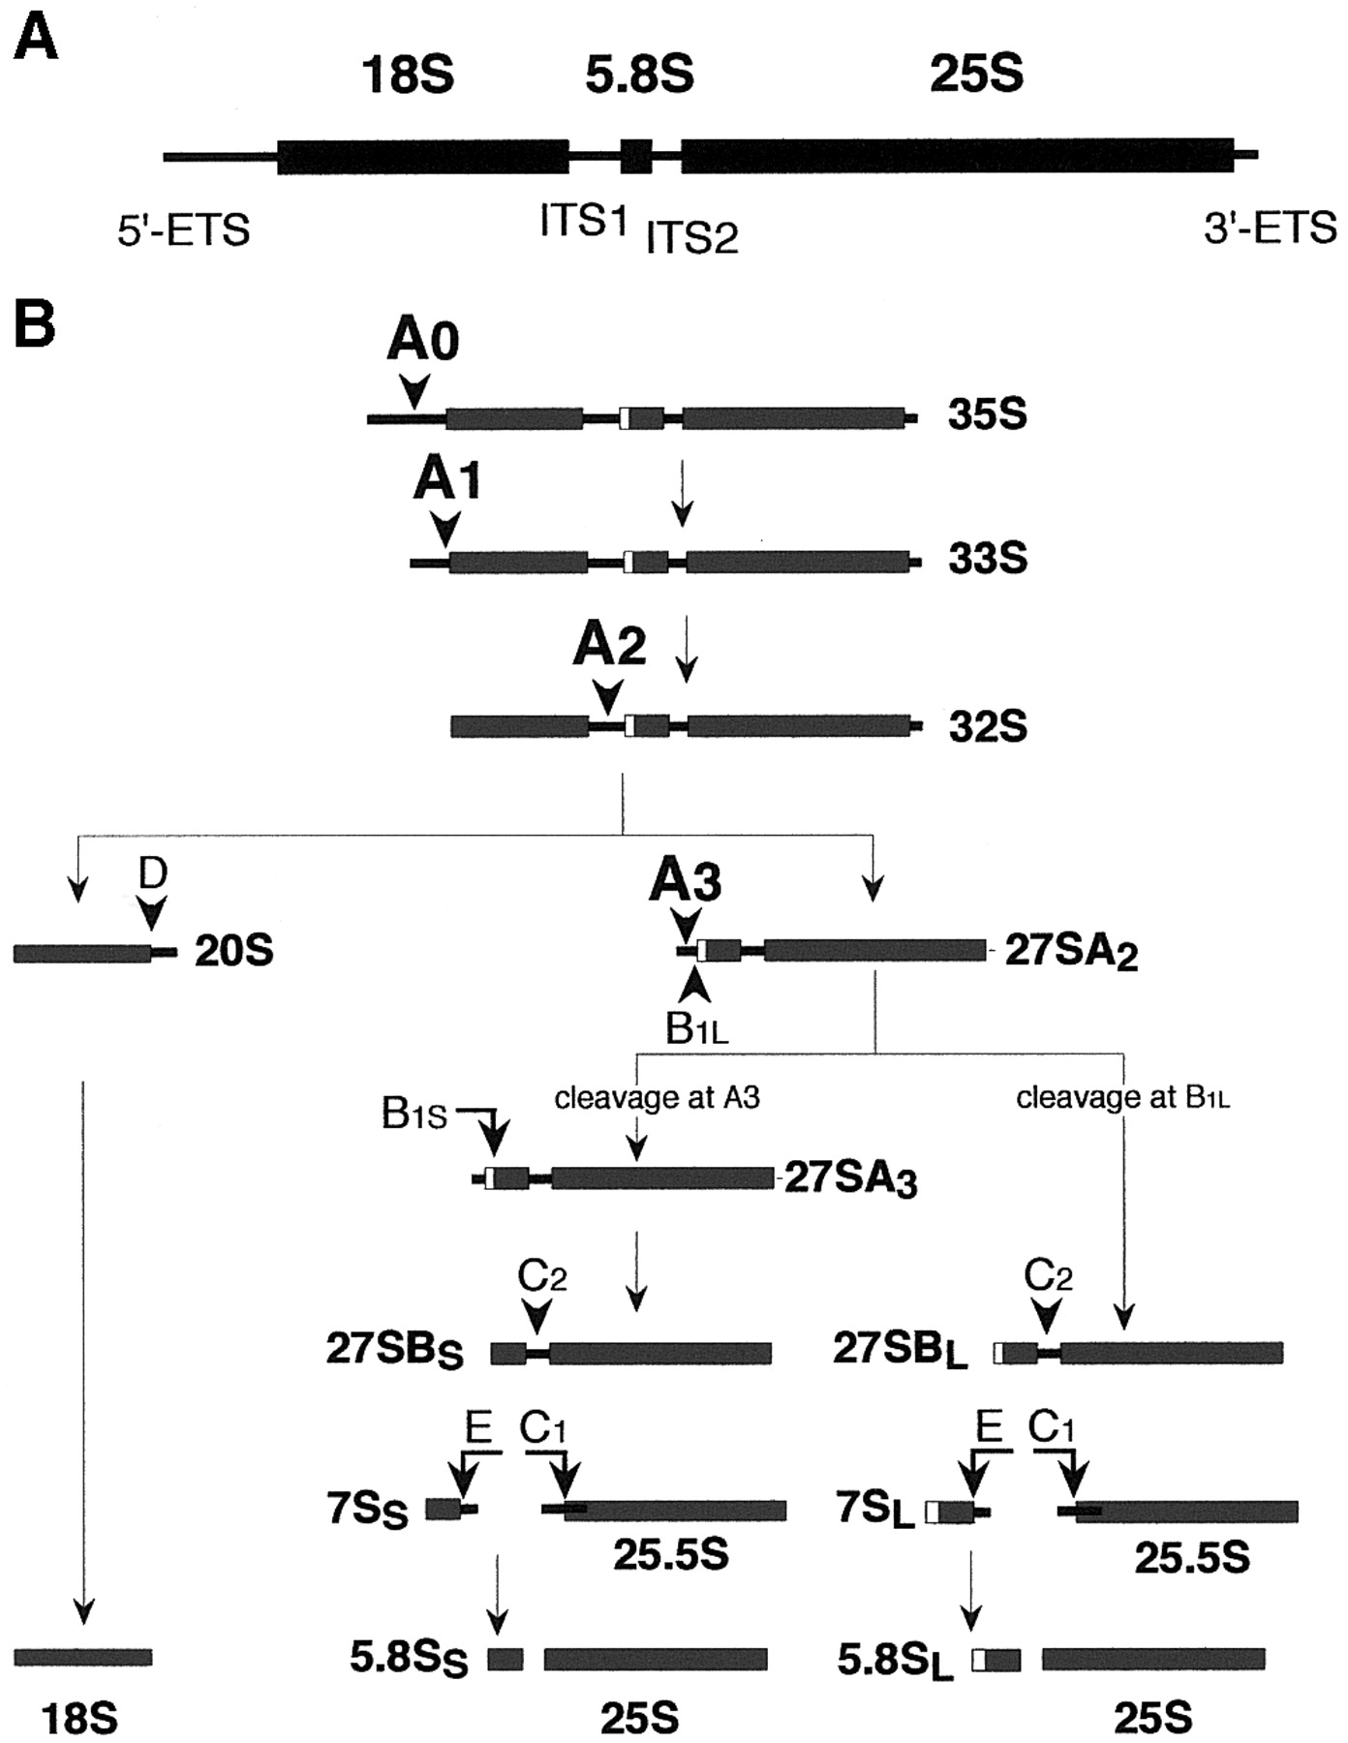
Figure 1. Processing of pre‐rRNA in S.cerevisiae . ( A ) Structure of the rDNA transcription unit. Mature ...
Notes:
Figure 1. Processing of pre‐rRNA in S.cerevisiae . ( A ) Structure of the rDNA transcription unit. Mature rRNA sequences are indicated by the thick bars, transcribed spacer sequences by the thin lines. ( B ) The pre‐rRNA processing pathway. The processing cleavages requiring Rrp5p are show in large type. Straight arrows indicate endonucleolytic cleavages, kinked arrows represent exonucleolytic processing events. Note that the manner in which the 27SA 2 pre‐rRNA is converted into 27SB L is not known.
Unless provided in the caption above, the following copyright applies to the content of this slide:

Slide 2
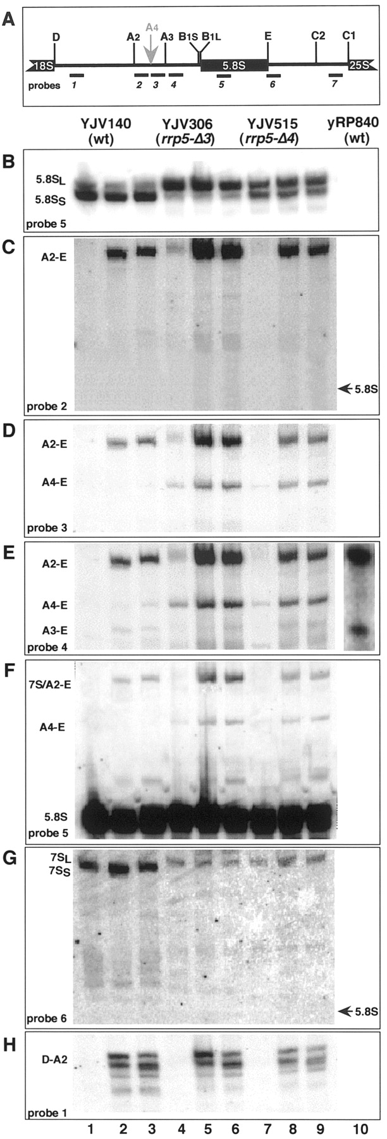
Figure 2. Northern analysis of low‐molecular‐weight processing intermediates in rrp5‐ Δ 3 and rrp‐ Δ 4 cells. ...
Notes:
Figure 2. Northern analysis of low‐molecular‐weight processing intermediates in rrp5‐ Δ 3 and rrp‐ Δ 4 cells. Cultures of strains YJV306 ( rrp5‐ Δ 3 ), YJV515( rrp5‐ Δ 4 ) and the wild‐type parental strain YJV140 were grown on YPD medium to mid‐exponential phase. Samples containing identical amounts of cells were taken before addition of 0.2 M LiCl and after further incubation in the presence of LiCl for 2 and 6 h. Total RNA was isolated, separated on 8% polyacrylamide gels and blotted onto nitrocellulose filters which were then hybridized in sequence with the probes indicated in (A). ( A ) The region of the pre‐rRNA spanning ITS1, 5.8S rRNA and part of ITS2, including the processing sites. The position of the different oligonucleotides used for northern hybridization and primer extension experiments is indicated. The sequences of these oligonucleotides are shown in Table 1. ( B – H ) Northern hybridization. Lanes 1–3, YJV140; lanes 4–6, YJV306; lanes 7–9, YJV515. Lanes 1, 4 and 7, samples taken before addition of LiCl; lanes 2, 5 and 8, samples taken 2 h after addition of LiCl; lanes 3, 6 and 9, samples taken 4 h after addition of LiCl. Lane 10 in (E) shows hybridization of probe 4 to RNA isolated from the wild‐type strain yRP840 (19) 2 h after addition of LiCl.
Unless provided in the caption above, the following copyright applies to the content of this slide:

Slide 3
Figure 3. Primer extension analysis of precursor intermediates in the rrp5‐ Δ 3 and rrp‐ Δ 4 cells. Total RNA ...
Notes:
Figure 3. Primer extension analysis of precursor intermediates in the rrp5‐ Δ 3 and rrp‐ Δ 4 cells. Total RNA was isolated from exponentially growing wild‐type and mutant cells immediately before and 2 h after addition of 0.2 M LiCl. Primer extension analysis was carried out using probes 4 ( A ), 6 ( B ) or 7 ( C ; see Fig. 2A for location of the probes). The positions of the primer extension stops corresponding to processing sites A2, A3 and A4 are indicated. In (B) and (C) only the samples from LiCl‐treated cells are shown.
Unless provided in the caption above, the following copyright applies to the content of this slide:

Slide 4
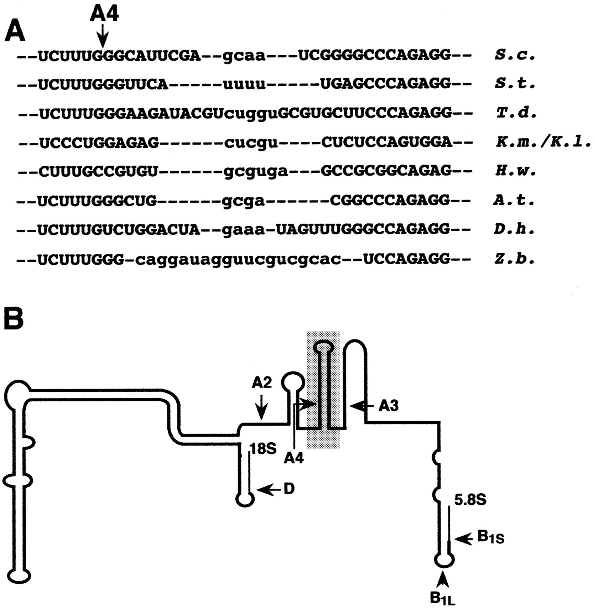
Figure 4. Structural conservation around site A4 among various yeast species. ( A ) Sequence comparison of ...
Notes:
Figure 4. Structural conservation around site A4 among various yeast species. ( A ) Sequence comparison of the region of ITS1 spanning site A4 that is highlighted in (B). Nucleotides in upper case are part of the stem, nucleotides in lower case form the loop of the conserved hairpin structure containing site A4. S.c. , S.cerevisiae ; S.t. , Saccharomyces transvaalensis ; T.d. , Torulospora delbrückii ; K.m. , Kluyveromyces marxianus ; H.w. , Hansenula wingei ; A.t. , Arxioma telluris ; D.h. , Debaromyces hansenii ; Z.b. , Zygosaccharomyces bisporus. ( B ) Schematic representation of the structure of the S.cerevisiae ITS1 according to Yeh et al. ( 40 ). The stem–loop structure formed by the sequence shown in (A) is highlighted.
Unless provided in the caption above, the following copyright applies to the content of this slide:

Slide 5
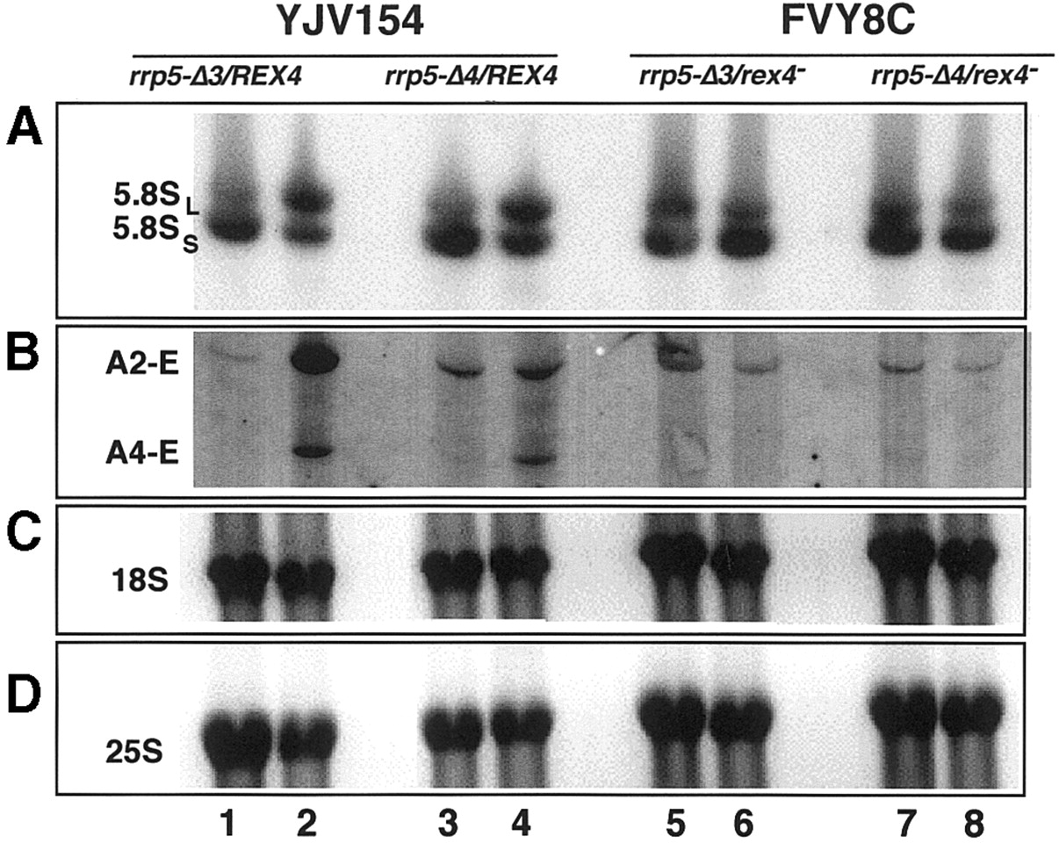
Figure 5. Effect of inactivation of REX4 on formation of mature rRNA in rrp5‐ Δ 3 and rrp ‐Δ 4 . Strain FVY8C ...
Notes:
Figure 5. Effect of inactivation of REX4 on formation of mature rRNA in rrp5‐ Δ 3 and rrp ‐Δ 4 . Strain FVY8C carrying a genomic wild‐type RRP5 gene under control of the GAL promoter, a rex4 null allele and a plasmid‐encoded rrp5‐ Δ 3 or rrp‐ Δ 4 gene under control of the authentic RRP5 promoter was shifted from galactose‐ to glucose‐based medium and total RNA was isolated immediately before and 24 h after the shift. The RNA was subjected to northern analysis using probes complementary to the mature 5.8S, 18S and 25S rRNAs [( A ), ( C ) and ( D ), respectively] as well as probe 3 (see Fig. 2A) located directly upstream from cleavage site A3 (B). Strain YJV154, which is isogenic with FVY8C except for the presence of a wild‐type REX4 gene, was used as a control. Lanes 1, 3, 5 and 7, RNA from galactose‐grown cells. Lanes 2, 4, 6 and 8, RNA from cells shifted to glucose for 24 h. The nature of the products detected is indicated.
Unless provided in the caption above, the following copyright applies to the content of this slide:

Slide 6
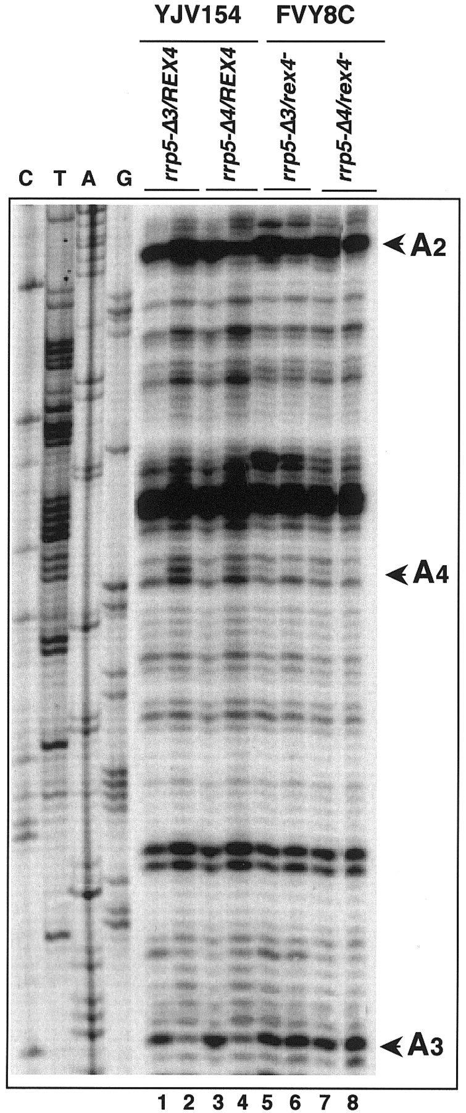
Figure 6. Effect of inactivation of REX4 on ITS1 processing in rrp5‐ Δ 3 and rrp‐ Δ 4 mutant cells. Strain ...
Notes:
Figure 6. Effect of inactivation of REX4 on ITS1 processing in rrp5‐ Δ 3 and rrp‐ Δ 4 mutant cells. Strain FVY8C carrying a genomic wild‐type RRP5 gene under control of the GAL promoter, a rex4 null allele and a plasmid‐encoded rrp5‐ Δ 3 or rrp‐ Δ 4 gene under control of the authentic RRP5 promoter was shifted from galactose‐ to glucose‐based medium and total RNA was isolated immediately before and 24 h after the shift. The RNA was subjected to primer extension analysis using probe 4 , located between sites A3 and B1 (see Fig. 2A). The position of the stops corresponding to cleavage sites A2, A3 and A4 is indicated. Lanes 1, 3, 5 and 7, RNA from galactose‐grown cells. Lanes 2, 4, 6 and 8, RNA from cells shifted to glucose for 24 h.
Unless provided in the caption above, the following copyright applies to the content of this slide:

Slide 7
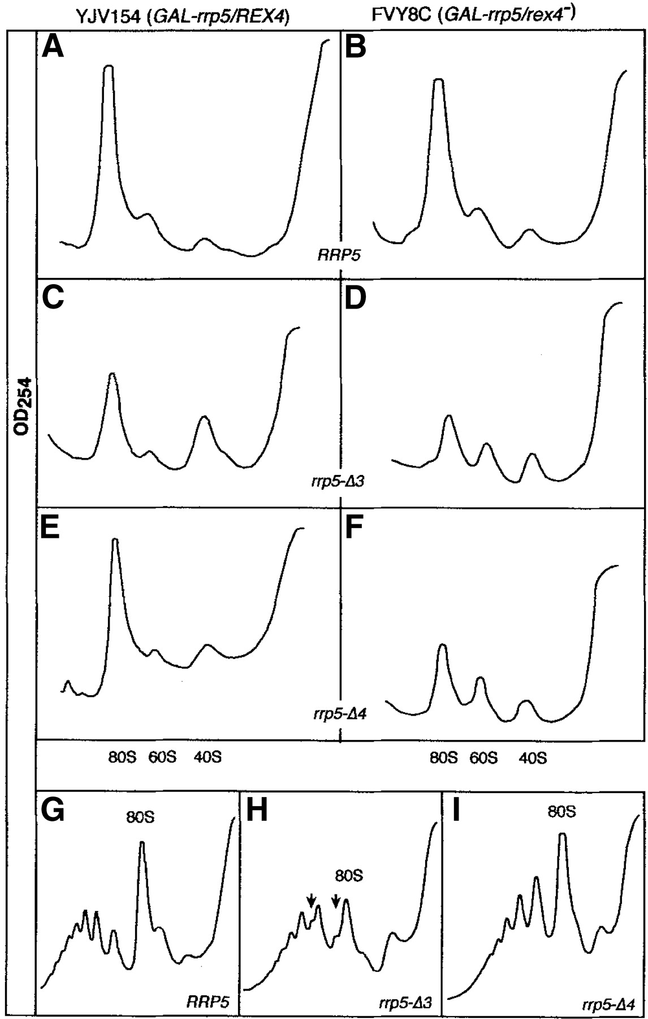
Figure 7. Effect of inactivation of the REX4 gene on ribosome biogenesis in rrp5‐ Δ 3 and rrp‐ Δ 4 cells. ...
Notes:
Figure 7. Effect of inactivation of the REX4 gene on ribosome biogenesis in rrp5‐ Δ 3 and rrp‐ Δ 4 cells. Cultures of YJV154 ( GAL‐rrp5/REX4 ) and FVY8C ( GAL‐rrp5/rex4–) cells carrying either the wild‐type RRP5 gene or one of the rrp5‐ Δ deletion alleles on a plasmid were shifted from galactose‐ to glucose‐based medium and extracts were prepared 24 h later. 20 OD 260 units of extract were analyzed on 15–35% ( A – F ) or 10–50% sucrose gradients ( G – I ). Sedimentation is from right to left. (A, C and E) Extracts from strain YJV154 carrying the wild‐type RRP5 (A), rrp5‐ Δ 3 (B) or rrp‐ Δ 4 (C) allele. (B, D and F) Extracts from strain FVY8C carrying the wild‐type RRP5 (B), rrp5‐ Δ 3 (D) or rrp5‐ Δ 4 (F) allele. (G–I) Polysome profiles for YJV154 carrying the wild‐type RRP5 (G), rrp5‐ Δ 3 (H) or rrp5‐ Δ 4 (I) allele. The arrows in panel H indicate the ‘halfmers’.
Unless provided in the caption above, the following copyright applies to the content of this slide:

