Slide 1
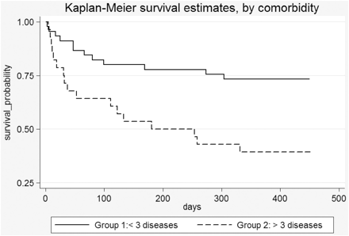
Figure 1 Mortality rate estimates between Group 1 (less than three diseases) and Group 2 (more than three diseases).
Notes:
Figure 1 Mortality rate estimates between Group 1 (less than three diseases) and Group 2 (more than three diseases).
Unless provided in the caption above, the following copyright applies to the content of this slide: © The Author 2009. Published by Oxford University Press on behalf of the European Public Health Association. All rights reserved.

