Slide 1
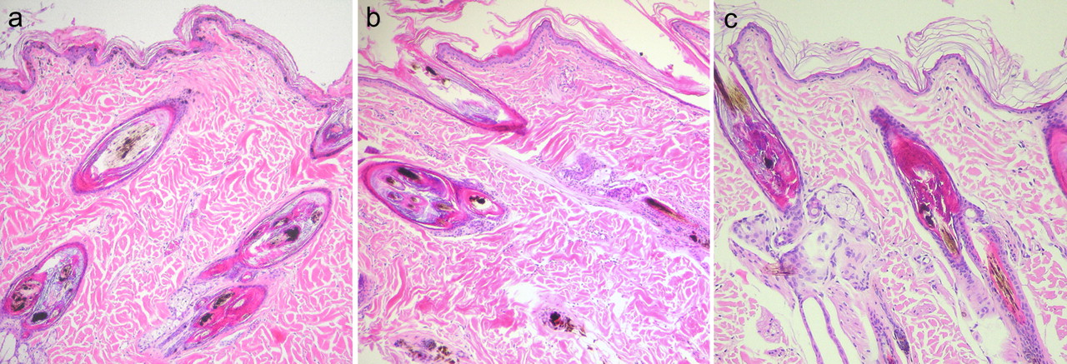
Figure 1 Representative histological phenotypes of dogs, which were homozygous A/A at MLPH c.-22G>A and suspected of ...
Notes:
Figure 1 Representative histological phenotypes of dogs, which were homozygous A/A at MLPH c.-22G>A and suspected of being affected with CDA or BHFD. Biopsies from dogs with ( a ) confirmed clinical symptoms of CDA/BHFD and clumped melanin in epidermis, hair follicles, and hair shafts; ( b ) clinical symptoms compatible with CDA/BHFD and clumped melanin only in the hair follicle; and ( c ) clinical symptoms different from accepted CDA/BHFD criteria and clumped melanin restricted to the hair follicle. Note that melanin clumping in the hair follicle is similar in all 3 cases, and the definitive diagnosis of CDA/BHFD can only be made based on additional clinical findings. Hematoxylin and eosin ×200. (This figure appears in color in the online version of Journal of Heredity .)
Unless provided in the caption above, the following copyright applies to the content of this slide: © The American Genetic Association. 2009. All rights reserved. For permissions, please email: journals.permissions@oxfordjournals.org.

