Slide 1
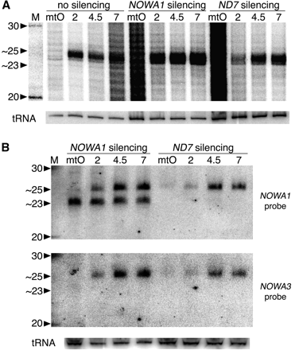
Figure 1. Evidence for meiosis-specific ∼25-nt RNAs distinct from the ∼23-nt siRNAs. (A) Total RNA samples from starved ...
Notes:
Figure 1. Evidence for meiosis-specific ∼25-nt RNAs distinct from the ∼23-nt siRNAs. (A) Total RNA samples from starved reactive cells (mtO, mating type O; mtE gave similar results) just before the mixing of mating types, or at different times post-mixing (2, 4.5 and 7 h), were 5′-end-labelled and run on a 15% polyacrylamide-urea gel. The size marker (M) shows the positions of 20 and 30-nt RNAs. Three different experiments are shown: before conjugation, cells were fed either with Klebsiella (no silencing) or with E. coli strains producing dsRNA homologous to parts of the NOWA1 or ND7 coding sequences, as indicated. The high background seen in reactive cells (mtO) silenced for these genes is likely due to bacterial RNA being degraded. The lower panel (tRNA) shows subsequent hybridization of the same membrane with a tRNA probe, as a loading control. (B) A similar gel of samples from the conjugation of NOWA1- and ND7-silenced cells was blotted and revealed successively with probes specific for the NOWA1 dsRNA sequence, for the NOWA3 gene, and for the same tRNA as in A, as indicated. The faint band seen at ∼25 nt in reactive cells (mtO) prior to the initiation of conjugation is due to a small fraction of cells (<3%) undergoing autogamy, a self-fertilization sexual process.
Unless provided in the caption above, the following copyright applies to the content of this slide: © 2008 The Author(s)This is an Open Access article distributed under the terms of the Creative Commons Attribution Non-Commercial License (http://creativecommons.org/licenses/by-nc/2.0/uk/) which permits unrestricted non-commercial use, distribution, and reproduction in any medium, provided the original work is properly cited.

Slide 2
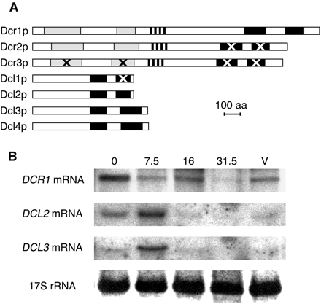
Figure 2. Dicer and Dicer-like genes in P. tetraurelia. (A) Schematic representation of protein domains. Grey boxes, ...
Notes:
Figure 2. Dicer and Dicer-like genes in P. tetraurelia. (A) Schematic representation of protein domains. Grey boxes, helicase and helicase C-terminal domains. Hatched boxes, DUF283. Black boxes, RNaseIII domains. Black or white Xs mark domains that are unlikely to be catalytically active because of non-conservative substitutions at key residues. For accession numbers, see Supplementary Figures S1 and S2. (B) Northern blot analysis of the expression of the DCR1, DCL2 and DCL3 mRNAs in total RNA samples extracted at different times during autogamy. The 0 time point was arbitrarily set when 12% of cells in the culture had undergone meiosis, as indicated by their fragmented MAC. That percentage was 50% at 7.5 h, 98% at 16 h, and 100% at 31.5 h. Developing new MAC was visible in 20% of cells at 16 h and 98% at 31.5 h. V, total RNA extracted from starved vegetative cells at 84 h, after refeeding the culture for a few vegetative divisions. The bottom panel shows 17S rRNA (negative of ethidium bromide stain, before blotting) as a loading control.
Unless provided in the caption above, the following copyright applies to the content of this slide: © 2008 The Author(s)This is an Open Access article distributed under the terms of the Creative Commons Attribution Non-Commercial License (http://creativecommons.org/licenses/by-nc/2.0/uk/) which permits unrestricted non-commercial use, distribution, and reproduction in any medium, provided the original work is properly cited.

Slide 3
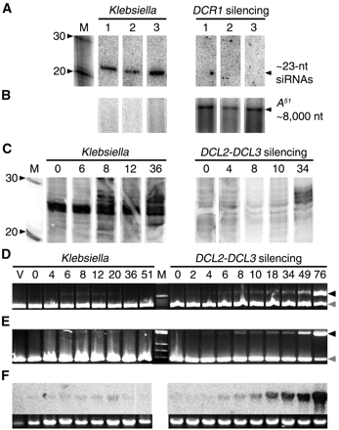
Figure 3. Functional analysis of Dicer and Dicer-like genes. (A, B) Northern blot analysis of total RNA from 3 clones ...
Notes:
Figure 3. Functional analysis of Dicer and Dicer-like genes. (A, B) Northern blot analysis of total RNA from 3 clones transformed with a 3′-truncated A51 transgene (lanes 1–3), grown on the normal food bacterium (Klebsiella) or on E. coli producing DCR1 dsRNA (DCR1 silencing). RNAs were resolved on 15% polyacrylamide (A) or 1% agarose (B) denaturing gels, blotted and hybridized with an A51-specific probe. The size marker (M) shows the positions of 20 and 30-nt RNAs. (C) 5′-end-labelled total RNA from different time points (as indicated in hours) during autogamy of cultures fed with Klebsiella or with E. coli producing DCL2 and DCL3 dsRNA prior to meiosis. The t = 0 time points were arbitrarily set when 5% (Klebsiella) or 8% (DCL2-DCL3 silencing) of cells showed fragmented macronuclei; that fraction reached 54% at 6 and 4 h, and 99% at 20 and 18 h, respectively. (D, E) Total DNA samples from the same autogamy time courses, extracted at the indicated times (hours), were amplified with primers flanking IESs 51G2832 (D) or 51G4404 (E) (36). V, vegetative sample before induction of meiosis. IES-containing and IES-excised PCR fragments (black and grey arrowheads, respectively) are co-amplified in each reaction, allowing semi-quantitative assessment of the accumulation of unexcised IES copies in developing MAC. (F) A Southern blot of the same DNA samples (uncut) is hybridized with a probe specific for the Sardine transposon. The lower panel shows ethidium bromide staining as a loading control.
Unless provided in the caption above, the following copyright applies to the content of this slide: © 2008 The Author(s)This is an Open Access article distributed under the terms of the Creative Commons Attribution Non-Commercial License (http://creativecommons.org/licenses/by-nc/2.0/uk/) which permits unrestricted non-commercial use, distribution, and reproduction in any medium, provided the original work is properly cited.

Slide 4
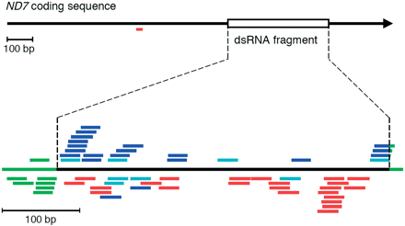
Figure 4. Distribution of ND7 siRNAs. The black arrow represents the full length of the ND7 coding sequence; the open ...
Notes:
Figure 4. Distribution of ND7 siRNAs. The black arrow represents the full length of the ND7 coding sequence; the open box indicates the position of the 397-bp fragment cloned into the feeding vector for dsRNA production. The bottom line shows the full length of the dsRNA molecule produced in E. coli; green extensions on both sides of the ND7 fragment are vector sequences located between the convergent T7 promoters. Sense and antisense siRNAs are aligned above and below the line, respectively. Primary siRNAs obtained by random sequencing of the 23-nt fraction are shown in green and light blue; those obtained by hybridization-selection from the 25-nt fraction are shown in dark blue. PolyA+ siRNAs obtained by random sequencing or by selective reamplification of polyA+ molecules are shown in red; one was found to map in the ND7 coding sequence upstream of the dsRNA fragment (top).
Unless provided in the caption above, the following copyright applies to the content of this slide: © 2008 The Author(s)This is an Open Access article distributed under the terms of the Creative Commons Attribution Non-Commercial License (http://creativecommons.org/licenses/by-nc/2.0/uk/) which permits unrestricted non-commercial use, distribution, and reproduction in any medium, provided the original work is properly cited.

Slide 5
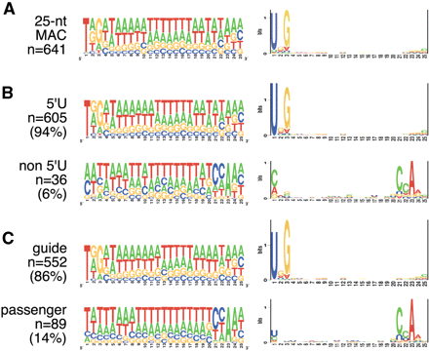
Figure 5. Compositional profile of MAC 25-nt scnRNAs. (A) The whole set of 641 non-redundant sequences. In the logo on ...
Notes:
Figure 5. Compositional profile of MAC 25-nt scnRNAs. (A) The whole set of 641 non-redundant sequences. In the logo on the left, the height of each nucleotide symbol is proportional to its frequency at each position. In the logo on the right, the height of each symbol represents the relative entropy between the observed frequency of the nucleotide at that position and its a priori probability (0.36 for A and U, 0.14 for C and G). (B) The same representations are provided for two subsets of the 641 sequences: those beginning with a 5′U and those beginning with another nucleotide. (C) The 641 sequences are here classified into ‘guide’ or ‘passenger’ subsets by the automatic procedure described in the text.
Unless provided in the caption above, the following copyright applies to the content of this slide: © 2008 The Author(s)This is an Open Access article distributed under the terms of the Creative Commons Attribution Non-Commercial License (http://creativecommons.org/licenses/by-nc/2.0/uk/) which permits unrestricted non-commercial use, distribution, and reproduction in any medium, provided the original work is properly cited.

